Slide 1
Communication
Context and Meaning
Notes:
https://jamboard.google.com/d/1xB0HQNO2JHDfPmtz-VaIgB9VI7SiCWpZo_nm-fcEzws/edit?usp=sharing

Slide 2
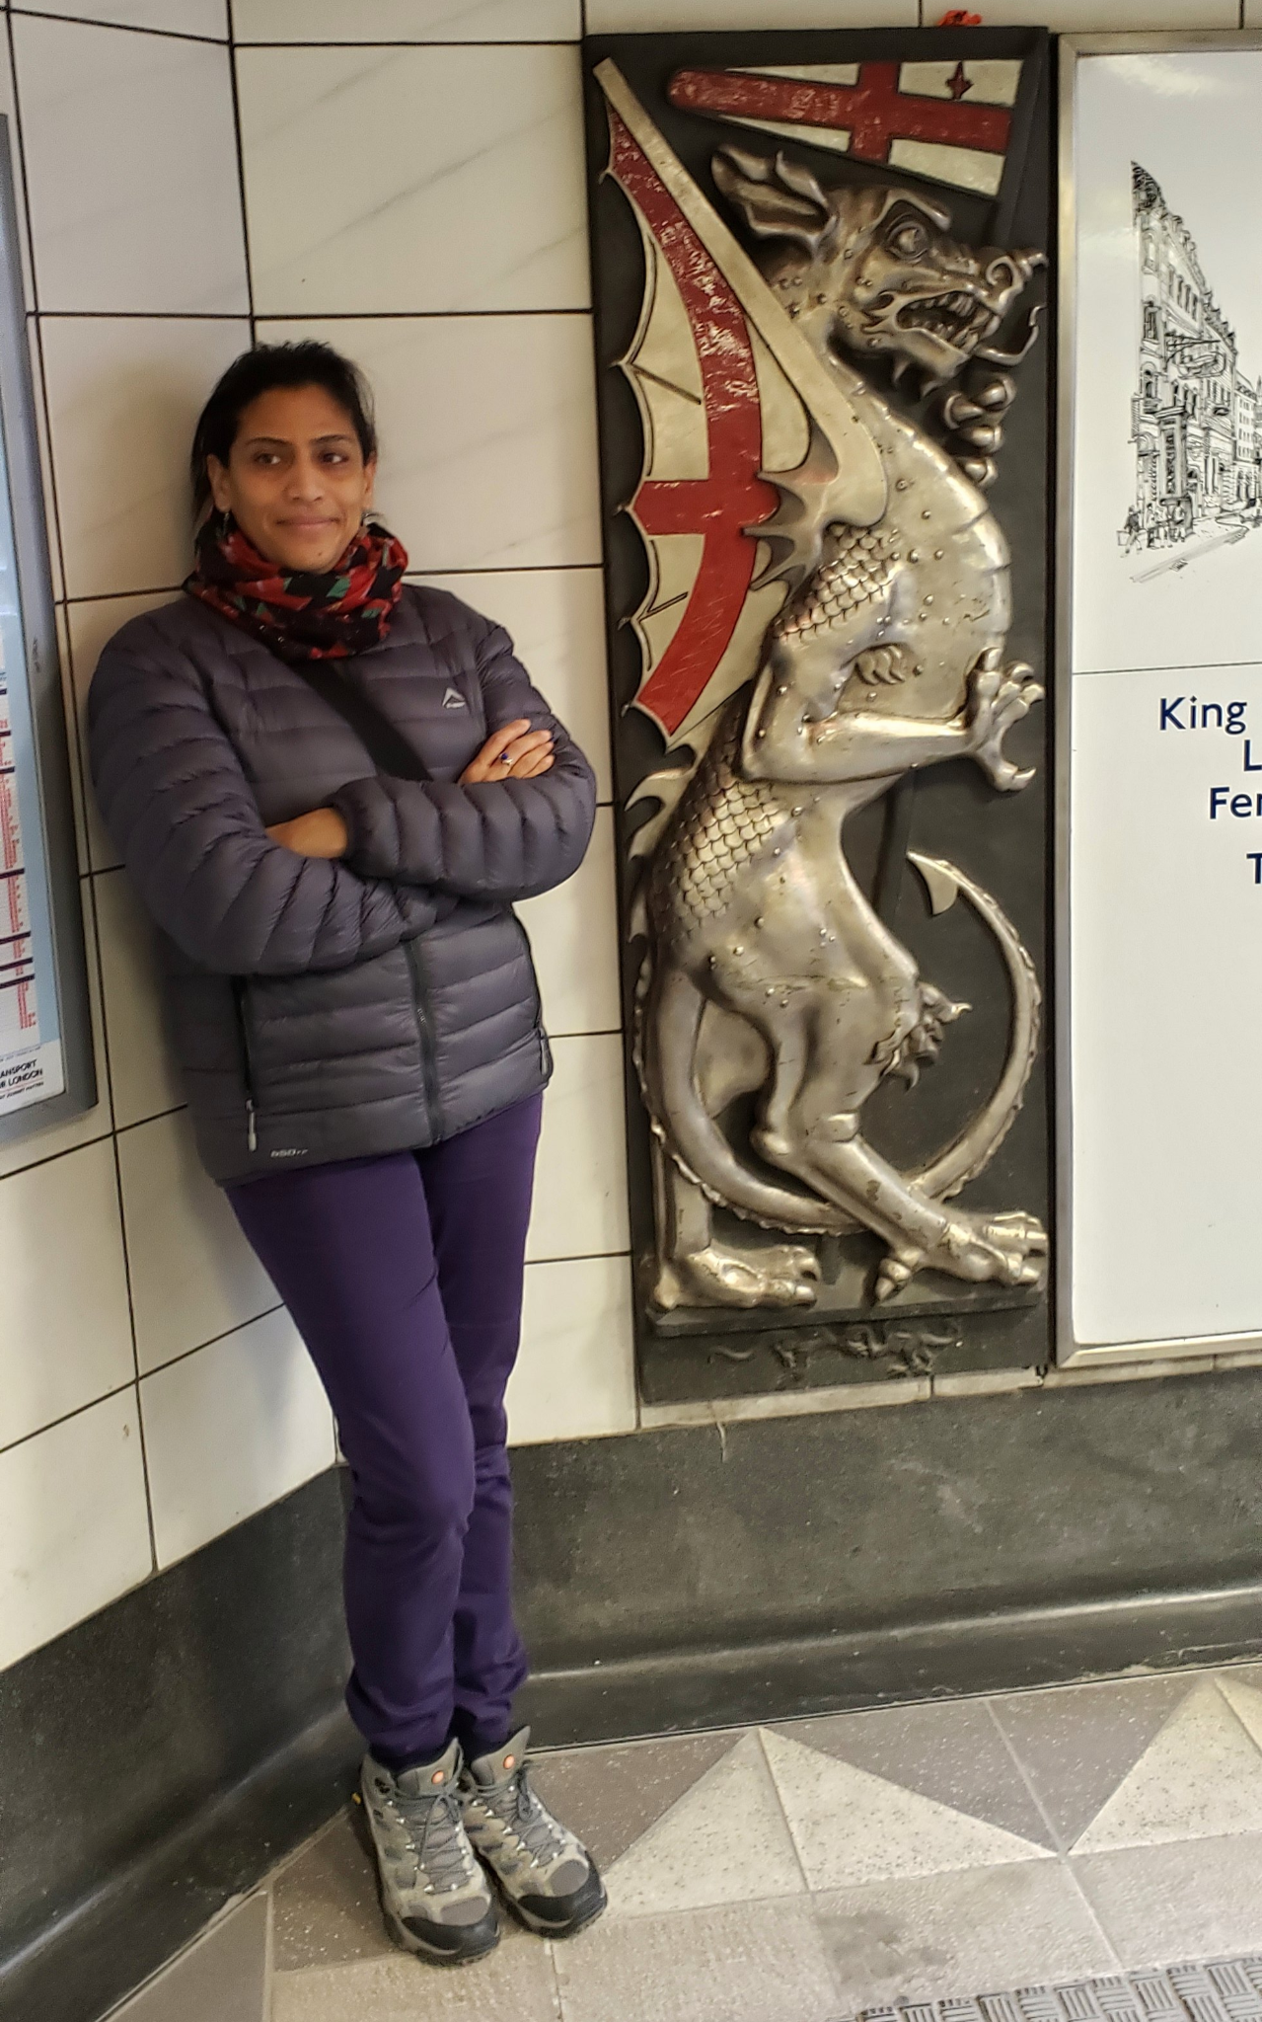
Presenter
Sharon Grant
Department of Information Technology
Field Museum of Natural History
Notes:
Presenter Introduction

Slide 3
Agenda
Words and How we Use Them
01
Words with Impact - Place Names
02
Bias in Collections Data - Things to Consider
03
Disclaimers, Warnings and Labels
04
Real World Examples - Field Museum of Natural History
05
Notes:
This module is part of a series that is designed to challenge us to investigate:
the language we use,
how we communicate,
how we engage with the systems around us,
and how we go about making change in our sphere of influence.
What we will be looking at in this module is how the words that we use and that have been associated with the collections in our institutions can have both positive and negative impacts on the ways that we share our data and also on the people that encounter those data.
We will use examples to investigate how our own perceptions and biases can change the presentation of collections information in the digital realm and then we will see some ways to mitigate the impact of that information on both internal and external audiences.

Slide 4
Learning Objectives
Engage in exercises to determine the need for developing shared understandings when using words across contexts.
Explore the concept of toponomastics and be able to critically consider the way in which we interpret place-names through key factors such as our own perceptions, biases, and social and academic contexts.
Consider the processes for communicating information in the form of disclaimers, warnings, and labels.
Notes:
In this module, we will be engaging in exercises and discussions to better understand:
how the meanings of words and ideas are altered by context. The historical, social, political and cultural time frames within which scientific exploration was carried out and within which we work alter and shape meaning.
the types of bias inherent in collections data, both our own and those of others
and then we look at some methods that can be used protect, inform, engage and give ourselves and users of collections data agency.

Slide 5
First a disclaimer…
PREAMBLE
If you take away only one thing? It’s this.
It is presumed that all issues of copyright and access around the specimens, items and researcher’s archives have been taken care of. You should know whether or not your institution has clear title to what it has in its possession and if there is doubt that should be investigated before sharing or making data/information available.
Notes:
But first, a disclaimer…

Slide 6
Words and How we Use Them
Notes:
In this first section we are going to be using examples to look at words and how we use them. We will investigate how what we bring to each moment of communication can change and is inherently based on our own perspectives.

Slide 7
Context Alters Meaning
WORDS AND HOW WE USE THEM
Words in and of themselves are impotent[…] It is the socially structured practices and historically situated circumstances constituting our social lives that pour content into words, endow them with meaning and power. ” Sally McConnell-Ginet
“Words are woven into the social fabric…”
Reference: https://news.cornell.edu/stories/2020/10/linguist-links-language-social-change-words-matter
Words Matter, McConnell-Ginet (2020) Cambridge University Press
Notes:
Languages by and large are not static and so the methods that we use to communicate ideas and concepts are also fluid and respond to changes over time. The words that we use have a history, often this history is connected to invasion and colonization, be it modern or ancient.
For example the early history of the British Isles includes five major invasions which contributed to the development of the language we today call English. So the word that we use in English have influences from:
the Roman invasion
the Anglo-Saxon invasions
the Christian “invasion”
the Viking invasions
the Norman French invasion
We’ll use some examples to see how our own perspective can affect the meaning of words.

Slide 8
Words and How We Use Them
How does context affect meaning?
Exercise 1a: blue
What comes to mind when you think about blue?
In the group chat tell us was comes to mind when you think about this.
Notes:
Many terms, phrases and concepts that we work with in Natural History Museums do not necessarily have singular, concrete definitions.
The question then is how do we openly discuss & think through how these terms? What are the multiple ways that they can be interpreted? The context in which an idea comes up, can be important and we should consider broader perspectives and history.
Exercise 1a (2+3 mins) - INSTRUCTIONS: “Blue”.
On the jamboard ask participants to type words and thoughts that come to mind when they think about BLUE. If participants speak any other languages ask them to share what the word means with the group. Remember that there are no completely correct or incorrect responses.

Slide 9
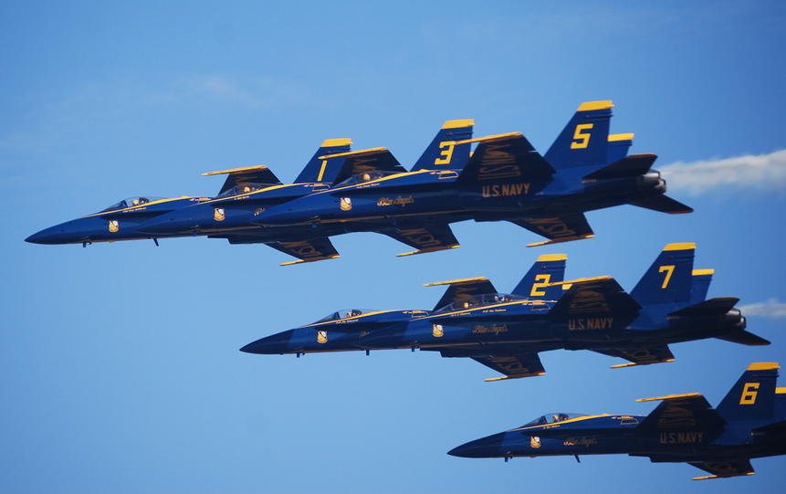
Words and How We Use Them
How does context affect meaning?
Exercise 1a: blue
Denotation: dictionary definition
“Blue. The hue of that portion of the visible spectrum lying between green and indigo, evoked in the human observer by radiant energy with wavelengths of approximately 420 to 490 nanometers; any of a group of colors that may vary in lightness and saturation, whose hue is that of a clear daytime sky; one of the additive or light primaries; one of the psychological primary hues.”
Connotations: associated or implied meanings
Melancholy, depressing.
Learned, intellectual
Profane, Indecent, risque
Tending to support [US] democratic candidates or policies;
Corporate
Notes:
The english language definition of blue is, how many of us would be able to give that definition off the top of our heads? Unless this is a group of physicists probably not many.
What things can up in the chat?
-- Exercise 1b (2+3 mins) - INSTRUCTIONS: “evolution”.
“Evolution” as an example of a word that has a specific scientific meaning in the English language. Ask participants to share what the word means to them. Remember that there are no completely correct or incorrect responses.
On the jamboard ask participants to type words and thoughts that come to mind when they think about BLUE. If participants speak any other languages ask them to share what the word means with the group. Remember that there are no completely correct or incorrect responses.

Slide 10
Words and How We Use Them
How does context affect meaning?
Connotations: associated or implied meanings
The use of the term evolution often implies an inevitable/inexorable path of progress - being better than before. This links to the use of evolution in social arguments. Ultimately it can ‘naturalize’ certain outcomes both in society and nature.
In a technical/scientific context, speaking strictly/formally about ‘evolution’ has a variety of underlying assumptions that may be entirely absent when speaking about it to broader public audiences or even to different academic/specialist groups.
Darwin
Social Darwinism.
?
Exercise 1b: evolution
Denotation: dictionary definition
“Biology. change in the gene pool of a population from generation to generation by such processes as mutation, natural selection, and genetic drift.”
Notes:
If there is time invite participants to give their thoughts on the word evolution.
“Evolution” as an example of a word that has a specific scientific meaning in the English language. Ask participants to share what the word means to them. Remember that there are no completely correct or incorrect responses.
Ask if participants are happy for their interpretations to be included in the glossary.

Slide 11
Words and How You Use Them.
Collate and document the definitions for a word or phrase from your work or area of expertise. How have they changed over time or between disciplines?
Examples of words from the biodiversity world could be: Diversity, Community, Science, Pipeline
Who defined the term first and when?
What differences did you find between definitions?
Did any definitions surprise you? Why?
Did you find definitions from outside of the domain?
Have the definitions changed over time?
DISCUSS!
Notes:
Notes: Depending on the length of the course, this may be an exercise that is done as pre-work or as homework after the session. Ask participants to pick a word from the work/museum discipline with which they are most familiar and investigate the history and definitions associated with it. Participants may pick a word in any language. Use the format in the example slides.
-- For future versions of the course. Ask if participants are happy for their interpretations to be included in the glossary.

Slide 12
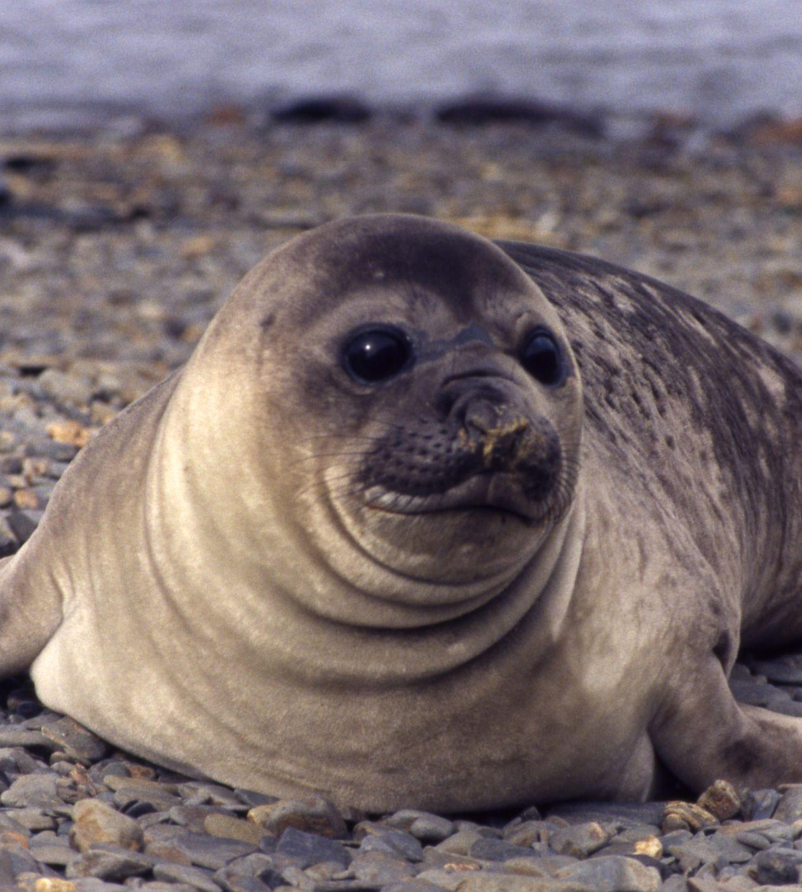
WORDS AND HOW WE USE THEM
Choosing the Right Words
Speaking and communicating
What concepts describe the object in the picture?
What objects do we know that have the qualities we listed?
Which of those is most likely to be the object in the picture?
https://picklebums.com/use-your-words-wisely/
Notes:
Image: https://www.flickr.com/photos/rondls_pics/50296766246/in/album-72157715795802266/ “juvenile female elephant seal. South Georgia”
Reference: https://picklebums.com/use-your-words-wisely/
Speaking is one of the actions we do the most every day and most people are very good at it: healthy fluent speakers can easily say 2–3 words per second, selected from tens of thousands of words in our mental dictionary. The process of speaking and by analogy communicating ideas and concepts, however, is not as simple in our brains as it seems when we are talking. Take, for example, naming a picture of an apple. Although the word apple comes easily to mind, several processes and brain regions are needed to allow us to fetch the word apple among all the words we have in our memory.
A study of what happens to our ability to choose words when parts of the brain regions are damaged has proposed that there are a series of steps that we go through in order to pick the words that we use, and this process happens so fast that you never even realize you do all these steps every time you name an object!
A simplification involves 3 steps:
Selecting words that described the qualities of the object that we are referring to:
Then collating a set of objects that have similar qualities or characteristics
Lastly we select the object that we think matches.

Slide 13

Choosing the Right Words.
How do we decide what something is?
Exercise 2
Describe the picture
Select words that describe the qualities of the object in the picture?
What objects do we know of that have the same qualities as those we listed?
Do you have enough information in step 1) to select the correct option from step 2)?
Notes:
Exercise 2 (10 mins) - INSTRUCTIONS:
Randomly divide the group into 2 halves
Group ONE stays in the main room.
Open the jamboard and watch. Discuss amongst yourselves what you think the object is that group 1 is describing.
Group TWO goes to a breakout room
Open the jamboard
You will be provided with a link to a picture
Spend 3 minutes on slide Ex 1.1 and 3 minutes on slide Ex 1.2
JAMBOARD: https://jamboard.google.com/d/1xB0HQNO2JHDfPmtz-VaIgB9VI7SiCWpZo_nm-fcEzws/viewer?f=0

Slide 14
Choosing the Right Words.
How do we decide what something is?
Exercise 2
Describe the picture
Did Group One identify the thing that Group Two was describing?
Notes:
Did group one land on the correct object?

Slide 15
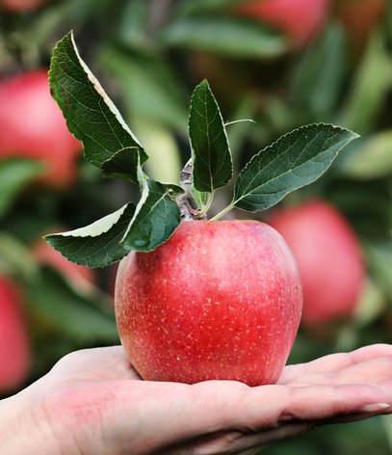
Choosing the Right Words.
How did we decide that this was an apple
Exercise 2
Describing the apple without using the word apple.
Select words that describe the qualities of the object in the picture?
What objects do we know of that have the same qualities as those we listed?
Do you have enough information in step 1) to select the correct option from step 2)?
Notes:
Did group
First we selected words that described the qualities of the object that we are referring to:
For example : sweet, crunchy, juicy, round, red
Then we collated a set of objects that have similar qualities or characteristics
for example: grape, apple, cherry, plum, cranberry
Lastly we select the one that has the most in common characteristics.

Slide 16
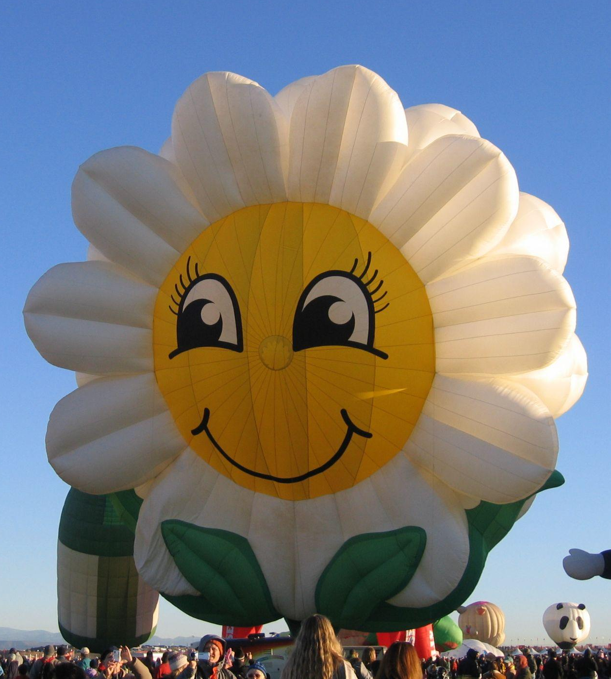
Choosing the Right Words.
How did we decide that this was an apple
Exercise 2 - alternate
Describing the apple without using the word apple.
Select words that describe the qualities of the object in the picture?
What objects do we know of that have the same qualities as those we listed?
Do you have enough information in step 1) to select the correct option from step 2)?
Notes:
image: https://www.flickr.com/photos/rondls_pics/3576464341/in/album-72157618977799328/ - “Flower shaped hot air balloon”
Did group
First we selected words that described the qualities of the object that we are referring to:
For example : sweet, crunchy, juicy, round, red
Then we collated a set of objects that have similar qualities or characteristics
for example: grape, apple, cherry, plum, cranberry
Lastly we select the one that has the most in common characteristics.

Slide 17
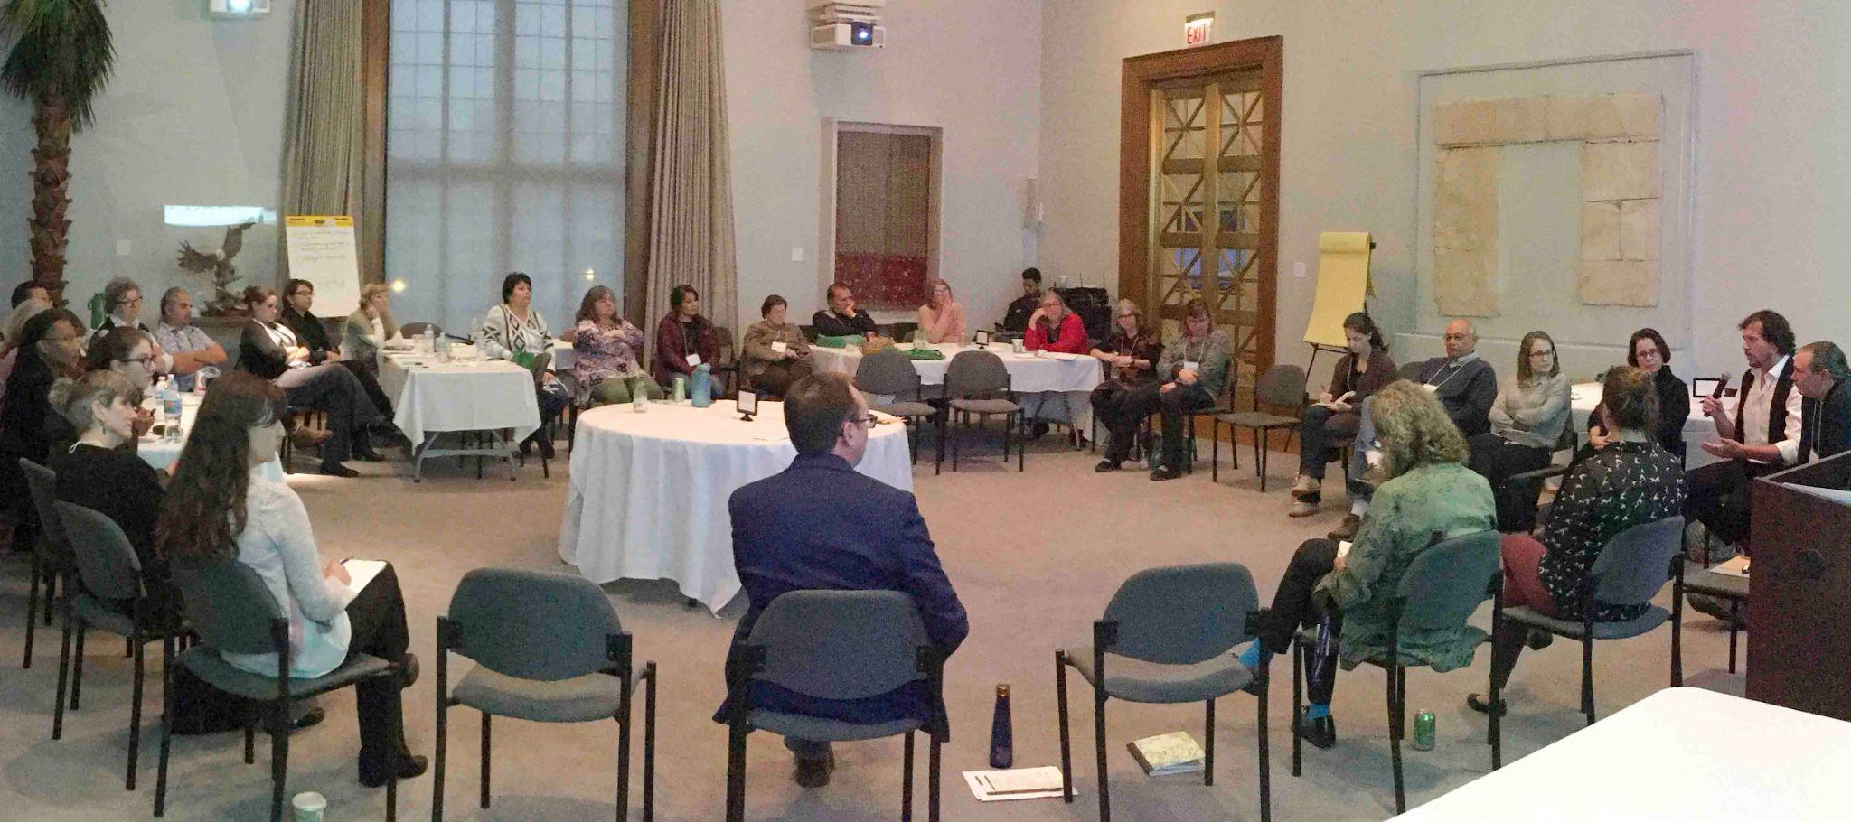
EXERCISES
Discuss
An example from the mathematical domain is “fewer v less”.
What makes the choosing the wrong term a “pet peeve”?
Do others share the same feeling towards the term?
IMLS Symposium:https://mm.fieldmuseum.org/f1fe1735-3b2e-4917-a59b-b200479ba5ea
Notes:
https://library.louisville.edu/ekstrom/criticalthinking/assumptions
Definitions, thoughts and ideas about a term or word can differ depending on the person doing the defining. What do you think?

Slide 18
Words With Impact - Place Names
Notes:
One of the most common tasks in a natural history museum is georeferencing. This is the process of assigning coordinates to a descriptive locality in order to generate distribution maps. Because of this, at some point, most people working with collections information across all domains will encounter place-names.
These place names have history, they are products of language, perspective and time and so can communicate more than just a location on a map. These deeper connotations can be illuminating and/or problematic on many levels.

Slide 19
The study of place names.
WORDS WITH IMPACT
Toponomastics is a taxonomic study of place-names (toponyms) based on etymological, historical and geographical information. A place-name is a word or words used to indicate, denote, or identify a geographic locality such as a town, river, or mountain.”
“Toponomastics divides place-names into 2 broad categories: habitation names and feature names.”
Reference: https://toponomastics.com/en/
Notes:
One of the tools that we can use to help understand why a particular place-name may cause harm, is Toponomastics. Toponomstics is a taxonomic study of place-names using it can help us understand and unpack this information in order to make better choices about how we handle it.

Slide 20
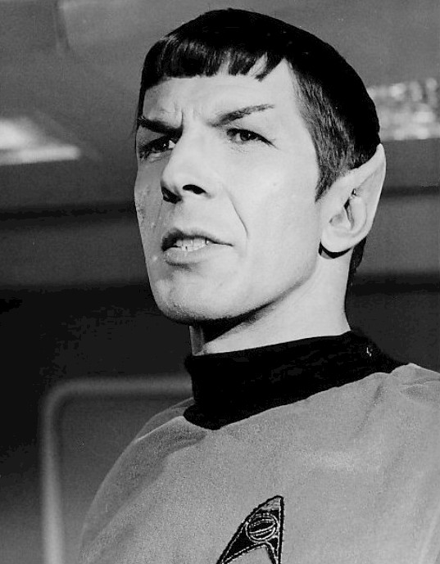
Place Names (fictitious)
What can you tell about the place from the name?
Exercise 3.1
Vulcan is the homeworld of the Star Trek characters Spock, T’Pol, Saavik and Tuvok.
Without doing any research what can you say about this place?
image: https://en.wikipedia.org/wiki/File:Leonard_Nimoy_Spock_1967.jpg
Notes:
image: https://en.wikipedia.org/wiki/File:Leonard_Nimoy_Spock_1967.jpg
Exercise 3 (10 mins) - INSTRUCTIONS:
Using the jamboards ask participants (from memory) to document what they think they know about the fictitious planet Vulcan.
-- If the group is large pick different fictitious locations for each.
Resources:
https://mythopedia.com/topics/vulcan
https://en.wikipedia.org/wiki/Vulcan_(Star_Trek)#Homeworld
https://www.smithsonianmag.com/smartnews-science/real-planet-discovered-where-vulcan-home-world-star-trek-set-180970335/

Slide 21
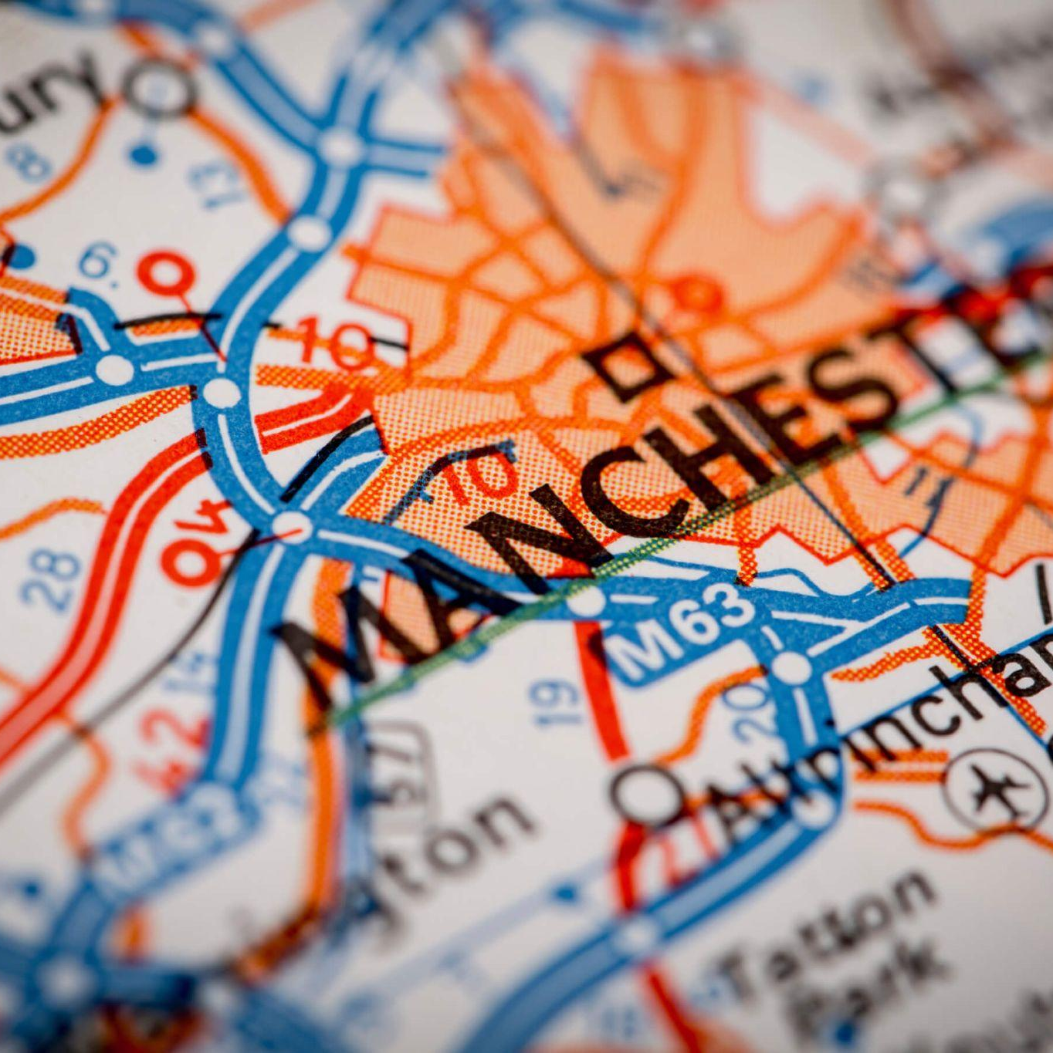
Place Names (real)
What can you tell about the place from the name?
Exercise 3.2
Manchester is a city in the north of England. Important people from Manchester include Ian McKellen, J.K Rowling, Benedict Cumberbatch and Louise daCocodia.
Without doing any research what can you say about the place?
After doing some research what can you say about the place.
Compare before you did your research and the facts that you found out afterwards.
image: https://cdn.citybaseapartments.com/blog/cba-media/2016-09/Manchester-City-on-a-Road-Map.jpg
Notes:
image: https://cdn.citybaseapartments.com/blog/cba-media/2016-09/Manchester-City-on-a-Road-Map.jpg
Exercise 3 (10 mins) - INSTRUCTIONS:
Using a real place as an example.
Have participants do a toponomistic review of the name. What do you find and what assumptions about the place and the people from that place do you make based on what they know and find out.
Manchester in the north of England was founded by the Romans in 79AD and although the name has evolved over the last two millennia, its original name was Mamucium which was a combination of two words, both hailing from common Brittonic which was an ancient Celtic language spoken in Britain. The first word is ‘mamm’ which means a breast like hill and the second is ‘ceaster’ which means a fortification or an old city; the name was also Latinised by adding the suffix ‘ium’ towards the end. From this we can then infer that Manchester was a Roman fort, built on a rounded hill’.
-- For future versions. Include examples from different countries and different languages.

Slide 22
EXERCISES
Discuss
Select a place (habitation or feature) and use the internet to discover the origins of the name.
Was the place named because of the way it looks or after a person or people?
Are there different names in different languages?.
How long has the place had a name?
Has the placename changed over time and why did it change?
IMLS Symposium:https://mm.fieldmuseum.org/f1fe1735-3b2e-4917-a59b-b200479ba5ea
Notes:
https://library.louisville.edu/ekstrom/criticalthinking/assumptions
Notes: This can either be done on an individual basis before the session or as a group in the session. The spreadsheet has a list of suggestions, some are more problematic than others.
Select a habitation or feature and use the internet to discover the origins of its name. Things to consider:
Was the place named because of the way it looks are after a person?
Are there different names in different language(s)
How long has place had a name?
Has the place name changed over time and why did it change?
-- For future versions. Include examples from different countries and different languages.

Slide 23
Bias in Collections Data -
Things to Consider

Slide 24
Bias in Collections Data
Things to consider
The data
  How might bias manifest in data, information, and statistics?
The people
  What categories of people are involved in the creation of collections data?
The system
  How does “authority” impact future research and data?
Notes:
The purposes of synopsis we’ll consider three broad areas where bias is inherent to what we do as museum professionals.
The data itself
The people involved with the data
and the systems that the people are part of (more of this though in late modules)

Slide 25
Bias in the Data
BIAS IN COLLECTIONS DATA
How might bias manifest in data, information, and statistics?
Sources consulted when compiling data
Data and information included or excluded
Data and information emphasised and considered significant
Limitations or biases in funding, staff, or access to materials and information
When evaluating a source, consider:
Who compiled and presented the data?
Where? Is there a specific audience or potential cultural frame used?
When? Is there outdated information or historical prejudices?
Why? Does the source have a goal that must be taken into account?
How? Does the format imply bias?

Slide 26
Understanding the People
BIAS IN COLLECTIONS DATA
Four (potential) categories of people involved in data:
Those creating/working with the data/images
Those receiving/learning from the data/images
Those impacted by the data/images
(If the data is about people) Those being researched in the data
Category 3 and 4 almost always overlap, although category 3 can overlap with any category.
When evaluating a source, consider:
Are the researchers removed from the community, culture, issue, or phenomenon they’re researching?
If so, how does that impact their perspective?
Do the people, communities, or cultures being researched or impacted by the research have a voice in the data?
How does that impact the perspective of the research?

Slide 27
Authority and Feedback Loops
BIAS IN COLLECTIONS DATA
How does “authority” impact future research and data?
Reliance on trusted sources as starting points for new research
An incorrect or prejudiced starting source can lead to more incorrect or prejudiced research
When evaluating a source, consider:
Questions of source bias
How is it perceived by other researchers with from a similar background?
How is it perceived by researchers from different backgrounds or perspectives?
What do these perspectives suggest about the source?

Slide 28
Disclaimers, Warnings and Labels.
Notes:
As collections professionals we are custodians not only of the physical collections that are in our cupboards, compactors and shelves, but we are also responsible for the ethical and appropriate sharing of the information that describes those collections.
The many people within a museum interact with this information as different times and for different purposes. It is critical that no matter our role we be aware of the potentially sensitive nature of the information that we have access to.
Disclaimers, Warnings and Labels are different ways of letting the people interacting with our collections information know more about the context of what they will see and read.
We will be looking at these with particular reference to how they are used in a digital context.

Slide 29

Types of Disclaimer
DISCLAIMERS, WARNINGS AND LABELS
Copyright
Confidentiality
Liability
Fair Use
Investment
Warranty
Expression
Guarantee
Does one size fit all?
If you run a website, a legal disclaimer is a notice that is related to your website’s content. It allows you inform people about your website’s content, and it legally protects you from getting exposed to legal issues.
Types of Disclaimer
Types of Warning
Types of Label
http://www.linfo.org/database.html
https://www.passivetactics.com/what-is-a-disclaimer-8-types-you-need-to-know
Notes:
https://www.passivetactics.com/what-is-a-disclaimer-8-types-you-need-to-know
There are 8 types of disclaimer that your legal or general counsel department may have associated with your website and the content on it.

Slide 30
Disclaimer or Terms and Conditions?
DISCLAIMERS, WARNINGS AND LABELS
A disclaimer is a defensive measure. Usually, it’s purpose is to protect people or companies from unwanted liability or legal claims.”
Terms and conditions include topics such as legally establishing usage and the structure of a legal relationship between website users and website owner”
Reference: https://www.passivetactics.com/what-is-a-disclaimer-8-types-you-need-to-know/
https://www.passivetactics.com/how-to-write-disclaimer/
Notes:
Disclaimer VS Terms And Conditions, What’s The Difference?
Many people assume that disclaimers and terms and conditions are the same things. However, there are some key differences between these two. Some website owners use terms & conditions instead of using a disclaimer.
A disclaimer is something that ensures that you are not liable for the content you have on your website.
A terms and conditions page includes many topics such as legally establishing the use of the site, imposing limitations, and a structure of a legal relationship between website users and website owner.
Many museums write both terms & conditions and disclaimer pages.

Slide 31
Warnings
DISCLAIMERS, WARNINGS AND LABELS
Does one size fit all?
Content Warnings
Trigger Warnings
Types of Disclaimer
Types of Warning
Types of Label
It is important that individuals know what to expect and that they are put in a position where they can act in their own best interest without ridicule or scrutiny.
https://sites.lsa.umich.edu/inclusive-teaching/wp-content/uploads/sites/853/2022/04/An-Introduction-to-Content-Warnings-and-Trigger-Warnings.pdf
Notes:
Resources:
https://sites.lsa.umich.edu/inclusive-teaching/wp-content/uploads/sites/853/2022/04/An-Introduction-to-Content-Warnings-and-Trigger-Warnings.pdf
https://sites.lsa.umich.edu/inclusive-teaching-sandbox/wp-content/uploads/sites/853/2021/02/An-Introduction-to-Content-Warnings-and-Trigger-Warnings-Draft.pdf.
We have discussed some of the data and information that we handle as museum professionals has impact beyond its scientific importance. Warnings are a way to allow others to be prepared for what they may be exposed to when working with or browsing the information that we make available.
These warnings are not intended to censure nor invite individuals to avoid material that challenges them. On the contrary, warnings of challenging material can help engagement by individuals and give them the ability to take charge of their own health and learning.

Slide 32
What are content warnings?
DISCLAIMERS, LABELS AND WARNINGS
Content warnings are verbal or written notices that precede potentially sensitive content. These notices flag the contents of the material that follows, so readers, listeners, or viewers can prepare themselves to adequately engage or, if necessary, disengage for their own wellbeing.”
https://sites.lsa.umich.edu/inclusive-teaching-sandbox/wp-content/uploads/sites/853/2021/02/An-Introduction-to-Content-Warnings-and-Trigger-Warnings-Draft.pdf
Notes:
Notes:

Slide 33
DISCLAIMERS, WARNINGS AND LABELS
Categories of Content Warning
DISCLAIMERS, LABELS AND WARNINGS
Homophobia and heterosexism
Kidnapping and abduction
Miscarriages/abortion
Mental illness and ableism
Pornographic content
Pregnancy/childbirth
Racism and racial slurs
Self-harm and suicide
Sexism and misogyny
Sexual assault
Transphobia and trans-misogyny
Violence
Abuse
Animal cruelty or animal death
Child abuse/pedophilia/incest
Blood
Classism
Death or dying
Eating disorders, body hatred, and fat phobia
Hateful language direct at religious groups (e.g., Islamophobia, anti-Semitism)
Homophobia and heterosexism
Does one size fit all?
Types of Disclaimer
Types of Warning
Types of Label
This list is NOT exhaustive.
https://sites.lsa.umich.edu/inclusive-teaching/wp-content/uploads/sites/853/2022/04/An-Introduction-to-Content-Warnings-and-Trigger-Warnings.pdf
Notes:
This is a list of some of the most common content warning categories, but it is not mean exhaustive.
If your collections information is already transcribed you may already know which categories you are dealing with and so you can include appropriate warnings wherever the data and information may be available. However, until it is digitized you may not know and so it is best to over warn than under warn..
What is important is that as the individual setting up a project you be aware that it is possible and you can (and should) use warnings as a way to let your colleagues and workers know what they may be exposed to.

Slide 34
What is a Trigger Warning?
DISCLAIMERS, WARNINGS AND LABELS
Are a specific variety of content warnings that attempt to forewarn audiences of content that may cause intense physiological and psychological symptoms for people with Post Traumatic Stress Disorder (PTSD) and other anxiety disorders.
Reference: https://www.passivetactics.com/what-is-a-disclaimer-8-types-you-need-to-know/
Notes:
Trigger warnings are a special case of warning and relate specifically in the case of Post Traumatic Stress Disorder.

Slide 35
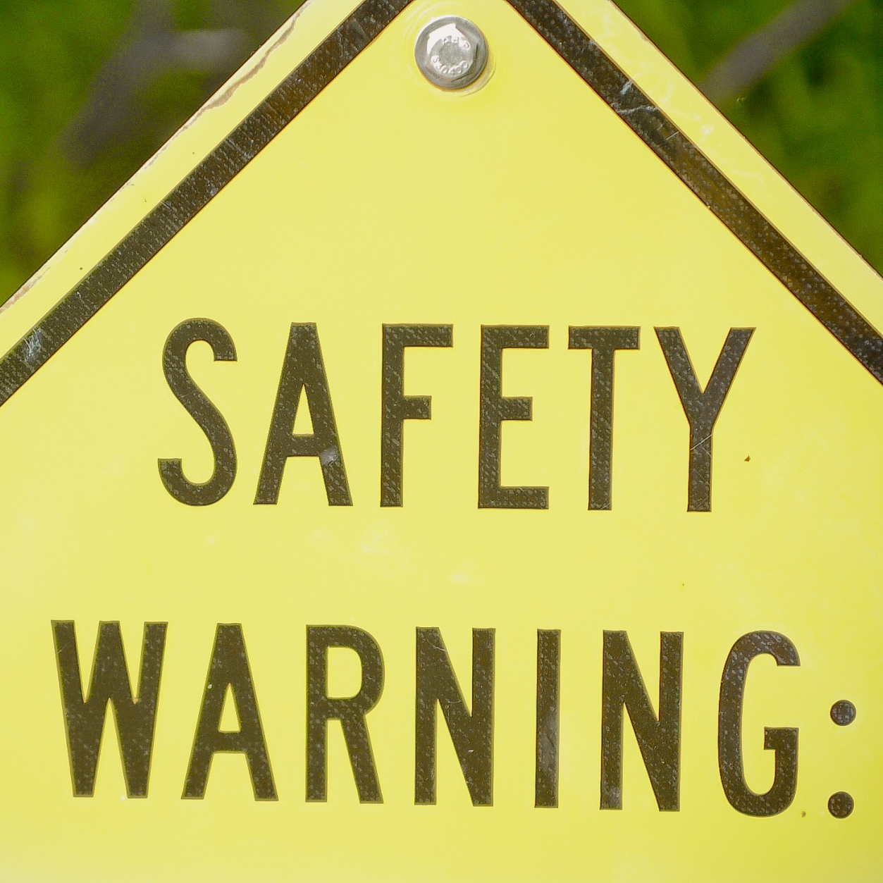
Disclaimers, Terms & Conditions and Warnings…
Can you find the pages on your institutions website that cover legal disclaimers, terms & conditions and warnings?
Exercise 4
When you have found yours, try to find those of a sister institution.
What is similar?
What is different?
image: https://www.publicdomainpictures.net/pictures/230000/velka/safety-warning.jpg
Notes:
image: https://www.publicdomainpictures.net/pictures/230000/velka/safety-warning.jpg
Exercise 4 (10 mins) - INSTRUCTIONS:
Ask participants to find the disclaimer on their institutions website,
post a links in the chat
Together look at the links and discuss the different things that you see.
FMNH: https://www.fieldmuseum.org/website-terms-use

Slide 36
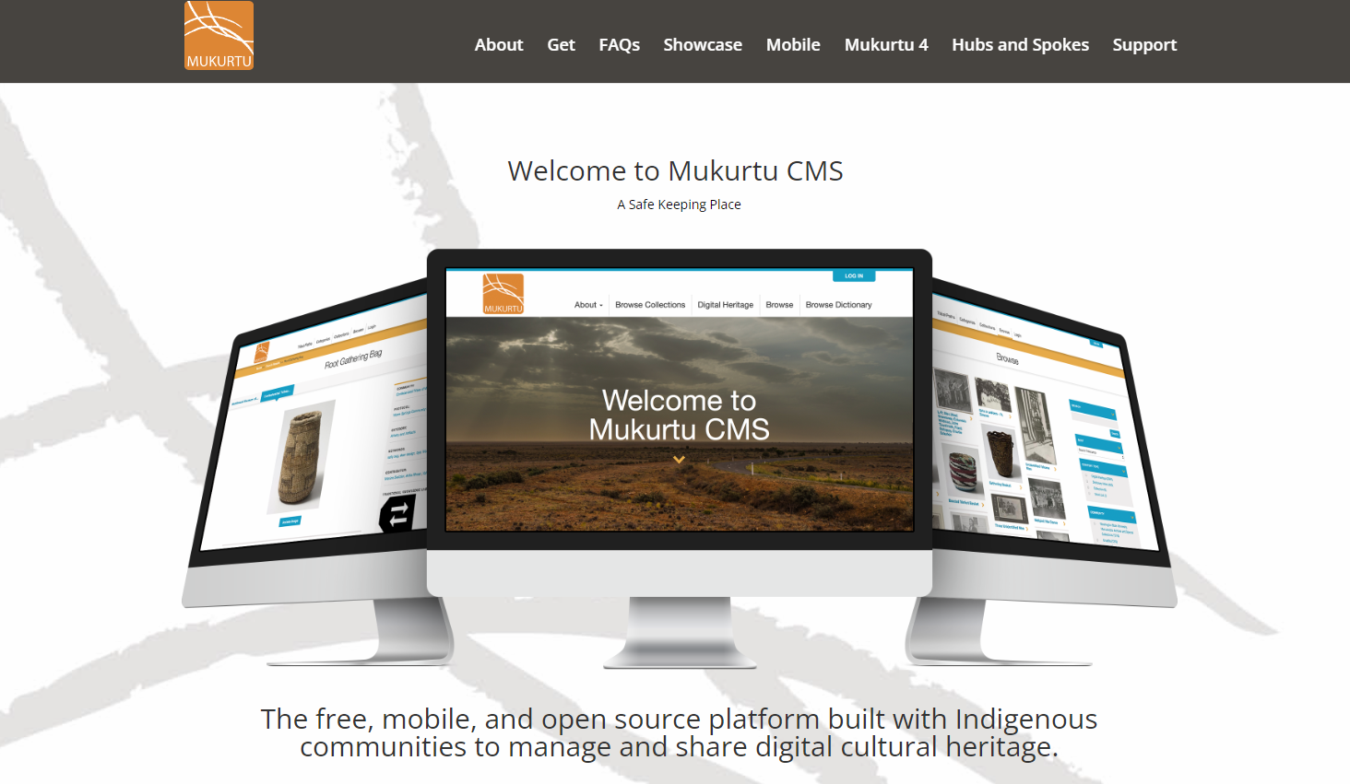

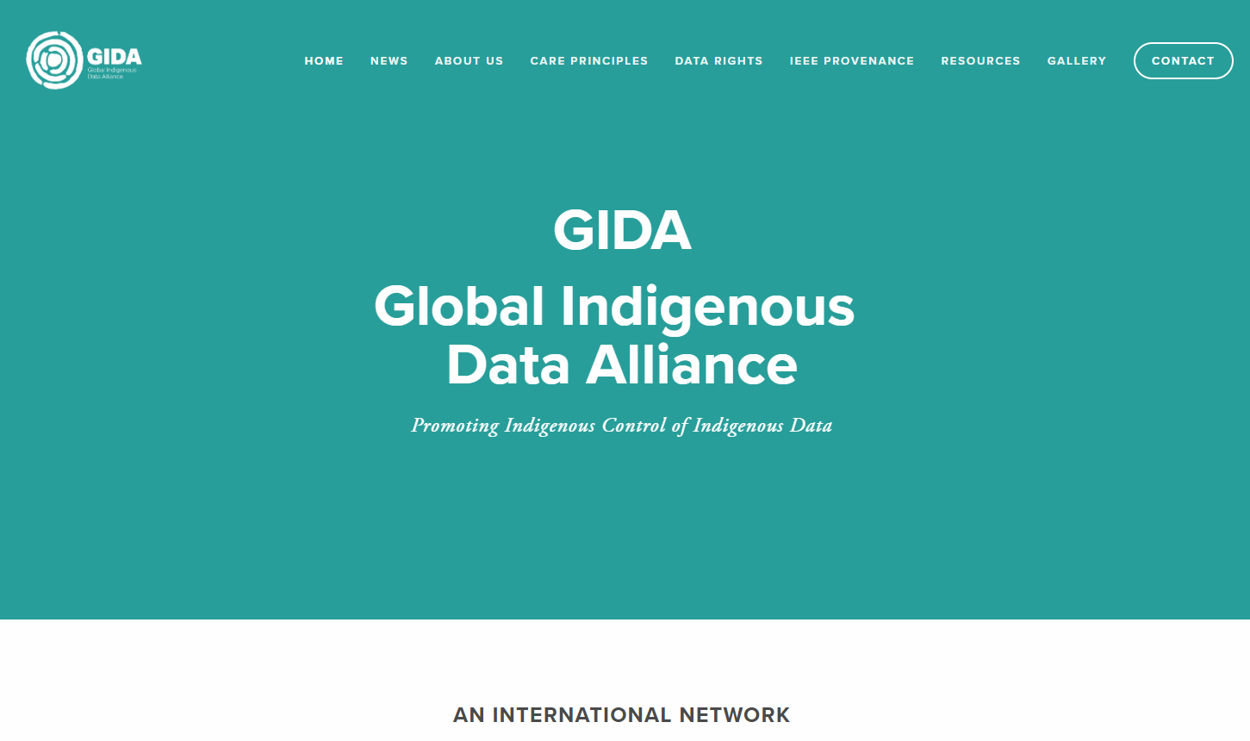
DISCLAIMERS, LABELS AND WARNINGS
Types of Label
Initiatives in the cultural data space
Mukurtu
https://mukurtu.org/
Local Contexts
https://localcontexts.org/
Global Indigenous Data Alliance https://www.gida-global.org/
Mukurtu (MOOK-oo-too) is a grassroots project aiming to empower communities to manage, share, and exchange their digital heritage in culturally relevant and ethically-minded ways.
We are committed to maintaining an open, community-driven approach to Mukurtu’s continued development. Our first priority is to help build a platform that fosters relationships of respect and trust.
Local Contexts is a global initiative that supports Indigenous communities with tools that attribute cultural authority of heritage and data.
By focusing on Indigenous Cultural and Intellectual Property and Indigenous Data Sovereignty, Local Contexts helps Indigenous communities repatriate knowledge and gain control over how their data is collected, managed, displayed, accessed, and used in the future.
Advancing Indigenous Data Sovereignty & Governance
Asserting Indigenous Peoples rights and interests in data
Advocating for data for the self-determined wellbeing of Indigenous Peoples
Reinforcing the rights to engage in decision-making in accordance with Indigenous values and collective interests
Notes:
Labels are an important category of extended metadata that have been developed in the cultural domain. These are particularly directed to support indigenous communities in making sure that there is appropriate attribution of cultural authority and heritage in the digital realm.
Mukurtu and Local Contexts are 2 important international resources or labels for both cultural and natural history collections.

Slide 37
Real World Examples -
Field Museum of Natural History

Slide 38
Example - Field Museum 2023
EXAMPLES
The Field Museum houses both cultural and natural collections. It endeavours to publish its collections information as openly as possible with appropriate attribution.
Data Norms
Collection Warnings
References: https://www.fieldmuseum.org/science/research/use-collections-data-and-images
Notes:
Notes: The facilitator may choose to use the norms, warnings and labels from their own institution as the example.

Slide 39
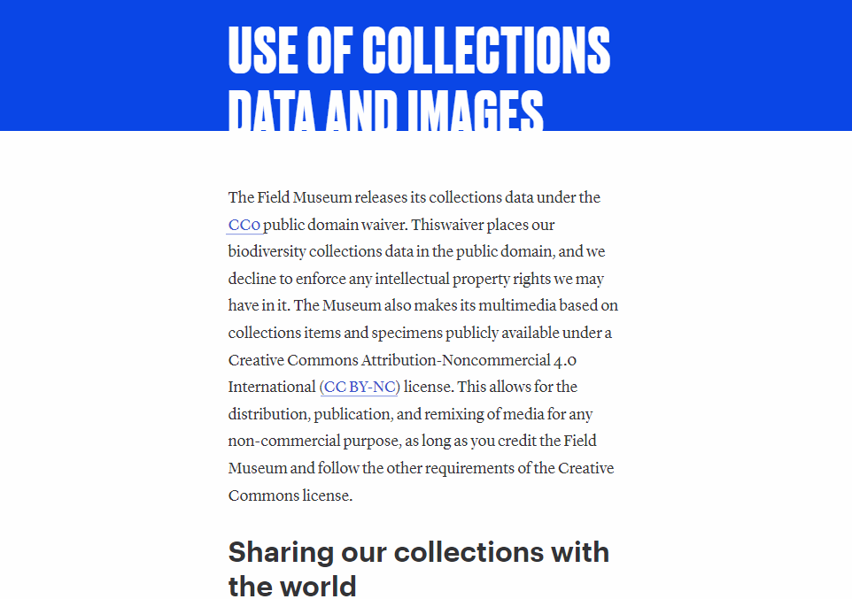
Example - Field Museum - Data Norms
EXAMPLES
Add subtitle if needed
Reference: https://www.fieldmuseum.org/science/research/use-collections-data-and-images
Notes:
NOTES: Review the Field Museum’s Data Norms. Discuss the process that the Museum went through to be able to agree on what is included there. Also, important to emphasize that this is built on other norms documentation from other institutions.
https://www.fieldmuseum.org/science/research/use-collections-data-and-images
Norms and warnings are time sensitive and should be reassessed over time.

Slide 40
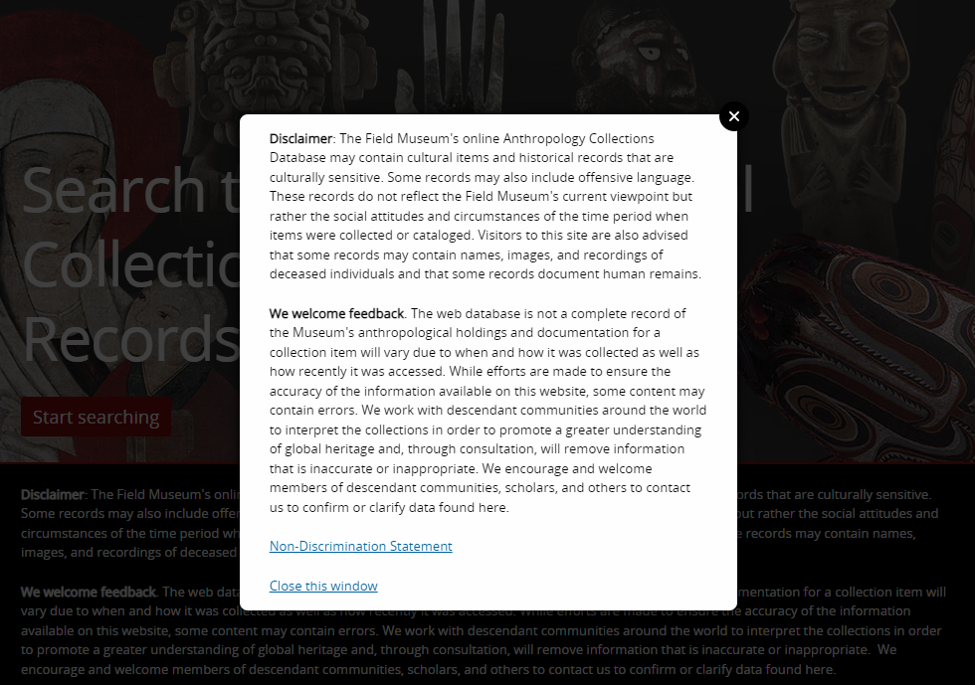
Example - Field Museum - Anthropology Collections
EXAMPLES
Is this a disclaimer or a warning?
Reference: https://collections-anthropology.fieldmuseum.org/
Notes:
NOTES: Review the text and process that the Field Museum went through the get the text that we have. Each department has slightly different wording.
https://collections-anthropology.fieldmuseum.org/

Slide 41
Example - Field Museum 2023
EXAMPLES
The Field Museum uses the collections management system EMu to house its catalogue records, observations and exhibition management content.
Changes to reflect better understanding.
References: https://www.fieldmuseum.org/science/research/use-collections-data-and-images
Notes:
Notes: The facilitator may choose to use the norms, warnings and labels from their own institution as the example.

Slide 42
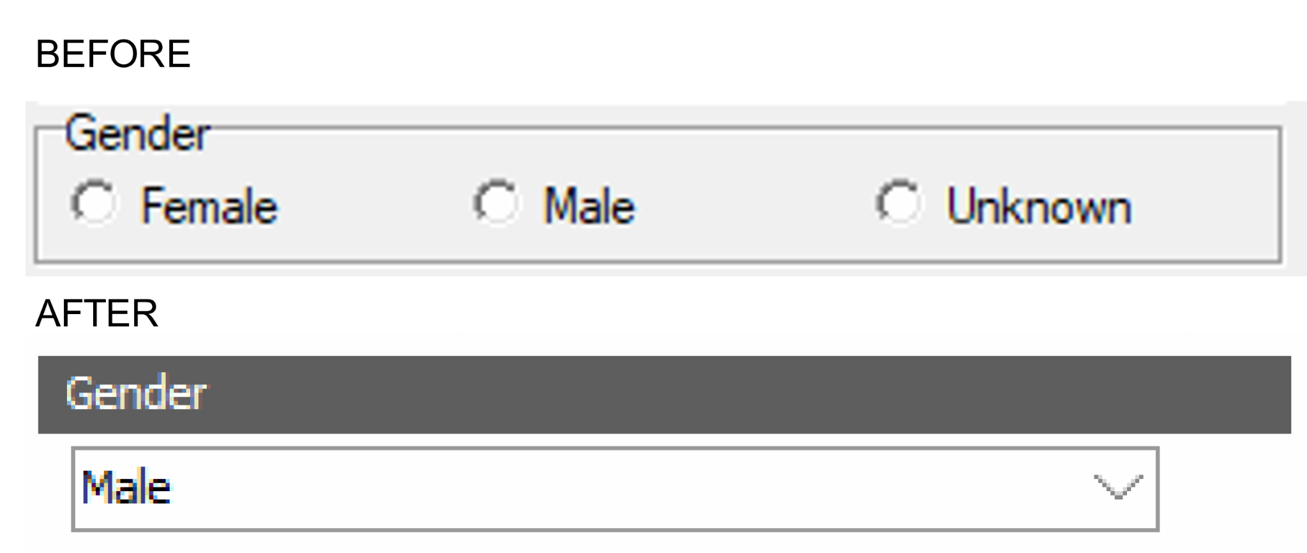
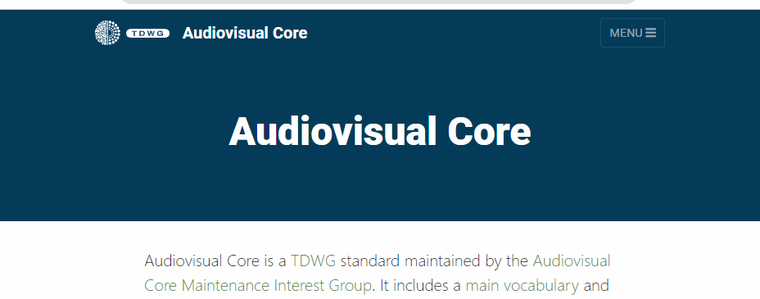
Databases and data structures
EXAMPLES
Databases need not be static monoliths and the data structures that they have, can, do and should change over time, to better reflect the understanding of the information that they hold.
Representing People
Sex and Gender
Redressing harm
Naming Conventions
Replacing binary options for gender with multi-valued lookup fields allows for a broader range of options. Allowing people to describe themselves as they choose.
Naming things after people is a common way of acknowledging the impact of a person on science. As more information is revealed these can and should change.

Slide 43

Abby McArthur-Self
For coming back again
Sara Furr
www.fieldmuseum.org
Heidi Carillo
For choosing to be a part of the team
Sharon Grant
www.fieldmuseum.org
Thank you!
Janeen Jones
www.fieldmuseum.org
Helen Robbins
www.fieldmuseum.org
Kate Webbink
www.fieldmuseum.org
Notes:
This project was made possible in part by the Institute of Museum and Library Services [include IMLS grant number when space allows]."
You may choose to include this acknowledgment in Spanish:
“Este proyecto ha sido posible en parte por el Instituto de Servicios de Museos y Bibliotecas, [include IMLS grant number when space allows].

