Slide 1
Self-Awareness & Assumption
Can Data be Cultured?
Notes:
Welcome to the module on Self-Awareness and Assumption.

Slide 2
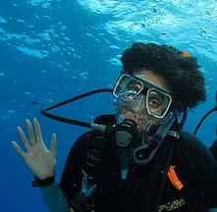
Presenter
Sharon Grant
Department of Information Technology
Field Museum of Natural History
Notes:
Presenter Introduction

Slide 3
Agenda
Perception and Assumption
01
Social Identity
02
Self Awareness
03
Critical Consciousness
04
Use Case and Final Exercises
05
Notes:
Through a series of exercises and discussions our agenda today will cover the following topics as they relate to the work that we do.
Assumptions and Perception
Self Awareness
Social Identity
Critical Consciousness
Given the time that we have we certainly won’t be covering the vast body of research that surrounds each these topics. The hope is that we to start to think about the ways that we, as Museum professionals can critically evaluate the context around the data and information that we are tasked with working with on a daily basis.
And finally
We’ll work on the creation of a Thoughtful Team Page for our website.

Slide 4
Learning Objectives
Examine our own assumptions and perceptions as they relate to our role as a museum professional.
Practice self-awareness and reflect on our own identity through a series of discussions and exercises.
Explore tools for developing reflective practices to support continued growth in ourselves as a part of a museum community.
Notes:
In this module, we will consider the importance of asking ourselves questions about how our identity impacts our perceptions of the work that we do in a Museum space, and how by doing that we can generate a greater collective empathy and understanding for others; and a safer space to deal with the impact of the collections that we work on both as individuals and also for the communities that they come from
This module is the first in a series and is meant to challenge us to investigate how the ways that we view ourselves (and others) influences:
the language we use,
how we communicate,
how we engage with the systems around us,
and how we go about making change in our sphere of influence.

Slide 5
First an assumption…
PREAMBLE
If you take away only one thing? It’s this.
It is presumed that all issues of copyright and access around the specimens, items and researcher’s archives have been taken care of. You should know whether or not your institution has clear title to what it has in its possession and if there is doubt that should be investigated before sharing or making data/information available.
Notes:
But first, an assumption!

Slide 6
Perception and Assumption

Slide 7
Perception and Assumption
Things to consider
Perceptions and assumptions are tools that we all use everyday to make our decisions and actions efficient however, they way we create, interpret and use them are NOT obvious or simple.
What is embedded in the way we perceive information?
How do we interpret what we perceive?
Why do we change our minds?
How do you interrogate your own perspectives?
What assumptions do you bring to the data and information that you encounter?
Consider: How do these change over time?
Notes:
Perceptions and assumptions are tools that we all use everyday to make our decisions and actions efficient, but the way we create, interpret and use them are NOT obvious or simple.
In this section on assumptions and perception we are going to use a series of exercises to start to get our minds thinking about ourselves and what we bring to our work as unique individuals in a museum space. For example:
How do we examine your own perspectives?
…And the perspectives of people around us?
What are our assumptions?
How do we change or reinforce them?
Do we notice them or does someone or something else bring them to our attention?
As examine our assumptions
Is an “objective” point of view possible?
and how confident are we about our assumptions?
What is “neutrality”?
When or Why do we trust something as true?
What does objectivity or neutrality mean in the context of Museum science?
What assumptions do individuals bring to the data they see?

Slide 8
Perceptions and Assumptions
LEARNING OBJECTIVE
SOCIAL IDENTITIES
What is Perception?
Perception is fundamentally individual to each person. While some people may share a largely common perception of an event, there will always be some subtle differences. Often, people will have divergent perceptions of what occurred based on their assumptions, expectations, experience and history.
Perception is defined in the dictionary as “a way of regarding, understanding or interpreting something” (COD 10th Edition).
“Perception is the process of selecting, organizing, and interpreting information. This process, includes the perception of select stimuli that pass through our perceptual filters, are organized into our existing structures and patterns, and are then interpreted based on previous experiences.”
What are they and why do they matter?
Perception and Assumption
Social Identity
Self Awareness
Critical Consciousness
Creating a Thoughtful Team Pae
https://2012books.lardbucket.org/books/a-primer-on-communication-studies/s02-communication-and-perception.html
Notes:
References:
https://2012books.lardbucket.org/books/a-primer-on-communication-studies/s02-communication-and-perception.html
https://journals.sagepub.com/doi/full/10.1177/1744629519849974
https://www.linkedin.com/pulse/why-perception-so-important-workplace-penny-jones-hr
First some definitions. Grossly oversimplified but a place to start.
Perceptions are fundamentally individual to each and everyone of us. At work and in the work that we do, it's important to remember that everybody has their own beliefs and unique mix of traits, preferences and perceptions. What this means is that we each have our own view of the world and have a certain way of approaching things. In this respect we are no different to the people who can before us and who will follow us. As a result intention might not match the impact our words or actions actually have. What we say is not necessarily what others hear and just because we give a message doesn't mean our listeners understand or agree with it.

Slide 9
Perceptions and Assumptions
LEARNING OBJECTIVE
SOCIAL IDENTITIES
What is Assumption
Assumption is defined in the dictionary as “a thing that is assumed to be true” (COD 10th Edition).
It is normal to make assumptions in our daily lives. When we make assumptions about another’s intentions, reasons for action, or their understanding of the situation we may be laying a flawed foundation for our understanding...
Identifying and checking out our assumptions and giving the other person an opportunity to identify and check out their own assumptions is crucial to developing a common understanding of a problem or situation.
What are they and why do they matter?
Perception and Assumption
Social Identity
Self Awareness
Critical Consciousness
Creating a Thoughtful Team Pae
Reference: https://adm.viu.ca/workplace-conflict/assumptions-perceptions-expectations#
Notes:
References:
https://adm.viu.ca/workplace-conflict/assumptions-perceptions-expectations#
An assumption is an unexamined belief: what we think without realizing we think it. Our inferences (also called conclusions) can often be based on assumptions that we haven't thought about critically. A critical thinker, however, is attentive to these assumptions because they are sometimes incorrect or misguided. Just because we assume something is true doesn't mean it is.
That said assumptions can be helpful things. Without them we would be paralysed by the daily need to seek evidence on which to make every decision, and our ability to plan would be severely compromised. From time to time, these assumptions can be challenged and we are forced to reconsider what we previously believed to be true. This can also be helpful as it enables us to examine what we know, why we know it and what the implications are. However, assumptions can also be dangerous when we fail to recognise that sometimes they are just assumptions and are not based on either experience or other forms of evidence.

Slide 10
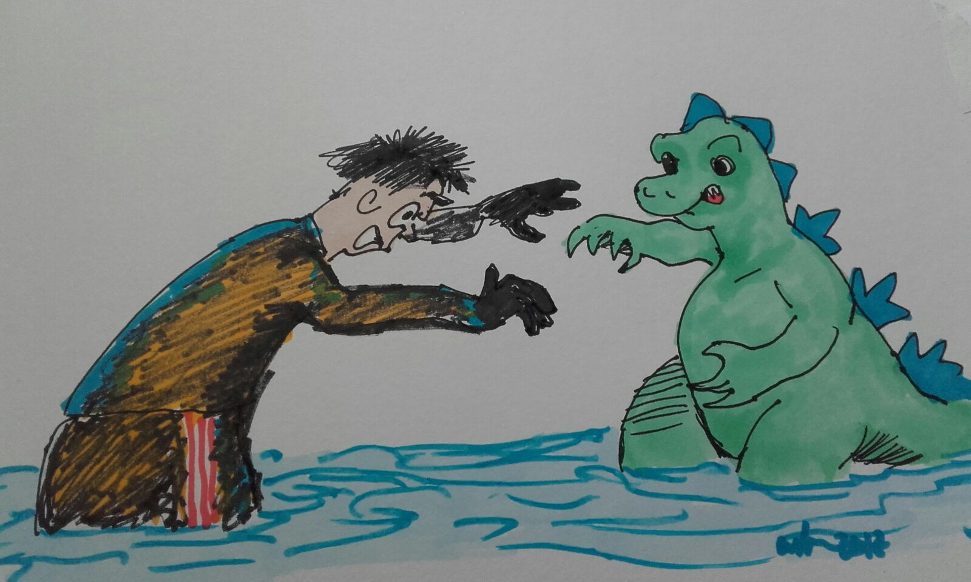
Perception and Assumption
Assuming and Confirming
Exercise 1
In groups of three:
Person 1: you are the subject,
Person 2: you are the data gatherer,
Person 3: you need to find out the true answers
Does the person have any pets?
Does the person have any siblings?
What’s their favorite color?
Paul Austin: https://www.flickr.com/photos/rondls_pics/28338380949/in/album-72157690193876242/
Notes:
Image credit: Paul Austin: https://www.flickr.com/photos/rondls_pics/28338380949/in/album-72157690193876242/
References: https://edu.gcfglobal.org/en/iceberg-thinking/an-eye-for-an-eye/1/
INSTRUCTIONS: Assign each role to the triples (make it as random as you can)
2 mins for person 1
3 mins for person 3
= 5 mins in total
Invite each set (ones, twos and threes) to report back to the group
Person 1: How did it feel to have someone make assumptions about you?
Person 2: What did you have to do to answer the questions?
Person 3: How different were the answers before and after?

Slide 11
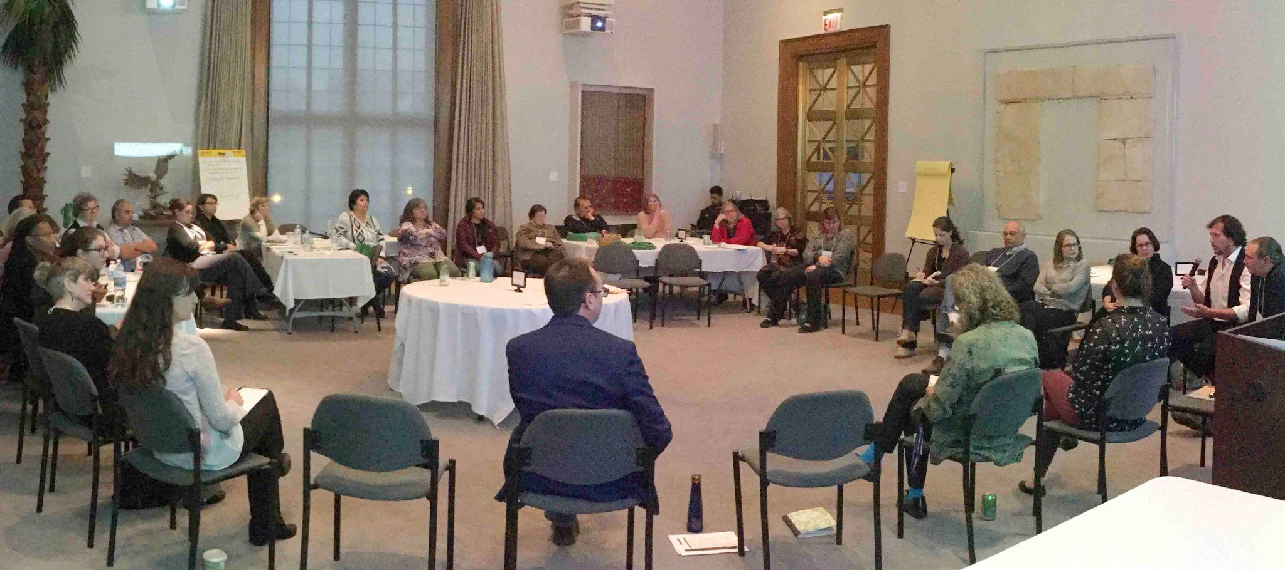
EXERCISES
Exercise 1: Discuss
Where to begin? Pathways for reflection
Questions to Ask Yourself
What am I taking for granted?
Am I assuming something I shouldn't?
How can I determine whether this assumption is accurate?
How do we distinguish between thoughts, beliefs, value, and “facts”? How do we value alternative perspectives?
IMLS Symposium:https://mm.fieldmuseum.org/f1fe1735-3b2e-4917-a59b-b200479ba5ea
Notes:
https://library.louisville.edu/ekstrom/criticalthinking/assumptions
Welcome back.
In our work with collections it behooves us to think carefully about our assumptions when finding and analyzing information, but it is also important to think carefully about the assumptions of others. Whether you're looking at a website or a scholarly article, you should always consider the author's assumptions. Are the author's conclusions based on assumptions that she or he hasn't thought about logically?
5 mins for discussion

Slide 12
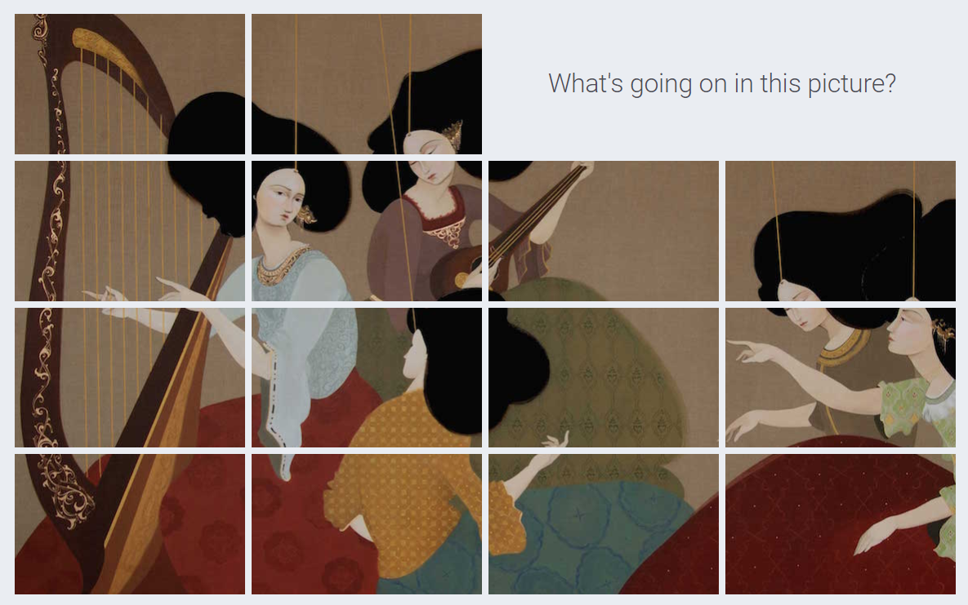
EXERCISES
Example (perception)
What’s going on in this picture?
Think of words or phrases that describe what you see.
Think about what you see that makes you say or think that.
Online Exercise from Visual Thinking Strategies: https://vtshome.org/
Notes:
Online Exercise from Visual Thinking Strategies: https://vtshome.org/
Our next example
INSTRUCTIONS: Presenter runs through this exercise (slides 8-12) as an example for the following exercises.
Ask yourself what’s going on in this image?
And think about what you see that makes you say or think that?

Slide 13
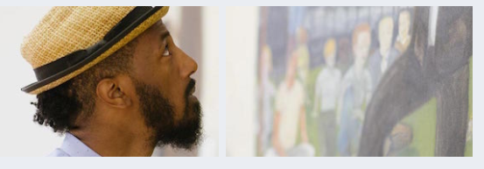
EXERCISES
Example (perception)
What’s going on in this picture?
LOOKING
Online Exercise from Visual Thinking Strategies: https://vtshome.org/
Notes:
Looking

Slide 14
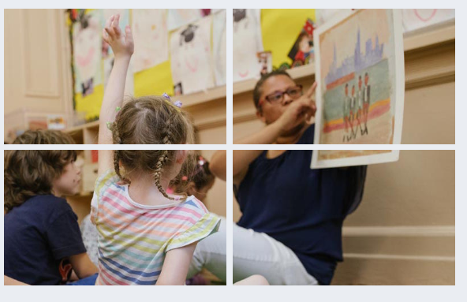
EXERCISES
Example (perception)
What’s going on in this picture?
THINKING
Online Exercise from Visual Thinking Strategies: https://vtshome.org/
Notes:
Thinking

Slide 15
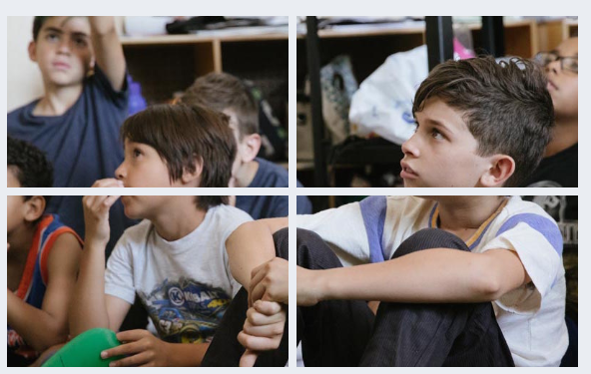
EXERCISES
Example (perception)
What’s going on in this picture?
LISTENING
Online Exercise from Visual Thinking Strategies: https://vtshome.org/
Notes:
Listening

Slide 16
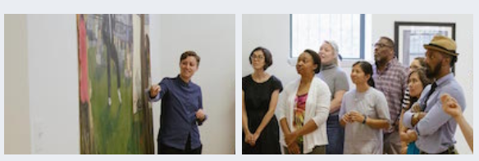
EXERCISES
Example (perception)
What’s going on in this picture?
COLLABORATING
Online Exercise from Visual Thinking Strategies: https://vtshome.org/
Notes:
Collaborating

Slide 17
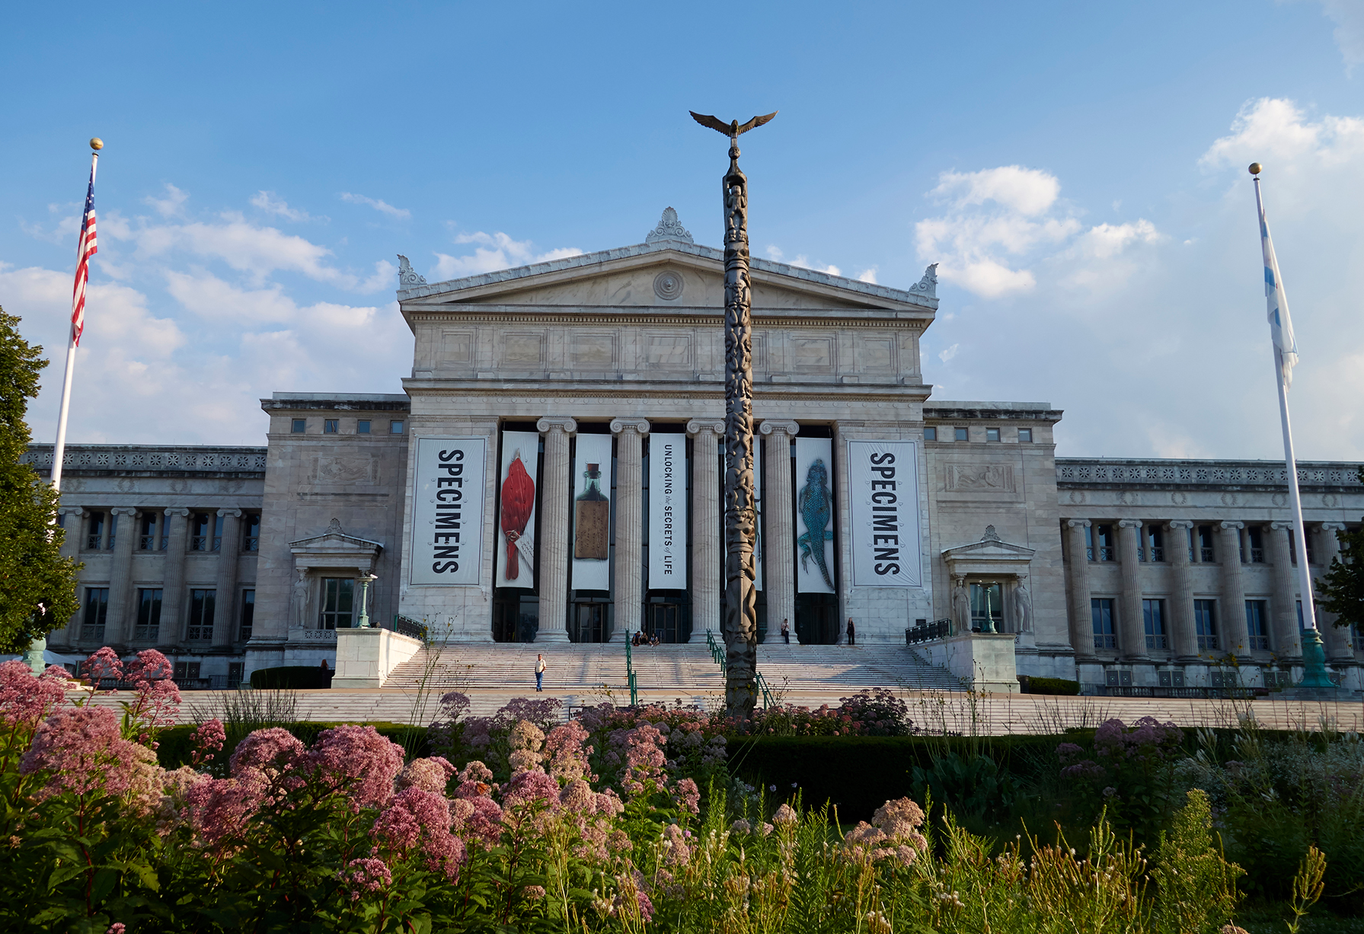
EXERCISES
Exercise 2
What’s going on in this picture?
Add a words or phrases to the jamboard that describe what you see in the image.
What do you specifically notice or focus on?
Full size: https://fm-digital-assets.fieldmuseum.org/2206/729/GN92435_048d.jpg
Notes:
Image credit: North facade. Photograph by John Weinstein. (c) Field Museum of Natural History. https://mm.fieldmuseum.org/eb7ea6b6-96f9-4c24-b9e6-0a6fae6f1df8
Jamboard link: https://jamboard.google.com/d/19HC0UgZgiDB1cHY3iJs9me2m31_EcbGHGUIAEKVRphY/viewer?ts=6632635e&pli=1&f=0
INSTRUCTIONS: Divide the group into 2 for example:
Field Museum and Non-Field Museum
Science and Non-science
Men and Women
Using the Jamboard each group has 5 minutes to list to words or phrases to describe what they see or think about the image.
Group 1 should use blue sticky notes
Group 2 should use yellow sticky notes

Slide 18
EXERCISES
Discuss
Where to begin? Pathways for reflection
Questions to ask yourself
What is embedded in the way we perceive?
How do we interpret what we perceive?
IMLS Symposium:https://mm.fieldmuseum.org/f1fe1735-3b2e-4917-a59b-b200479ba5ea
Notes:
https://jamboard.google.com/d/19HC0UgZgiDB1cHY3iJs9me2m31_EcbGHGUIAEKVRphY/viewer?ts=6632635e&pli=1&f=0
Presenter should take a minute to read aloud what has been added to the chat.
What things are similar and what things are different. Are there differences between the groups?
5 mins for discussion

Slide 19
Social Identity

Slide 20
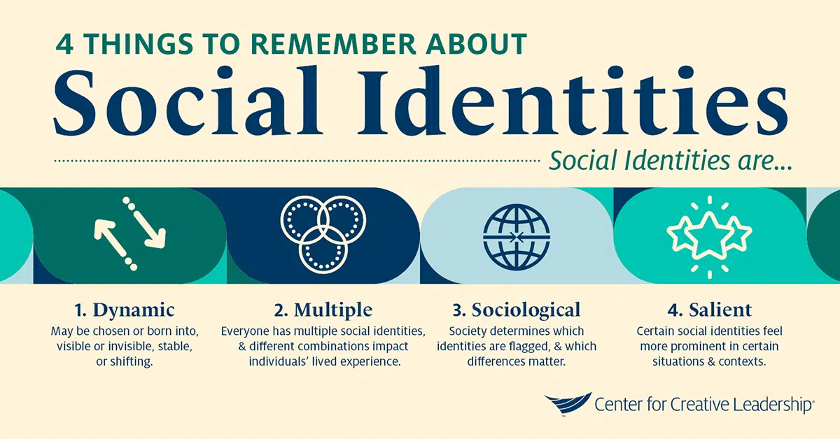
LEARNING OBJECTIVE
SOCIAL IDENTITIES
Social Identities
Concepts to Consider
Social identities are dynamic.
Everyone has multiple social identities, and combinations matter.
Social identities are shaped by society.
Social identities can be more or less salient, depending on context.
https://www.ccl.org/
Notes:
https://www.ccl.org/articles/leading-effectively-articles/understand-social-identity-to-lead-in-a-changing-world/
Social identity isn’t static; it can change over time. You could be born into one social identity group or acquire one as a result of specific career choices. At other times, a lived experience may create a new social identity. Some social identities are visible, while others are invisible. Some social identities you may hold your whole life, while others may shift throughout your life.
Although social identities are often talked about in terms of a single category, everyone has multiple social identities that combine in unique ways
Society and culture determine when and how differences between people become social identities. For example, eye color is not considered a social identity in most current social groups, but skin color is. Because social identities are norm dependent, what is and is not considered a social identity can change over time and in different cultures.
Certain social identities may feel more prominent in certain situations and contexts. For example, if you are a White American living in North America, you might not often think about your national identity. However, if you were to take an expat position in China, this might suddenly feel like a huge part of your identity, because it will likely impact how others see you, as well as how you interpret your experiences.

Slide 21
Social Identity
LEARNING OBJECTIVE
SOCIAL IDENTITIES
What is Social Identity?
Social identities are labels that people use to categorize or identify themselves and/or others as members of specific groups.
Social identity is one of the aspects of your “self-concept” — how you see yourself as a person.
Hurtado and Gurin (2004) define social identities as “one’s group memberships and the emotional attachment one has for these group memberships,”
What is it and why does it matter?
Perception and Assumption
Social Identity
Self Awareness
Critical Consciousness
Creating a Thoughtful Team Pae
Reference: https://ccl.org/articles/leading-effectively-articles/understand-social-identity-to-lead-in-a-changing-world/
Notes:
Reference: https://ccl.org/articles/leading-effectively-articles/understand-social-identity-to-lead-in-a-changing-world/
What is Social Identity?
Social identities are labels that people use to categorize or identify themselves and/or others as members of specific groups. Some common social identities include generation, ethnicity, race, religion, gender, sexual orientation, nationality, (dis)ability, political affiliation, relationship status, profession, and socioeconomic status.
Social identity is one of the aspects of our “self-concept” — how you we ourselves as a person. Along with our personal identity (for example personal attributes that you use to describe yourself, like being tall or conscientious), social identity influences our values, the stories we tell about ourselves and others, and things that motivate us toward action.

Slide 22
Social Identity
LEARNING OBJECTIVE
SOCIAL IDENTITIES
Why does Social Identity Matter?
Social identities are powerful because they’re also often at the root of unequal power or privilege.
Aspects of social identity affect how you lead and work with others. A social identity lens can help spot situations when people don’t feel free to share their perspectives or are being unintentionally shut out, or when actions or decisions may be rooted in unconscious bias.
What is it and why does it matter?
Perception and Assumption
Social Identity
Self Awareness
Critical Consciousness
Creating a Thoughtful Team Pae
Reference: https://ccl.org/articles/leading-effectively-articles/understand-social-identity-to-lead-in-a-changing-world/
Notes:
Reference: https://ccl.org/articles/leading-effectively-articles/understand-social-identity-to-lead-in-a-changing-world/
Social identities are powerful because they’re also often at the root of unequal power or privilege. As humans, we categorize ourselves and each other into groups along social identity lines. This categorization often lays the foundation for bias, stereotypes, prejudice, and favoritism. It also often serves as a catalyst for action.
Understanding the nuances of social identity is critical because aspects of social identity affect how you lead and work with others. A social identity lens can help spot situations when people don’t feel free to share their perspectives or are being unintentionally shut out, or when actions or decisions may be rooted in unconscious bias. It’s also foundational to any organizational-level efforts to foster a more inclusive culture.

Slide 23
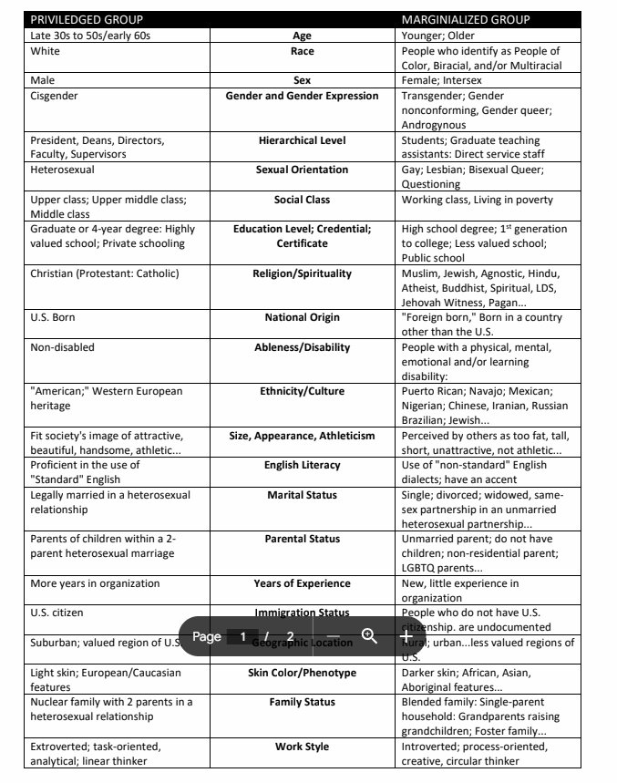
EXERCISES
Exercise 3
List as many of your social identities as you can
Make a copy of the worksheet for yourself.
Reflect on the social identities listed
Consider categories such as age, sex, social class, ethnicity, religion, occupation, nationality, social or relational roles, (dis)ability, neurotypical status, etc.
Worksheet:https://docs.google.com/document/d/1_pbH8Xh8m94qQ4aDUrH_nXe92Fzmy979utpZcmNmhQo
Notes:
Worksheet URL: Identity Salience and Social Location Handout
PDF
Googledoc
INSTRUCTIONS: Each participant should make a copy of the googledoc and highlight the cell (left or right) that you most closely identify with. You can make it bold or colour the cell.
Time: 10 mins

Slide 24
EXERCISES
Discuss
Where to begin? Pathways for reflection
As members of the Museum community,
Which of the identities are sources of power and privilege in your discipline, prior experience as a learner, or in higher education in general?
Which of the identities are marginalized/not advantaged in your discipline or higher education in general?
IMLS Symposium:https://mm.fieldmuseum.org/f1fe1735-3b2e-4917-a59b-b200479ba5ea
Notes:
Reference: https://tll.mit.edu/teaching-resources/inclusive-classroom/identities-positionality/
After the 10 minutes is done.
The left-most column describes privileged identities and the right-most column describes marginalized identities. Does anyone want to share their thoughts?
It’s ok if no one does.

Slide 25
Self Awareness
Notes:
Our next topic is self-awareness

Slide 26
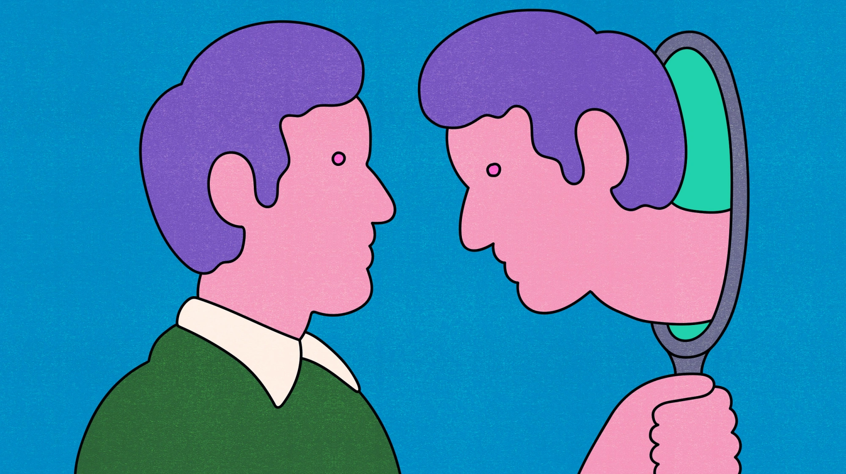
LEARNING OBJECTIVE
SOCIAL IDENTITIES
Self Awareness
Concepts to Consider
Self awareness is an ongoing process of reflection about ourselves and our assumptions:
how we see the world
how we make meaning of our experiences and identities
how we behave in the world
Self awareness allows us to determine who we want to be by helping us understand who we are now and what impact we have on others.
image:https://www.nbcnews.com/better/amp/ncna1067721
Notes:
references:
https://www.nbcnews.com/better/amp/ncna1067721
https://www.understood.org/en/articles/the-importance-of-self-awareness
Self-awareness is the ability to tune in to our own feelings, thoughts, and actions. When people are self-aware, we understand our strengths and challenge. We also understand that how we see ourselves may be different from how others see us
Self-awareness is the ability to tune in to our feelings, thoughts, and actions.
Being self-aware also means being able to recognize how other people see us.
People who are self-aware recognize their strengths and their challenges.

Slide 27
Self Awareness
LEARNING OBJECTIVE
SOCIAL IDENTITIES
What is Self Awareness (Theory)?
“Self-awareness is the ability to see yourself clearly and objectively through reflection and introspection.” (Ackerman, 2020)
“Self-awareness theory is based on the idea that you are not your thoughts, but the entity observing your thoughts; you are the thinker, separate and apart from your thoughts (Duval & Wicklund, 1972).”
What is it and why does it matter?
Perception and Assumption
Social Identity
Self Awareness
Critical Consciousness
Creating a Thoughtful Team Pae
Reference: https://uncagedfhs.org/11124/opinion/defining-critical-consciousness-and-its-importance-in-education/#
Notes:
References:
Ackerman, 2020, https://positivepsychology.com/self-awareness-matters-how-you-can-be-more-self-aware/
Although everyone has a fundamental idea of what self-awareness is, we don’t know exactly where it comes from, what its precursors are, or why some of us seem to have more or less than others.
This is where the self-awareness theory comes in. Self-awareness theory is based on the idea that you are not your thoughts, but the entity observing your thoughts; you are the thinker, separate and apart from your thoughts.
When we engage in self-evaluation, we can give some thought to whether we are thinking and feeling and acting as we “should” or following our standards and values. This is referred to as comparing against our standards of correctness. We do this daily, using these standards as a way to judge the rightness of our thoughts and behaviors.

Slide 28
Self Awareness
LEARNING OBJECTIVE
SOCIAL IDENTITIES
Why is it important to be self aware?
It can make us more proactive, boost our acceptance, and encourage positive self-development (Sutton, 2016).
Self-awareness allows us to see things from the perspective of others, practice self-control, work creatively and productively, and experience pride in ourselves and our work as well as general self-esteem (Silvia & O’Brien, 2004).
It leads to better decision making (Ridley, Schutz, Glanz, & Weinstein, 1992).
It can make us better at our jobs, better communicators in the workplace, and enhance our self-confidence and job-related wellbeing (Sutton, Williams, & Allinson, 2015).
What is it and why does it matter?
Perception and Assumption
Social Identity
Self Awareness
Critical Consciousness
Creating a Thoughtful Team Pae
Reference: https://uncagedfhs.org/11124/opinion/defining-critical-consciousness-and-its-importance-in-education/#
Notes:
References:
Ackerman, 2020, https://positivepsychology.com/self-awareness-matters-how-you-can-be-more-self-aware/
This theory has been around for several decades and because of this the depth of knowledge on self-awareness, its correlates, and its benefits can provide us with a healthy foundation for enhancing self-awareness in ourselves and potentially in others.

Slide 29
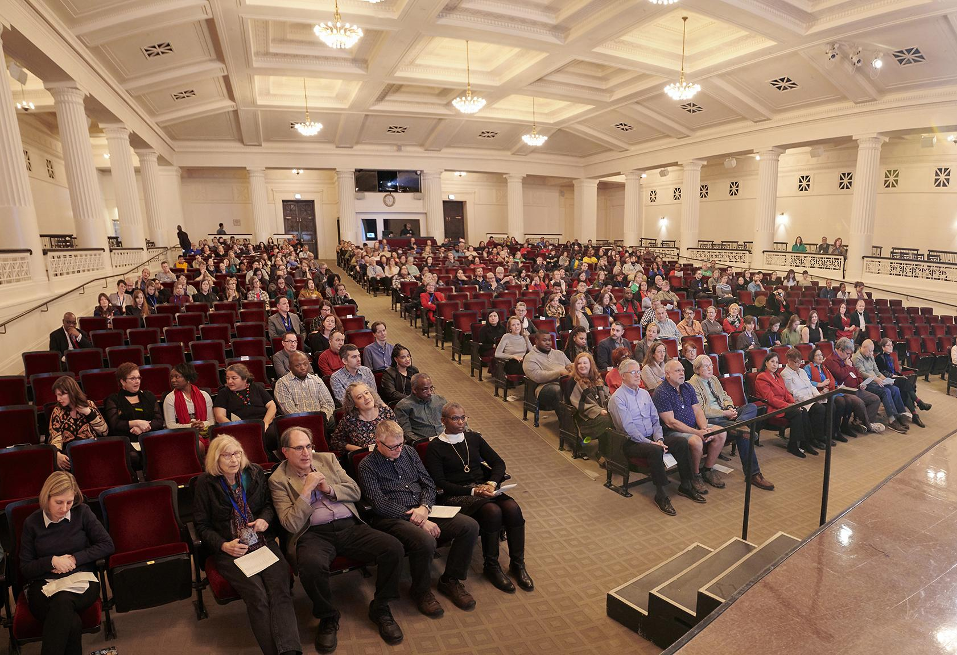
EXERCISES
Exercise 4
What do you see?
Using the jamboard try to describe the picture without making assumptions.
What do you notice or focus on?
Think about what it is that you see that makes you say/think that?
Full size: https://mm.fieldmuseum.org/98cb6d58-f5f1-45ce-bc9a-1d58bb33f2dd
Notes:
Image credit: Audience, Employee Recognition Ceremony, in James Simpson Theater. Photograph by John Weinstein. (c) Field Museum of Natural History. https://mm.fieldmuseum.org/98cb6d58-f5f1-45ce-bc9a-1d58bb33f2dd
Jamboard link: https://jamboard.google.com/d/19HC0UgZgiDB1cHY3iJs9me2m31_EcbGHGUIAEKVRphY/viewer?ts=6632635e&pli=1&f=0
PAN-ning – pay attention now - to help a participant step away from judging [e.g. “is part of why we don’t talk about a thing b/c we’re afraid of being wrong/judged/etc?”]
e.g. – judgement + emotional/personal topics
show photo and ask “what do you see / describe the image”
how would you describe photo without making assumptions – breaking down “family” to “man/adult” with …

Slide 30
Critical Consciousness
Notes:
The last topic we will cover is critical thinking

Slide 31
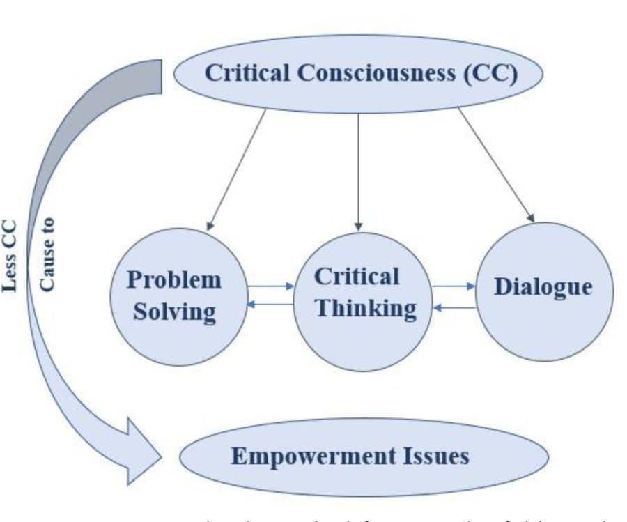
LEARNING OBJECTIVE
CRITICAL CONSCIOUSNESS
Critical Consciousness
Concepts to Consider
The key components of CC are dialogue, critical thinking and problem solving.
““Critical consciousness helps you to be able to see beyond your own personal experience and understand the diverse experiences that other people in the country have,”
Zayna Jamil, Contributor. June 9, 2022
Notes:
Reference: https://uncagedfhs.org/11124/opinion/defining-critical-consciousness-and-its-importance-in-education/
This graphic explains the stages and key components of Critical Consciousness: Problem Solving, Critical Thinking and Dialogue.
Use of the term ‘critical thinking’ to describe an educational goal goes back to the American philosopher John Dewey (1910), who more commonly called it ‘reflective thinking’. He defined it as
active, persistent and careful consideration of any belief or supposed form of knowledge in the light of the grounds that support it, and the further conclusions to which it tends. (Dewey 1910: 6; 1933: 9)
and identified a habit of such consideration with a scientific attitude of mind. His lengthy quotations of Francis Bacon, John Locke, and John Stuart Mill indicate that he was not the first person to propose development of a scientific attitude of mind as an educational goal.

Slide 32
Critical Consciousness
LEARNING OBJECTIVE
SOCIAL IDENTITIES
What is Critical Consciousness (CC)?
CC is a theory founded by the Brazilian educator, Paulo Freire (1973, 1968/2000), that focuses on achieving in-depth knowledge of social, political and economic structures in society to solve real world problems.
“CC [is] the dynamic interplay of three components. Critical reflection describes awareness and analysis of inequitable social conditions, critical motivation includes a commitment to creating positive social change that results in more equitable and just systems and outcomes, and critical action describes behaviors that support such change along with actions that directly address social inequities”(Luke J. Rapa and G. John Geldhof 2020)
What is it and why does it matter?
Perception and Assumption
Social Identity
Self Awareness
Critical Consciousness
Creating a Thoughtful Team Pae
Reference: https://uncagedfhs.org/11124/opinion/defining-critical-consciousness-and-its-importance-in-education/#
Notes:
References:
https://uncagedfhs.org/11124/opinion/defining-critical-consciousness-and-its-importance-in-education/#
Luke J. Rapa and G. John Geldhof 2020 https://www.ncbi.nlm.nih.gov/pmc/articles/PMC7443156/
Critical consciousness in its modern form is a popular education and social concept developed by Brazilian educational theorist Paulo Freire, it focuses on achieving an in-depth understanding of the world, allowing for the perception and exposure of social and political contradictions. Critical consciousness also includes taking action against the oppressive elements in one's life that are illuminated by that understanding

Slide 33
Critical Consciousness
LEARNING OBJECTIVE
SOCIAL IDENTITIES
What is the importance of Critical Consciousness (CC)?
“Critical consciousness helps you to be able to see beyond your own personal experience and understand the diverse experiences that other people in the country have,” said Faiza Jamil, a Human Development Professor at Clemson University.
“Critical consciousness – the degree to which individuals are able to “read” social conditions critically and feel empowered to act to change those conditions” (Godfrey & Rarick 2016)
What is it and why does it matter?
Perception and Assumption
Social Identity
Self Awareness
Critical Consciousness
Creating a Thoughtful Team Pae
Reference: https://uncagedfhs.org/11124/opinion/defining-critical-consciousness-and-its-importance-in-education/#
Notes:
References:
https://uncagedfhs.org/11124/opinion/defining-critical-consciousness-and-its-importance-in-education/#
Godfrey & Rarick 2016 https://link.springer.com/referenceworkentry/10.1007/978-3-319-32132-5_809-1
https://plato.stanford.edu/entries/critical-thinking/
Critical consciousness is an important theory in the realm of social justice. It describes how oppressed or marginalized people learn to critically analyze their social conditions and act to change them.
Its three components are often described as—critical reﬂection, political efﬁcacy, and critical action.
Critical reﬂection refers to a social analysis and moral rejection of societal inequities, such as social, economic, racial/ethnic, and gender inequities that constrain well-being and human agency.
Political efﬁcacy is the perceived capacity to effect social and political change by individual and/or collective activism.
Critical action refers to individual or collective action taken to change aspects of society, such as institutional policies and practices, which are perceived to be unjust.
This is a broad view of activism that includes participation in activities such as voting, community organizing, and peaceful protests.

Slide 34
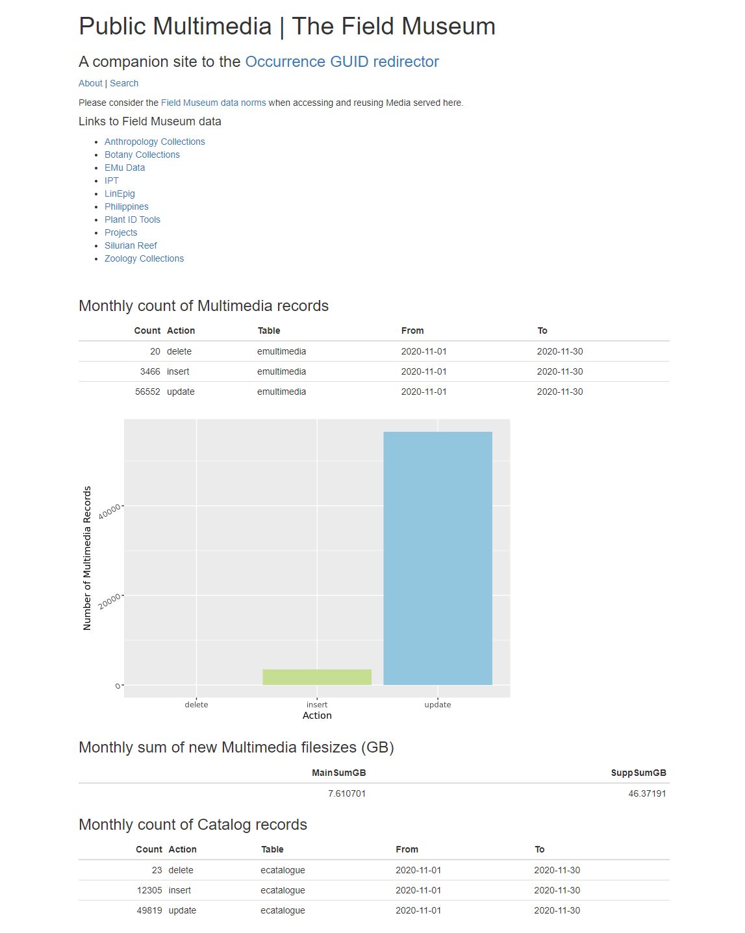
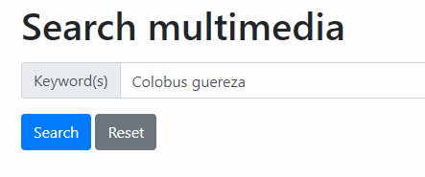
EXERCISES
Exercise 5
Search for “Colobus guereza” on mm.fieldmuseum.org
Thinking about the concepts we have reviewed. Add a thoughts about what you find from the search to the jamboard.
What do you notice or focus on?
How do the results make you feel?
Think about what it is that you see that makes you say/think that?
https://mm.fieldmuseum.org/search/Colobus+guereza?start=0
Notes:
Search URL: https://mm.fieldmuseum.org/search/Colobus+guereza?start=0
Jamboard link: https://jamboard.google.com/d/19HC0UgZgiDB1cHY3iJs9me2m31_EcbGHGUIAEKVRphY/viewer?ts=6632635e&pli=1&f=0

Slide 35
Use Case and Homework

Slide 36
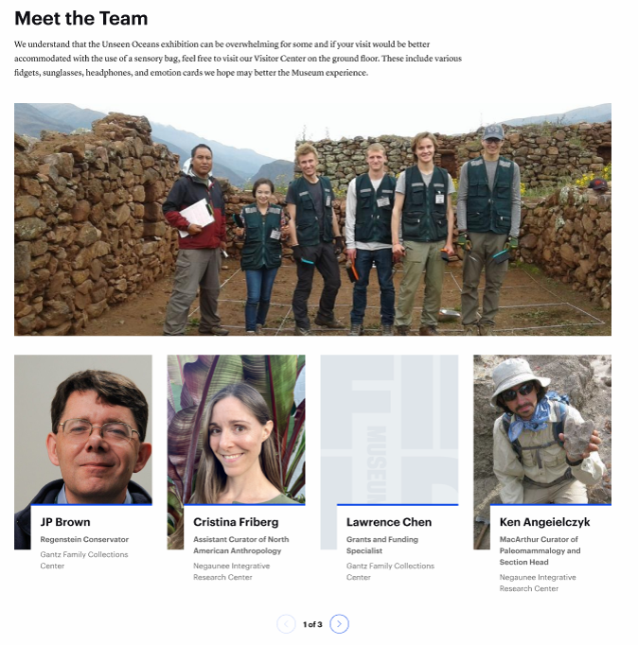
EXERCISES
Use Case Exercise
The use case requires the website to include a section about the team and includes individual team member pages.
Assuming the role of the projects principal investigator:
Draft the introduction to the project team
Draft your personal statement as a member of the team.
What do you think is important for visitors to the site to understand about the team and your role in the project?

Slide 37

Sara Furr
www.fieldmuseum.org
Sharon Grant
www.fieldmuseum.org
Thank you!
Janeen Jones
www.fieldmuseum.org
Helen Robbins
www.fieldmuseum.org
Kate Webbink
www.fieldmuseum.org
Notes:
This project was made possible in part by the Institute of Museum and Library Services [include IMLS grant number when space allows]."
You may choose to include this acknowledgment in Spanish:
“Este proyecto ha sido posible en parte por el Instituto de Servicios de Museos y Bibliotecas, [include IMLS grant number when space allows].

Slide 38
Exercises
Homework
Name: Critical Consciousness
Duration: [~25 min]
Platform: [Virtual/In Person]
Data: Neutral/Conceptual
Description:
Use the Critical Consciousness Self Reflection worksheet to begin understanding where you are currently in self awareness, positionality, and action.
Notes:
Creation of a positionality statements
  Talking about my views of ed - how i understand it + who i am / how i collect data
e.g. I ascribe to this theory + who i am as a researcher
How attach theory / framework of a discipline to you as a person
Integrated conceptual framework
Some is forward-looking and/but some seems inclined to destroying the discipline; can get tangled with authority/taking an [overly] authoritative voice
Worksheets using real museum data
(may have to remove some things for privacy etc.)
Assumption & Perception
Self Awareness
Social Location & Identity
Critical Consciousness
Creating a Thoughtful Team Page
Notes:
from the [DRAFT] overview slide deck (if helpful reference):
https://docs.google.com/presentation/d/1oXSDt7wIgqxueD4G5TEktEzEUAkLowAj/edit#slide=id.g1348323866e_4_47
Name: Critical Consciousness
Duration: [~25 min]
Platform: [Virtual/In Person]
Data: Neutral/Conceptual
Description:
Use the Critical Consciousness Self Reflection worksheet to begin understanding where you are currently in self awareness, positionality, and action.
Notes:
Creation of a positionality statements
Talking about my views of ed - how i understand it + who i am / how i collect data
e.g. I ascribe to this theory + who i am as a researcher
How attach theory / framework of a discipline to you as a person
Integrated conceptual framework
Some is forward-looking and/but some seems inclined to destroying the discipline; can get tangled with authority/taking an [overly] authoritative voice
Worksheets using real museum data (may have to remove some things for privacy etc.)

Slide 39
Exercises
Homework
Name: Identity and Social Location
Duration: [~20 min &/or ongoing?]
Platform: [Virtual/In Person]
Data: Neutral/Conceptual
Description:
Identity pie
Identity Salience and Social Location Handout
Notes: Privilege & marginalization in 2020s, in communities in [Chicago/IL/Midwest…]
  Not intended as a tool for categorizing/labeling/pigeonholing; meant to help notice/become aware of patterns [in assumptions/behavior/experiences]
  What is given value from a societal level [vs systemic / individual level]?
  What do we as individuals care about / get to care about vs …others/society care about?
  What roles these can play in systemic vs/and/or interpersonal interactions
  How dynamic are these?
Learning Objectives:
Goals: [2023-jan-kw]
  To explore concepts of privilege & marginalization
  To consider individual experiences (one’s own, one’s peers…) of privilege/marginalization
Assumption & Perception
Self Awareness
Social Location & Identity
Critical Consciousness
Creating a Thoughtful Team Page
Notes:
from the [DRAFT] overview slide deck (if helpful reference):
https://docs.google.com/presentation/d/1oXSDt7wIgqxueD4G5TEktEzEUAkLowAj/edit#slide=id.g1348323866e_4_47
Name: Identity and Social Location
Duration: [~20 min &/or ongoing?]
Platform: [Virtual/In Person]
Data: Neutral/Conceptual
Description:
Identity Salience and Social Location Handout
Notes: Privilege & marginalization in 2020s, in communities in [Chicago/IL/Midwest…]
Not intended as a tool for categorizing/labeling/pigeonholing; meant to help notice/become aware of patterns [in assumptions/behavior/experiences]
What is given value from a societal level [vs systemic / individual level]?
What do we as individuals care about / get to care about vs …others/society care about?
What roles these can play in systemic vs/and/or interpersonal interactions
How dynamic are these?
Learning Objectives:
Goals: [2023-jan-kw]
To explore concepts of privilege & marginalization
To consider individual experiences (one’s own, one’s peers…) of privilege/marginalization

Slide 40
Self-Awareness / Underlying assumptions:
Intellectual / examining your thoughts/experiences
  e.g. academia is about re-examining / methods of measuring world
Hearing what you sound like from another perspective
Trying to hear what someone else hears you say
  your intention isn’t necessarily their interpretation/understanding
Reflects past experiences & how we remember them
  (like language, underlies how we convey & see information / direction / feelings / thoughts)

Slide 41
Self-awareness
LEARNING OBJECTIVES
SELF
Self-awareness…
is an ongoing process of reflection about ourselves and our assumptions:
how we see the world
how we make meaning of our experiences and identities
how we behave in the world
allows us to determine who we want to be by helping us understand who we are now and what impact we have on others.
Assumption & Perception
Self Awareness
Social Location & Identity
Critical Consciousness
Creating a Thoughtful Team Page
Notes:
I think we need to add here that self-awareness is also about how we make meaning of our identities and experiences. (often more natural with marginalized identities than dominant identities, i.e., did that happen b/c of x factor about me?)
This objective is about the individual.
& providing individual with tools:
Tools to interrogate assumptions and perceptions
Visual Thinking & Strategy
Pay Attention Now
Tools to raise self-awareness & awareness of identity
Social Location & Identity
Critical Consciousness

Slide 42
LEARNING OBJECTIVES
SELF
Self Awareness
Questions to consider throughout the module:
What is embedded in the way something is expressed or presented?
How do we interpret or make meaning
of what we experience?
How do you interrogate your own interpretations?
What do we value?
Why? What assumptions do you bring to data that you see?
  Remember! Personal and communal values, assumptions, and biases change over time.
Notes:
“interrogate” vs “examine” – to emphasize not just examining but critically evaluating whether a given perspective should stay/change/go
What is embedded in the way we perceive?
How do we interpret what we perceive?
Why do we change our minds?
How do you interrogate your own perspectives?

Slide 43
LEARNING OBJECTIVES
SELF-AWARENESS
Self-Awareness
Questions about self-awareness & identity to consider throughout the module:
What is embedded in the way we express ideas?
How do you interrogate your own perspectives?
How do you want to sound or look?
How do people see or understand you?
How do we define our identities?
How does that affect your views of the world?
Notes:
Paralleling/Contrasting “self-awareness” and awareness of alternative perspectives
Critically evaluating assumptions, values…
“interrogate” vs “examine” – to emphasize not just examining but critically evaluating whether a given perspective should stay/change/go
How do we distinguish between thoughts, beliefs, value, and “facts”? How do we value alternative perspectives?
“blind commitment to a theory is not an intellectual virtue; it is an intellectual crime.”
Imre Lakatos (1973) - https://www.lse.ac.uk/philosophy/science-and-pseudoscience-overview-and-transcript/
Is science neutral? Or objective? Can it (or any method/framework/ideology) be inherently good, or …?
Consider exercise/tool:
PAN-ning – pay attention now - to help a participant step away from judging [e.g. “is part of why we don’t talk about a thing b/c we’re afraid of being wrong/judged/etc?”]
e.g. – judgement + emotional/personal topics
show photo of [e.g. family / kids went to a farm] & ask “what do you see / describe the image”
see a family (why do you think so)
what season?
how would you describe photo without making assumptions – breaking down “family” to “man/adult” with …
Alternative images/prompts / instead of the provided image:
find images of individuals with whom the facilitator &/or participants interact or relate to.
find a collections image & have group describe it
describe an experience:
what assumptions

Slide 44
Self-Awareness
EXERCISES
How do we define our identities?
  By experiences and values?
  By how others define us?
  In different contexts?
How does that affect your views of the world?
  Throughout life?
  Within the museum [data]?
  In different communities/contexts (society, science)
Assumption & Perception
Self Awareness
Social Location & Identity
Critical Consciousness
Creating a Thoughtful Team Page
Notes:
Paralleling/Contrasting “self-awareness” and awareness of alternative perspectives
Critically evaluating assumptions, values…
“interrogate” vs “examine” – to emphasize not just examining but critically evaluating whether a given perspective should stay/change/go
How do we distinguish between thoughts, beliefs, value, and “facts”? How do we value alternative perspectives?
“blind commitment to a theory is not an intellectual virtue; it is an intellectual crime.”
Imre Lakatos (1973) - https://www.lse.ac.uk/philosophy/science-and-pseudoscience-overview-and-transcript/
Is science neutral? Or objective? Can it (or any method/framework/ideology) be inherently good, or …?
Consider exercise/tool:
PAN-ning – pay attention now - to help a participant step away from judging [e.g. “is part of why we don’t talk about a thing b/c we’re afraid of being wrong/judged/etc?”]
e.g. – judgement + emotional/personal topics
show photo of [e.g. family / kids went to a farm] & ask “what do you see / describe the image”
see a family (why do you think so)
what season?
how would you describe photo without making assumptions – breaking down “family” to “man/adult” with …

Slide 45
EXERCISES
Exercise
How can identity affect the way we look at the world?
Specifically within the museum [data]?
&
Broadly throughout life?
Notes:
Paralleling/Contrasting “self-awareness” and awareness of alternative perspectives
Critically evaluating assumptions, values…

Slide 46
Assumptions
How do you examine your own perspective?
…And perspectives of people around you?
What are your assumptions?
How do you change or reinforce them?
Do you notice them or does someone or something else bring them to your attention?
“Perspective”
Assumption & Perception
Self Awareness
Social Location & Identity
Critical Consciousness
Creating a Thoughtful Team Page
Notes:
How do you examine your own & others’ perspective?
What do you notice or focus on?
Why?
Suggested discussion directions:
Discuss ideas of “perspective”
How and why do we see (or not see) what we focus on?
Underlying assumptions in data [in EMu / museums]?
Bridge from assumptions to awareness of them &/or to self-awareness
How do assumptions affect how we see and interpret science & museums?
Bridge from individual perspective to each others’ / social perspective
How does what we see affect our own situations / how we work/live
How do our perspectives affect each others’ situations?

Slide 47
Assumptions
Is an “objective” point of view possible?
  How can you examine your assumptions?
  Or your confidence?
What is “neutrality”?
  What can be embedded in ‘how’ something is expressed?
  When or Why do we trust something as true?
Is there objectivity or neutrality in science?
  What assumptions do individuals bring to the data they see?
“Objectivity”
Assumption & Perception
Self Awareness
Social Location & Identity
Critical Consciousness
Creating a Thoughtful Team Page
Notes:
NOTE: THIS MAY FIT BETTER ELSEWHERE – IN ANOTHER SLIDE OR SECTION of the course
Suggested discussion directions:
Discuss ideas of “objectivity”
What is the tie between self awareness & data or museums?
How do we define our perspectives?
Underlying assumptions in data [in EMu / museums]?
Bridge from assumptions to awareness of them &/or to self-awareness
How do assumptions affect how we see and interpret science & museums?
Bridge from individual perspective to each others’ / social perspective
How does what we see affect our own situations / how we work/live
How do our perspectives affect each others’ situations?

Slide 48
EXERCISES
PLACEHOLDER
Exercise
What or Who do you see?
Why do you think that?
Full size:
Notes:
Image credit: [title]. Photograph by [photographer]. (c) [copyright-holder]. [mm identifier / if any]
The image/square on this slide is a PLACEHOLDER for the facilitator to insert a personally-relevant image for the PAN-ning exercise described below.
Alternatively, revisit the ‘visual thinking strategies’ exercise from the previous slides with the FMNH North Facade photos.
PAN-ning – pay attention now - to help a participant step away from judging [e.g. “is part of why we don’t talk about a thing b/c we’re afraid of being wrong/judged/etc?”]
e.g. – judgement + emotional/personal topics
show photo of [e.g. family / kids went to a farm] & ask “what do you see / describe the image”
see a family (why do you think so)
what season?
how would you describe photo without making assumptions – breaking down “family” to “man/adult” with …
Alternative images/prompts:
on this slide, use an image of individual/s with whom the facilitator &/or participants interact or relate to.
find a collections image & have group describe it
describe an experience:
How do we define our identities?
By experiences and backgrounds?
By what we do and value?
By what those around us value?
What does it mean to say you’re a scientist? … or that you “believe in science”?

