Slide 1
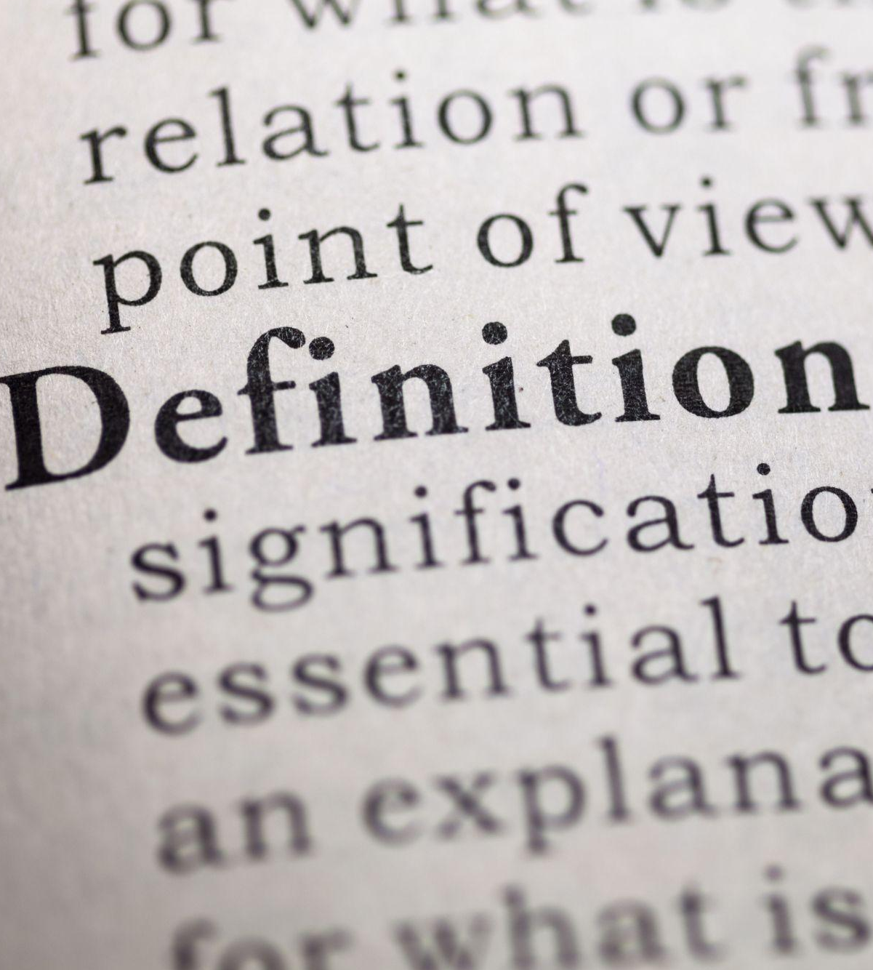
Fundamentals: Terminology
There’s a word for that…
Notes:
Subtitle: There’s a word for that…

Slide 2
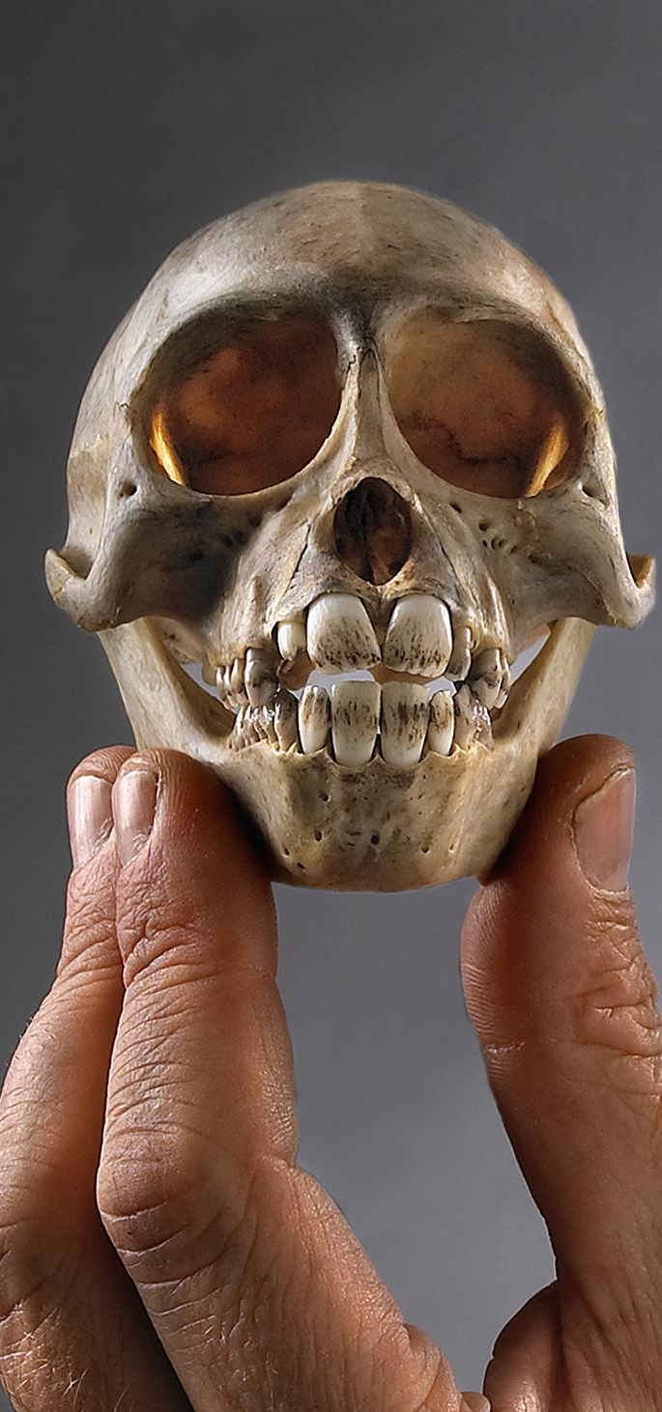

Agenda
Cleanliness is King
01
Let’s Agree to Agree
02
A Rose by Any Other Name
03
Planes, Trains and Automobiles…
04
Here be Dragons.
05
Reference: (c) Field Museum of Natural History - CC BY-NC 4.0 https://mm.fieldmuseum.org/3994ee8a-634d-4e95-bbd7-b008d415fb81 (accessed on 6-15-2022)
Notes:
This session is part of the Fundamentals for Data Cleanup series. We will be introducing you to the language, terminology and definitions for some of the basic concepts, functions and processes that you are going to be putting into use during the rest of the course.

Slide 3
Cleanliness is King

Slide 4
Cleanliness is King
Fitness for Use
01
Quality
02
Correctness
03
Consistency
04
Notes:
In this section, we’ll cover data quality and what makes data fit for use.

Slide 5
Fitness for Use
CLEANLINESS IS KING
“… data quality is related to use and cannot be assessed independently of the user. In a database, the data have no actual quality or value (Dalcin 2004); they only have potential value that is realized when someone uses the data to do something useful. Information quality relates to its ability to satisfy its customers and to meet customers’ needs (English 1999).”
Do you understand your data and can you explain its purpose to someone else?
  Accessible: How easily can someone get to your data? You can’t use it if you can’t find it.
  Accurate: Can you trust the data? For example are identifications recent and by known experts?
  Timely: Will the data be made available soon enough for it to be of use to you? How often is it updated? How out of date is it?
  Complete/Comprehensive: Which parts of the dataset are fully fleshed out? It may be taxonomically comprehensive for some groups and not others.
  Consistent with other sources: Is the data in each field always of the same type? For example are all your dates in the format Day Month Year.
  Relevant: How similar is this dataset to others that have been used successfully for the same purpose?
  Well documented (outside of your head): How much resolution is there in your data? For example at what scale can it be used to map species distributions?
  Be easy to read and easy to interpret: Is the dataset documented in a clear and concise way? For handwritten documents are they legible?
Reference: Chapman, A. D. 2005. Principles of Data Quality, version 1.0. Report for GBIF, Copenhagen. ISBN 87-92020-03-8.
Notes:
Whether or not data is fit for use is based on a number of factors:
Accessibility
Accuracy
Timeliness
Completeness/Comprehensiveness
Consistency with other sources
Relevance
Documentation
Readability/Interpretability
To determine if your data is usable, ask yourself the questions related to each point.

Slide 6

Quality
CLEANLINESS IS KING
“All data include error — there is no escaping it! It is knowing what the error is that is important, and knowing if the error is within acceptable limits for the purpose to which the data are to be put. (Chapman 2005)”
Correctness (Accuracy)
  How close was the recorded value to the actual value?
Consistency (Precision)
  How often did you get it right?
Reference: http://www.businessdictionary.com/definition/data-cleaning.html
Notes:
Quality is a combination of correctness and consistency. Correctness and consistency are related but often confused terms.
Correctness is how accurate the data is: how close the recorded values are to the actual values.
Consistency is how precise the data is: how often the data is correct.

Slide 7
Correctness — Examples
CLEANLINESS IS KING
Data cleaning is the process of correcting or removing dirty data caused by contradictions, disparities, keying mistakes, missing bits, etc. It also includes validation of the changes made, and may require normalization.
Correctness (Accuracy)
  How close was the recorded value to the actual value?
    Is Thismia a fossil bird?
    Is 60305 the right zip code for Kalamazoo?
    Did Richard Spruce travel to the Peru in 1863?
    Can an Adelie penguin be 180 m tall?
    The speed of sound is 10.29 ms⁻¹.
Reference: http://www.businessdictionary.com/definition/data-cleaning.html
Notes:
Here are some examples of data correctness concerns.

Slide 8
Consistency – Examples
CLEANLINESS IS KING
Data cleaning is the process of correcting or removing dirty data caused by contradictions, disparities, keying mistakes, missing bits, etc. It also includes validation of the changes made, and may require normalization.
Consistency (Precision)
  How often did you get it right?
    Full Name = Joseph Dalton Hooker
    Full Name = Hooker, J.
    Full Name = W. J. Hooker
    Full Name = Hook.f.
    Full Name = Hook.
Reference: http://www.businessdictionary.com/definition/data-cleaning.html
Notes:
Here are some examples of data consistency concerns.

Slide 9
Let’s Agree to Agree

Slide 10
Let’s Agree to Agree
What’s a standard?
01
Everyday standards
02
Natural History standards
03
Darwin Core
04
Notes:
In this section, we’ll cover the purpose of standardization and some of the standards people use.

Slide 11
What is a Standard?
LET’S AGREE TO AGREE
“An agreed way of doing something.”
Norm
Convention
Specification
Requirement
Restriction
Rule
Notes:
A standard is an agreed way of doing something. We all use standards, although they may also be called norms, conventions, rules, or another similar term.

Slide 12
Everyday Standards
LET’S AGREE TO AGREE
“The main purpose for standards is to create a framework to ease sharing. They should provide clarity and help communication.”
Existing Standards
  Units of measurement (metric; imperial)
  Numeral systems (Hindu-Arabic; Roman numerals)
  Alphabets
  Languages
  Emojis
  ISO Country Codes, US Postal Addressing Standards
  PCI Data Security
  Morse Code
Reference: https://www.bsigroup.com/en-US/Standards/Information-about-standards/What-is-a-standard/
Notes:
The purpose of standards is to make information and data more easily accessible between people and groups.
Common standards like languages allow people to understand each other when they speak, sign or write.
Standards like Postal Codes make it easier for people to send mail to the correct location by ensuring that everyone is formatting the address information in the same way.

Slide 13
Natural History Standards
LET’S AGREE TO AGREE
“Data standards are the rules by which data are described and recorded. In order to share, exchange, and understand data, we must standardise the format as well as the meaning.” (USGS)
Existing Standards
  Ecological Metadata Language Standard (EML)
  Audubon Media Description (a.k.a. Audubon Core)
  Global Genome Biodiversity Network (GGBN)
  Ocean Data Standards and Best Practices Project (ODSBP),
  Darwin Core
The main purpose for a data standard is to create a framework to allow easy sharing of data. The result of using a standard is that you will increase data integrity, accuracy and consistency by clarifying ambiguous meaning, minimizing redundant data, and documenting “business” rules.
Notes:
When it comes to data, different fields have their own standards based on what they need from their data.
Natural History Standards
Darwin Core: In this presentation, we’ll discuss Darwin Core, one common standard for storing natural history data.

Slide 14
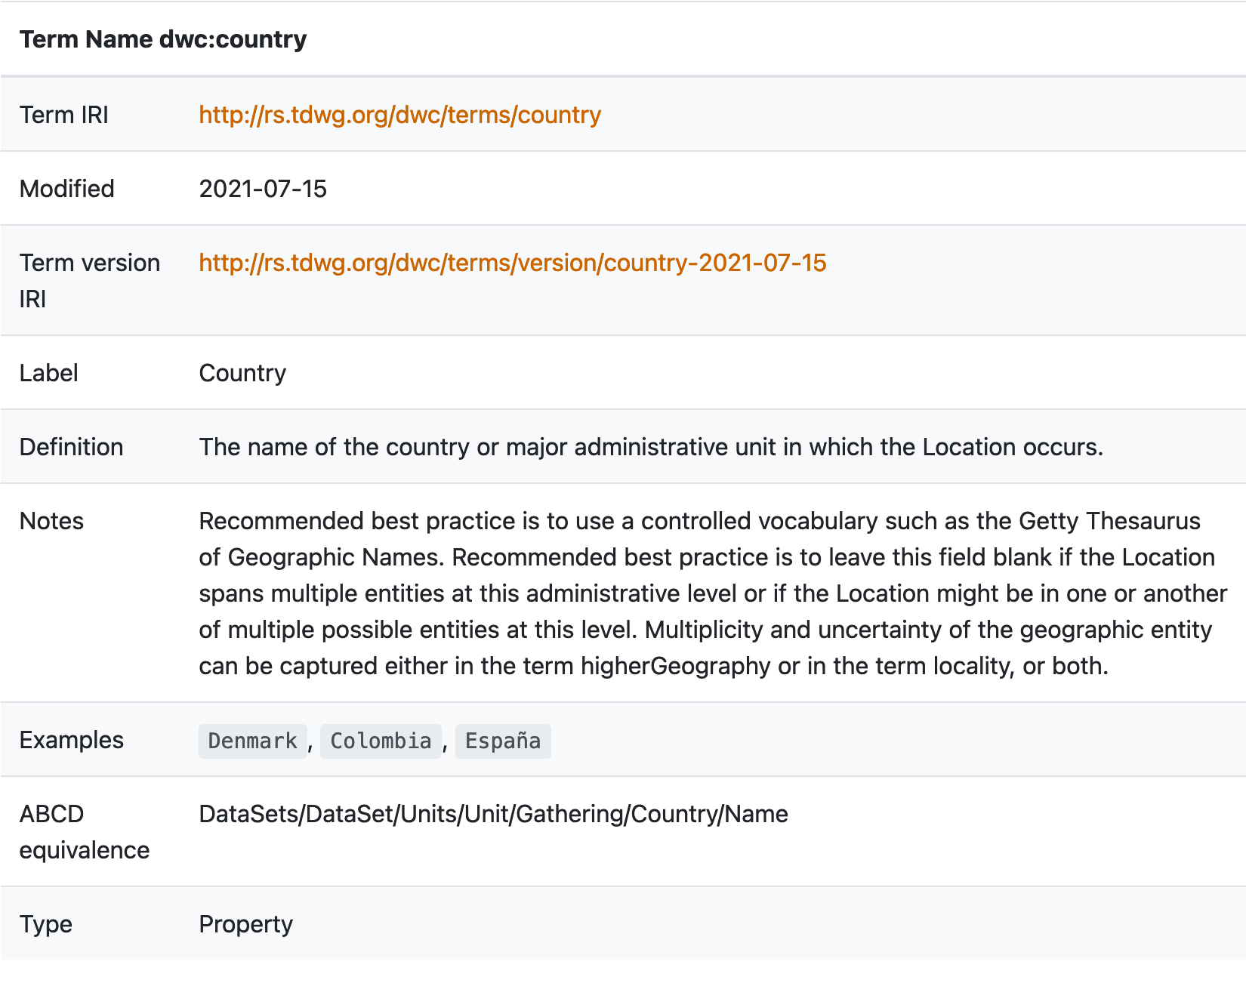
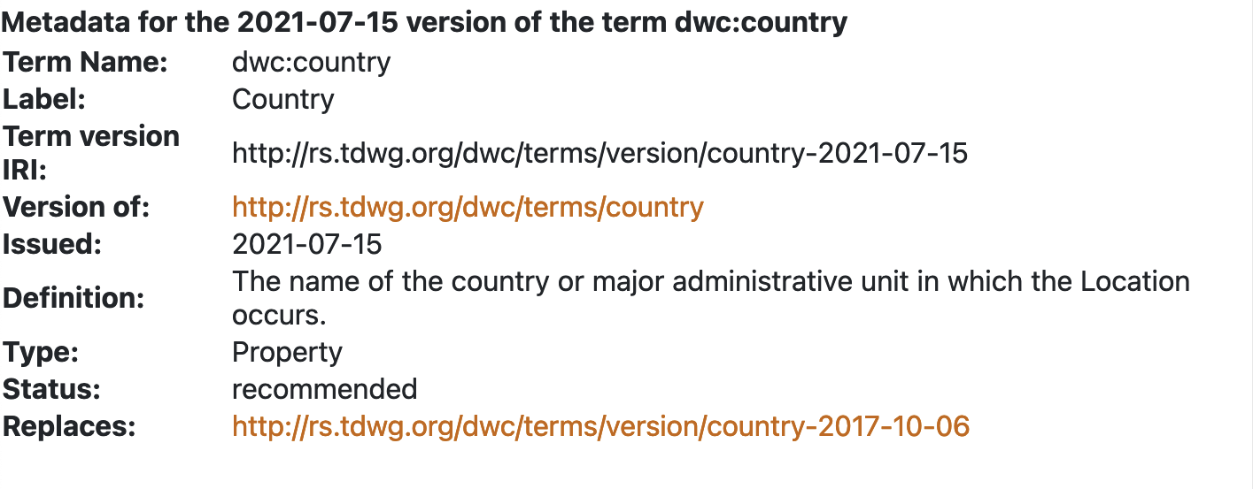
Reference(s): Governance, http://www.tdwg.org; Standard, http://rs.tdwg.org/dwc.
LET’S AGREE TO AGREE
What is
Darwin Core?
“List of fields and their definitions, as they relate to biodiversity data.”
Example term: dwc:country
Reference: Governance, http://www.tdwg.org; Standard, http://rs.tdwg.org/dwc.
Notes:
Darwin Core standards include a list of fields and how to format data within them. Darwin Core is typically used for data relating to biodiversity.

Slide 15
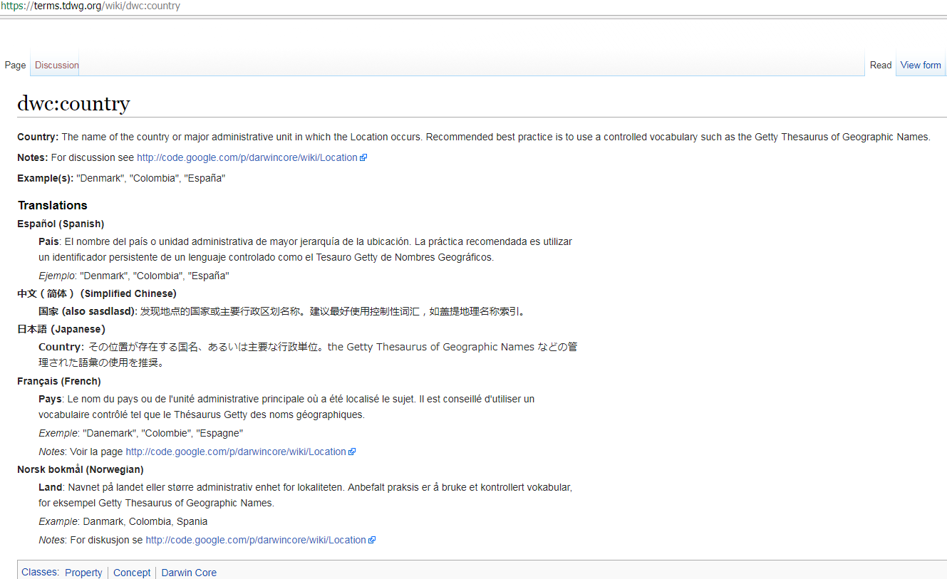
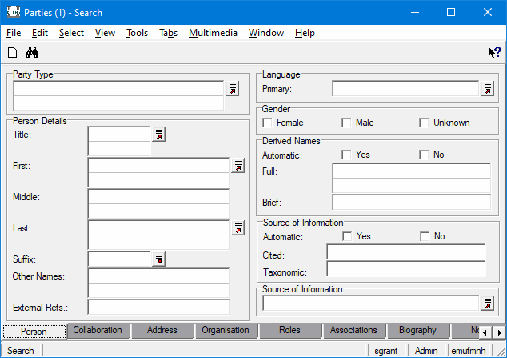
LET’S AGREE TO AGREE
What is
Darwin Core?
Reference: https://terms.tdwg.org/wiki/dwc:country
Notes:
The page pictured on this slide shows the entry for the Country field in Darwin Core.

Slide 16
A Rose by Any Other Name

Slide 17
A Rose by Any Other Name
Words with Data
01
Field vs. Labels
02
Lists
03
Characters
04
Notes:
In this section we will look at some of the many different terms and phrases that exist within the world of data and information management.
We will be using these throughout the course and it is important that you be familiar with, when and how to use them.

Slide 18

What’s the Difference? Words with “data”
A ROSE BY ANY OTHER NAME
WORDS WITH DATA
“All the World’s a [database].”
database language
database program /
software / platform
a data-cleaning tool
database
Reference: Spiske, M. Nov. 2018, Unsplash License, https://unsplash.com/photos/hvSr_CVecVI
Notes:
Subtitle: “All the World’s a [database].”
Let’s focus for a moment on some common words and phrases that contain the word data.
All of the phrases here use the word database, but are they all the same, and if not, then what is the difference?
So, what is a “Database”? There are many definitions, but what they all have in common is the theme that a database is a structured and organised collection of data and/or information held on a computer.
Everything else in the list is just a way to help you achieve this data nirvana! Let’s dig a little deeper then into those other terms.

Slide 19
What’s the Difference? Database
Language
A ROSE BY ANY OTHER NAME
WORDS WITH DATA
is a method to create all the logical objects like tables, views, procedures and packages in the database and we need some interface between the user and the database, so that we can access the data stored in it.
allows a user to select records from a database. It may be in the form of typed commands such as the widely used SQL language, a predefined query menu or a query by example (QBE).
is a generic term referring to a class of languages used for defining and accessing databases. A particular database language will be associated with a particular database management system.
is used for reading, updating and storing data in a database. There are several such languages that can be used for this purpose; one of them is SQL (Structured Query Language).
method, create, tables, views, procedures, packages, interface, select, commands, query, defining, accessing, reading, updating, storing
“And all the [languages]...”
database language
database program /
software / platform
a data-cleaning tool
database
http://www.linfo.org/database.html
Notes:
Let us take a look at the phrase “database language”.
According to the Oxford English dictionary “language” is the method of human communication, […], consisting of the use of words [or symbols] in a structured and conventional way.
For our purposes, database languages — and their close allies the array languages — are the way by which a human communicates with a computer to manipulate and move around data.
Examples that you may have come across are
Java,
SPARQL,
SQL
and Python.
They are simply methods used to define and create tables, views and queries and also allow users to access, update, store and move data around.

Slide 20
What’s the Difference? Program
A ROSE BY ANY OTHER NAME
WORDS WITH DATA
is a utility used for creating, editing and maintaining database files and records.
is designed to create databases and to store, manage, change, search, and extract the information contained within them.
is a business information system that provides file creation, data entry, update, query and reporting functions.
is sometimes also known as database management software (DBMS).
is a user interface.
utility, creating, editing, update, store, manage, change, user interface, search, extract, query, reporting
“And [programs]...”
database language
database program /
software / platform
a data-cleaning tool
database
http://www.linfo.org/database.html
Notes:
Subtitle: “And [programs]...”
Now let’s look at the phrase “database program or software”.
Again going to the Oxford English dictionary a “program/programme” is a set of related measures or activities with a particular long-term aim.
In this context, a “database program or software” combines and presents functions and features for manipulating data together in a unified interface.
Examples that you may come across are:
Microsoft Access,
FilemakerPro
and Oracle.
So, database programs or software are grouped utilities which allow a user, via a database language, to store, manage, query and report data held in the system.

Slide 21
What’s the Difference? Software
A ROSE BY ANY OTHER NAME
WORDS WITH DATA
software that assists the process of identifying and repairing inaccurate, incomplete, redundant, or non-conforming data.
software that assists in discovering and analyzing the quality of your data. Helps to find the patterns, missing values, character sets and other characteristics of your data values.
is a tool for working with messy data: cleaning it; transforming it from one format into another; and extending it with web services and external data.
cleans your database of duplicate data, bad entries and incorrect information.
tool, assists, identifying, repairing, discovering, analyzing, quality, messy, cleaning, transforming
“Merely [software]...”
database language
database program /
software / platform
a data-cleaning tool
database
http://www.datasciencecentral.com/profiles/blogs/5-data-cleansing-tools
Notes:
Subtitle: “Merely [software]...”
The last term is “data cleaning tool”.
Data cleaning tools are systems whose utilities focus on the manipulation of data with the aim of increasing fitness for use.
Examples that you may be familiar with or will learn about during the course are:
OpenRefine,
Access and Base
and spreadsheets.
A data cleaning tool should assist the user in the discovery and repair of messy data in order to improve quality.

Slide 22
What’s the Difference? Database
A ROSE BY ANY OTHER NAME
WORDS WITH DATA
a structured set of data held in a computer, especially one that is accessible in various ways.
a collection of information organized to provide efficient retrieval.
a data structure that stores organized information.
a collection of pieces of information that is organized and used on a computer.
definition, a comprehensive collection of related data organized for convenient access, generally in a computer.
a set of data that has a regular structure and that is organized in such a way that a computer can easily find the desired information.
structured, organized, collection, data, information, computer
“That ends this strange, eventful [database].”
database language
database program /
software / platform
a data-cleaning tool
database
Notes:
Subtitle: “That ends this strange, eventful [database]”
All these components – a language, program, and software are necessary for a database. Databases are structured collections of data and information.

Slide 23
What’s the difference? Field vs. Label
A ROSE BY ANY OTHER NAME
“Things you see and things you don’t.”
Field names/column names:
  An assigned name for a field (e.g., NAME, ADDRESS, CITY, STATE, etc.) that will be the same in every record.
  In computer science, a name identifying a field in a database record.
  The underlying unique descriptor for a field.
unique, assigned, identifying
Label names/output names
  Descriptive human readable name for a column or field.
  What you see in a form or output such as a report or user-interface
descriptive, readable, user-interface
Reference: Chapman, A. D. 2005. Principles of Data Quality, version 1.0. Report for GBIF, Copenhagen. ISBN 87-92020-03-8.
Notes:
Subtitle: “Things you see and things you don’t.”
Continuing on with some more terms that you should be familiar with we will look at the differences between the terms Field, Label and List.
You will often hear references made to field or column names and field labels or headings.
Often they will be used interchangeably, however they are different things.
Field or column names refer to the actual column in the database table.
They are often short, not always in plain language, sometimes computer generated; but in a properly formed database they are ALWAYS unique.
Field names are almost always used by database languages because they avoid ambiguity.
Labels and headers on the other hand, refer to the human readable versions of the field names.
Most often you will see these in the graphical user interface of your software and on exports and reports. In some software you can in fact have different labels to the same field on a user-by-user or group basis!

Slide 24
What’s the difference? Lists
A ROSE BY ANY OTHER NAME
“They make lists most usual and lists most unusual…”
Lookup table:
  An array that replaces runtime computation with a simpler array indexing operation.
Lookup field:
  a read-only field that displays values at runtime based on search criteria you specify.
Drop-down list:
  is a graphical control element, similar to a list-box, that allows the user to choose one value from a list. (abbreviated drop-down; also known as a drop-down menu. drop menu, pull-down list, picklist)
Controlled vocabulary:
  Controlled vocabulary is an organized arrangement of words and phrases used to index content and/or to retrieve content through browsing or searching. It typically includes preferred and variant terms and has a defined scope or describes a specific domain.
Notes:
Subtitle: “They make lists most usual and lists most unusual…”
As you work with your data you will come across the phrases “drop-down list” and “controlled vocabulary”
On the surface they can appear to be the same. Indeed they are both powerful tools to help you keep your data clean, but they are different.
A drop-down list, also sometimes called a lookup table, is a data entry element that is created in your database software.
It allows you to select a value from a predefined set of options.
They can also be generated from the data itself on the fly.
A controlled vocabulary on the other hand, is a very strictly defined, domain specific set of values that should be applied to a particular field.
They are an integral part of a well-defined standard.
Such values can be used in a drop-down list as mentioned previously.

Slide 25
What’s the difference? Characters
A ROSE BY ANY OTHER NAME
“What a difference a byte makes.”
A character set (repertoire):
  has nothing to do with computers.
  “It is the the set of characters one might use for a particular purpose.”
  For example, the letters used in Western European languages.
A coded character set (code page):
  translates characters to numbers.
  “Is a set of characters for which a unique number has been assigned”.
Character encoding:
  translates numbers to binary.
  “Reflects the way the coded character set is mapped to bytes for manipulation by a computer.”
  It’s important to be aware of character encoding when migrating data from one environment to another.
Reference: https://www.w3.org/International/articles/definitions-characters/#charsets
Notes:
Subtitle: “What a difference a byte makes.”
Next, we will look at what the term character means in relation to data and computers.
As a reminder computers “see” in binary. Everything that you type in, is held in memory as a series of ones and zeros.
The computer does not “see” the repertoire of letters and symbols on your keyboard. It needs a map to translate the character set that you would write or type, into its binary language and then back again to show it to you on the screen or a printer.
This map is made up of two parts:
The “coded character set” and the “character encoding.”
Each symbol or glyph is assigned a numeric value and that number is then converted to binary.

Slide 26
A ROSE BY ANY OTHER NAME
Characters
“Representing
and transforming”
A = 065 = 01000001
Latin Alphabet = Sharon
ASCII = [083] [104] [097] [114] [111] [110]
HEX = [53] [68] [61] [72] [6F] [6E]
BINARY = [1010011] [1101000] [1100001] [1110010] [1101111] [1101110]
Reference: http://www.asciitable.com/
Notes:
Subtitle: “Representing and transforming”
In this example we see how character encoding is used to map the capital letter A in the western alphabet.
The ASCII value is the decimal number 65 which in HEXADECIMAL is 041 and in BINARY 01000001.
Try mapping your own name to Binary using the link at the bottom of the screen:
Link: https://www.asciitable.com/
In effect, when you type into a keyboard and save a file, the software that you are using will select an encoding to save with it.
When you open that file again the software needs to know which encoding (map) to use to redisplay the information back to you correctly.
So why is this important to you as a data custodian?
Let’s say that you translate the start of Hamlet’s soliloquy: “To be or not to be, that is the question” into French and then save the file with a text editor that uses the encoding Latin-1. Then you send it to a colleague to check the translation. Voila!
When they open the file in Microsoft Word this is what they see … Mon dieu! (French for My God!)
There are some unexpected characters.
You forgot to tell your colleague that you were using Latin-1 as the encoding.
Microsoft Word on their end was set to use the encoding set Unicode UTF-8. The maps did not match.
Depending on the software the data may be irretrievably corrupted.

Slide 27
Planes, Trains and Automobiles…

Slide 28
Planes, Trains, and Automobiles…
Field Types / Data Types
01
Character Sets
02
Data Structures
03
Functions
04
Structure and Integrity
05
Notes:
In the section on STRUCTURES we will be working on understanding the field and data types that hold data, the structures that help to organise and protect that data and lastly look at what these mean for the integrity and security of your data.

Slide 29
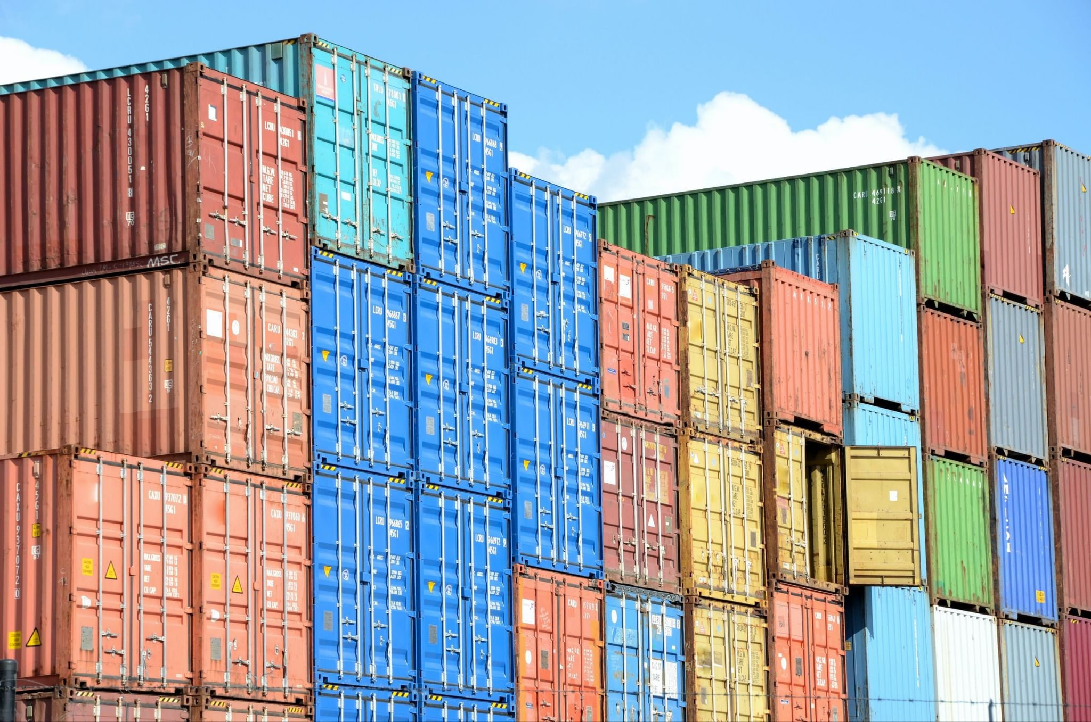
Containers
for Data
PLANES, TRAINS, AND AUTOMOBILES…
“There are different shaped containers for your data. Some are simple, some are crazy. Beware.”
Field types / Data types
Character sets
Data structures
Functions
Structure and Integrity
Reference: Teysen, P. Oct. 2020, Unsplash License, https://unsplash.com/photos/bukjsECgmeU
Notes:
Subtitle: “There are different shaped containers for your data. Some are simple, some are crazy. Beware.”
In this section on basic database Structures we will focus on the different elements that databases, software tools and languages use to handle the data that you enter.

Slide 30
Containers
for Data
PLANES, TRAINS, AND AUTOMOBILES…
Numbers (numeric) — Two types:
  integer, long integer
  float, double
Text (alphanumeric) — character, string
System Value (date) — date/time, date, time
Unstructured Text (memo) — long text, longchar, blob
Binary (boolean) — 1/0, 0/1: Yes/No, Y/N, True/False
Structured Text (factor)
“There are different shaped containers for your data. Some are simple, some are crazy. Beware.”
Field types / Data types
Character sets
Data structures
Functions
Structure and Integrity
Notes:
First, let's look at field types, also known as data types.
Data Types lets the computer know what kind of data is expected in a particular field.
This then dictates what functions can be performed on it.
They can be simple and encompass a single concept or combine concepts depending on the software or language you are using.
Either way the essential building blocks are the same. So, let’s look at six that you will come across most frequently.
First, Numeric fields:
This data type holds numbers, and there are two kinds:
Integers and long integers hold whole numbers.
For example: 1, 2, 3, 99, 2000 …
The size of the number depends on the number of bits assigned to the field (more about that later).
For now just remember that a long integer field will hold a bigger number than an integer.
Floats, also referred to as doubles, hold fractions or parts of whole numbers.
For example 4.5, 19.47.
The important thing to remember here is that a float always has decimal places, so the number 10 will be stored as 10.0.
The number of decimal places is an integral element of the type. This has implications when it comes to precision and accuracy.
Alphanumeric fields:
Alphanumeric fields are also referred to as text, character or string fields.
They can hold any letter, number or symbol in the coded character set and usually have a defined character limit.
Entering more characters than the character limit can often result in truncation and loss of data on save.
Another type of text field that you will come across is the Unstructured text field, also known as memo, long char or blob fields.
This type of field is used to hold large amounts of unformatted text and, unlike alphanumeric fields, may not have an obvious character limit.
In simple systems, they are generally less flexible in terms of processing — for example, sorting and indexing — than their smaller alphanumeric cousins.
With decreased storage costs and the rise of NoSQL document-oriented database programs, such as MongoDB, this is changing.
System Value fields have a double nature: what you see on the screen is not usually the actual value that the software is storing in memory.
Date and time fields are the most common example of this type of field.
In this example you typed “1 March 1971” into a cell in Excel and hit return.
Now it says “1-Mar-71” in the cell AND “3/1/1971” in the function bar.
Excel is applying a display format to the cell, which you can change at will.
HOWEVER, if you remove the format you see that what is actually being stored in the field is the number 25993.00! So you can see that the field is actually a float.
You should beware because that system value will not be the same from software to software. Exports should be checked to make sure the actual date is exported and not the system value.
Boolean fields:
Boolean fields — also known as Binary fields — only contain one of two values that represent a one or a zero.
They are a special case of System Value field
As mentioned earlier, while the software actually saves a number, it often displays values such as: Yes/No, Yes/no, Y/N, True/False.
You should take care to find out which way around the system you are using translates. Is a 1 a yes or no?
Structured Text fields are less common but mentioned here for completeness.
They are fields that can be made up of combinations of the simple data types or even be defined by the data itself.
Most often these are used in programming languages to allow flexibility and handling of complex concepts.
An example is the factor field used in the R programming language, which is defined as a type vector containing a set of numeric codes with character-valued levels.

Slide 31
Field Types: Simple
PLANES, TRAINS, AND AUTOMOBILES…
FIELD TYPES / DATA TYPES
Integer
“56”
“56”
“What happens when you put data into a field?
Float
“0.98”
0.98
Alphanumeric
“Mrs Pink”
“Mrs Pink”
Boolean
“0” or “1”
“0” or “1”
Date
“01 March 1971”
“25993”
“01 March 1971”
Notes:
This table displays simple field types and examples of data you might find in these fields. The shapes used in this table will reoccur throughout the presentation series to mark field types.
Integer: Purple Square Horizontal
Float: Purple Square Diagonal
Alphanumeric: Green 8-Pointed Polygon
Boolean: Orange Triangle
Date: Blue Pentagon

Slide 32
Field Types: Simple
PLANES, TRAINS, AND AUTOMOBILES…
FIELD TYPES / DATA TYPES
“What happens when you put data into a field?
Alphanumeric
“Mrs Pink”
“Mrs Pink”
Alphanumeric
56
“56”
Alphanumeric
0.98
“0.98”
Notes:
Alphanumeric Fields are often used for names and other such text, but they can also handle Integer and Float data, as depicted here.

Slide 33
Field Types:
Complex
PLANES, TRAINS, AND AUTOMOBILES…
FIELD TYPES / DATA TYPES
Memo
The quick brown fox...
“What happens when you data into a field?”
Memo
56, 0.5, skull, 25788
Factor
10,
1 March 1971,
0
Notes:
There are also more complex fields like memos and factors. The table shows some examples of data in those fields.

Slide 34
Modifying Field Types
PLANES, TRAINS, AND AUTOMOBILES…
FIELD TYPES / DATA TYPES
“What happens when you put data into a field?
Integer
“56”
“5678”
“456789”
Alphanumeric
“Mrs Pink”
“Mrs Pink has a big hat.”
“Mrs Pink has a big hat and a fat cat.”
Notes:
Fields can accommodate data of varying lengths, as long as it is the appropriate type of data.

Slide 35
The Wrong Field Types
PLANES, TRAINS, AND AUTOMOBILES…
FIELD TYPES / DATA TYPES
“What happens when you put data into a field?
Integer
0.98
Weird behavior
Integer
1 March 1971
“25993”
Integer
“Mrs Pink”
Weird behavior
Weird behavior
Notes:
When data doesn’t match the field type, it may cause issues or unexpected behavior. Non-integer data cannot fit into integer fields. Dates in an integer field may have an output, but it will be a series of numbers, rather than a date.

Slide 36
Containers
for Data
PLANES, TRAINS, AND AUTOMOBILES…
ASCII
Latin1
UTF / Unicode
“There are different shaped containers for your data. Some are simple, some are crazy. Beware.”
Field types / Data types
Character sets
Data structures
Functions
Structure and Integrity
Notes:
Data can be encoded and saved in different character sets. Knowing how your data is encoded and saved will make it easier to access.
Some common character sets:
ACSII
Latin 1
UTF/Unicode

Slide 37
PLANES, TRAINS, AND AUTOMOBILES…
CHARACTER SETS
Characters — ASCII
“Representing and transforming”
American Standard Code for Information Interchange.
It was the first character encoding standard.
It defined 128 different alphanumeric characters that could be used on the internet.
Each is represented with a 7-bit binary number (a string of seven 0s or 1s)
These included:
  Numbers (0-9),
  English letters (Aa-Zz),
  Some special characters like ! $ + - ( ) @ < >
Reference: https://www.w3schools.com/html/html_charset.asp
Notes:
ASCII stands for American Standard Code for Information Exchange
It was the first character encoding standard.
Includes 128 alphanumeric characters.

Slide 38
PLANES, TRAINS, AND AUTOMOBILES…
CHARACTER SETS
Characters — ISO Latin 1
“Representing and transforming”
ISO Latin 1 ISO-8859-1:
Is a standard character set developed by the International Organization for Standardization.
Released in 1998
It is a superset of the ASCII character encoding standard
It is the default in HTML 4.01
There are several variants which encompass other alphabets
Reference: http://casa.colorado.edu/~ajsh/iso8859-1.html
Notes:
ISO Latin 1 is a character encoding standard for Latin characters. ISO stands for International Organization for Standardization.
There are other standards by the ISO for other alphabets.
Default standard for HTML 4.01

Slide 39
PLANES, TRAINS, AND AUTOMOBILES…
CHARACTER SETS
Characters — Unicode
“Representing and transforming”
UNICODE: Unique, Universal, and Uniform character enCoding.
The Unicode Consortium developed the Unicode Standard.
Because the character set described in ISO-8859 was too limited.
Unicode is an encoding standard.
The latest version contains a repertoire of 136,755 characters
Unicode can be implemented by different character sets.
The 1st 128 characters correspond 1:1 with ASCII
Reference: https://www.w3schools.com/charsets/ref_html_utf8.asp
Notes:
Unique, Universal, Uniform character encoding, developed by the Unicode Consortium
Contains 136,755 characters, first 128 correspond 1:1 with ASCII characters

Slide 40
PLANES, TRAINS, AND AUTOMOBILES…
CHARACTER SETS
Characters — UTF-8
“Representing and transforming”
Unicode Transformation Format
UTF is variable width character encoding
The most common encodings are UTF-8 and UTF-16
  UTF-8 uses a minimum of 8 bits describe a character
  UTF-16 uses 16 bits to describe a character
The latest version contains a repertoire of 1,112,064 characters
UTF-8 is the default encoding in HTML-5
Reference: http://casa.colorado.edu/~ajsh/iso8859-1.html
Notes:
Stands for Unicode Transformation Format. Common variations are UTF-8 and UTF-16, 8 and 16 bit character encoding respectively.
Latest version includes 1,112,064 characters
Default encodings for HTML 5

Slide 41
Containers
for Data
PLANES, TRAINS, AND AUTOMOBILES…
Grid vs. Table?
What is a record? (What does a row actually represent? What is a column?)
null — NA, NULL, 0?
“There are different shaped containers for your data. Some are simple, some are crazy. Beware.”
Field types / Data types
Character sets
Data structures
Functions
Structure and Integrity
Notes:
Now that you have an understanding of the field types used to represent your data elements, let's talk about the containers or structures that many database programs and software use collate and display your data.
First is the cell. This is the smallest data structure, it holds a single value and has a single data type associated with it.

Slide 42
PLANES, TRAINS, AND AUTOMOBILES…
DATA STRUCTURES
Grid
“What happens when you put data into the cells of a grid?”
Notes:
As you start to organise cells you begin to build a grid. Grids have implied structure in the form of Rows and Columns.
When you organise cells into rows and columns, obviously, what you get is a grid!
This looks very much like a spreadsheet right? Well, yes.
The difference, however, between a spreadsheet grid and a table is the strength of the ties that hold the rows and columns together.

Slide 43
PLANES, TRAINS, AND AUTOMOBILES…
DATA STRUCTURES
Table
“What happens when you add structure to a grid?”
ID | Expired? | Date | Zip | State | Name | Age
Notes:
So, let’s now talk about those connections. What are the implications for the integrity and security of your data of loose unenforced relationships between rows and columns?
What actually makes a table useful are the connections that we create to give the data in the structure meaning.
We intrinsically make patterns of attributes that turn data into information.
Rows become records and Columns become attributes…
In a spreadsheet, however, the connections between cells are idiomatic, loose and unenforced. It is easy for the attributes between the rows to get jumbled up or for the values to get changed and then the meaning is lost.
This lack of enforced connections makes a spreadsheet easy to use but these same qualities also cause problems.
Errors are easy to make and hard to catch
Connections and relationships are not documentable and so subject to interpretation and mutation
Spreadsheets are not built to scale in terms of size or numbers of users, so they can be slow, crashy and easily corruptible.
Spreadsheets are easy to copy and email, so they are hard to version and keep track of.
The question is what is the solution?

Slide 44
PLANES, TRAINS, AND AUTOMOBILES…
DATA STRUCTURES
Table
“What happens when you add structure to a grid?”
Row
Record
Column
Attribute
Notes:
Let’s look back at the connections in a bit more detail.
We generally understand that the data in each row of a table means something.
For example each row can represent a specimen or a taxa that was found at a particular place, at a particular time, by a particular person.
It would be odd to have one row in a table that represents a specimen followed by a row that represents a collection site.
We also often want to analyse, sort and compare values of particular attributes between rows.
For example you may want to find the mean weight of all the Kenyan bats. So ideally we want to use a system to store our data that:
always holds the rows together;
does not mix data types;
and segregates data in each table to a single concept or theme.
These are functions of a database!
Functions in a true database inherently bind rows together, and columns may only have a single data type.
Tables in a database are held together by virtual links called keys.
These keys are identifiers that match between tables and allow data to be connected efficiently.
It is these two key concepts that distinguish a spreadsheet from a database.

Slide 45
PLANES, TRAINS, AND AUTOMOBILES…
DATA STRUCTURES
Table
“What happens when you add structure to a grid?”
ID | Expired? | Date | Zip | State | Name | Age
Notes:
This is an example of a filled-in table. We’ll be working with this table on and off throughout the presentation

Slide 46
PLANES, TRAINS, AND AUTOMOBILES…
DATA STRUCTURES
Table
“What happens when you add structure to a grid?”
ID | Expired? | Date | Zip | State | Name | Age
Notes:
In this example table, a row contains all the data for one record, and each column contains a different type of data, such as ID data, expiration data, date data, Zip Code data, State data, Name data, and Age data.

Slide 47
PLANES, TRAINS, AND AUTOMOBILES…
DATA STRUCTURES
Nothing?
“What happens when there is data missing from a table?”
ID | Expired? | Date | Zip | State | Name | Age
?
?
?
?
?
?
Notes:
Subtitle 47: “What happens when there is data missing from a table?”
There is one concept that you should beware of when it comes to cells and that is the “empty cell”.

Slide 48
PLANES, TRAINS, AND AUTOMOBILES…
DATA STRUCTURES
Nothing?
“An empty cell doesn’t necessarily mean an empty field.”
?
0
Null
N/A
“”
Notes:
Subtitle 48: “An empty cell doesn’t necessarily mean an empty field.”
“An empty cell doesn’t necessarily mean an empty field.”
Some software “fills” an empty field with a system value based on the data type.
Examples are “NULL” “N/A” or even zero!

Slide 49
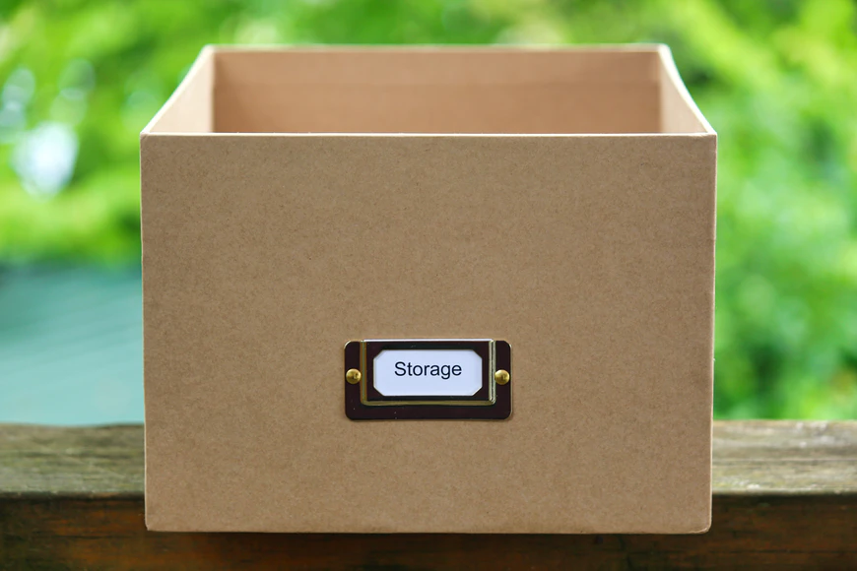
Containers
for Data
PLANES, TRAINS, AND AUTOMOBILES…
“There are different shaped containers for your data. Some are simple, some are crazy. Beware.”
Field types / Data types
Character sets
Data structures
Functions
Structure and Integrity
Reference: Trevarthen, L. Feb. 2020, Unsplash License, https://unsplash.com/photos/gWvdUpNQr6g
Notes:
Data can be transformed with functions. We’ll look at some examples in the next slides.

Slide 50
PLANES, TRAINS, AND AUTOMOBILES…
FUNCTIONS
Table
“How do you combine the data in cells to create data in other cells?”
x + y = z
+
=
15 | 6 | x+y
“15” | “6” | Error
15.0 | 6.0 | 21.0
15 | 6 | 21
Notes:
“How do you combine the data in cells to create data in other cells?”
One option is a simple addition function that can combine that data from two cells into new data in a third cell.
This example combines the data mathematically and only works with integer and float fields. Even though the data in the third row is numerical, it’s in an alphanumeric field, not an integer or float field, so it produces an error.

Slide 51
PLANES, TRAINS, AND AUTOMOBILES…
FUNCTIONS
Functions and Formulas
“How do you combine the data in cells to create data in other cells?”
abc plus xyz = abcxyz
IL
60605
abc plus xyz
+
=
“IL”
“60605”
“IL60605”
“IL”
60605
Expect weird behavior
Notes:
Text data can also be combined. Instead of summing the data, text will be combined. The function can combine text and numbers, but only if both are in alphanumeric fields.

Slide 52
PLANES, TRAINS, AND AUTOMOBILES…
FUNCTIONS
Functions and Formulas
“How do you combine the data in cells to create data in other cells?”
Date plus # of days = new date
21 May 2017
7 or 7.0
Date plus # of days
+
“21 May 2017”
7 or 7.0
“Weird behavior”
=
42876
7 or 7.0
42883
42876 (21 May 2017)
7 or 7.0
28 May 2017
Notes:
Functions can also combine dates and numeric data to get a new date. When using functions, it is essential to know the field types of the function you’re using and the field types of your data.

Slide 53
Containers
for Data
PLANES, TRAINS, AND AUTOMOBILES…
“There are different shaped containers for your data. Some are simple, some are crazy. Beware.”
Field types / Data types
Character sets
Data structures
Functions
Structure and Integrity
Reference: Trevarthen, L. Feb. 2020, Unsplash License, https://unsplash.com/photos/gWvdUpNQr6g
Notes:
In the next few slides, we’ll discuss structure and integrity for your data.

Slide 54
Unstructured Grid
Structured Table
PLANES, TRAINS, AND AUTOMOBILES…
STRUCTURE AND INTEGRITY
Grid to Table
“From unstructured to structured.”
ID | Exp? | Date | Zip | State | Name | Age
Notes:
Using a table instead of a grid adds structure to your data. In a grid, rows and columns are arbitrary.

Slide 55
PLANES, TRAINS, AND AUTOMOBILES…
STRUCTURE AND INTEGRITY
The Problem With Structured Tables
“What happens if you move things around?”
ID | Expired? | Date | Zip | State | Name | Count
In a structured table there is nothing to stop you rearranging things except your knowledge of the data. If that happens you are right back where you started. So how do you stop that happening?
Notes:
Although tables add structure to data and improve upon grids, you can move data around, which would break the table’s structure.

Slide 56
PLANES, TRAINS, AND AUTOMOBILES…
STRUCTURE AND INTEGRITY
Data Integrity and Security
“The difference between a spreadsheet and a database table.”
ROW
Attributes of a record ALWAYS stay together.
COLUMN
Any attribute has the SAME field/data type for every record.
TABLE
All data in a table refers to a SINGLE concept.
Notes:
In a database table, the attributes of a record stay together in rows, and all the data in a column has the same type/field.
All the data in a table should refer to a single concept.

Slide 57
PLANES, TRAINS, AND AUTOMOBILES…
STRUCTURE AND INTEGRITY
Efficiency and Standardization
“Streamlining your data.”
 |  |  |  | State
Notes:
In a database, you can connect data between tables. In the next few slides, we’ll review a few possible connections.

Slide 58
Lookup
PLANES, TRAINS, AND AUTOMOBILES…
STRUCTURE AND INTEGRITY
The Problem With Structured Tables
“Streamlining your data.”
 |  |  |  | State
Notes:
Databases can connect to and use lookup tables – tables connected to the original that track a specific type of data. Lookup tables are often used to validate data.

Slide 59
PLANES, TRAINS, AND AUTOMOBILES…
STRUCTURE AND INTEGRITY
Related Data
“Streamlining your data.”
 |  |  |  | State
 | “Illinois” | 1
 | “Wisconsin” | 2
 | “Indiana” | 3
Joined Table
Notes:
Databases can also join tables that share data. In the example on the slide, both tables include information about states on driver’s licences. Unlike the Lookup table, the new Joined Table contains additional information, along with the shared column.

Slide 60

PLANES, TRAINS, AND AUTOMOBILES…
STRUCTURE AND INTEGRITY
Relational Data
“What happens when you use more than one table?”
StateID
 |  |  |  | StateFK
1 | “Illinois” | “IL” | “Springfield”
2 | “Wisconsin” | “WI” | “Madison”
3 | “Indiana” | “IN” | “Indianapolis”
Structured Table with Enforced Integrity
This is a very simple relational database. Data about States is held in a separate table to the main records and connected via a Foreign Key (an integer).
Notes:
Related tables like the ones in the previous slides can be connected with “Foreign Keys” integers that help preserve the table structure and connections.

Slide 61
PLANES, TRAINS, AND AUTOMOBILES…
STRUCTURE AND INTEGRITY
Normalization
“The process used to organize a database into efficient tables and columns.”
First Normal Form (1NF)
Remove duplicate columns
Create separate tables for related data.
Identify each row with a primary Key
Second Normal Form (2NF)
Remove subsets of data for multiple rows
Create relationships with foreign keys
Third Normal Form (3NF)
Remove columns not dependant on the primary key
Notes:
Normalization is “the process used to organize a database into efficient tables and columns.”
Some important steps in normalization include removing duplicate data, separating data into tables, and creating keys for the data.

Slide 62
Here be Dragons.

Slide 63
Here be Dragons.
Mapping Data
01
Data Relationships
02
Planning…
03
Notes:
In this last section, we’ll cover how to map your data and understand data relationships.

Slide 64
Mapping Data
HERE BE DRAGONS.
“Process of Identifying the start field(s) within dataset A, and its(their) corresponding field(s) in dataset B.”
ID | Exp? | Date | Zip | State | Name | Age | Pink Elephant | Notes | Spouse Notes
1 | Y | 1/1/67 | 60607 | IL | F. Barrie | 76 | Blah | dom: 5/9/94 | Mary Fry: 80
2 | N | 8/6/89 | 56001 | WI | C. Walsh | 45 | Vex |  | dom: 1/3/08
3 | N | 4/12/67 | 53001 | WI | Nick Hornby | 39 | Huh? |  | Beth Hornby
Integer | Boolean | Date | Text | Complex
Donor Dataset
Notes:
Mapping data is the process of determining where your original data will need to end up in the final, cleaned dataset.

Slide 65
X
Recipient Dataset
Mapping Data
HERE BE DRAGONS.
“Process of Identifying the start field(s) within dataset A, and its(their) corresponding field(s) in dataset B.”
ID | Exp? | Day | Month | Year | Zip 5-4 | Country | State | Pink Elephant | Age | Spouse Age | Spouse Name | First Name | Last Name | Date Married
1:1 | 1:1 | 1:∞ | 1:∞ | ∞:1 | 1:0 | 0:1 | 1:1 | 1:0 | 1:1 | ∞:∞ | ∞:∞ | 1:∞ | 1:∞ | ∞:∞
 | Integer |  | Boolean |  | Date |  | Text |  | Complex
Notes:
In order to accurately map data, you need to determine the data’s relationships. Data relationships describe how many fields the data comes from in the original set and how many fields it will end up in in the final set.
This slide shows the format of the final dataset.

Slide 66
Data Relationships
HERE BE DRAGONS.
“What is the relationship between the field in dataset A and dataset B?”
Some fields will map one-to-one (1:1)
Some fields will map many-to-one (∞:1)
Some fields will map one-to-many (1:∞)
Some fields might not exist yet: zero-to-one (0:1)
Some fields might not have a place to go: one-to-zero (1:0) ?
Some fields will map many-to-many (∞ : ∞)
Reference: https://www.w3schools.com/charsets/ref_html_utf8.asp
Notes:
There are six data relationships.
One to one (1:1) – this data comes from one field in the current dataset and will end up in one field in the final dataset.
Many to one (∞:1) – this data comes from multiple fields in the current dataset and will be consolidated into one field in the final dataset.
One to many (1:∞) – this data comes from one field in the dataset and will be split into multiple fields in the dataset.
Zero to one (0:1) – this data does not exist in the current dataset but will be needed in the final dataset.
One to zero (1:0) – this data exists in the current dataset, but will not be needed in the final dataset.
Many to many (∞:∞) – this data comes from multiple fields in the current dataset and will be moved to multiple fields in the final dataset.
We’ll discuss data relationships in further depth in the Fundamentals – Implementation presentation.

Slide 67
✕
Mapping Data
HERE BE DRAGONS.
“Process of Identifying the start field(s) within dataset A, and its(their) corresponding field(s) in dataset B.”
ID | Exp? | Date | Zip | State | Name | Age | Pink Elephant | Notes | Spouse Notes
ID | Exp? | Day | Month | Year | Zip 5-4 | Country | State | Pink Elephant | Age | Spouse Age | Spouse Name | First Name | Last Name | Date Married
1:1 | 1:1 | 1:∞ | 1:∞ | ∞:1 | 1:0 | 0:1 | 1:1 | 1:0 | 1:1 | ∞:∞ | ∞:∞ | 1:∞ | 1:∞ | ∞:∞
 | Integer |  | Boolean |  | Date |  | Text |  | Complex
Notes:
This slide shows both the current dataset and the field types for the final dataset, along with the relationships between the data.

Slide 68
Planning
HERE BE DRAGONS.
“Where the rubber hits the road.”
one-to-one (1:1)- Beware your field types.
many-to-one (∞:1)- These fields will need to be joined together.
one-to-many (1:∞)- These fields will need to be split apart.
zero-to-one (0:1)- You will have to work out how (or if) you can fill these in.
one-to-zero (1:0)- You will have to either throw away the data or add a field.
many-to-many (∞ : ∞)- “for the love of a higher being!”
Reference: https://www.w3schools.com/charsets/ref_html_utf8.asp
Notes:
When you plan to move the data to make the final set, pay particular attention to the data relationships. Each relationship will have different steps to move the data properly.

Slide 69
Questions?
Ask now; we might have answers!
Notes:
Check to see if your audience has any questions about the presentation.

Slide 70
Presenter name
SECTION TITLE
Title or credentials
Insert Presenter Image
Bio
Contact Information
Notes:
Give yourself a round of applause!

Slide 71


Thank you!
Sharon Grant
sgrant@fieldmuseum.org
https://www.fieldmuseum.org/
Janeen Jones
jjones@fieldmuseum.org
https://www.fieldmuseum.org/
Kate Webbink
kwebbink@fieldmuseum.org
https://www.fieldmuseum.org/
Notes:
This project was made possible in part by the Institute of Museum and Library Services [include IMLS grant number when space allows]."
You may choose to include this acknowledgment in Spanish:
“Este proyecto ha sido posible en parte por el Instituto de Servicios de Museos y Bibliotecas, [include IMLS grant number when space allows].

