Slide 1

LibreOffice Calc for Data Cleaning
What is a spreadsheet?
A tool for holding data in rows and columns.
Why use spreadsheets?
For disposable data-cleanup or visualization…
Reference: Naidoo, H (Hush Naidoo Jade Photography), October 2020, Unsplash License, https://unsplash.com/photos/SutAduhzdRQ
Notes:
TIP: Click on image and choose “Replace image” in the menu. To move around the visible part of the image within the placeholder, click on “Crop” and move the image up or down.

Slide 2
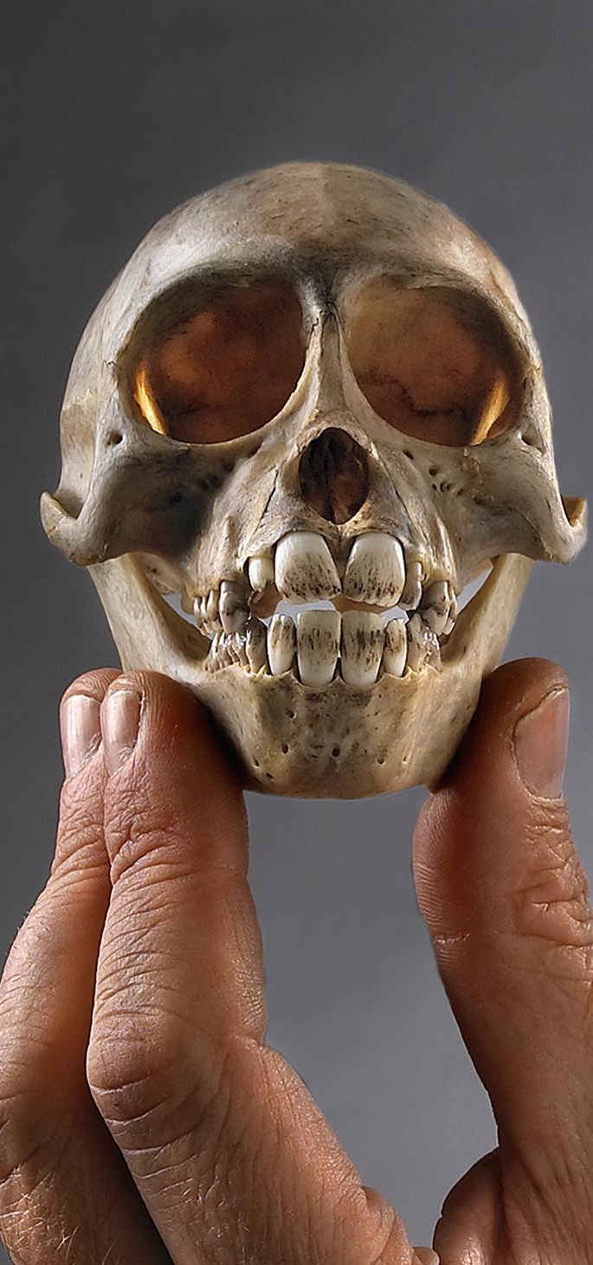

Agenda
What are Spreadsheet Tools?
01
Getting Data into Calc
02
Summarizing/Slaughtering Data in Calc
03
Manipulating/Mangling Data in Calc
04
Getting Data Out of Calc
05
Recap & Alternatives to Calc
06
Reference: (c) Field Museum of Natural History - CC BY-NC 4.0 https://mm.fieldmuseum.org/3994ee8a-634d-4e95-bbd7-b008d415fb81 (accessed on 6-15-2022)
Notes:
TIP: Click on image and choose “Replace image” in the menu. To move around the visible part of the image within the placeholder, click on “Crop” and move the image up or down.

Slide 3
What are
Spreadsheet Tools?

Slide 4



Examples of Spreadsheet Tools
WHAT ARE SPREADSHEET TOOLS?
Excel is Microsoft’s standalone spreadsheet program. Available with the Office suite.
LibreOffice Calc is the Document Foundation’s free open-source spreadsheet program. Available here: www.LibreOffice.org
Google Sheets is part of the Google Apps Suite. If you have a Gmail and Google Drive, you have it.
Notes:
TIP: To quickly change the bullet point style, simply right-click on the bullet and choose another icon.

Slide 5
WHAT ARE SPREADSHEET TOOLS?
What Can/Can’t LibreOffice Calc Do?
 | Excel | LibreOffice Calc | Google Slides
Formulas
Charts & Graphs
Auto-formats fields
Allow creation of lookup lists
Allow character sets besides Latin1 (e.g., UTF-8) | Limited
Track changes after closing | Limited | Limited
Maintain integrity between rows and columns | Limited | Limited | Limited
Enforce referential integrity between different sheets | Limited | Limited | Limited

Slide 6
Spreadsheet Don’ts
WHAT ARE SPREADSHEET TOOLS?
What should you AVOID doing in a spreadsheet?
Mixing multiple datasets in a single spreadsheet
Using multiple tabs in a workbook
Not filling in zeros
Using problematic null values (e.g., -999, +/-, Null, NA)
Using visual formatting (color-highlights, fonts, borders) to convey information
Using visual formatting to make the data sheet look pretty
Placing comments or units in cells
Entering more than one piece of information in a cell
Using problematic field names
Using special characters in data (e.g., line breaks, em-dashes, quotation marks)
Inclusion of metadata in data table
P.S. DO NOT MERGE CELLS. DO NOT. BAD. SHAME.
github.com/datacarpentry/spreadsheet-ecology-lesson/blob/gh-pages/_episodes/02-common-mistakes.md
Notes:
TIP: To quickly change the bullet point style, simply right-click on the bullet and choose another icon.

Slide 7
Tables vs. Spreadsheets
WHAT ARE SPREADSHEET TOOLS?
Tables:
= records & attributes
= actual structure
= safer data…
Spreadsheets:
= rows & columns
= illusion of structure
= accident-prone data…
1 Excel file can hold multiple spreadsheets = more illusion...
Notes:
TIP: To quickly change the bullet point style, simply right-click on the bullet and choose another icon.

Slide 8
Getting Data into Calc

Slide 9
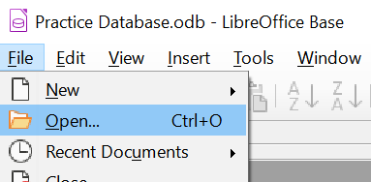
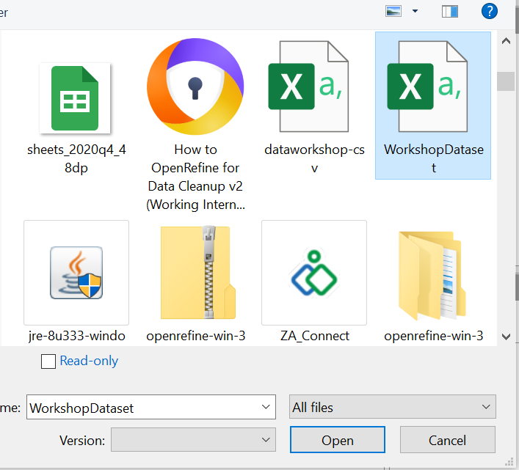
GETTING YOUR DATA
Getting Data into Calc
Open LibreOffice.
From the File menu, click Open… to open the data file. If the data is saved in a standard format such as a .csv, LibreOffice will open it in Calc by default.

Slide 10
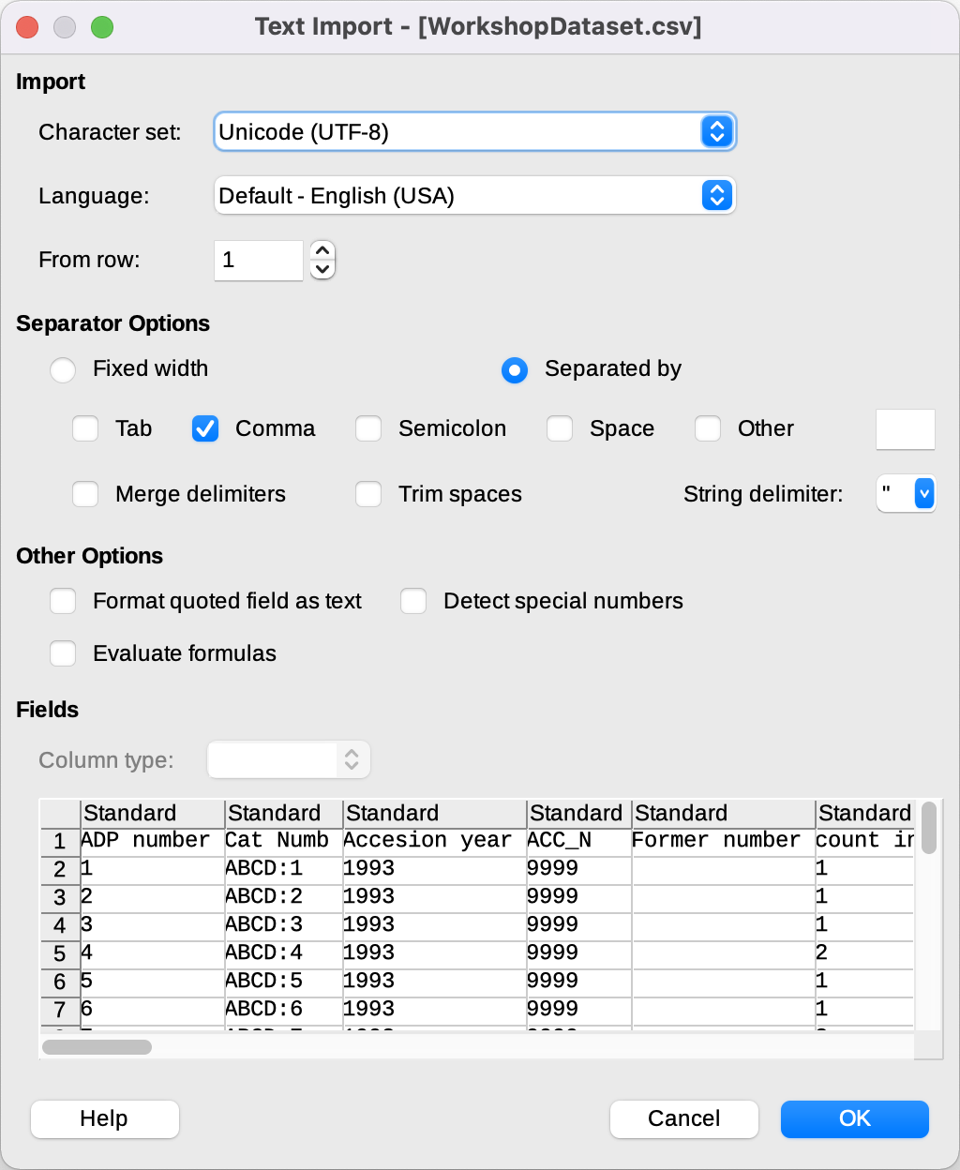
GETTING YOUR DATA
Getting Data into Calc
A Text Import wizard will open.
Certain options will be selected by default. Review them to make sure the settings are fit for the data file.
  Latin-1 and UTF-8 are the most common character sets.
If something seems off in the preview window at the bottom of the wizard, try adjusting the Separator Options.

Slide 11
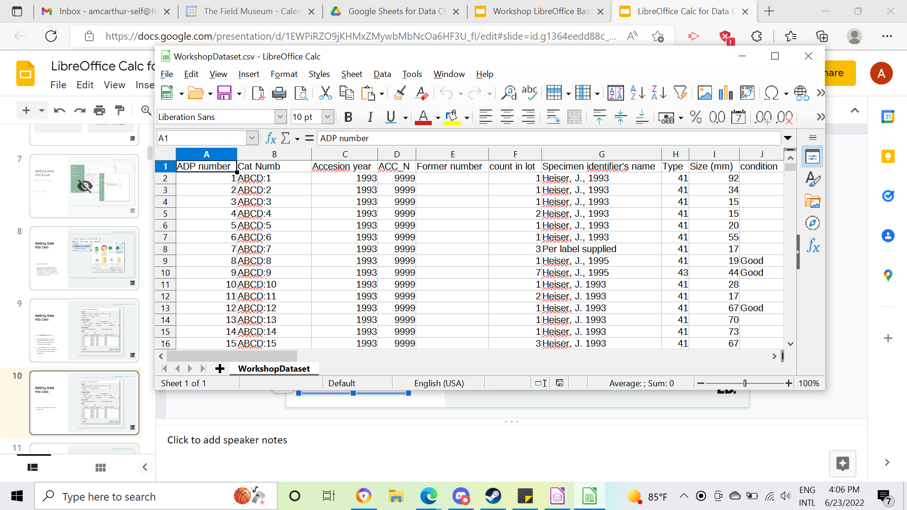
GETTING DATA INTO A SPREADSHEET TOOL
Getting Data into Calc
When everything looks good, click OK. The data will open in a Calc file.

Slide 12
GETTING YOUR DATA
Getting Data into Calc
When everything looks correct, click OK.
Calc will open as a live date file.
  Using Save (from File menu) after making any edits and selecting the Use Text CSV Format option will overwrite the original data file.
  Instead, select Use ODF Format or use Save As….

Slide 13
GETTING DATA INTO SPREADSHEET TOOLS
Getting Data into Calc
Data files (CSV, XLS, TXT, etc.) are encoded in a specific character-set.
Most commonly they are either Latin-1 or UTF-8.

Slide 14
Summarizing/
Slaughtering Data in Calc

Slide 15

Summarizing/
Slaughtering Data in Calc
Sorting and Filtering
There are four sort/filter buttons in the menu bar (left to right):
Sort
Sort Ascending
Sort Descending
AutoFilter

Slide 16
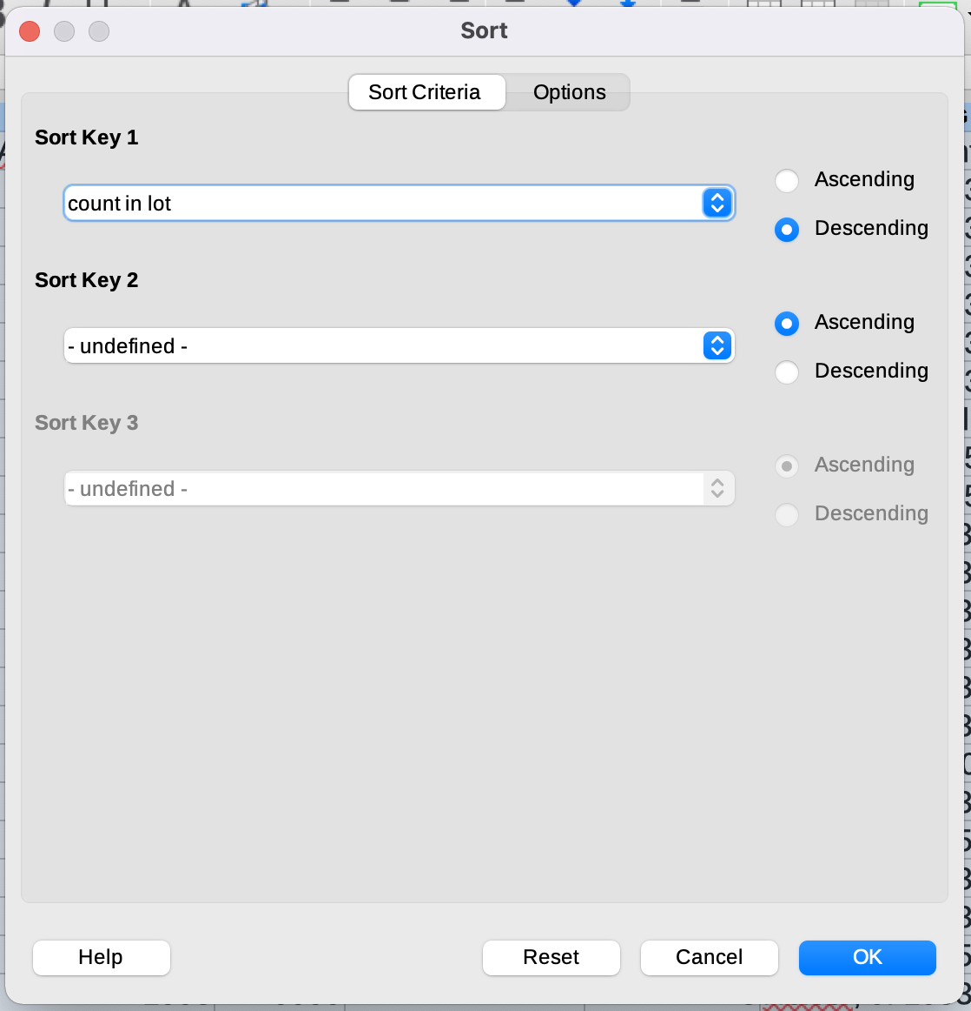
Sorting
SUMMARIZING/SLAUGHTERING
DATA IN CALC
Sort, Sort Ascending, Sort Descending
Sort Ascending and Descending
  The two buttons are contextual. They will sort based on the highlighted cell.
  Note: Calc automatically selects all data.
Sort
  The Sort button will open the Sort window.
  Set Sort Key 1 to “count in lot” or the column you’d like to sort.
  Select Descending or the desired sorting direction.
Notes:
TIP: To quickly change the bullet point style, simply right-click on the bullet and choose another icon.

Slide 17
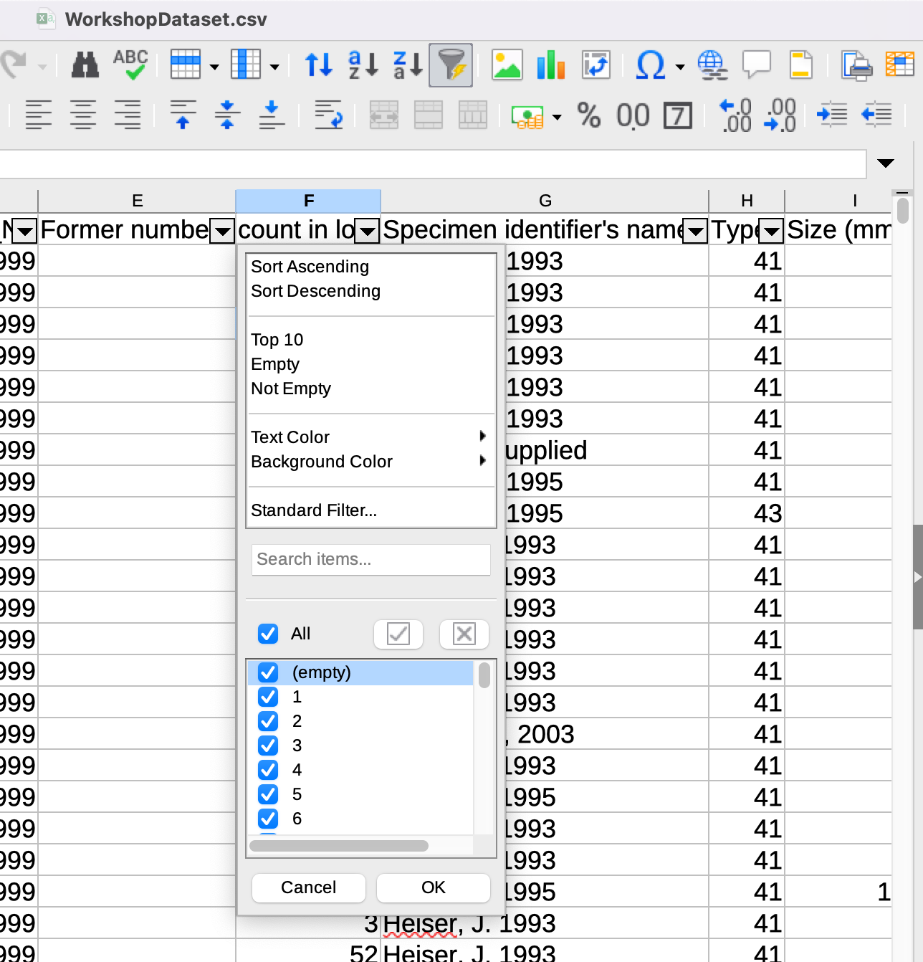
SUMMARIZING/SLAUGHTERING
DATA IN CALC
Sorting
…or use AutoFilter.
To sort data using AutoFilter:
Click the AutoFilter button
Click the dropdown menu button for the desire column
Select Sort Ascending or Sort Descending

Slide 18
What is the difference between
sorting and filtering?
WHAT ARE SPREADSHEET TOOLS?
Sorting
Sorting rearranges the presentation of the data within a table — including all values.
Filtering
Filtering rearrange the presentation of the data within a table — including only the values that meet the specified criteria.
In Calc, the AutoFilter button places drop-down menus at the top of each column with options for both sorting and filtering.
Notes:
TIP: To quickly change the bullet point style, simply right-click on the bullet and choose another icon.

Slide 19
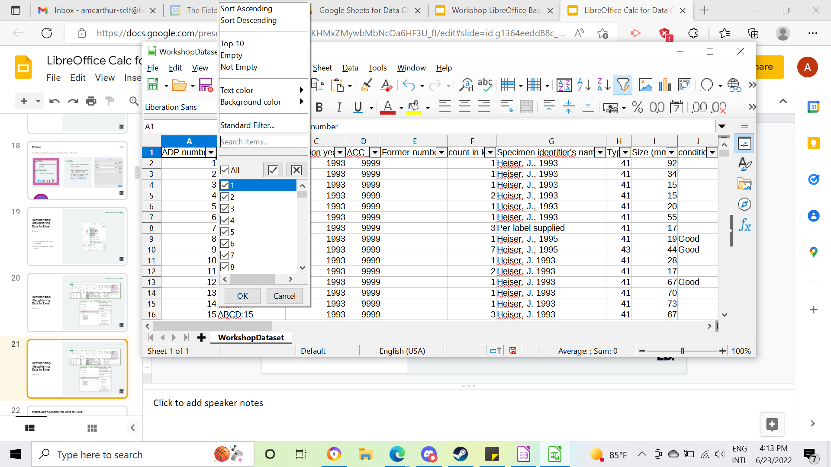
SUMMARIZING/SLAUGHTERING
DATA IN CALC
Summarizing/
Slaughtering Data in Calc
If you left click the icon, it will “Autofilter,” placing grey dropdown menus on all the columns.
Filtering

Slide 20
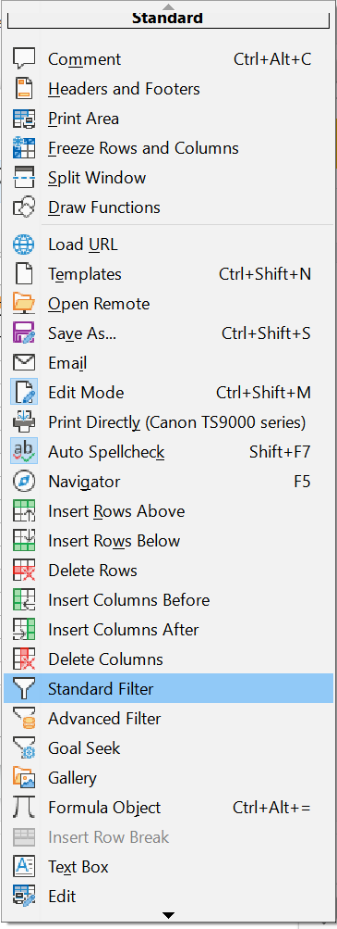
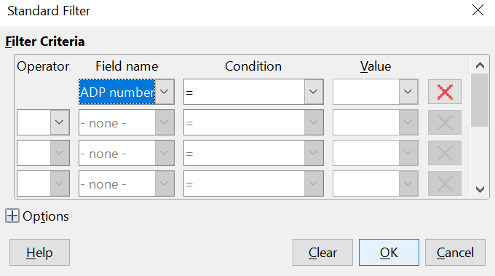
SUMMARIZING/SLAUGHTERING
DATA IN CALC
If you right-click on the icon, it will open a menu with more options. You can select Standard Filter to create your own filter.
Summarizing/
Slaughtering Data in Calc
Filtering

Slide 21
Manipulating/
Mangling Data in Calc

Slide 22
MANIPULATING/MANGLING DATA IN CALC
Manipulating/Mangling Data in Calc
Functions
Build your own:
  CONCATENATE
  VLOOKUP
Built-in:
  Split Text-to-Columns
  Deduplication
Notes:
TIP: To quickly change the bullet point style, simply right-click on the bullet and choose another icon.

Slide 23
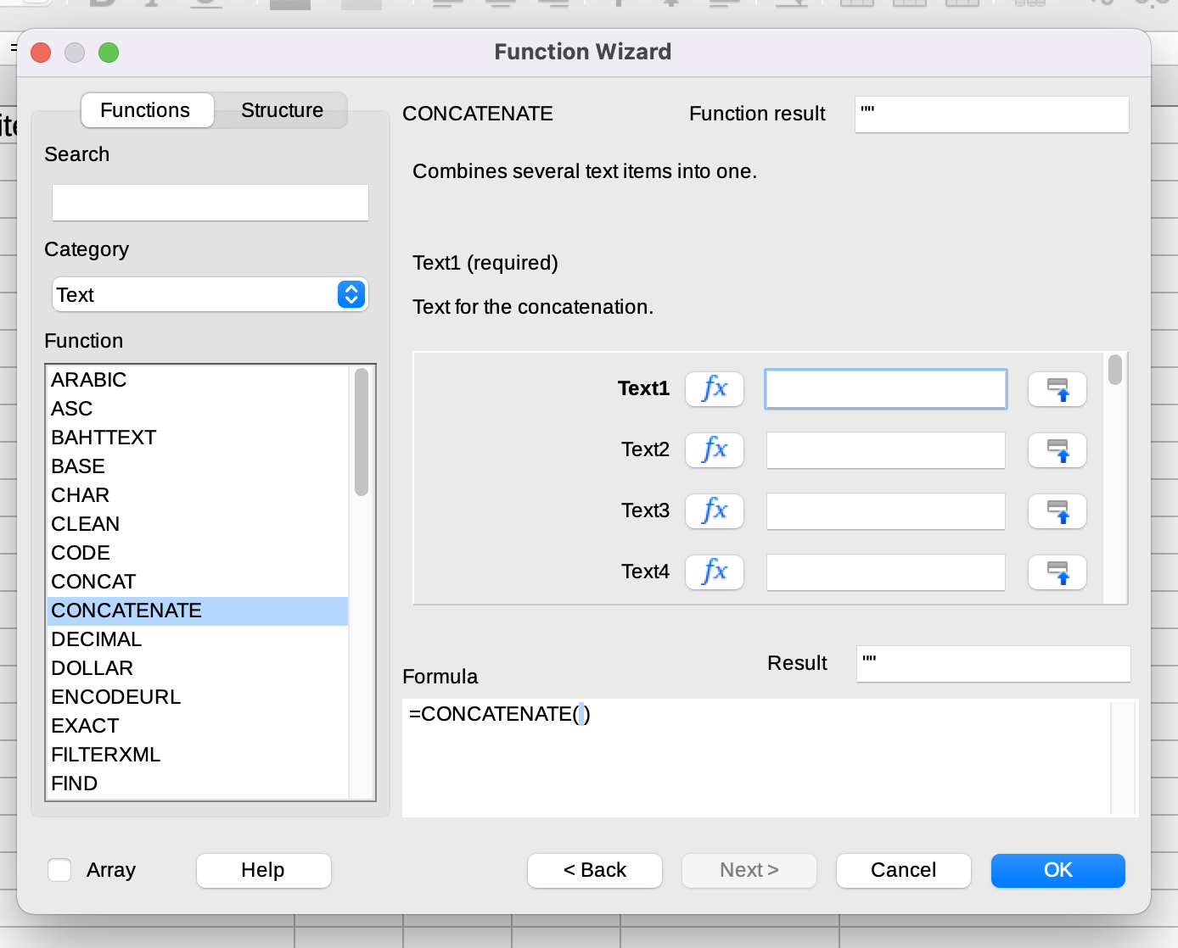
Build Your Own Functions
MANIPULATING/MANGLING DATA IN CALC
Function Wizard: CONCATENATE
Syntax: =FUNCTION(arguments)
Built-in help offers a syntax guide:

Slide 24
Build Your Own Functions
MANIPULATING/MANGLING DATA IN CALC
Function Wizard: CONCATENATE
To build the function using the Function Wizard:
Click the Function Wizard button with the target cell highlighted.
Select the function from the Function box. Use the Search bar to search for the CONCATENATE function.
Click the Next button.

Slide 25
Build Your Own Functions
MANIPULATING/MANGLING DATA IN CALC
Function Wizard: CONCATENATE
Input cell names and text into the Text for the concatenation boxes. For this example: AD3, “-”, AE3, “-”, AF3 for fields Text1 through Text5.
The Result box will allow you to preview the displayed value of the cell. Click OK.

Slide 26
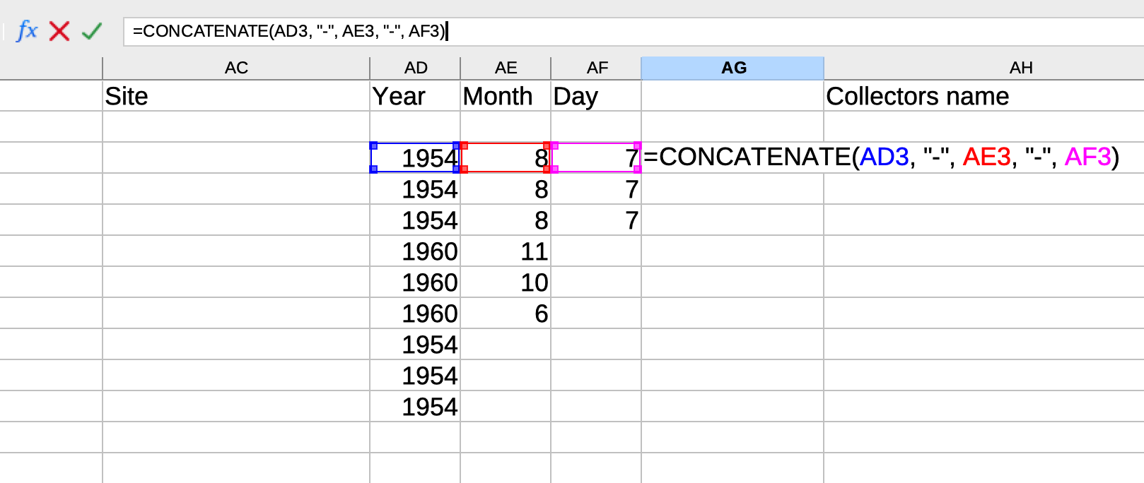
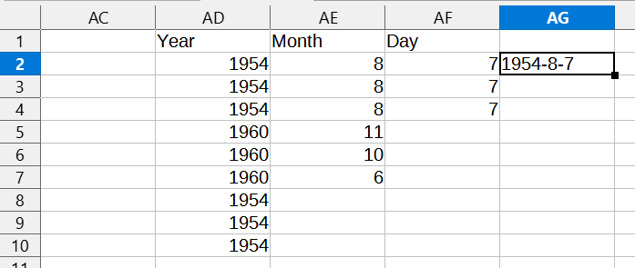
Build Your Own Functions
MANIPULATING/MANGLING DATA IN CALC
Function Wizard: CONCATENATE
CONCATENATE(arguments)

Slide 27
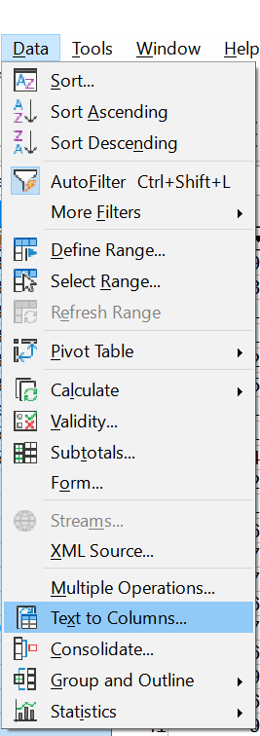
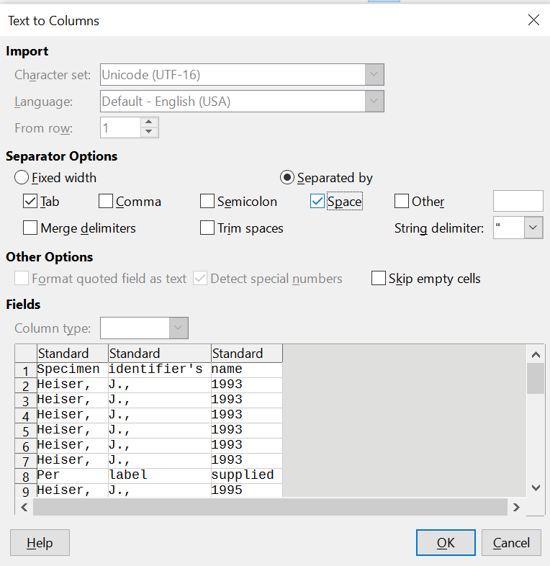
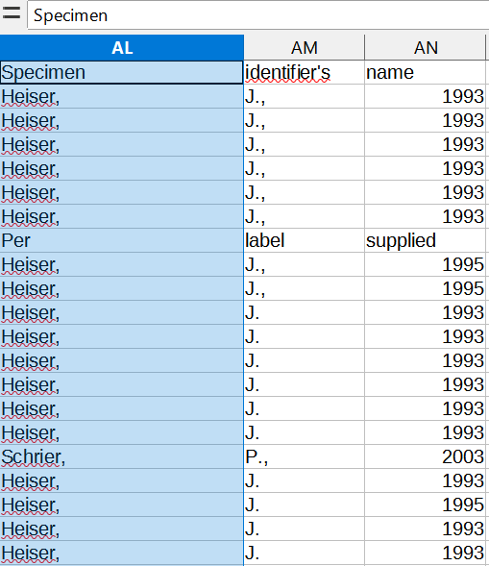
Built-in Functions
MANIPULATING/MANGLING DATA IN CALC
Split Text → Columns
Select Text to Columns… from the Data menu.
Select your settings in the Text to Column Wizard. Make sure the right delimiter is selected by previewing the data in the bottom window.

Slide 28
Functions
MANIPULATING/MANGLING DATA IN CALC
Calc does not have a built-in deduplication tool. There are two options:
Install an Extension:
Remove Duplicates is a free extension for Calc.
Use Formatting:
Calc includes functions for conditional formatting and filtering, which can be used to find and remove duplicates.
Notes:
TIP: To quickly change the bullet point style, simply right-click on the bullet and choose another icon.

Slide 29
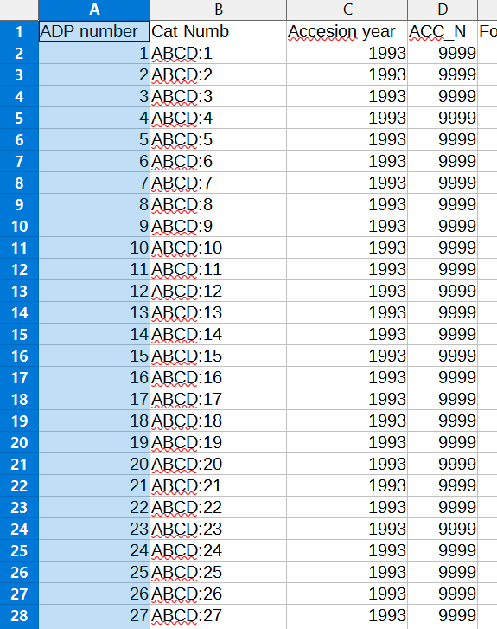
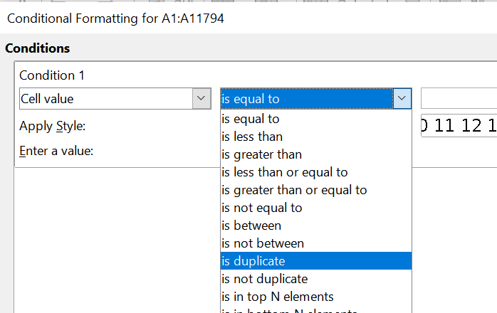
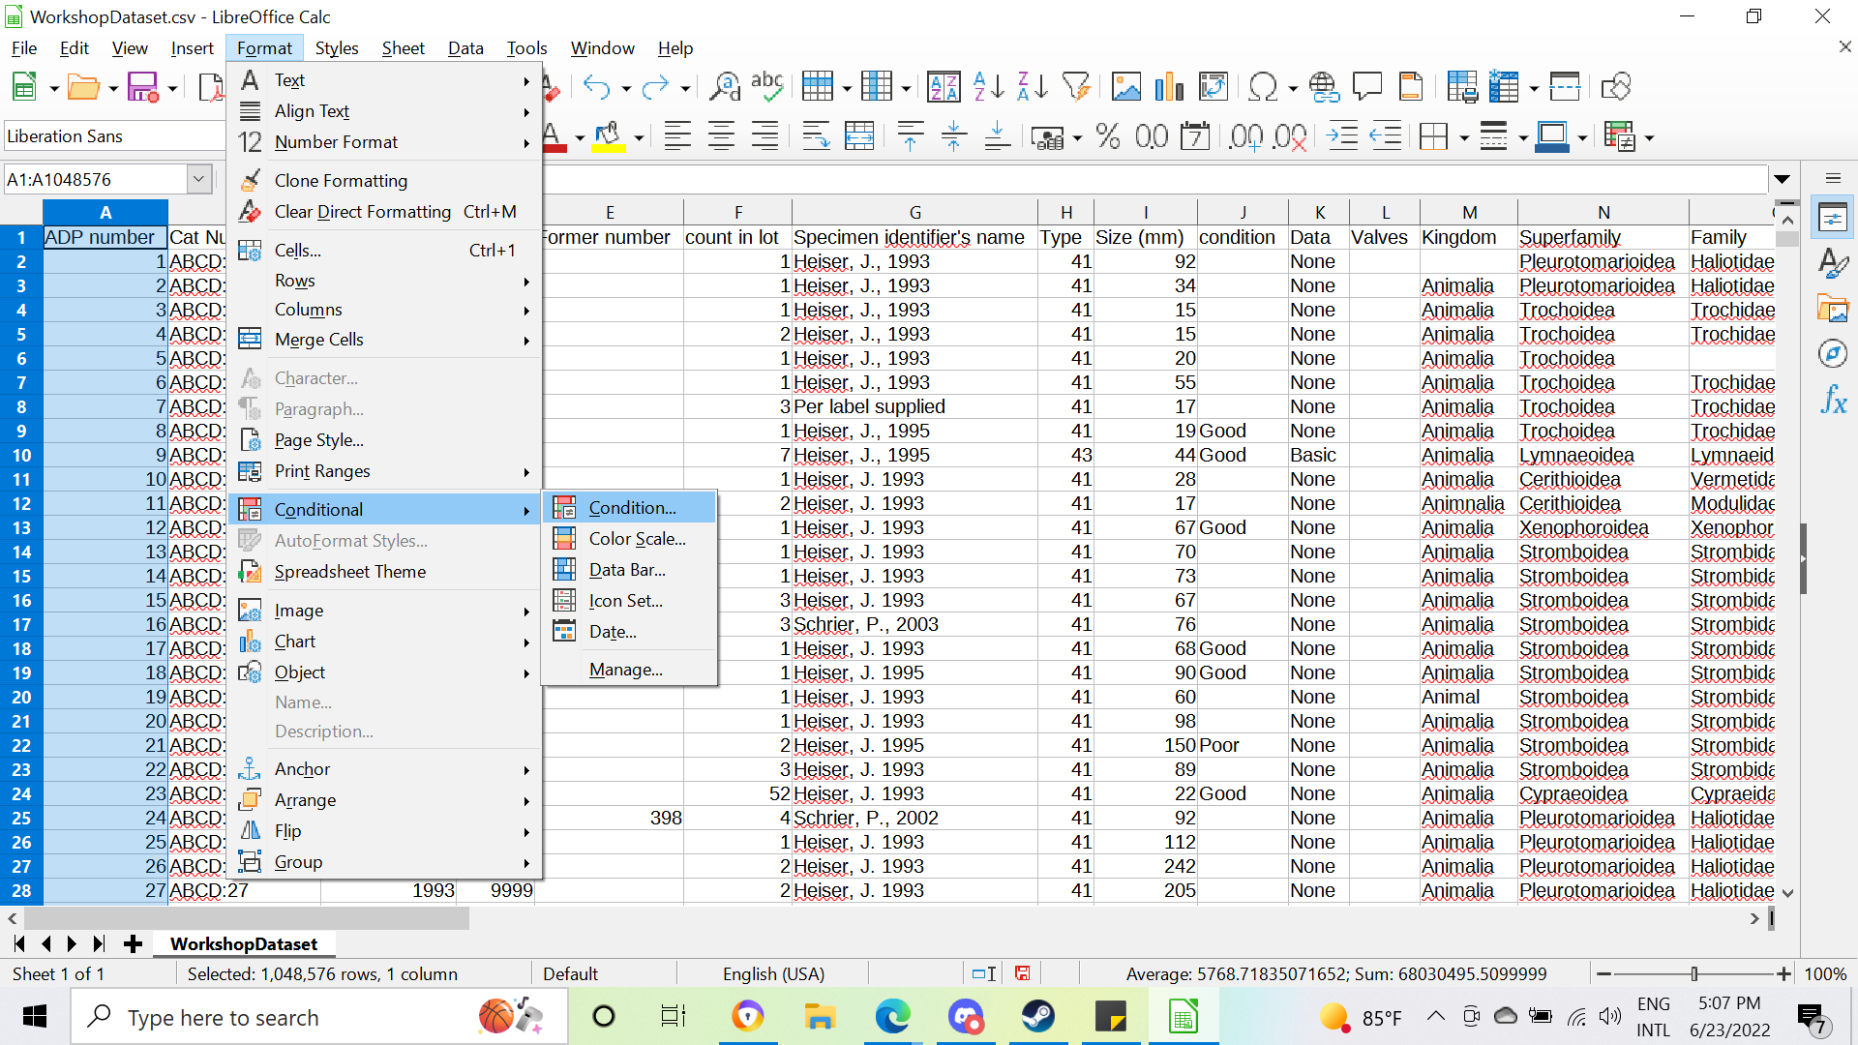
Functions
MANIPULATING/MANGLING DATA IN CALC
Deduplicating Rows
To deduplicate rows, highlight the column to sort for duplicates. Under Format, select Conditional → Condition…
Set the condition to “is duplicate” and set the style for the conditionally formatted boxes.

Slide 30
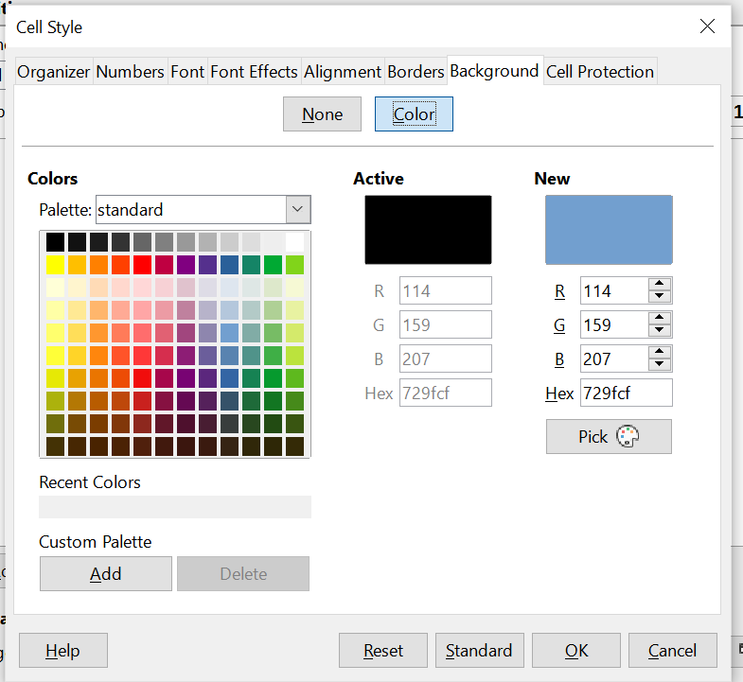
Functions
MANIPULATING/MANGLING DATA IN CALC
Deduplicating Rows
If you haven’t used conditional formatting this way in the program, you may have to create a new style that changes the background color rather than font style.

Slide 31
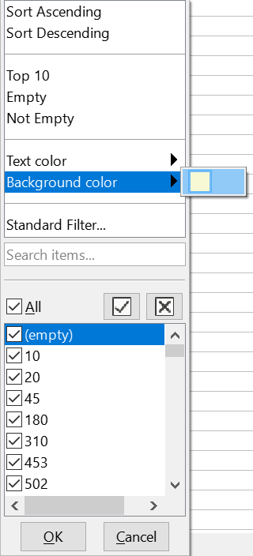
Functions
MANIPULATING/MANGLING DATA IN CALC
Deduplicating Rows
Once you’ve formatted any duplicates, use the autofilter setting. Select Background color from the dropdown menu to bring duplicates to the top.
From there, check and remove any rows that are duplicates.

Slide 32
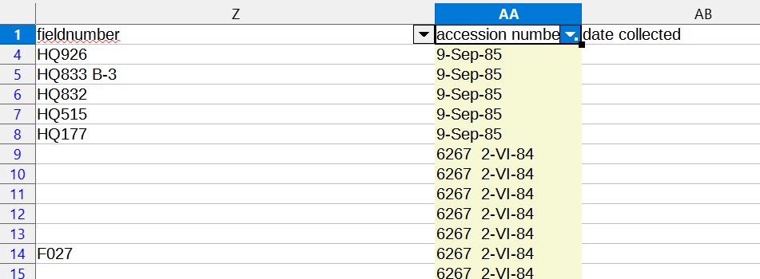
Functions
MANIPULATING/MANGLING DATA IN CALC
Deduplicating Rows
Typically, it’s best to avoid background colors because they can make a spreadsheet look messy.
When removing duplicates, however, all rows with a different background color will be deleted.

Slide 33
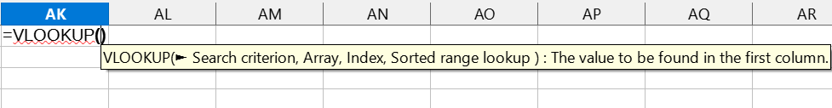
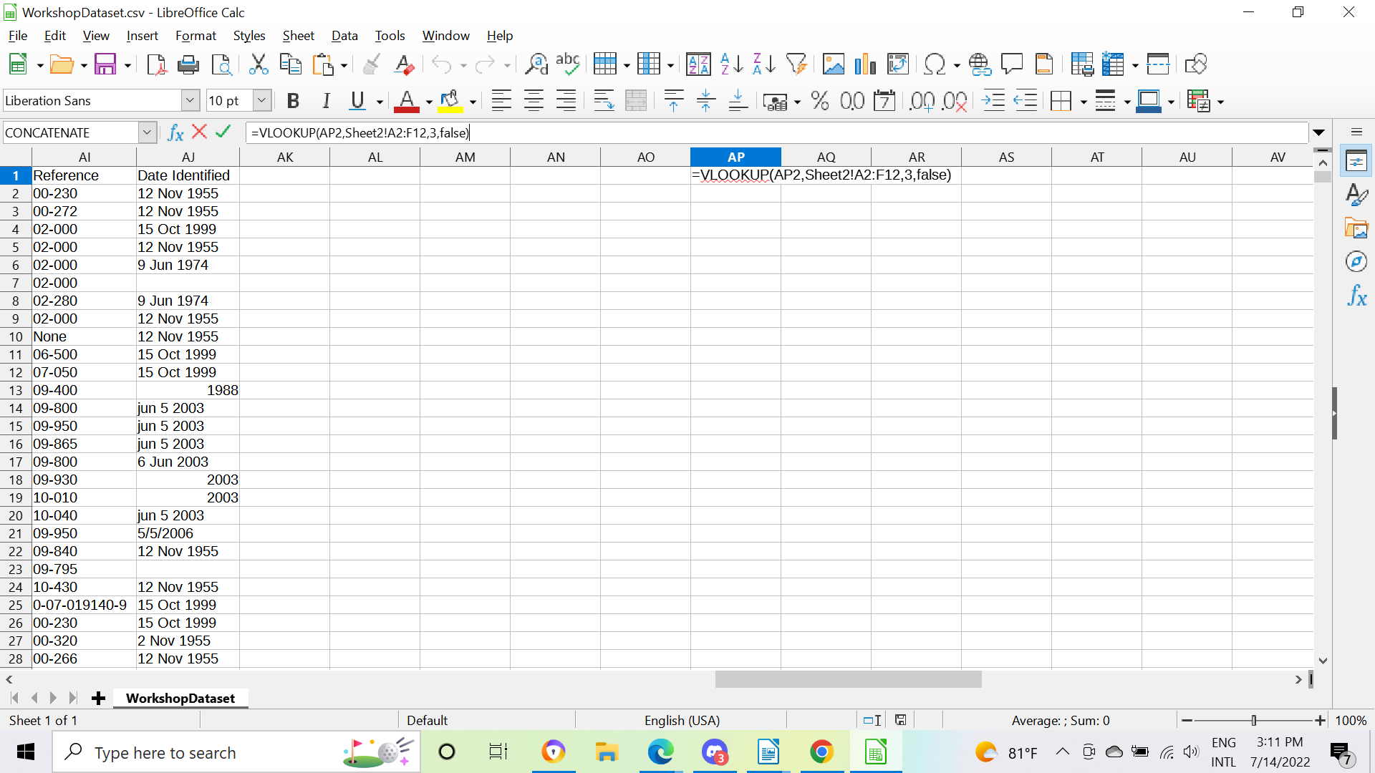
Build Your Own Functions
MANIPULATING/MANGLING DATA IN CALC
Lookup Lists with VLOOKUP
You can type =VLOOKUP directly into the spreadsheet to use the function. Calc will give you minimal help.
=VLOOKUP( [cell with a value to replace]
[range where column 1 = matches & column X = replacements]
[column number X]
FALSE to prevent approximate matches )

Slide 34
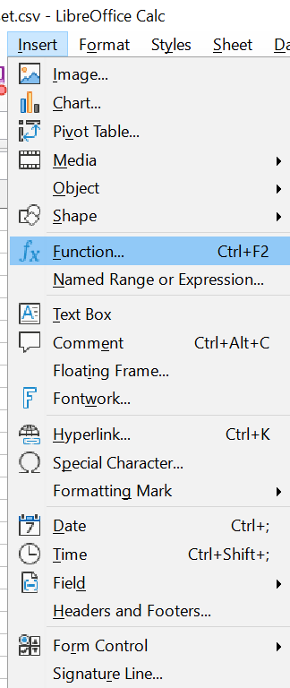
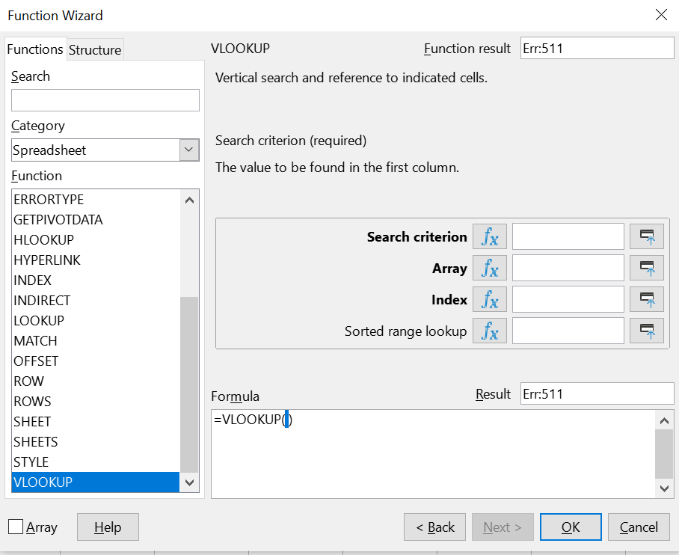
Build Your Own Functions
MANIPULATING/MANGLING DATA IN CALC
If you want more help writing your function, you can Insert → Function to open the Function Wizard.
Lookup Lists with VLOOKUP
=VLOOKUP( [cell with a value to replace]
[range where column 1 = matches & column X = replacements]
[column number X]
FALSE to prevent approximate matches )

Slide 35
Getting Data Out of Calc

Slide 36
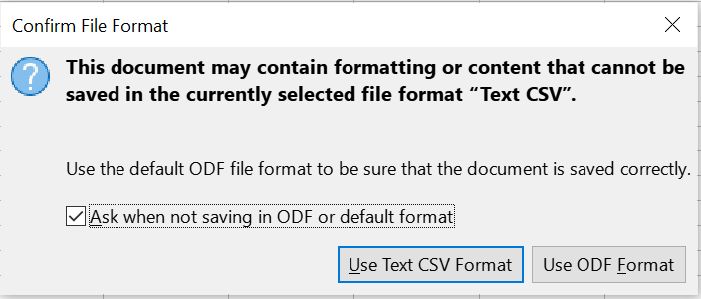
RECAP
Getting Data Out of Calc
You can use the “Save As” function to save the file in a variety of formats.
Text CSV
  Where text delimiter is specified and applied to all fields
  Readable by most programs
An ODF Spreadsheet
  The default spreadsheet format for LibreOffice, comparable to Microsoft Excel XLS and XLSX files.
If you attempt to Save directly to the original file, you will get a warning. To ensure you don’t mangle any data, Save As to make a copy, rather than overwriting the original.

Slide 37
Recap

Slide 38
Recap
RECAP
Data in spreadsheets:
  Good for one-time-use
  Not good for maintaining
  …Is it structured? No.
Alternatives to LibreOffice Calc:
  Google Sheets
  Excel
  Not using spreadsheets…?
Notes:
TIP: To quickly change the bullet point style, simply right-click on the bullet and choose another icon.

Slide 39
Questions?
Ask now; we might have answers!

Slide 40
Presenter name
SECTION TITLE
Title or credentials
Insert Presenter Image
Bio
Contact Information
Notes:
slide purpose: to acknowledge presenter (e.g. voiceover in recording or live presenter)
Replace “Title or cred” line/field with “role” - e.g. “Presenter”, “Content Developer/Contributor”
Bio - should include the person’s “Title/Credentials”

Slide 41


Thank you!
Sharon Grant
sgrant@fieldmuseum.org
https://www.fieldmuseum.org/
Janeen Jones
jjones@fieldmuseum.org
https://www.fieldmuseum.org/
Kate Webbink
kwebbink@fieldmusuem.org
https://www.fieldmuseum.org/
Abigail McArthur-Self
amcarthur-self@fieldmusuem.org
https://www.fieldmuseum.org/
Alexis Ramirez
aramirez@fieldmusuem.org
https://www.fieldmuseum.org/

