Slide 1
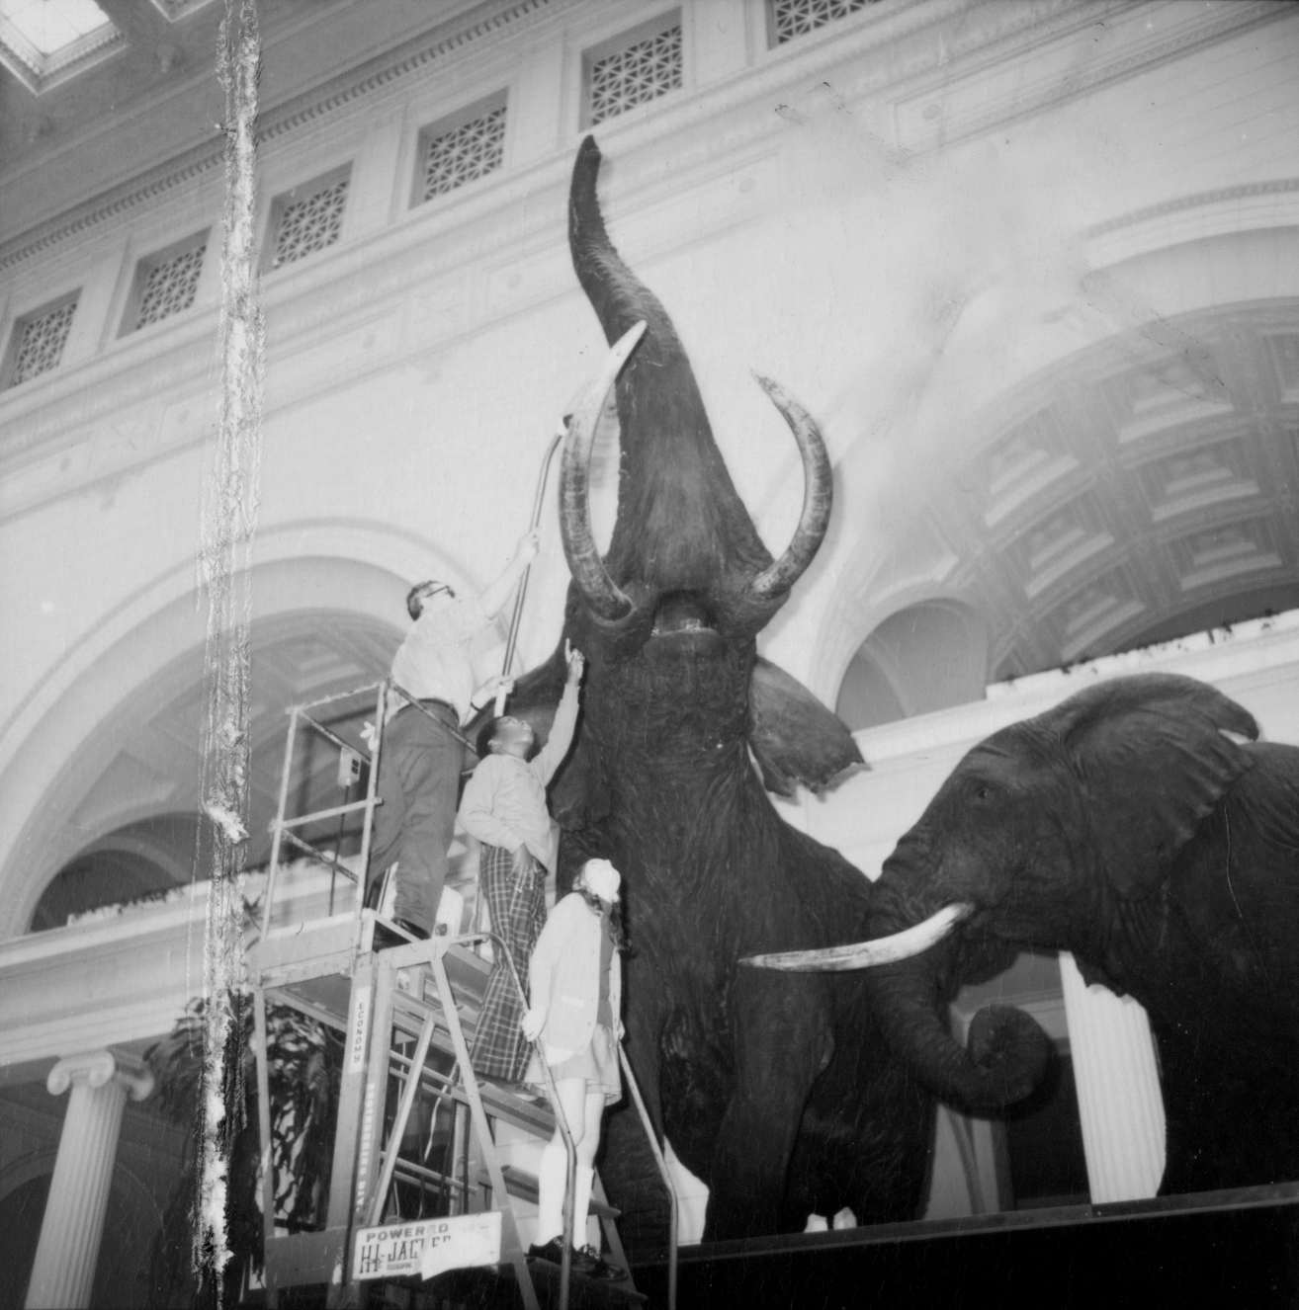

R for Data Cleaning
What is R? A scripting language
Why use R? To reproduce &/or share workflows.
Reference: Courtesy of: J. Bayalis. (c) Field Museum of Natural History. https://mm.fieldmuseum.org/136227d2-e642-4952-b993-3fe7c434cdc2 (accessed on 29 Oct 2021)
Notes:
TIP: Click on image and choose “Replace image” in the menu. To move around the visible part of the image within the placeholder, click on “Crop” and move the image up or down.

Slide 2


Agenda
Introduction to R
01
R-Studio Setup
02
Script Setup
03
Importing and Viewing Data
04
Reshaping Data
05
Exporting Data
06
Extras
07
Notes:
TIP: Click on image and choose “Replace image” in the menu. To move around the visible part of the image within the placeholder, click on “Crop” and move the image up or down.

Slide 3
Introduction to R

Slide 4


What is this thing called “R”?
INTRODUCTION TO R
R is both:
a scripting language
software to R-scripts
R-Studio is:
an IDE — “integrated development environment” (a program that makes coding more convenient)
R & R-Studio are useful for:
making reproducible data-handling workflows
sharing those workflows (as scripts & documentation)
Notes:
TIP: To quickly change the bullet point style, simply right-click on the bullet and choose another icon.

Slide 5
INTRODUCTION TO R
What Can/Can’t R Do?
 | R
Formulas
Charts & Graphs
Auto-formats fields | Some functions
Allow creation of lookup lists
Allow character sets besides Latin1 (e.g., UTF-8)
Track changes after closing
Maintain integrity between rows and columns
Enforce referential integrity between different sheets | Some assembly required

Slide 6
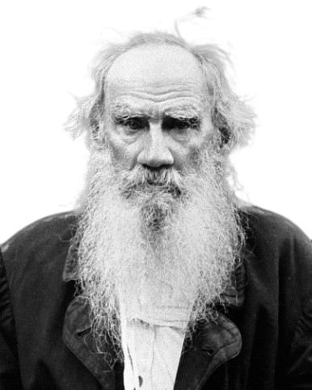
Useful Philosophy/ies
INTRODUCTION TO R
“All tidy data is alike; all messy data is messy in its own way.” – Hadley Wickham/Leo
Tidy data structure:
(based on Codd 1990/normalization)
1 row = 1 observation (record)
1 column = 1 variable (attribute)
1 value = 1 observation of 1 variable
1 table = 1 type of observational unit [1 record-type]
e.g.— 1 table for locality records; 1 table taxon records
Notes:
TIP: To quickly change the bullet point style, simply right-click on the bullet and choose another icon.

Slide 7
Useful Philosophy/ies
INTRODUCTION TO R
“All tidy data is alike; all messy data is messy in its own way.” – Hadley Wickham/Leo
Messy data structure
1 row != 1 observation (record)
1 column != 1 variable (attribute)
1 value != 1 observation of 1 variable
1 table != 1 type of observational unit [1 record-type]
e.g.— 1 table for locality records; 1 table taxon records
Notes:
TIP: To quickly change the bullet point style, simply right-click on the bullet and choose another icon.

Slide 8
Useful Philosophy/ies
INTRODUCTION TO R
“All tidy data is alike; all messy data is messy in its own way.” – Hadley Wickham/Leo
Messy data structure
1 row != 1 observation (record)
1 column != 1 variable (attribute)
1 value != 1 observation of 1 variable
1 table != 1 type of observational unit [1 record-type]
e.g.-- 1 table for locality records; 1 table taxon records
But Remember! Useful data
“Data cleaning is improving quality of data to make them ‘fit for use’”
Notes:
TIP: To quickly change the bullet point style, simply right-click on the bullet and choose another icon.

Slide 9
INTRODUCTION TO R
1
Reshaping Data
Cat # | ID-1 | ID-2 | ID-3
FM 15 | P. jagori | P. minor | P. vampyrus
FM 36 | R. inops | R. rufus | R. arcuatus
Cat # | ID-# | ID
FM 15 | ID-1 | P. jagori
FM 15 | ID-2 | P. minor
FM 15 | ID-3 | P. vampyrus
FM 36 | ID-1 | R. inops
FM 36 | ID-2 | R. rufus
FM 36 | ID-3 | R. arcuatus
Gathering and Spreading
The two actions are opposites:
Gathering: Adds rows to consolidate columns

Slide 10
INTRODUCTION TO R
1
Reshaping Data
Cat # | ID-1 | ID-2 | ID-3
FM 15 | P. jagori | P. minor | P. vampyrus
FM 36 | R. inops | R. rufus | R. arcuatus
Cat # | ID-# | ID
FM 15 | ID-1 | P. jagori
FM 15 | ID-2 | P. minor
FM 15 | ID-3 | P. vampyrus
FM 36 | ID-1 | R. inops
FM 36 | ID-2 | R. rufus
FM 36 | ID-3 | R. arcuatus
Gathering and Spreading
Obj | Meas. | Value
jar | height | 36
jar | width | 21
jar | depth | 5
vase | height | 20
vase | width | 6
vase | depth | 4
The two actions are opposites:
Gathering: Adds rows to consolidate columns
Spreading: Adds columns to consolidate rows
Obj | height | width | depth
jar | 36 | 21 | 5
vase | 20 | 6 | 4
2

Slide 11
Reshaping Data
INTRODUCTION TO R
Split-Apply-Combine is a philosophy/phrase commonly referenced with R users
Break down code and datasets into only the pieces relevant for each step
Similar to “faceting”, “querying” … other database platforms have other fancy names for it (map reduce?)
Gathering & spreading are similar to what you can do with Pivot Tables (in Excel/similar spreadsheet-software)
Except Pivot Tables tend to be unstable (especially with larger/more complex/memory-intensive datasets)
R stays stable
Notes:
TIP: To quickly change the bullet point style, simply right-click on the bullet and choose another icon.

Slide 12
R-Studio Setup

Slide 13
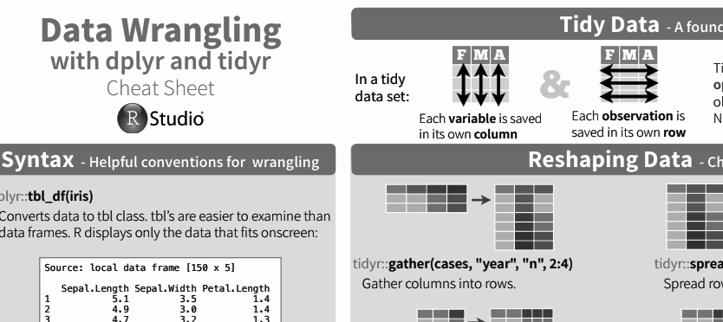
R-Studio – Some Help…
R-STUDIO SETUP
You can trust CRAN — the “Comprehensive R Archive Network.”
Installation
1st – Install R
cran.r-project.org
Cheat Sheet:
Overview of what a package can do.
rstudio.com/resources/cheatsheets
2nd – Install R-Studio
rstudio.com/products/rstudio/download
Notes:
TIP: To quickly change the bullet point style, simply right-click on the bullet and choose another icon.

Slide 14
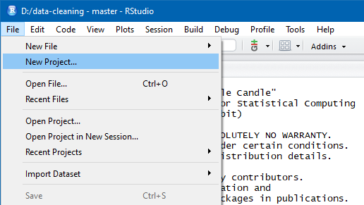
R-STUDIO SETUP
R-Studio Setup
Double click the R-Studio icon to start the program.
Make a new project:
Go to File → New Project

Slide 15
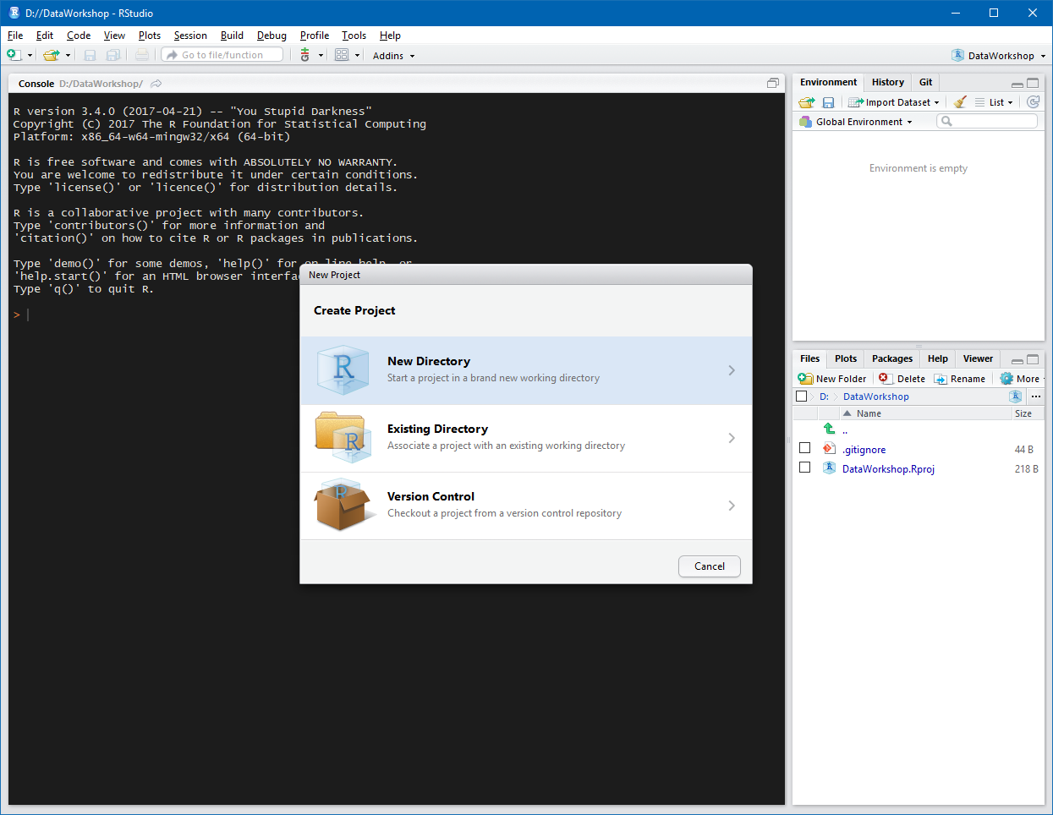
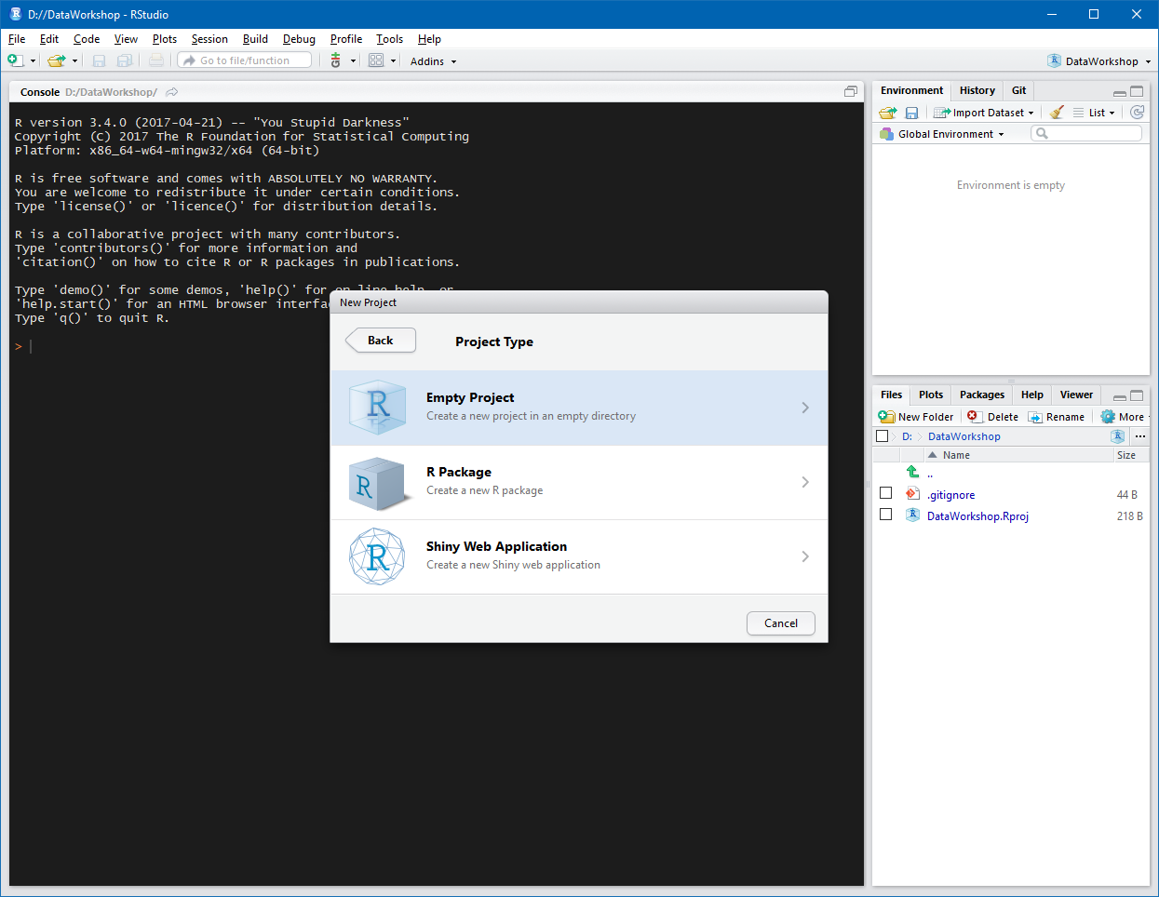
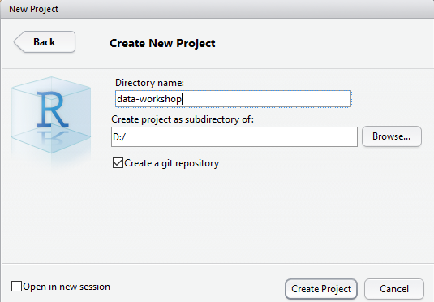
R-STUDIO SETUP
R-Studio Setup
Choose “New directory”
then choose “Empty project”
Name the new project directory Test, and save it to your Desktop.
After today, never save on Desktop!
Click “Create Project”

Slide 16
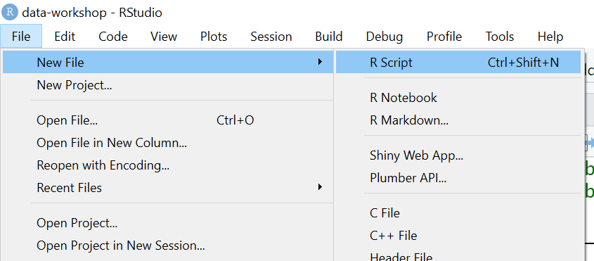
R-STUDIO SETUP
Opening a Script
In RStudio,
Go to File → New File → R-Script

Slide 17
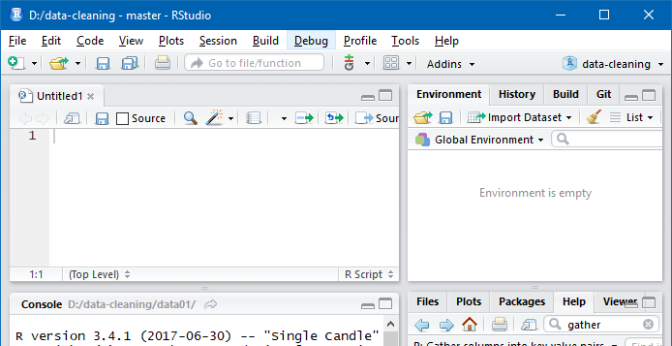
R-STUDIO SETUP
Opening a Script
In RStudio,
Go to File → New File → R-Script
The new R script will open in the Source Editor pane (upper left):

Slide 18
R-STUDIO SETUP
Opening a Script
My eyes are on fire! is there a way to change Script Editor background from white to a darker color?
Go to Tools -> Global Options -> Appearance -> choose a theme.
(“Merbivore Soft” is easy on the eyes)

Slide 19
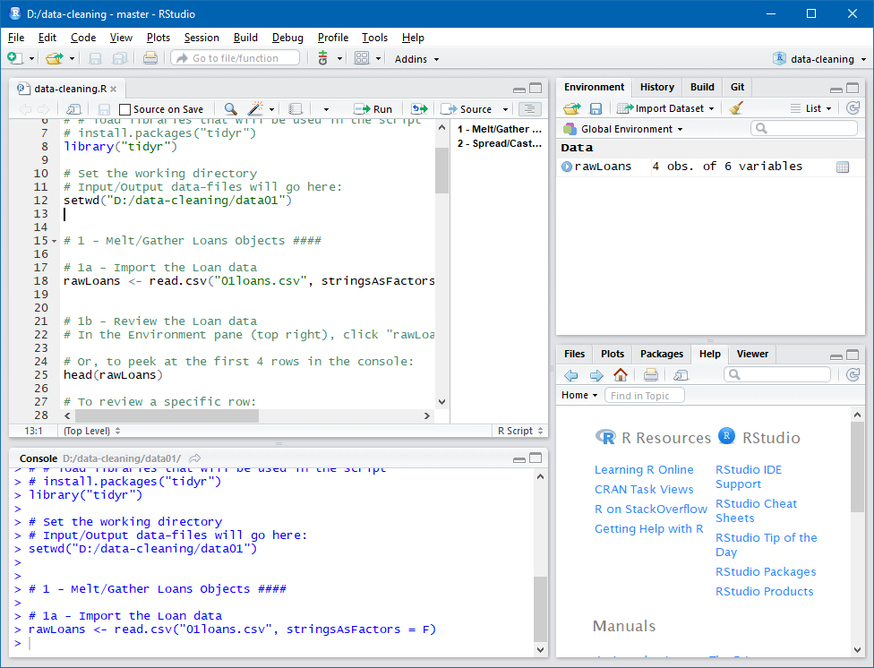
R-STUDIO SETUP
R-Studio Interface
Source Editor pane
(edit a script)
Environment
variables, history
Source Editor pane
= edit/save scripts
Console pane
= run scripts
Environment
= see objects
Help = help!
- Google...
- Stackoverflow...
File Browser & Help
Console pane
(run a script)

Slide 20
R-STUDIO SETUP
R-Studio Interface
Source Editor pane
(edit a script)
Environment
variables, history
File Browser & Help
More details here:
https://github.com/rstudio/cheatsheets/blob/master/source/pdfs/rstudio-IDE-cheatsheet.pdf.
Console pane
(run a script)

Slide 21
Mapping and Planning
R-STUDIO SETUP
Do your mapping & planning steps!
Specifically:
Map - which fields map directly to where they go?
Plan - which fields need to be split/combined/reshaped?
Find your functions & their corresponding packages:
Google “R how to [sort by one column, add rows, etc]”
In R Studio, search by name for packages/functions in the Help panel.
Notes:
TIP: To quickly change the bullet point style, simply right-click on the bullet and choose another icon.

Slide 22
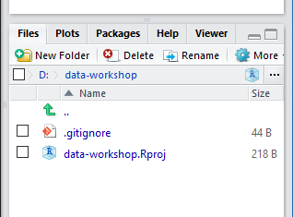
R-STUDIO SETUP
A little more R-Studio Setup
In the Help/Files pane (lower right),
6) click the “Files” tab:
add a folder named data01raw
and a folder named data02processed
7) Outside of RStudio, download WorkshopData.csv, and move the file to the data01raw folder inside your project directory..

Slide 23
Script Setup

Slide 24
SCRIPT SETUP
Script Setup (& some R syntax)
R-scripts are text files with a “.R” extension, and [hopefully] working code inside:
Objects Functions Arguments #Comments (nouns) (verbs)
column123 <- c(93,13,42)
# creates a numeric vector called column123
Arguments and their options modify what a function does

Slide 25
SCRIPT SETUP
Script Setup (& some R syntax)
R-scripts are text files with a “.R” extension, and [hopefully] working code inside:
Objects [nouns]: column123
data structures: Vectors, Data Frames (also: Lists, Data tables...)
data types: Numeric, Character, Factor, Integer, Logical, NA
Functions [verbs]: c()
# The function “c()” combines values into a vector
There are many built-in functions in the “base” package.
More can be added by installing extra packages.

Slide 26
SCRIPT SETUP
Script Setup (& some R syntax)
R-scripts are text files with a “.R” extension, and [hopefully] working code inside:
Defining some terms:
A data frame is a table
A vector is a field/column
“A package is a collection of R functions, data and compiled code”
“The location where the packages are stored is called the library”
Comment out lines (or parts of lines) with “#”
Tips on making objects:
Be consistent with:
meaningful & concise names, e.g.: "day_1" (not "first_day_of_the_month" or "djm1")
formatting & spacing
Reference: https://stackoverflow.com/questions/26900228/what-is-the-difference-between-a-library-and-a-package-in-r#:~:text=In%20R%2C%20a%20package%20is%20a%20collection%20of,and%20it%20will%20be%20stored%20in%20your%20library.
Notes:
TIP: To quickly change the bullet point style, simply right-click on the bullet and choose another icon.

Slide 27
SCRIPT SETUP
Script Setup (& some R syntax)
R-scripts are text files with a “.R” extension, and [hopefully] working code inside:
Formatting in R is very forgiving -- spaces and line breaks won’t affect how functions are executed
BUT be careful -- easy to get messy...
Consider following one of these style guides:
- http://adv-r.had.co.nz/Style.html
- https://google.github.io/styleguide/Rguide.xml
- http://jef.works/R-style-guide/

Slide 28
SCRIPT SETUP
Basics
1 | # Workshop script for cleaning messy data.
2 | # R version 3.4.0 (2017-04-21)
3 | # KWebbink
4 | # 16-Aug-2017
5
6
7
8
Step 2
The first 4 lines of your script should always be comments (#):
The script’s purpose
R version
Your EMu user name
The date

Slide 29
SCRIPT SETUP
Basics
1 | # Workshop script for cleaning messy data.
2 | # R version 3.4.0 (2017-04-21)
3 | # KWebbink
4 | # 16-Aug-2017
5
6 | install.packages("tidyr")
7 | library("tidyr")
8
Step 3
Install and load “tidyr” package.

Slide 30
SCRIPT SETUP
Basics
1 | # Workshop script for cleaning messy data.
2 | # R version 3.4.0 (2017-04-21)
3 | # KWebbink
4 | # 16-Aug-2017
5
6 | install.packages("tidyr")
7 | library("tidyr")
8
9 | # Input data-files will go here:
10 | setwd(“C:/path/to/project/data”)
Step 4
Set the working directory with setwd().
On Windows systems, a standard DOS file path begins with volume or drive letter, C: for the local disk.
In macOS, you may omit the local disk or use ~, which is shorthand for the home directory.

Slide 31
SCRIPT SETUP
Basics
1 | # Workshop script for cleaning messy data.
2 | # R version 3.4.0 (2017-04-21)
3 | # KWebbink
4 | # 16-Aug-2017
5
6 | install.packages("tidyr")
7 | library("tidyr")
8
9 | # Input data-files will go here:
10 | setwd(“C:/path/to/project/data”)
Step 5
Save your script by pressing Ctrl+S.
It will appear as a “.R” text file inside your project directory.

Slide 32
SCRIPT SETUP
1 | # Workshop script for cleaning messy data.
2 | # R version 3.4.0 (2017-04-21)
3 | # KWebbink
4 | # 16-Aug-2017
5
6 | install.packages("tidyr")
7 | library("tidyr")
8
9 | # Input data-files will go here:
10 | setwd(“C:/path/to/project/data”)
Executing Commands
Step 6
Run/Execute parts of your script by:
Highlighting the text
And pressing Ctrl+Enter (or in macOS, ⌘+Return)
Executed code will show in the Console pane (lower left).
When R is ready to run more code, a new “>” prompt will appear:
> # Workshop script for cleaning messy data.
>
> install.packages(“tidyr”)
> library(“tidyr”)
>
> # Input/Output data-files will go here:
> setwd(“C:/path/to/project/data”)
>

Slide 33
SCRIPT SETUP
Executing Commands
Step 7
> install.packages(“tidyr”)
> library(“tidyr”)
>
> # Input/Output data-files will go here:
> setwd(“C:/path/to/project/data”)
> getwd()
[1] “C:/path/to/project/directory”
>
In the Console pane, check your working directory by entering getwd() and hitting Enter.

Slide 34
Importing and Viewing Data

Slide 35
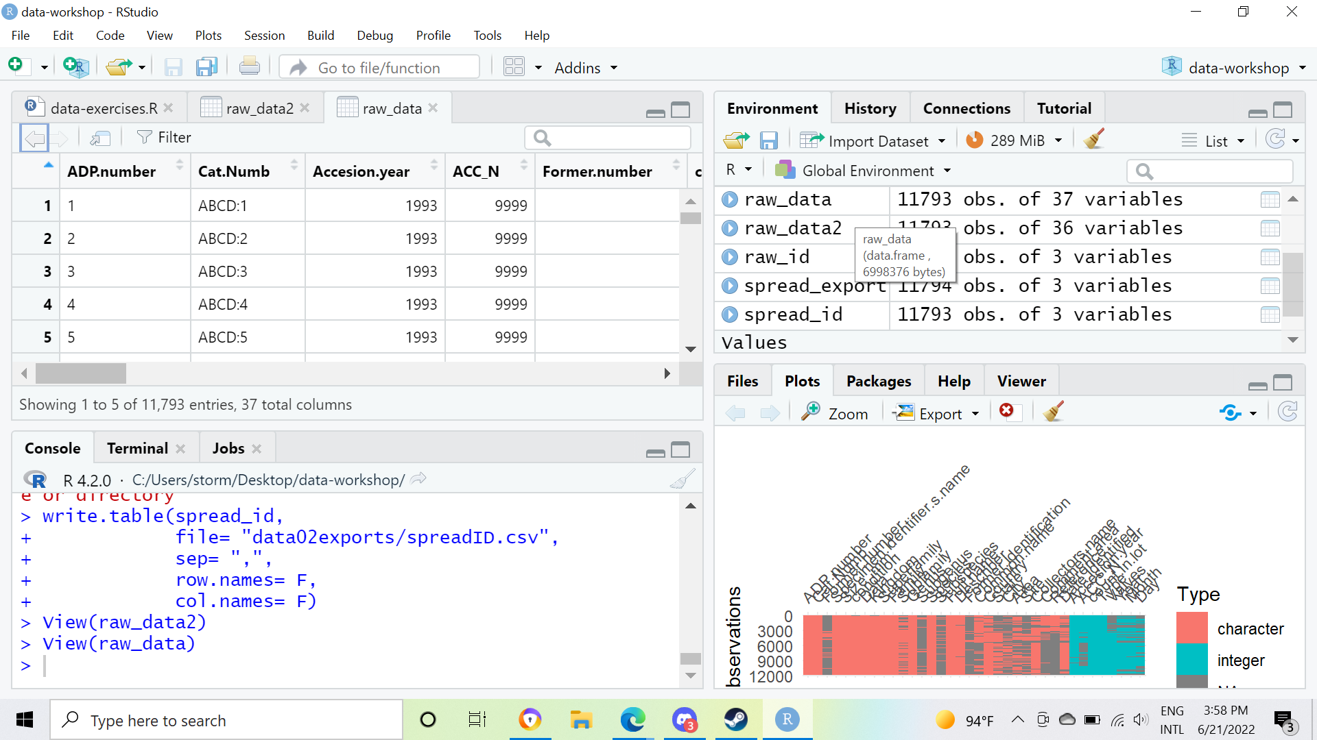
IMPORTING AND VIEWING DATA
9 | # Input/Output data-files will go here:
10 | setwd(“C:/path/to/project/data”)
11
12 | raw_data <- read.csv(“WorkshopDataset.csv”,
13 | stringsAsFactors = F)
Importing Data Into R
1) Import WorkshopDataset.csv with the function read.csv()
2) Run line 12-13 (by highlighting them & pressing Ctrl+Enter)
…The Environment pane will show information about the objects.
3) Click raw_data for a summary:

Slide 36
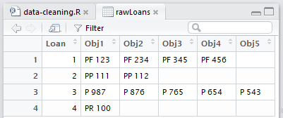
IMPORTING AND VIEWING DATA
Importing Data Into R
NOTE: In R, the data frame rawLoans…
is a copy of 01loans.csv held in your computer’s RAM.
is not a live view of the file “01loans.csv”
CSV
01loans.csv
editing rawLoans … is NOT … editing 01loans.csv

Slide 37
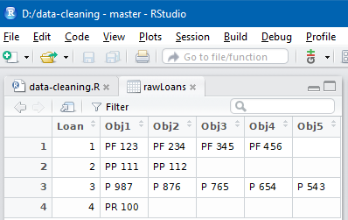
Summarizing in the dataframe preview
IMPORTING AND VIEWING DATA
Note: Sorting/filtering the data preview does not edit the actual dataframe.
Click Filter to filter by values in a single column.
Enter a value in the search bar to find records with that value in any field.
Click the sort-icons to sort by a column.

Slide 38
Reshaping Data

Slide 39
Reshaping data with gather() & spread()
RESHAPING DATA
gather() is similar to what often needs to be done with wide datasets, where multiple columns exist for the same attribute/type of value, and they need to be gathered into a single column.
spread() is similar to what often needs to be done with long datasets, where records have multiple rows to allow multiple values of the same attribute
e.g., multiple rows for one catalog record’s giant list of multi-value notes.
Notes:
TIP: To quickly change the bullet point style, simply right-click on the bullet and choose another icon.

Slide 40
RESHAPING DATA
gather()
7 | setwd(“C:/path/to/project/data”)
8
9 | rawLoans <- read.csv(“01loans.csv”)
10
11 | tidyLoans <- gather(rawLoans,
12 | key = “ObjKey”,
13 | value = “Objects”,
14 | 2:6)
Gather (or “melt”) rawLoans to make 1 column for “Loan #”, & 1 column for “Objects”.

Slide 41
RESHAPING DATA
gather()
7 | setwd(“C:/path/to/project/data”)
8
9 | rawLoans <- read.csv(“01loans.csv”)
10
11 | tidyLoans <- gather(rawLoans,
12 | key = “ObjKey”,
13 | value = “Objects”,
14 | 2:6)
Gather (or “melt”) rawLoans to make 1 column for “Loan #”, & 1 column for “Objects”.
gather() takes some arguments:
key = a new single column for the old column-names.
value = a new single column for the corresponding old column-values.
x:y = a range of selected columns (by name or index #) to gather.

Slide 42
RESHAPING DATA
gather()
7 | setwd(“C:/path/to/project/data”)
8
9 | rawLoans <- read.csv(“01loans.csv”)
10
11 | tidyLoans <- gather(rawLoans,
12 | key = “ObjKey”,
13 | value = “Objects”,
14 | 2:6)
Gather (or “melt”) rawLoans to make 1 column for “Loan #”, & 1 column for “Objects”.
Run/execute lines 11-14 by:
Highlighting the lines.
And pressing Ctrl+Enter

Slide 43
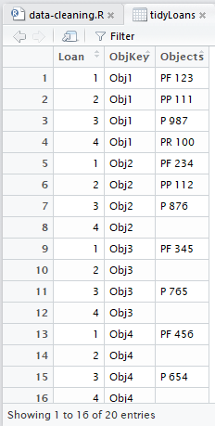
gather()
RESHAPING DATA
11 | tidyLoans <- gather(rawLoans,
12 | key = “ObjKey”,
13 | value = “Objects”,
14 | 2:6)

Slide 44
gather()
RESHAPING DATA
11 | tidyLoans <- gather(rawLoans,
12 | key = “ObjKey”,
13 | value = “Objects”,
14 | 2:6)

Slide 45
RESHAPING DATA
subsetting [ ]
11 | tidyLoans <- gather(rawLoans,
12 | key = “ObjKey”,
13 | 2:6)
14
15
16 | # Drop the ObjKey column by subsetting:
17 | tidyLoans2 <- tidyLoans [,2]
Gather (or “melt”) rawLoans to make 1 column for “Loan #”, & 1 column for “Objects”.
If we don’t want the ObjKey
column in the new dataframe:
Subset tidyLoans with lines 16-17 (tidyLoans[row,column])

Slide 46
subsetting [ ]
RESHAPING DATA
In dataframes: rows, columns, and values can be referenced by subsetting:
by numeric index
by $name
by logical condition
tidyLoans[1,3]
# returns the value in row 1, column 3
tidyLoans[1,]
# returns row 1 (all values)
tidyLoans[,-3]
# removes column 3 (all values)
tidyLoans$Loan
# returns all values in “Loan” column
tidyLoans$Loan[2]
# returns 2nd value in “Loan” column
tidyLoans[tidyLoans$Loan==2,]
# returns rows where “Loan” = “2”
Notes:
TIP: To quickly change the bullet point style, simply right-click on the bullet and choose another icon.

Slide 47
Exporting Data

Slide 48
EXPORTING DATA
Exporting Data
15 | # Drop the ObjKey column by subsetting:
16 | tidyLoans2 <- tidyLoans[,-2]
17
18 | write.csv(tidyLoans2,
19 | file = “tidy.csv”)
Export tidyLoans2 with the function write.csv().
Run/execute lines 18-19 by:
Highlighting the lines.
And pressing Ctrl+Enter

Slide 49
EXPORTING DATA
Exporting Data
15 | # Drop the ObjKey column by subsetting:
16 | tidyLoans2 <- tidyLoans[,-2]
17
18 | write.csv(tidyLoans2,
19 | file = “tidy.csv”)
Export tidyLoans2 with the function write.csv().
Run/execute lines 18-19 by:
Highlighting the lines.
And pressing Ctrl+Enter
Open up “tidy.csv” in Excel…
Text
Text

Slide 50
EXPORTING DATA
Exporting Data
15 | # Drop the ObjKey column by subsetting:
16 | tidyLoans2 <- tidyLoans[,-2]
17
18 | write.csv(tidyLoans2,
19 | file = “tidy.csv”,
19 | row.names = F)
Export tidyLoans2 with the function write.csv().
Run/execute lines 18-19 by:
Highlighting the lines.
And pressing Ctrl+Enter
Open up “tidy.csv” in Excel…
Is it mangled?
Try setting the argument “row.names” to “FALSE”:

Slide 51
Extras

Slide 52
Some other functions to try…
EXTRAS
Get summaries of columns
> summary(rawData)
Cat..Numb. University Collector UWP:122471: 2 Univ of Guatemala:760 Vargas I : 207
UWP:157339: 2 Betancur J : 203 UWP:100217: 1 Callejas R : 48
summary(rawLoans)
Notes:
TIP: To quickly change the bullet point style, simply right-click on the bullet and choose another icon.

Slide 53
Some other functions to try…
EXTRAS
Use regular expressions:
gsub(“\\s+”,
“ ”,
rawLoans$Loans)
# replace multiple spaces…
# …with a single space…
# …in this column.
Notes:
TIP: To quickly change the bullet point style, simply right-click on the bullet and choose another icon.

Slide 54
Some other functions to try…
EXTRAS
Run an R script in R-Studio:
setwd(“path/to/script-folder”)
source(“script.R”)
# output objects will show in Environment pane
Notes:
TIP: To quickly change the bullet point style, simply right-click on the bullet and choose another icon.

Slide 55
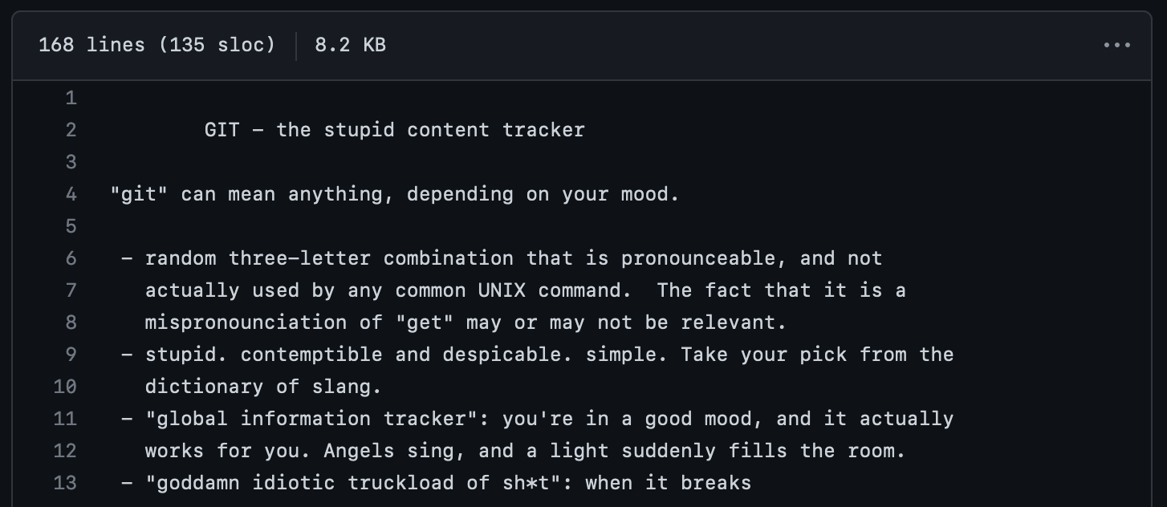
Git
EXTRAS
And now for something [slightly] different:

Slide 56
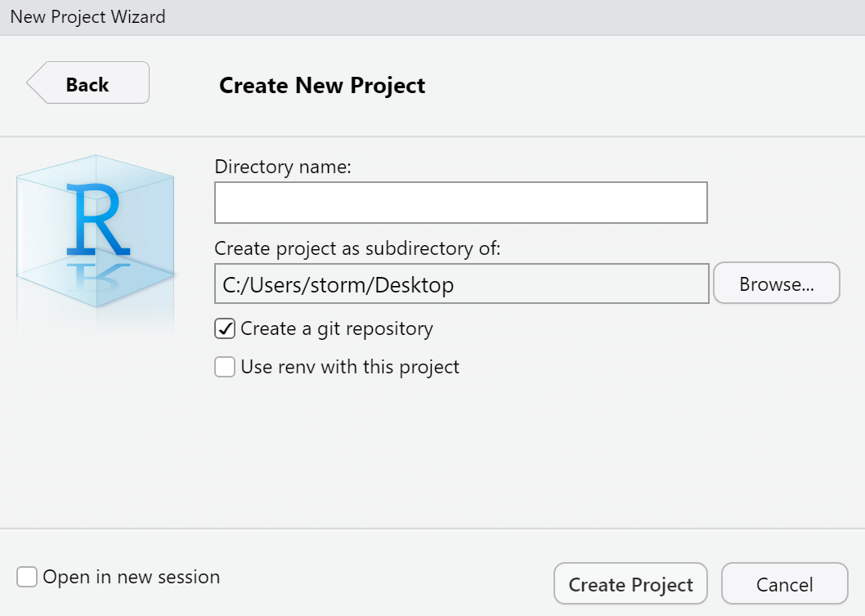
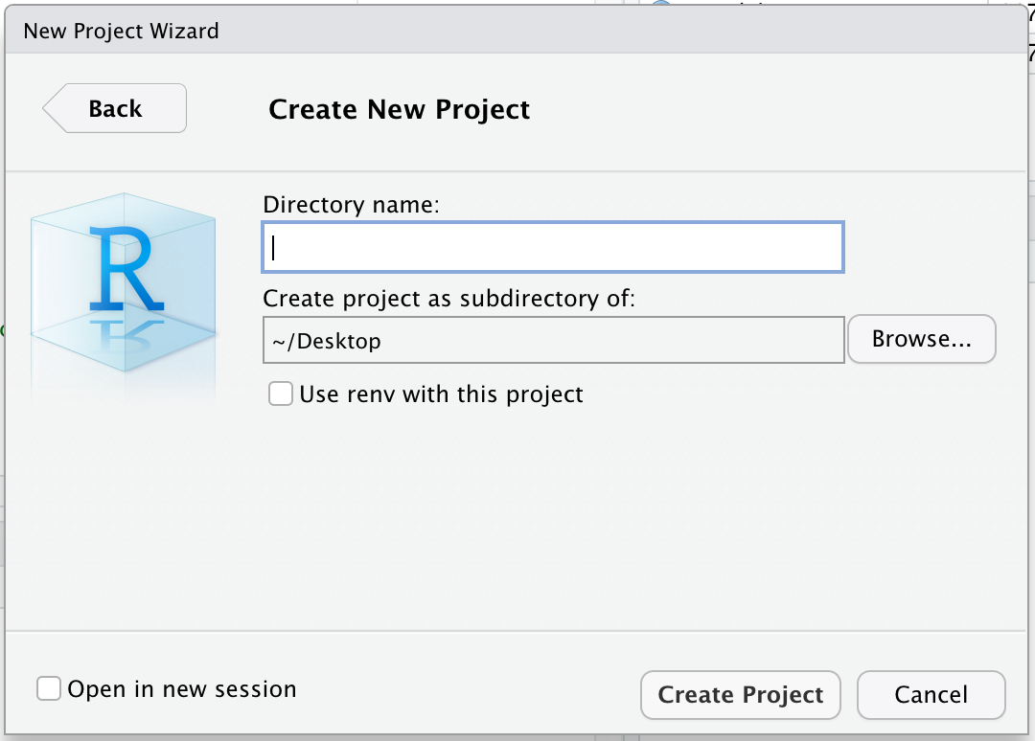
EXTRAS
Git
What is this thing called git?
Git: a way to share and track changes in code (or any digital content stored in a file or directory) control
If (when) you break your code, you can use git to retrieve (pull) a previously saved (pushed) version.
Github.com & Bitbucket.com
Online code repositories that use git.
Users can share (fork/branch) code.

Slide 57
R-Studio – More Help…
EXTRAS
Installation
1st – Install R
cran.r-project.org
2nd – Install R-Studio
rstudio.com/products/rstudio/download
For more help:
R-Studio’s built-in help
www.rOpenSci.org
RStudio.com/resources/cheatsheets
Other R Courses/Resources:
Roger Peng / Johns Hopkins
class: r-programming
blog: SimplyStatistics.org
Data Carpentry / R for Ecology
datacarpentry.org/R-ecology-lesson/
Notes:
TIP: To quickly change the bullet point style, simply right-click on the bullet and choose another icon.

Slide 58


Thank you!
Sharon Grant
sgrant@fieldmuseum.org https://www.fieldmuseum.org/
Janeen Jones
jjones@fieldmuseum.org https://www.fieldmuseum.org/
Kate Webbink
kwebbink@fieldmusuem.org https://www.fieldmuseum.org/
Abigail McArthur-Self
amcarthur-self@fieldmusuem.org https://www.fieldmuseum.org/
Alexis Ramirez
aramirez@fieldmusuem.org https://www.fieldmuseum.org/

