Slide 1
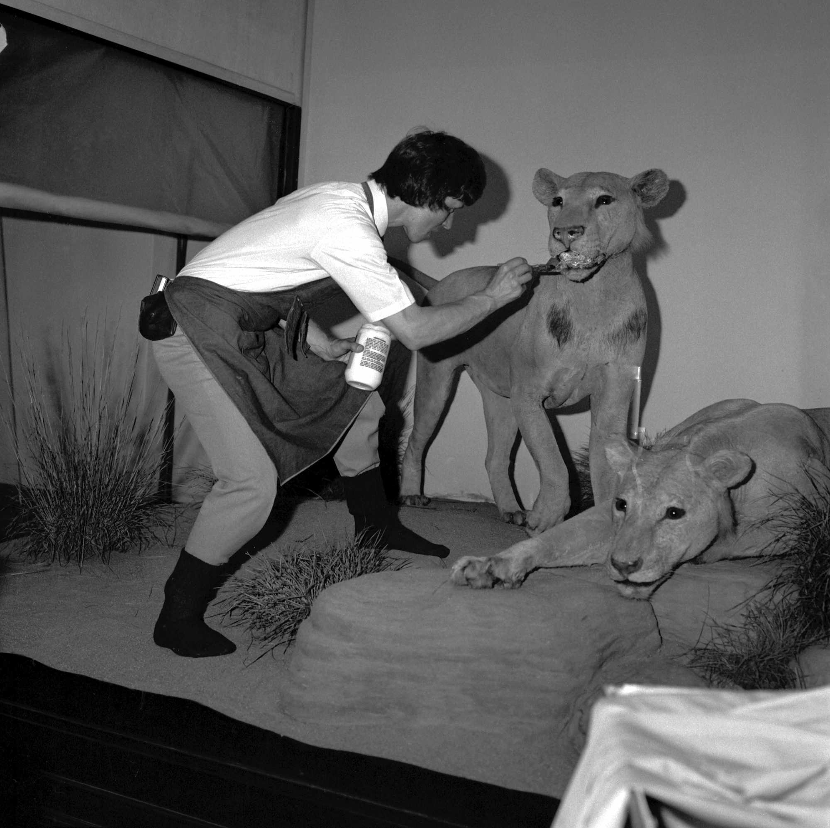
Access for Data Cleaning
Reference: Courtesy of: R. Testa. (c) Field Museum of Natural History. https://mm.fieldmuseum.org/f5332017-e914-4619-838b-a6896895b7e7 (accessed on 16 June 2022)
Notes:
TIP: Click on image and choose “Replace image” in the menu. To move around the visible part of the image within the placeholder, click on “Crop” and move the image up or down.

Slide 2
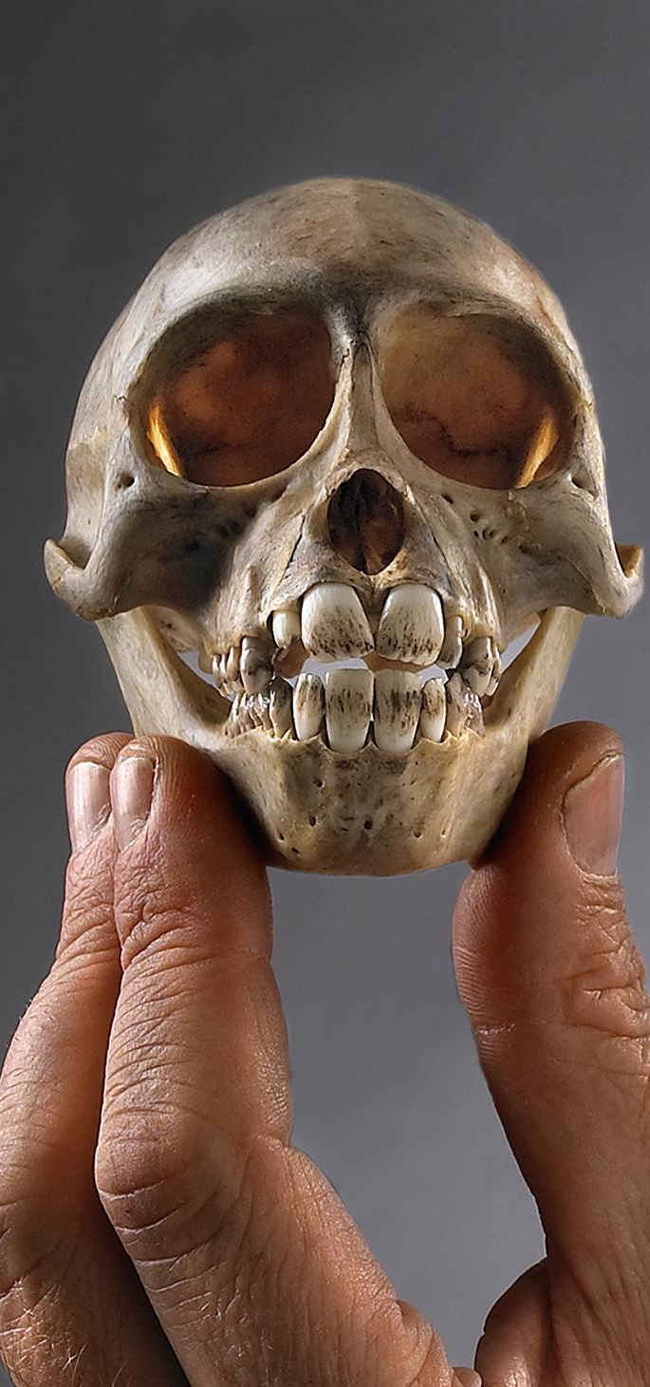

Agenda
Getting Access
01
Getting Your Data
02
Views
03
Filters
Queries
Functions
Relating Your Data
04
Reference: (c) Field Museum of Natural History - CC BY-NC 4.0 https://mm.fieldmuseum.org/3994ee8a-634d-4e95-bbd7-b008d415fb81 (accessed on 6-15-2022)
Notes:
TIP: Click on image and choose “Replace image” in the menu. To move around the visible part of the image within the placeholder, click on “Crop” and move the image up or down.

Slide 3
Getting Access

Slide 4
Access Essentials
GETTING ACCESS
What is Access?
Access is the Microsoft Office database platform
Why use Access?
Available to most
User interface doesn’t require knowledge of computer languages (although SQL helps)
When should Access be used?
To visualize large quantities of data for cleaning
To normalize and clean data
To produce an end product for import into the final database platform
Need help?
Access has a built in help feature and online help: https://support.office. com/en-US/Access
There are plenty of user group online sites that can provide help as well. Google your question directly with the word “Access” and the version to get a list of help blogs.
Notes:
TIP: To quickly change the bullet point style, simply right-click on the bullet and choose another icon.

Slide 5
GETTING ACCESS
Getting Access
Access is available with the Microsoft Office suite
Explanation of the differences between versions: https://www.stl-training.co.uk/versions/access-difference.php
Security settings for the program are available:
By clicking the Office button (2007)
By clicking the Options button on the File menu (2010)
The Microsoft Trust Center allows you to control the privacy settings and determine where Access saves data.

Slide 6
GETTING ACCESS
What Can/Can’t Access Do?
 | Access
Formulas
Charts & Graphs
Auto-formats fields
Allow creation of lookup lists
Allow character sets besides Latin1 (e.g., UTF-8)
Track changes after closing
Maintain integrity between rows and columns
Enforce referential integrity between different sheets
Directly changes your original data
Assists in formula writing | Limited

Slide 7
GETTING ACCESS
What is Access?
Access is a database program (or platform).
Access:
Uses Tables
Allows permanent and temporary relationships between tables
Enforces referential integrity in relational data
Builds and saves queries of different types in a user interface or SQL
And many more things (report development, forms, macros, links, etc.)
Access Help: https://support.office.com/en-US/Access

Slide 8
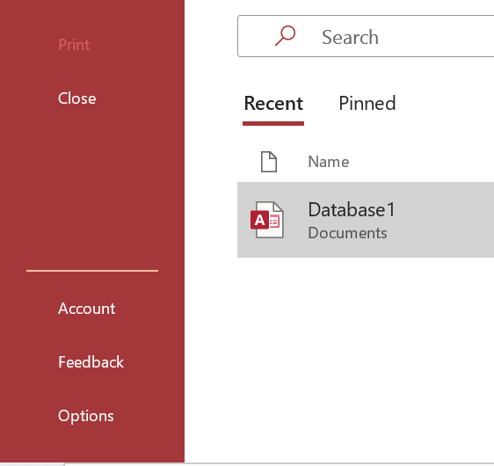
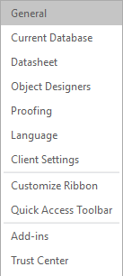
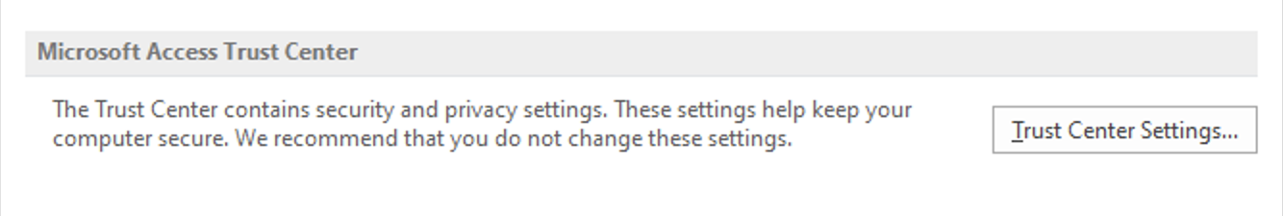
GETTING ACCESS
Security
Getting to the Trust Center

Slide 9
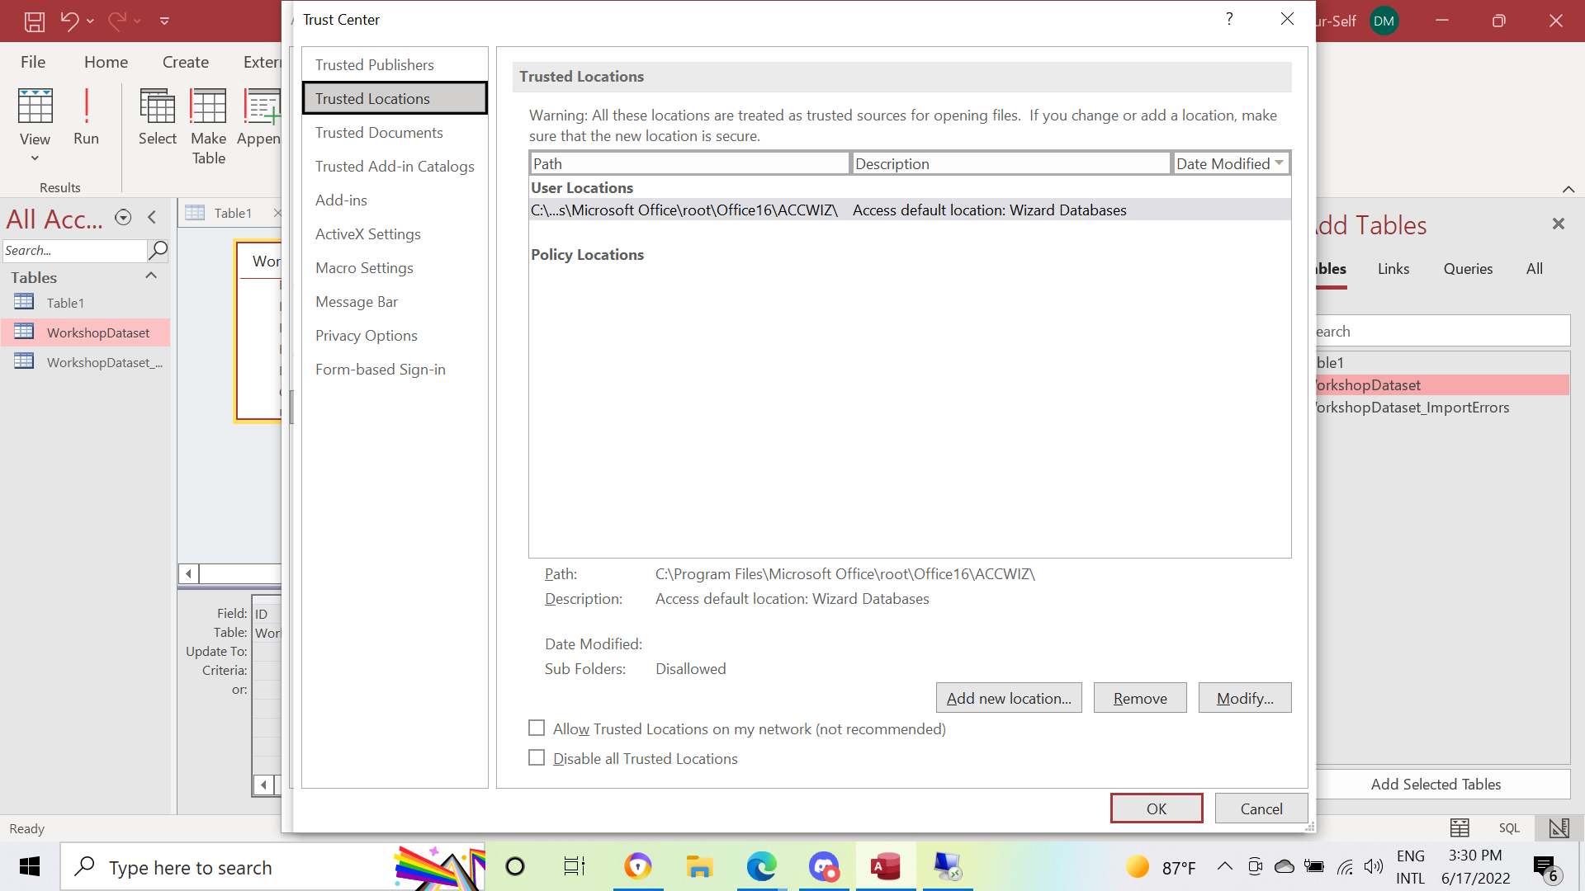
GETTING ACCESS
Security
Setting a Trusted Location

Slide 10
Getting Your Data

Slide 11
Getting Your Data
GETTING YOUR DATA
Import and Link
Know where your data is
Decide whether to import or link
Import (copies the data into Access)
Link (creates a link to the original data): Any changes made in Access are reflected in the data file. If the file is moved from the original path the link will break. (Linking data is found on the SharePoint list.)

Slide 12
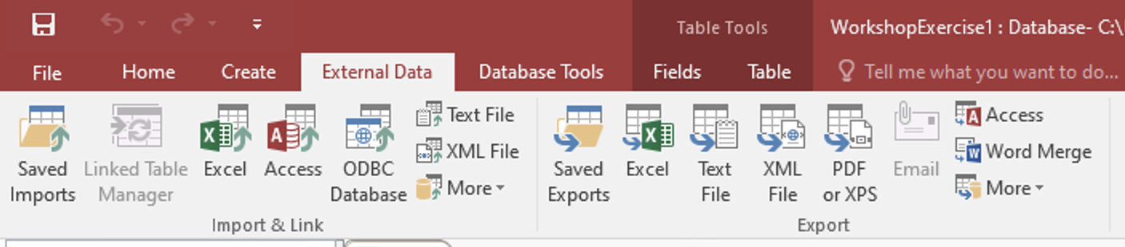
Getting Your Data
GETTING YOUR DATA
Importing Data
In the External Data tab of the ribbon, select the option for the type of data being imported. For CSV files select Text File.
Follow the steps of the import wizard. The wizard will prompt the user with the option to save the import. Save the import only if you plan on re-importing the file in exactly the same way.

Slide 13
Views

Slide 14
Views
Filters
01
Queries
02
Functions
03

Slide 15
Views vs. Actions
VIEWS
Views
A data view is a view or subset of data in a data table or virtual table.
You can create views that are filters/facets/preview pane/subsetting for content and/or fields.
Actions
Actions are functions performed on a dataset that changes either the values themselves or the underlying structure.
Notes:
TIP: To quickly change the bullet point style, simply right-click on the bullet and choose another icon.

Slide 16
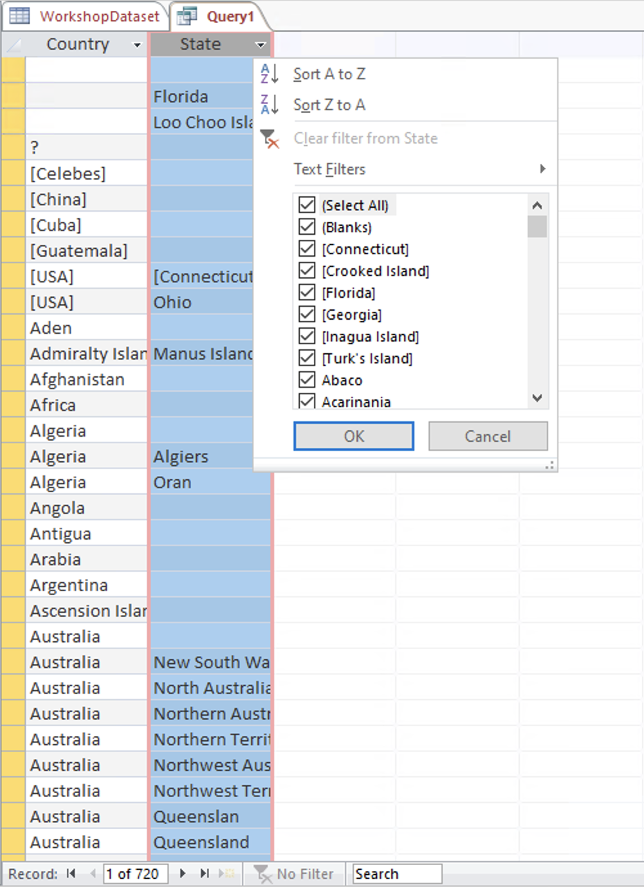
VIEWS
Views
Filters and Queries
Access allows users to view data in various ways.
The most common ways for the purposes of data cleaning are:
Filters
Queries
The query types used to view data are:
Summary queries
Select queries
Duplicate queries

Slide 17

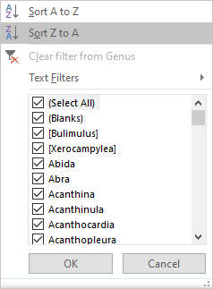
VIEWS FILTERS
Filters
Filters are available on every attribute in both tables and queries. To access them, click the drop-down icon to the right of the field name.
Notes:
TIP: To quickly change the bullet point style, simply right-click on the bullet and choose another icon.

Slide 18
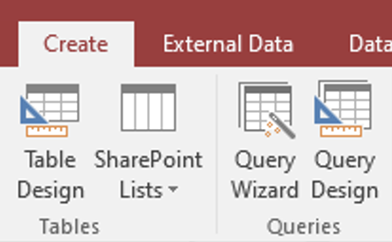
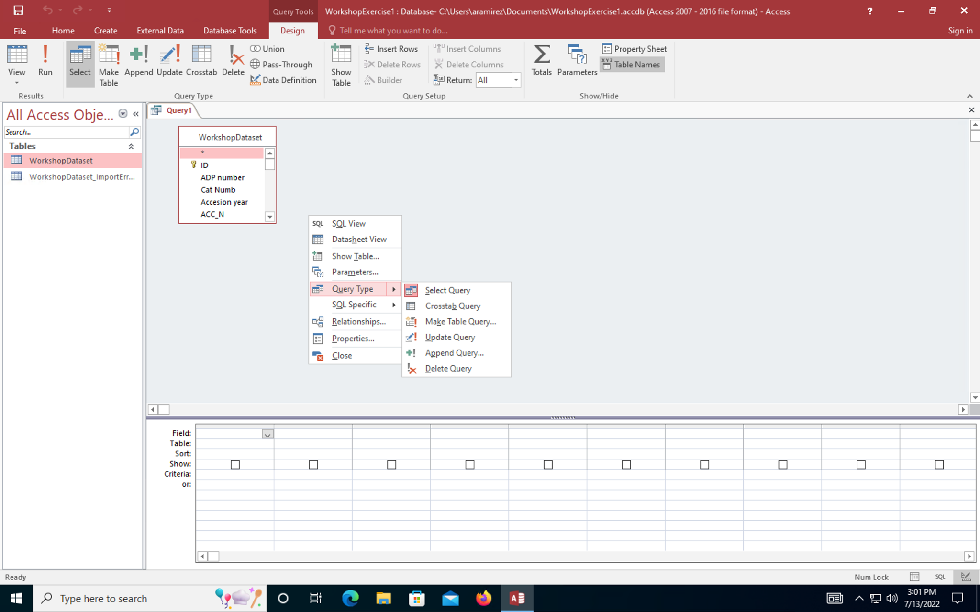
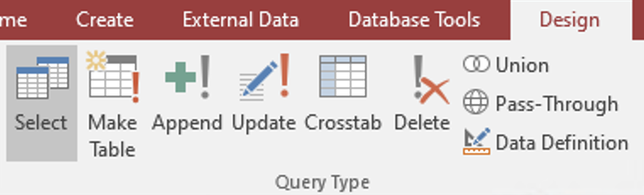
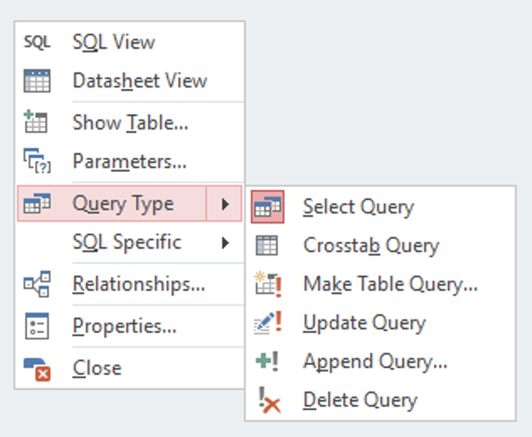
VIEWS QUERIES
Creating Queries
On the Create tab, choose either Query Wizard (pre-canned queries, for example “Find duplicates”) or Query Design for almost every other kind of query.
Design
Wizard
1
Click within this gray area to open the menu at left.
The default query type is Select. Create a query and change the type by selecting it from the menu, or …
2
… by right-clicking anywhere inside the blank gray area within the new Query’s tab and choosing it from the menu.
Notes:
TIP: To quickly change the bullet point style, simply right-click on the bullet and choose another icon.

Slide 19
VIEWS QUERIES
Types of
Queries
Select: Just views data
Make Table: Creates a new table from the selected data
Update: Changes data according to the criteria designated by the user
Append: Adds new rows to an existing table
Delete: Deletes data from a table based on the criteria designated by the user
Crosstab: Summarizes data and creates a new view; useful for data users plan to chart
To choose a query type right-click on Query Design and choose the Query Type option.

Slide 20
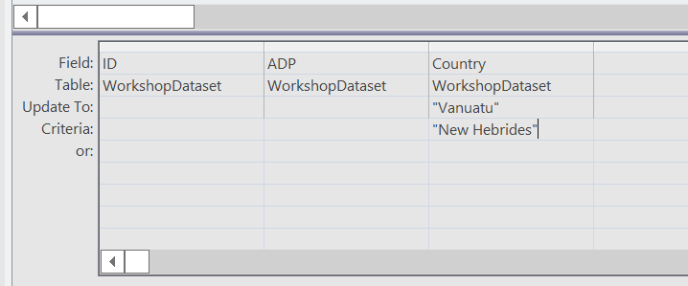
VIEWS QUERIES
Update Queries
Update queries change data in fields. Access allows users to define the change as simple text, another field, or a combination of the two.
update To: Defines the value that will replace original data.
Criteria: Records must meet this criteria before the change happens.
Records must meet this criteria before change happens.
update To: Defines the value that will replace original data.
Notes:
TIP: To quickly change the bullet point style, simply right-click on the bullet and choose another icon.

Slide 21
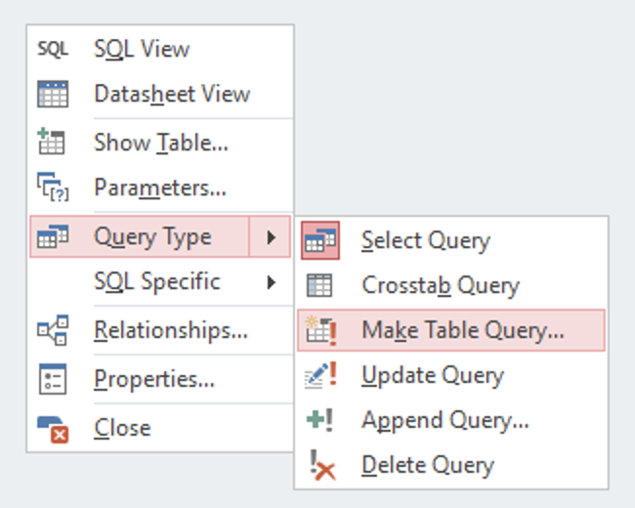
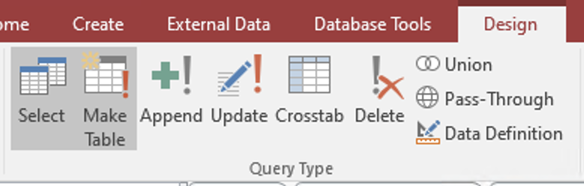
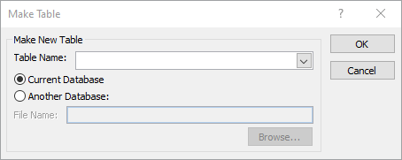
VIEWS QUERIES
Make Table Queries
Using tables to aid large data corrections.
To create a table query, click on Query Design and select Make Table Query… from the Query Type menu; or …
… create a query and change the type by clicking on Make Table.
Use the pop-up dialog to finish creating the table.

Slide 22
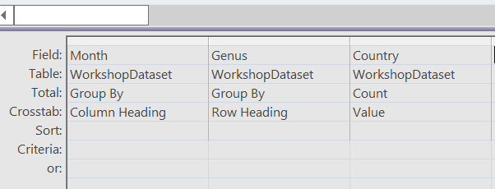
VIEWS QUERIES
Crosstab Queries
Summarizes data and creates a new view; useful for data you plan to chart.
To create a crosstab summary: select a field to serve as column headings and field to serve as row headings. Select a “value” field, the data which will be summarized in the new table.
For more information, see: https://www.techrepublic.com/article/how-do-i-create-a-crosstab-query-in-microsoft-access/
Notes:
TIP: To quickly change the bullet point style, simply right-click on the bullet and choose another icon.

Slide 23
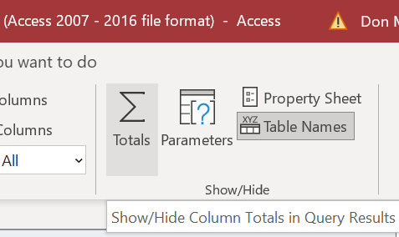
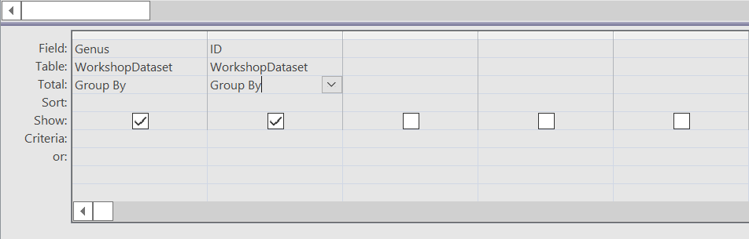
VIEWS QUERIES
Summary Queries
Although Access does not have a setting for “summary queries” as it does some other queries, the Totals Σ button can be used to add aggregating functions to a query.
Clicking the Totals icon adds a Total: option in the Query Design panel that can be used to select functions.
For more information, see: https://www.techrepublic.com/article/how-do-i-create-a-crosstab-query-in-microsoft-access/
Notes:
TIP: To quickly change the bullet point style, simply right-click on the bullet and choose another icon.

Slide 24
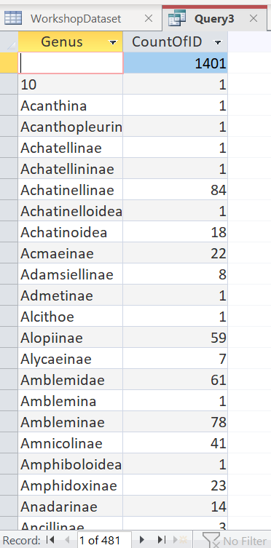
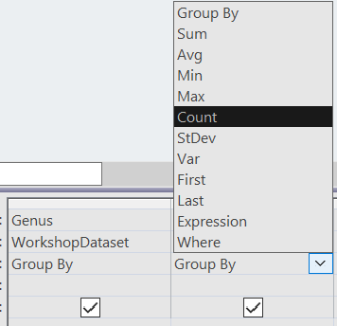
VIEWS QUERIES
Summary Queries
Although Access does not have a setting for “summary queries” as it does some other queries, the Totals Σ button can be used to add aggregating functions to a query.
Using Group By and Count in this example yields a table that displays the number of records with each Genus
Notes:
TIP: To quickly change the bullet point style, simply right-click on the bullet and choose another icon.

Slide 25
VIEWS
FUNCTIONS
Using formulas to concatenate and rename fields
Access reserved words and characters: words or characters that have a specific meaning to the program. Learn more: Learn about Access reserved words and symbols (microsoft.com)
Split on character:
Right: “Returns a Variant (String) containing a specified number of characters from the right side of a string”
Left: “Returns a Variant (String) containing a specified number of characters from the left side of a string.”
InStr: “Returns a Variant (Long) specifying the position of the first occurrence of one string within another.”
Len: “Returns a Long containing the number of characters in a string or the number of bytes required to store a variable.”
Concatenate: Combines text values
Use formulas in Select and Make Table Query… to complete actions.

Slide 26
VIEWS
FUNCTIONS
Using formulas to concatenate and rename fields
ALTER
BOOLEAN
COLUMN
DATABASE
EXISTS
FALSE
GROUP BY
etc.
Example reserved words and characters:

Slide 27
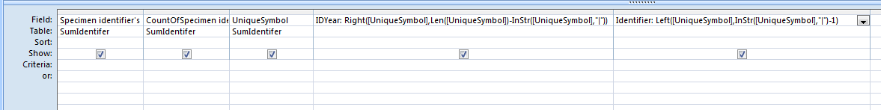
VIEWS
FUNCTIONS
Using formulas to concatenate and rename fields
Access will copy into a new field called Genus (Genus: the Former identification) values starting from the left (Left) and ending at the point in the string (InStr(...), "|") where there is a pipe,
and then remove the pipe (-1).
In the second column Access will copy the values from Former
Identification into a new field called species (species:) starting from the right (Right), starting at the end of the string (Len), starting after the first pipe (-Instr) and ("|").
Use formulas in Select and Make Table Query… to complete actions.

Slide 28
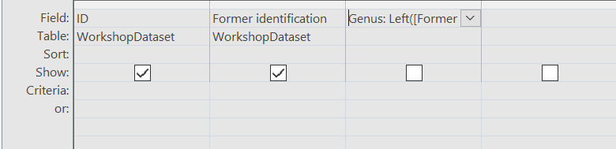

VIEWS
FUNCTIONS
Using formulas to concatenate and rename fields
Split:
Use formulas in Select and Make Table Query… to complete actions.
Concatenate:

Slide 29
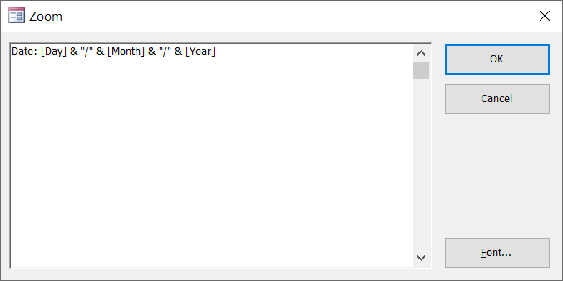
Using formulas to concatenate and rename fields
Concatenate:
Use the keyboard shortcut Shift+F2 to open a zoom pop-up window where the formulas are fully visible.

Slide 30
Relating Your Data

Slide 31
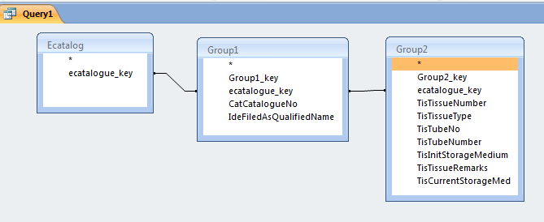
RELATING YOUR DATA
Relating Your Data
Use joins to create links between queries
Create joins between tables in queries by dragging the join fields between tables.
The fields must be of the same type.
The default join is only where tables are equal.

Slide 32
RELATING YOUR DATA
Types of
Joins
Equal: Only include rows where the joined fields from both tables are equal
Left: Include all records from “First Table” and only those records from the “Second Table” where the joined fields are equal
Right: Include all records from “Second table” and only those records from “First Table” where the joined fields are equal
Right click on the join line to redefine the type of join.

Slide 33
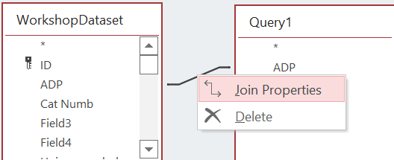
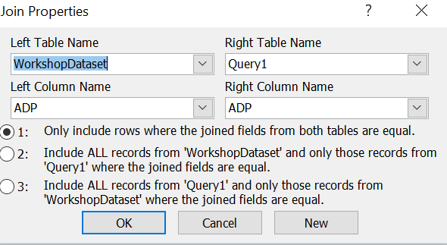
RELATING YOUR DATA
Relating Your Data
Use joins to create links between queries
To change the type of join between tables and queries, right click on the join line.
Select the desired join type from the join Properties menu.

Slide 34
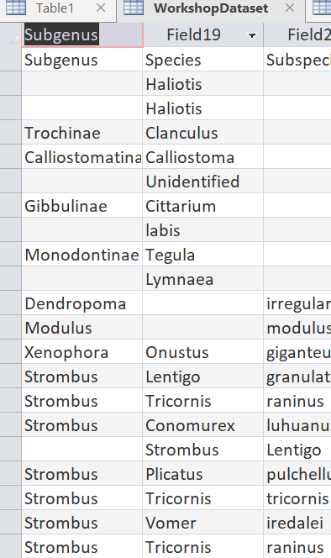

RELATING YOUR DATA
Renaming Fields
Direct Design rename
Double-click the field name to enter new text.
Using a query
LocDistrictCountyShire_tab: [WorkshopDataset.City]

Slide 35
Getting Your Data
GETTING YOUR DATA
Exporting Data
Know what table/query you are exporting, where it is going and in what format you are exporting it too.
Right click on the Access object and choose Export.
Choose a format to export to (txt if you’re exporting to csv).
Follow the instructions of the wizard. If you’re exporting to csv, be sure to change the extension either at the beginning or end of the export window.

Slide 36
Questions?
Ask now; we might have answers!

Slide 37
Presenter name
SECTION TITLE
Title or credentials
Insert Presenter Image
Bio
Contact Information

Slide 38

Sharon Grant
sgrant@fieldmuseum.org https://www.fieldmuseum.org/
Janeen Jones
jjones@fieldmuseum.org https://www.fieldmuseum.org/
Thank you!
Kate Webbink
kwebbink@fieldmusuem.org https://www.fieldmuseum.org/
Abigail McArthur-Self
amcarthur-self@fieldmusuem.org https://www.fieldmuseum.org/
Alexis Ramirez
aramirez@fieldmusuem.org https://www.fieldmuseum.org/
Notes:
This project was made possible in part by the Institute of Museum and Library Services [include IMLS grant number when space allows]."
You may choose to include this acknowledgment in Spanish:
“Este proyecto ha sido posible en parte por el Instituto de Servicios de Museos y Bibliotecas, [include IMLS grant number when space allows].

