Slide 1

OpenRefine for Data Cleaning
What is OpenRefine? A data cleaning tool.
Why use OpenRefine? Tracks changes and is easily reversible.
Reference: Naidoo, H (Hush Naidoo Jade Photography), October 2020, Unsplash License, https://unsplash.com/photos/SutAduhzdRQ
Notes:
TIP: Click on image and choose “Replace image” in the menu. To move around the visible part of the image within the placeholder, click on “Crop” and move the image up or down.

Slide 2


Agenda
What is OpenRefine?
01
Opening OpenRefine
02
Getting Data into OpenRefine
03
Manipulating/Mangling Data in OpenRefine
04
Getting Stuff out of OpenRefine
05
Reference: (c) Field Museum of Natural History - CC BY-NC 4.0 https://mm.fieldmuseum.org/3994ee8a-634d-4e95-bbd7-b008d415fb81 (accessed on 6-15-2022)
Notes:
TIP: Click on image and choose “Replace image” in the menu. To move around the visible part of the image within the placeholder, click on “Crop” and move the image up or down.

Slide 3
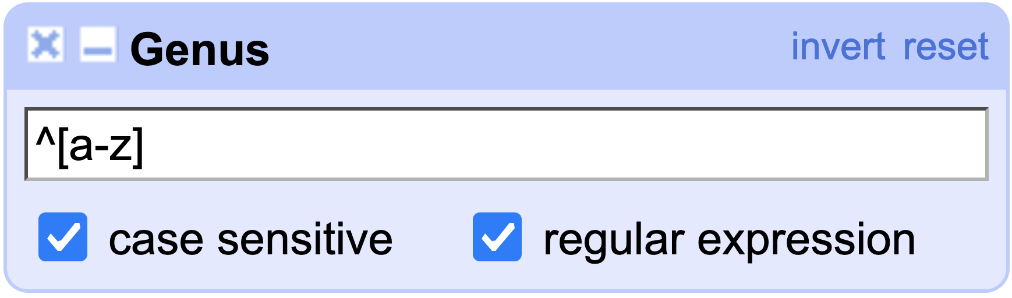
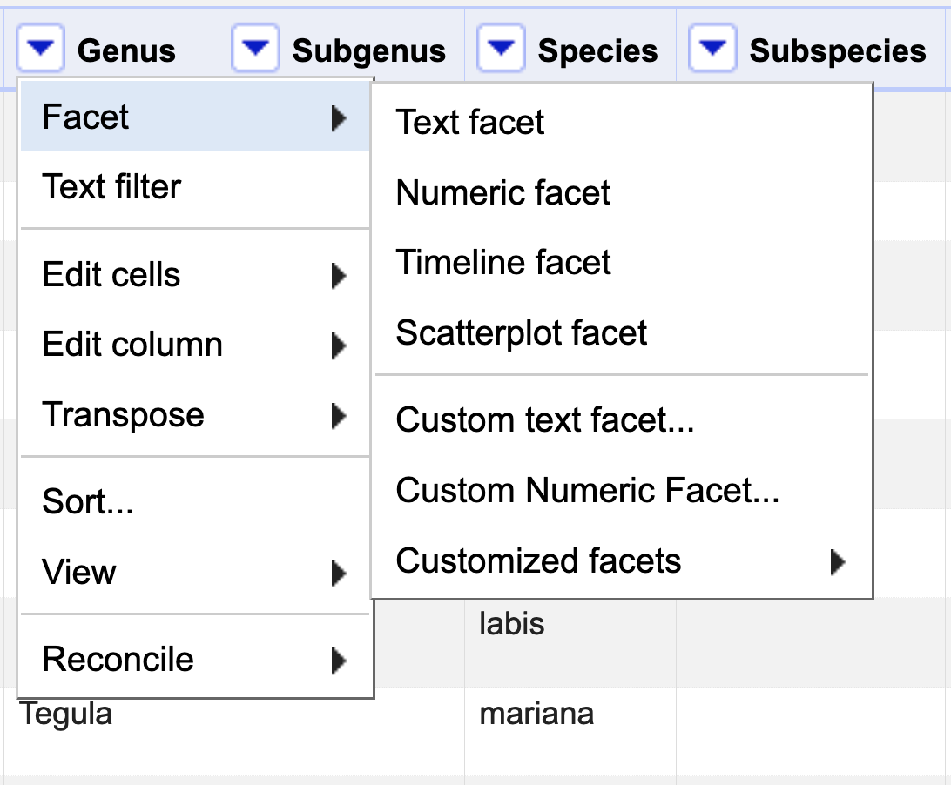
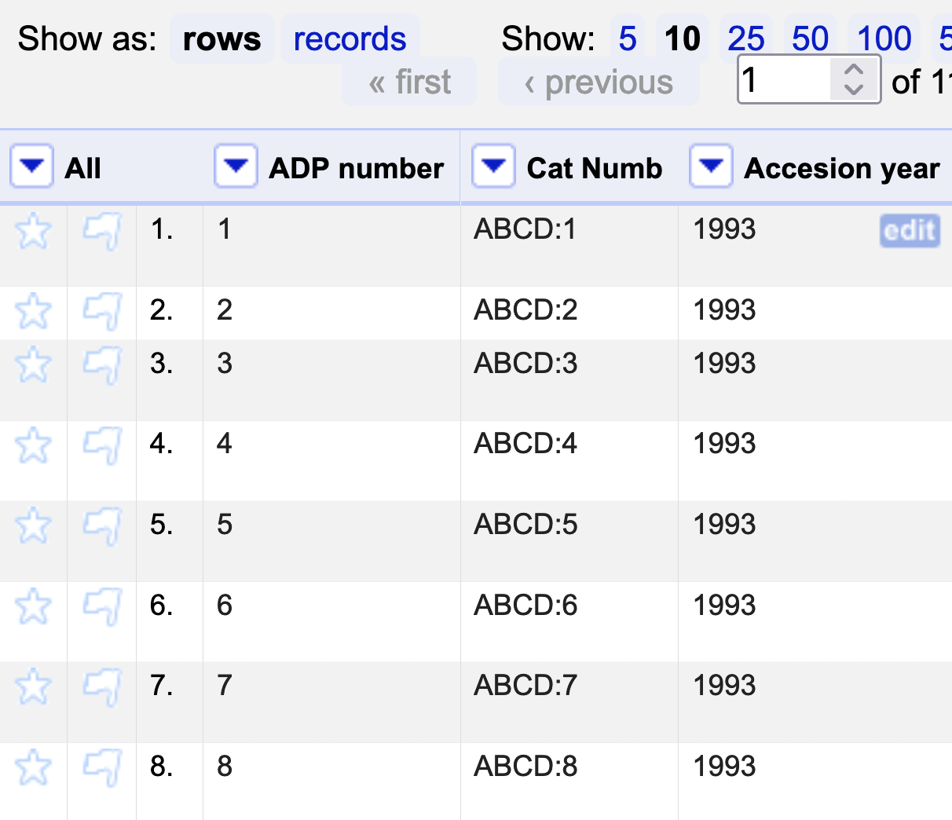
Conventions
INTRODUCTION
Formulas (copy and paste)
Text in blue
Example: …then paste the expression
^[a-z]
Commands in Refine
Text in magenta
Example: …and follow the route to Text facet
Column names
Text in green
Example: …go to column Cat. Numb
Column menu
Notes:
TIP: To quickly change the bullet point style, simply right-click on the bullet and choose another icon.

Slide 4

What is OpenRefine?
The tool formerly known as Google Refine
Free, open source project
Stand-alone desktop application
Uses General Refine Expression Language (GREL)
Reference: openrefine.org, Public domain, via Wikimedia Commons

Slide 5
WHAT IS OPENREFINE?
What Can/Can’t OpenRefine Do?
 | OpenRefine
Formulas
Charts & Graphs
Auto-formats fields
Allow creation of lookup lists
Allow character sets besides Latin1 (e.g., UTF-8)
Track changes after closing
Maintain integrity between rows and columns
Enforce referential integrity between different sheets
Creates a copy of original data
Allow you to share steps

Slide 6
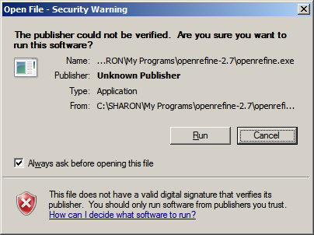
SECTION TITLE
Opening OpenRefine
Installation
Download OpenRefine: http://openrefine.org/download. html
OpenRefine requires Java to run.
Get Java: https://java.com/en/ download/
Extract all files from the .zip folder and run openrefine.exe
For detailed instructions see: https://docs.openrefine.org/ manual/installing

Slide 7
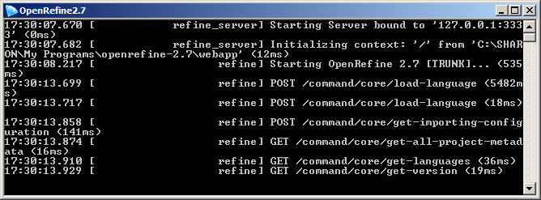
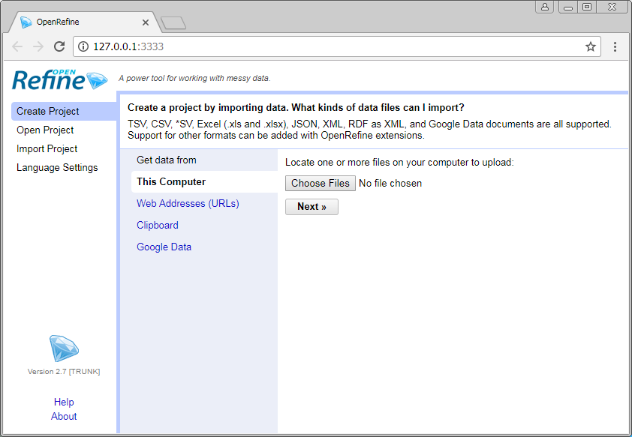
Opening OpenRefine
OPENING OPENREFINE
Once the program is installed, click openrefine.exe again to launch it.
When you open the program, a black screen with code will open and launch OpenRefine in your web browser. Leave the application running to use OpenRefine.

Slide 8
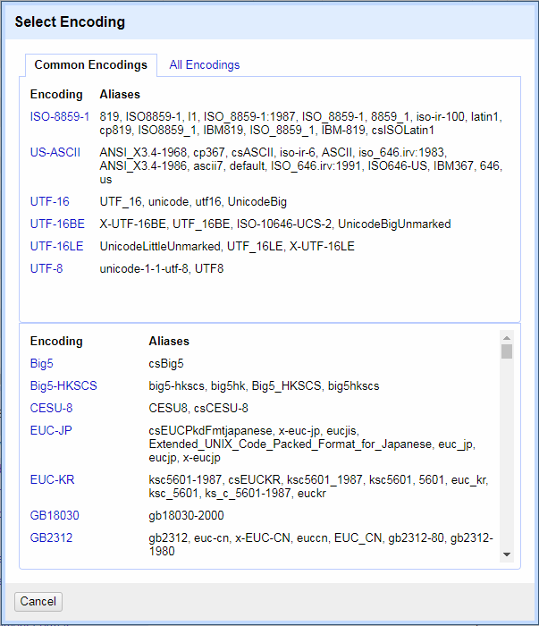
Getting Data into OpenRefine
There are two steps:
Loading a file
Creating a project

Slide 9

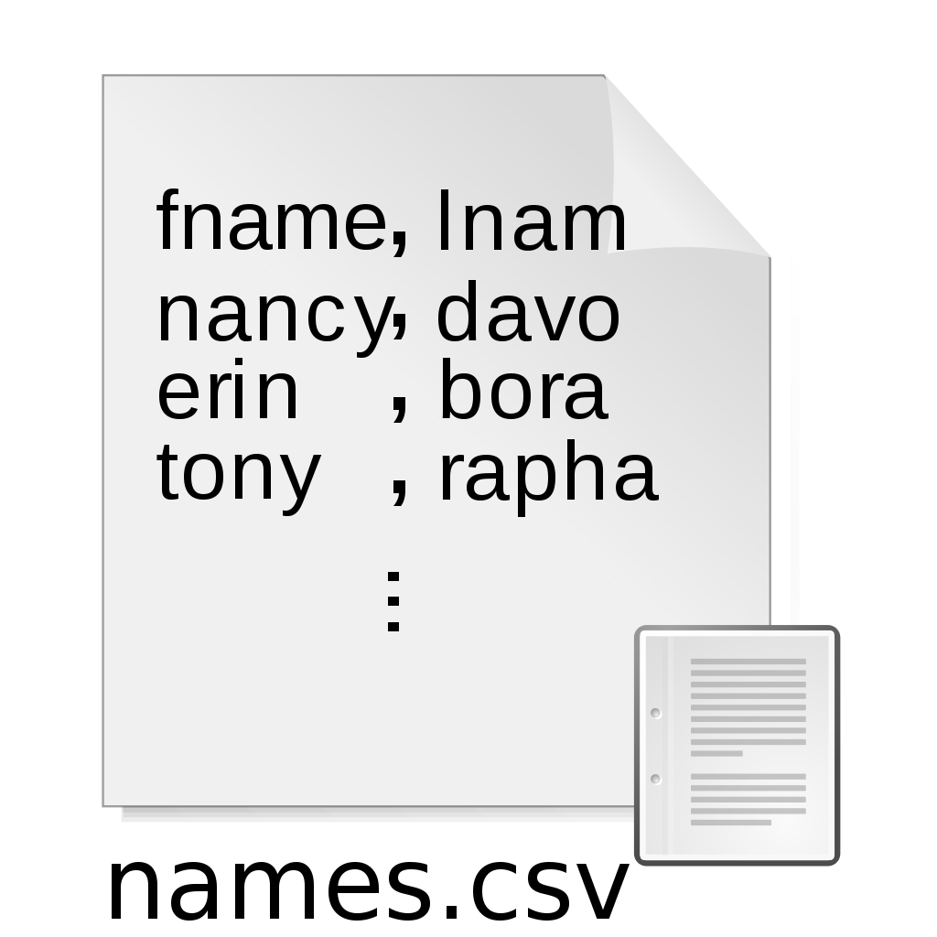


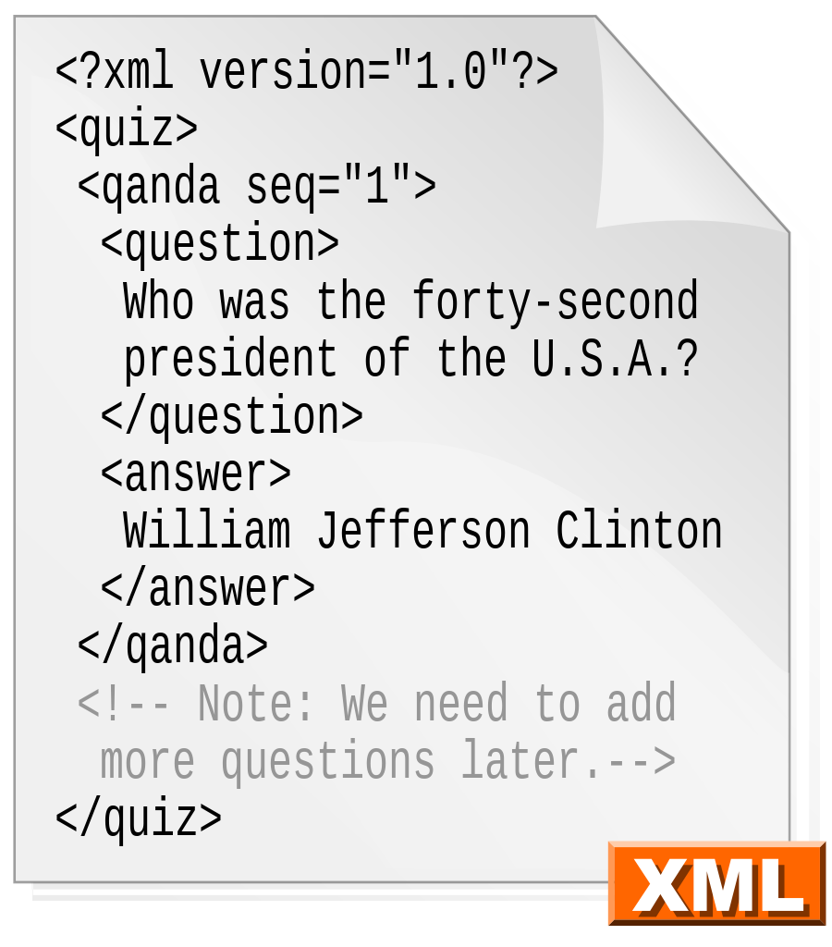
Getting Data into OpenRefine
Load File
OpenRefine can load data in a number of formats:
Text (tsv, csv)
Google Sheets
Excel
JSON
XML
RDF
Reference:
User:Dreftymac, CC BY-SA 2.5 <https://creativecommons.org/licenses/by-sa/2.5>, via Wikimedia Commons
Google, Public domain, via Wikimedia Commons
Douglas Crockford, Public domain, via Wikimedia Commons
en:User:Dreftymac, CC BY-SA 2.5 <https://creativecommons.org/licenses/by-sa/2.5>, via Wikimedia Commons
Microsoft Corporation, Public domain, via Wikimedia Commons

Slide 10
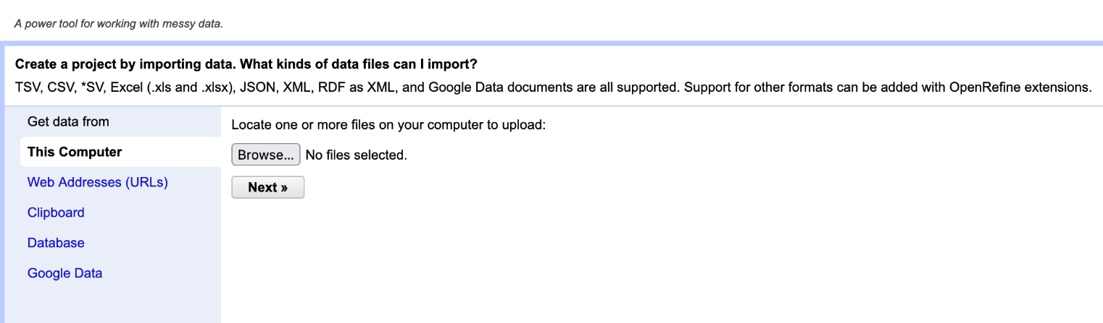
Getting Data into OpenRefine
GETTING DATA INTO OPENREFINE
Load File
Select the appropriate method for importing data from the Get data from menu.
For local data files, select This Computer.
Click the Browse… button and open the data file using the operating system’s file manager.
Click Next.

Slide 11
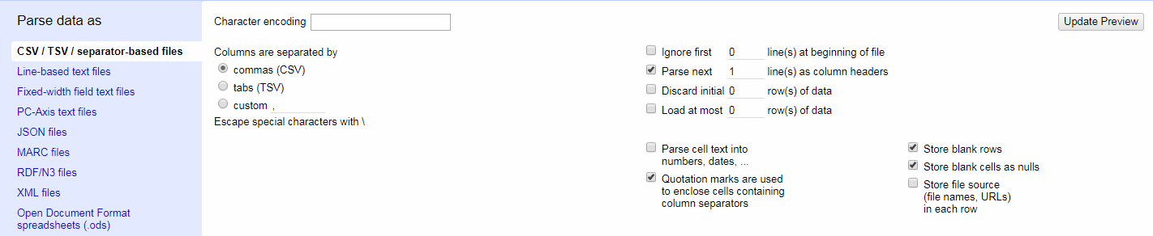
Load File
GETTING DATA INTO OPENREFINE
The following dialog will open in the bottom portion of the browser window:
Make sure the appropriate boxes are checked based on the data file’s format.

Slide 12
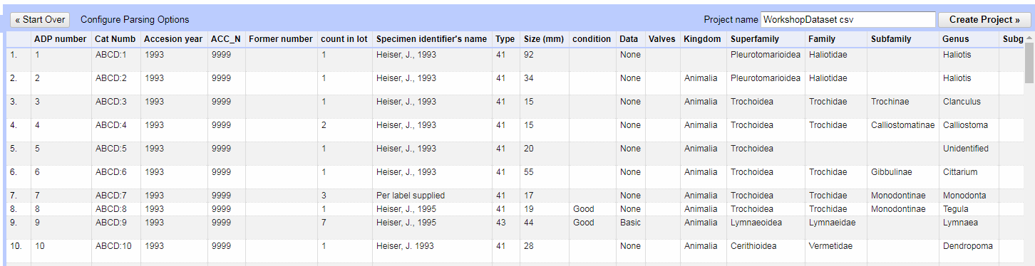
Load File
GETTING DATA INTO OPENREFINE
The top portion of the browser window will contain a preview of the imported data.
Rename the project in the upper righthand corner.

Slide 13

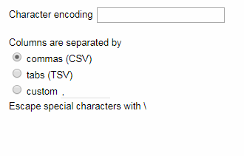
Load File
GETTING DATA INTO OPENREFINE
Make sure the right character encoding is selected.

Slide 14
Getting Data into OpenRefine
Create Project
A project is a combination of:
The imported data
Code that transforms the data

Slide 15
Create Project
GETTING DATA INTO OPENREFINE
The top portion of the browser window will contain a preview of the imported data.
Click Create Project.

Slide 16
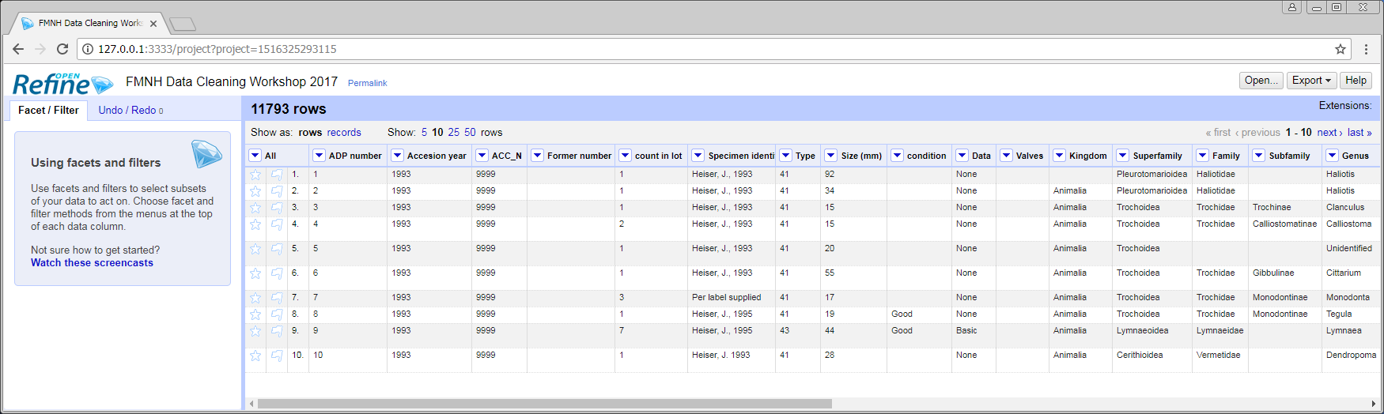
Create Project
GETTING DATA INTO OPENREFINE
The project will be displayed in a window like the one shown below:
The top bar displays the total number of rows of data.
The program displays ten rows per page by default, but this setting is adjustable.

Slide 17
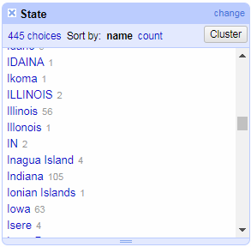
MANIPULATING/MANGLING DATA
Manipulating/
Mangling Data
Faceting
Faceting is a feature that allows users to:
Find anomalies
Group records

Slide 18
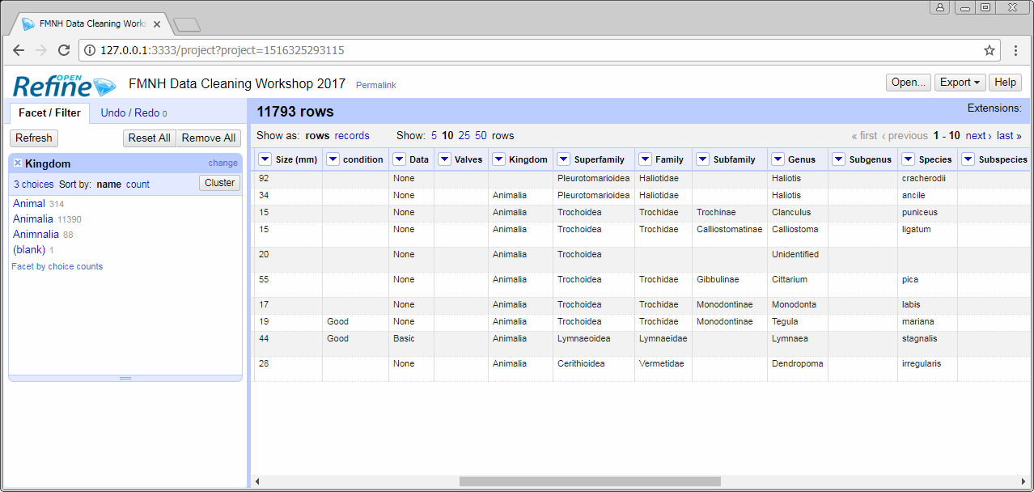
Faceting
MANIPULATING/MANGLING DATA
Select a column to start working with.

Slide 19
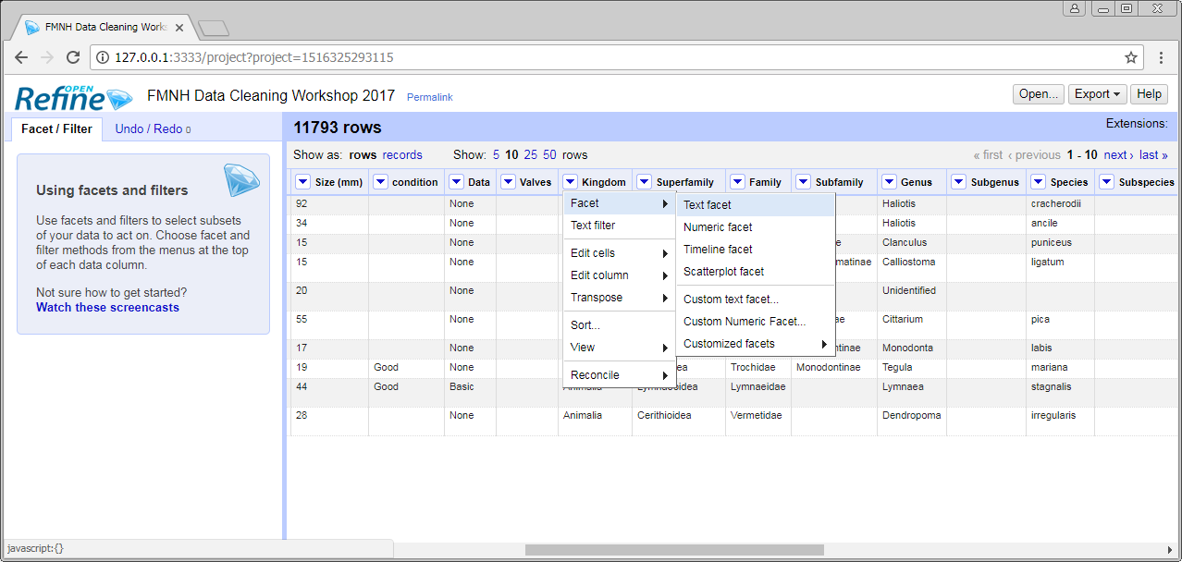
Faceting
MANIPULATING/MANGLING DATA
Click the drop-down icon in the corner of the column header, and select Text facet from the Facet options.

Slide 20
Faceting
MANIPULATING/MANGLING DATA
A new panel with the different data values from the column with open in the left-hand sidebar. Users can sort by (name or count) or edit these values.

Slide 21



MANIPULATING/MANGLING DATA
Manipulating/
Mangling Data
Filtering
Filtering is a feature that allows users to:
Search for values
Group records

Slide 22
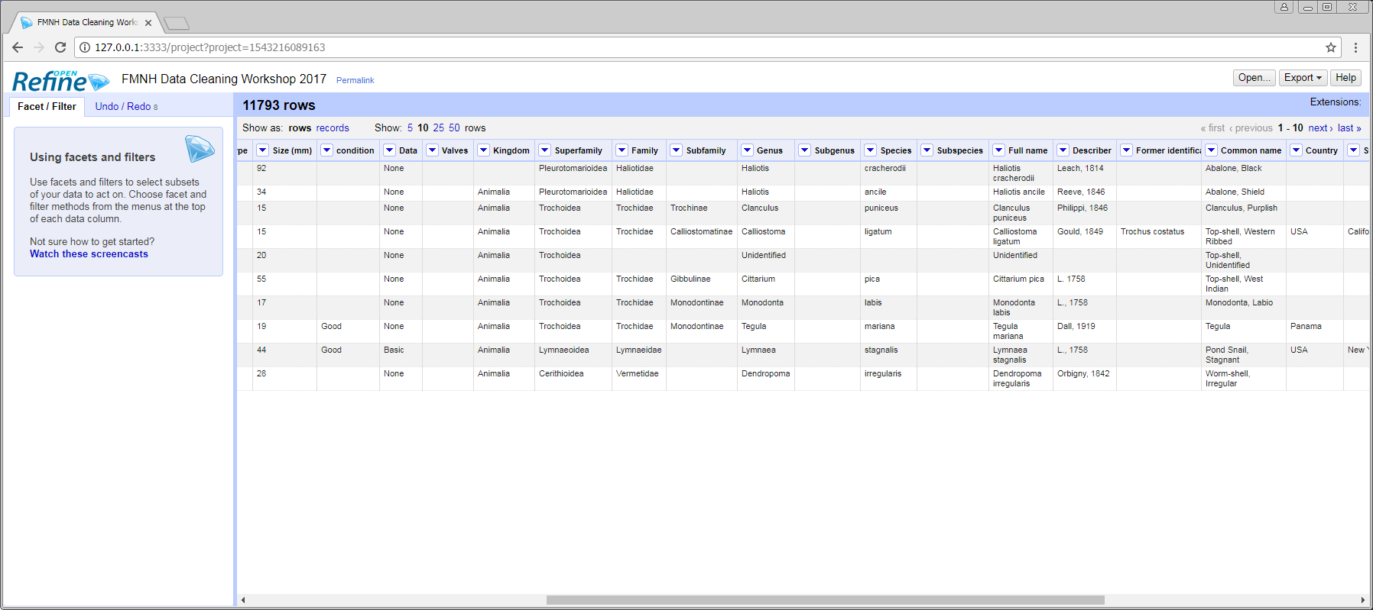
Filtering
MANIPULATING/MANGLING DATA
Go to column Full name and perform a Text filter.
Click the drop-down icon.

Slide 23
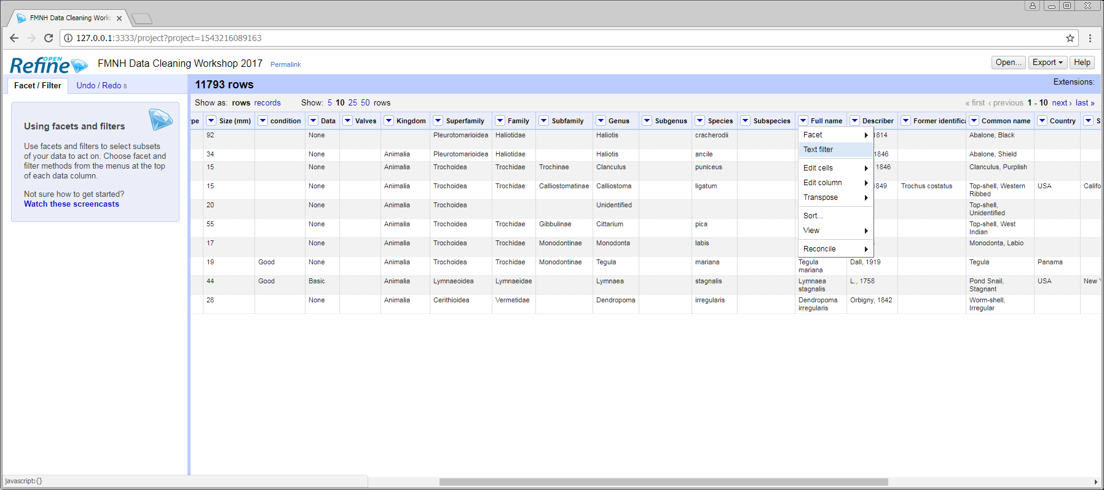
Filtering
MANIPULATING/MANGLING DATA
Text filter is the second option in the column menu.

Slide 24
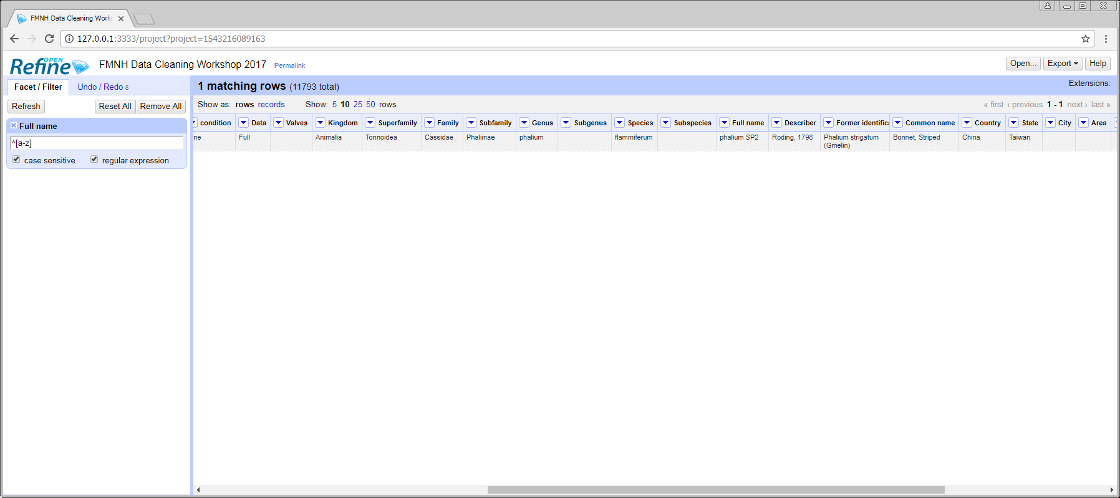
Filtering
MANIPULATING/MANGLING DATA
^[a-z]
Check regular expression and case sensitive, then paste the expression:
Note: This regular expression filters the strings in which the first letter is lowercase.

Slide 25
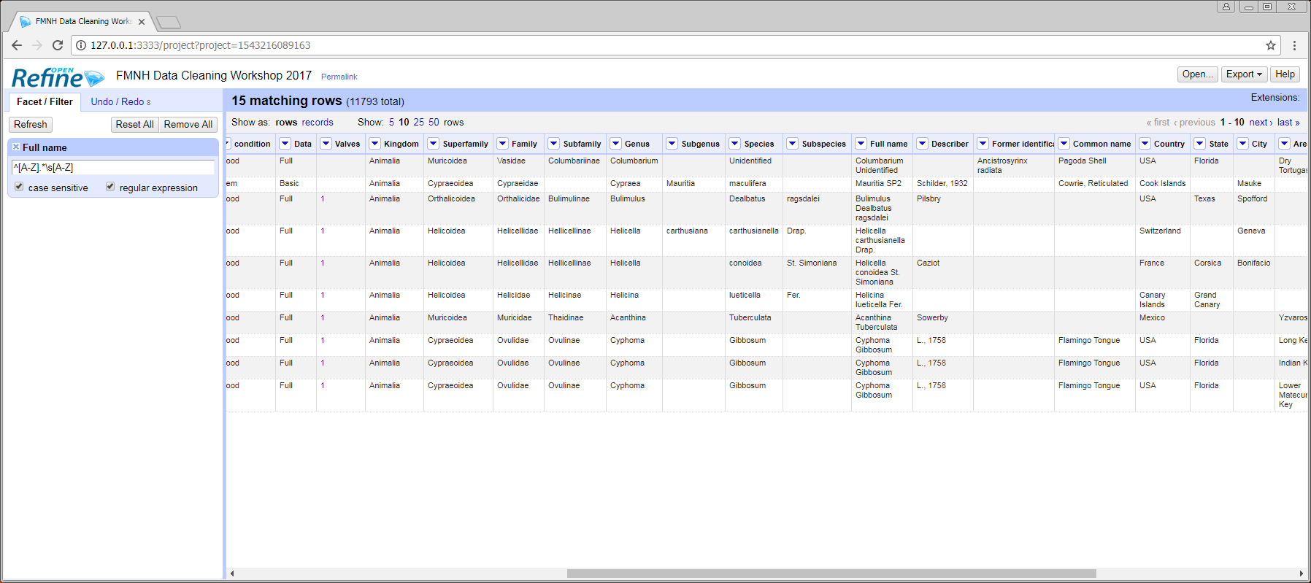
Filtering
MANIPULATING/MANGLING DATA
^[A-Z].*\s[A-Z]
Check regular expression and case sensitive, then paste the expression:
Note: This regular expression filters the strings that start with a capital letter followed by any character, then a space, then a capital letter.

Slide 26
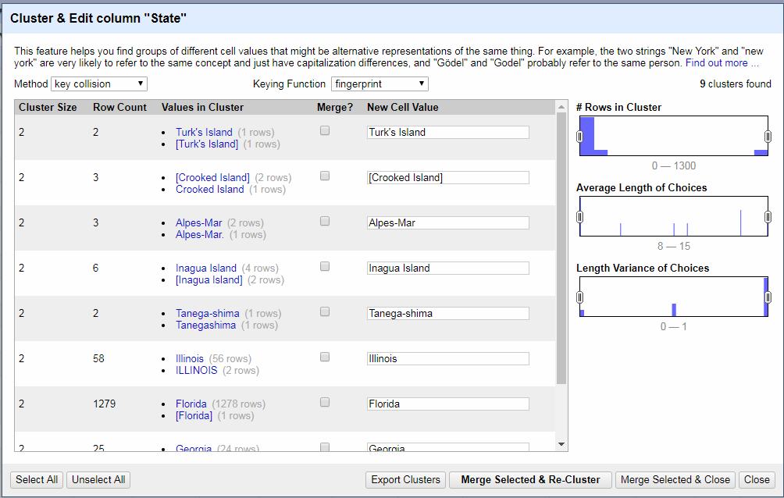
Manipulating/
Mangling Data
Clustering
Clustering is a feature that allows users to:
Find different versions
Group records

Slide 27
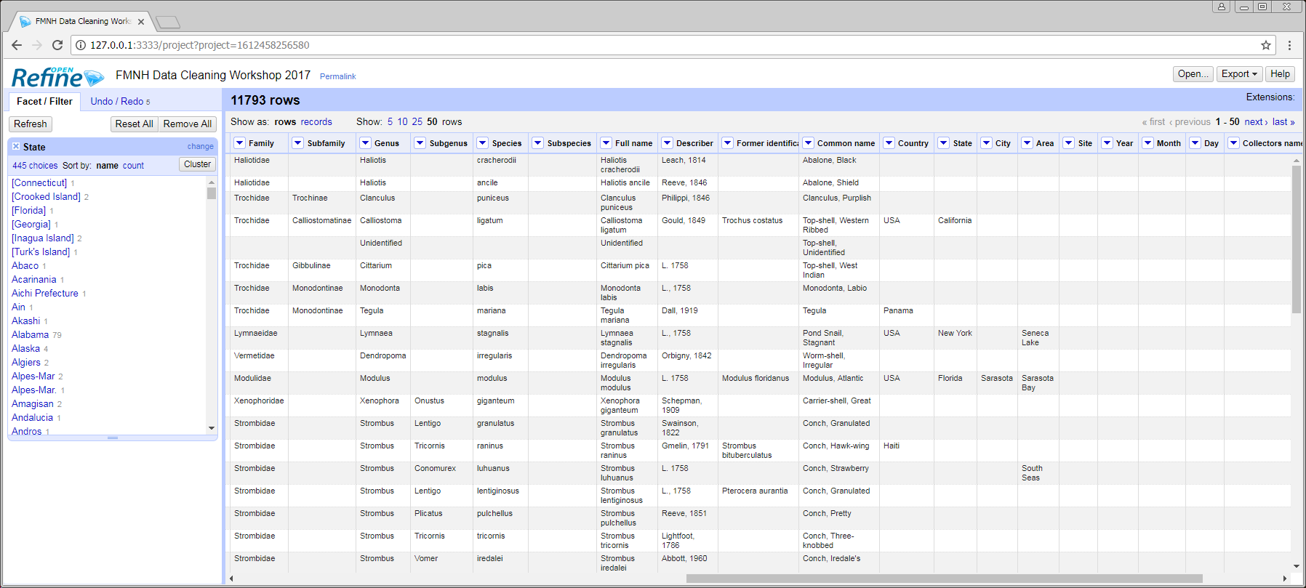
Clustering
MANIPULATING/MANGLING DATA
When a column is faceted, click the Cluster button in the right-hand corner of the sidebar panel.

Slide 28
Clustering
MANIPULATING/MANGLING DATA
The pop-up window displays values that may refer to the same thing. Users can use this screen to standardize them.

Slide 29
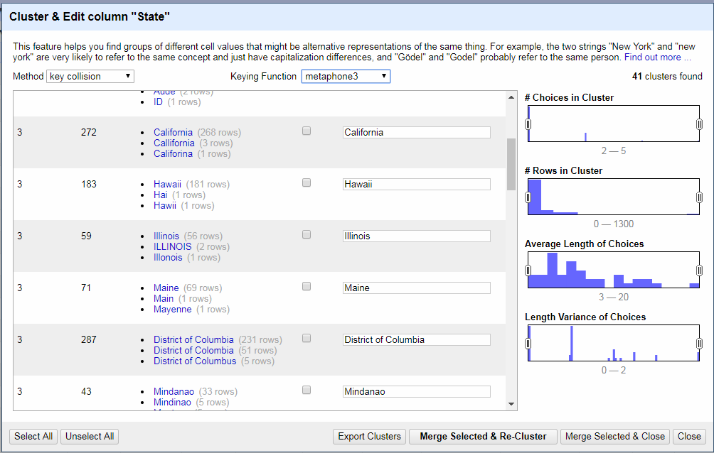
Clustering
MANIPULATING/MANGLING DATA
The Keying Function determines how the values are grouped. Use “metaphone3” to broaden the clusters.

Slide 30
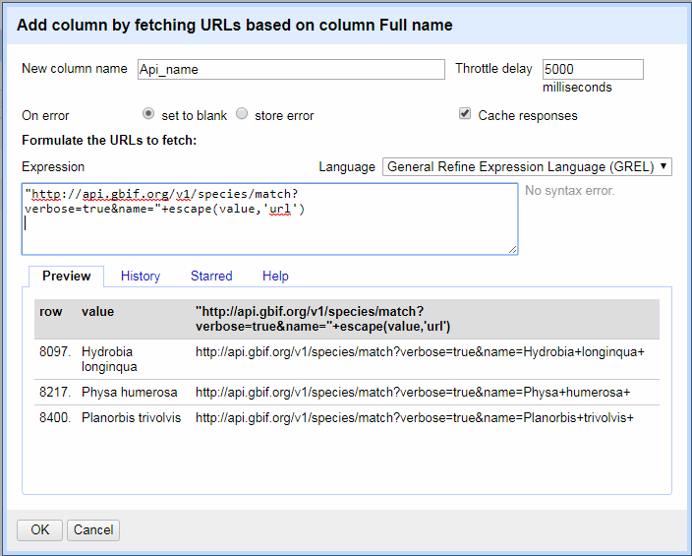
Manipulating/
Mangling Data
Reconciliation
Reconciliation is a feature that allows users to:
Check data against an external source
Import data from an external source

Slide 31
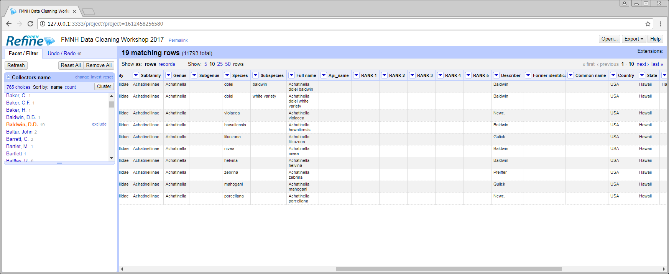
Reconciliation
MANIPULATING/MANGLING DATA
Select a column and use the facet feature to choose a set of entries.

Slide 32
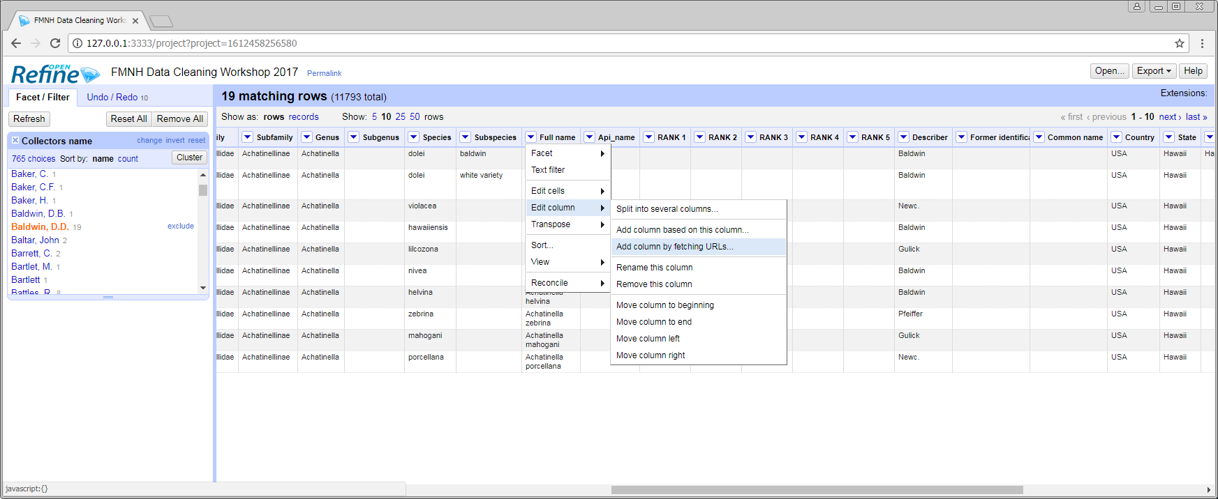
Reconciliation
MANIPULATING/MANGLING DATA
Click the drop-down icon. Under Edit column select Add column by fetching URLs.

Slide 33
Reconciliation
MANIPULATING/MANGLING DATA
A new box will open. Enter the URL to draw information from, as shown below.

Slide 34
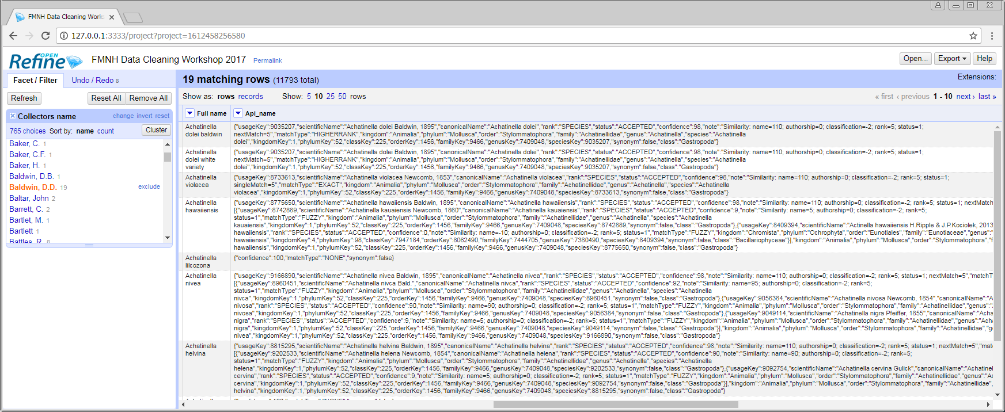
Reconciliation
MANIPULATING/MANGLING DATA
The data from API will be placed in a new column.

Slide 35
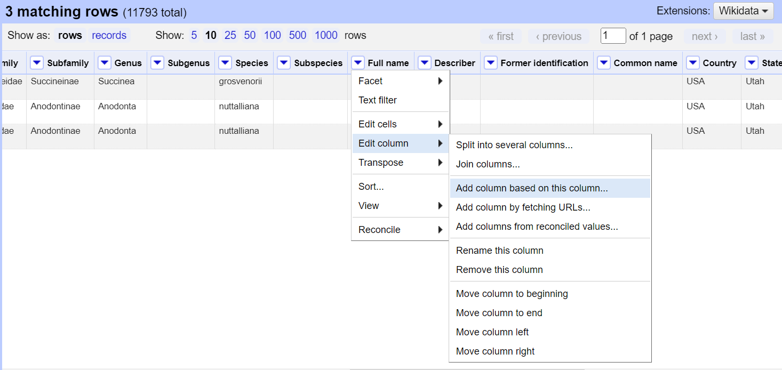
Reconciliation
MANIPULATING/MANGLING DATA
To extract only the necessary columns, select Add column based on this column from the Edit column options.

Slide 36
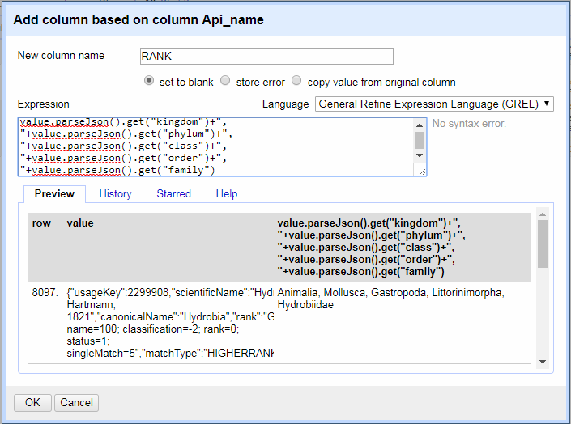
Reconciliation
MANIPULATING/MANGLING DATA
value.parseJson().get(“ ”)
In the Expression field, use the equation to select the categories for the program to separate by.

Slide 37
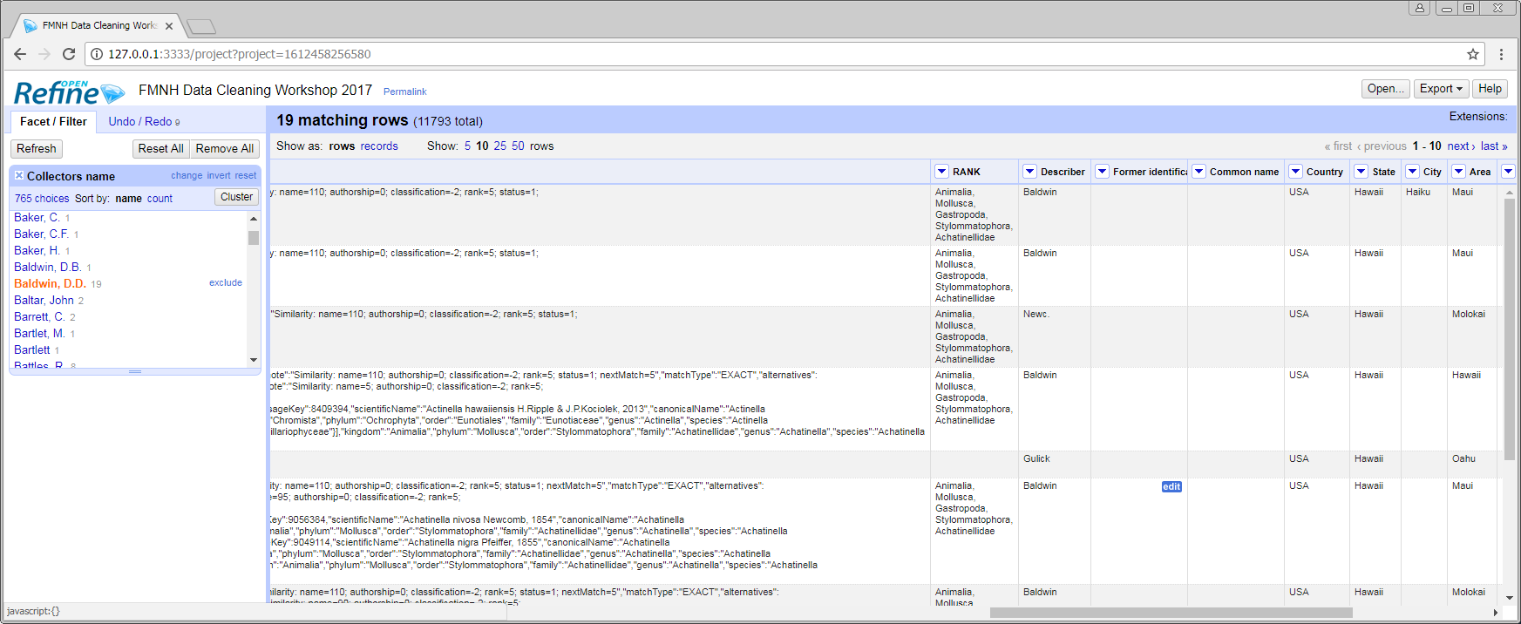
Reconciliation
MANIPULATING/MANGLING DATA
The data will be placed in a new column.

Slide 38
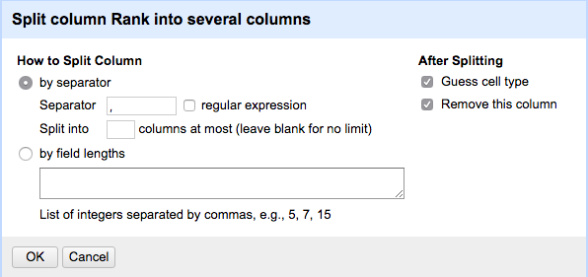
Reconciliation
MANIPULATING/MANGLING DATA
Under Edit column, you can also select Split into several columns…. Choose a character to separate on. A common separator, or delimiter, is a comma.

Slide 39
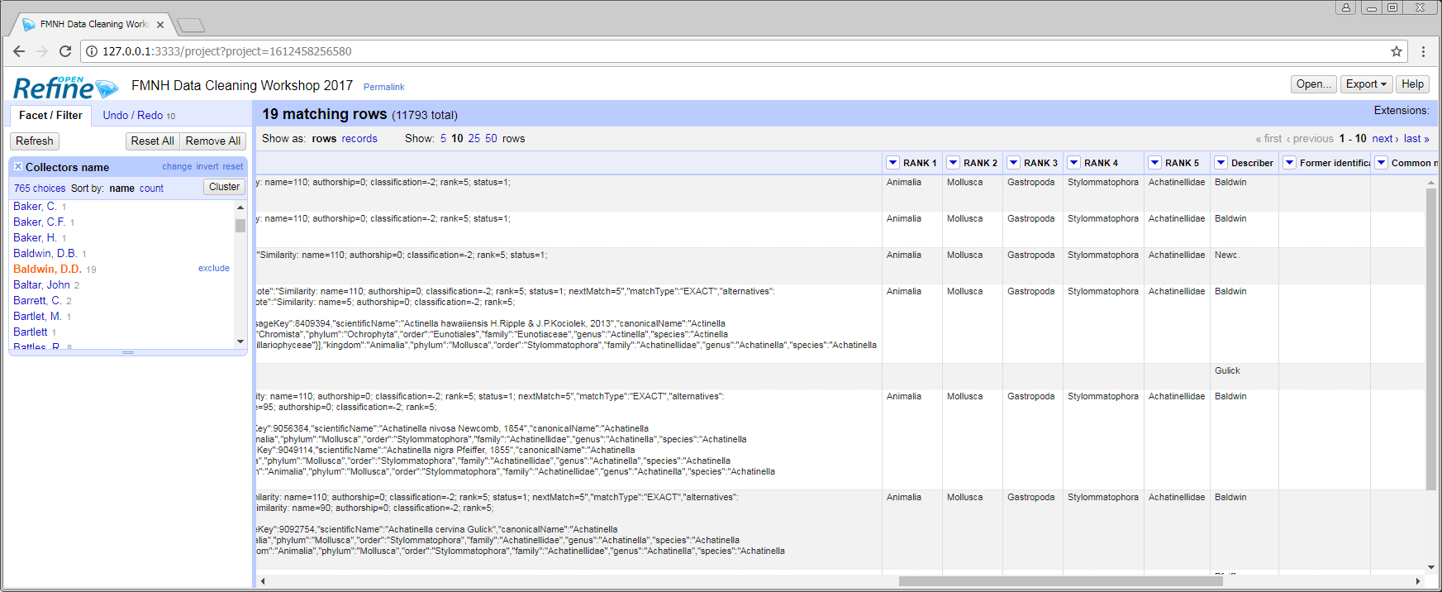
Reconciliation
MANIPULATING/MANGLING DATA
The data will be placed in new separate columns.

Slide 40
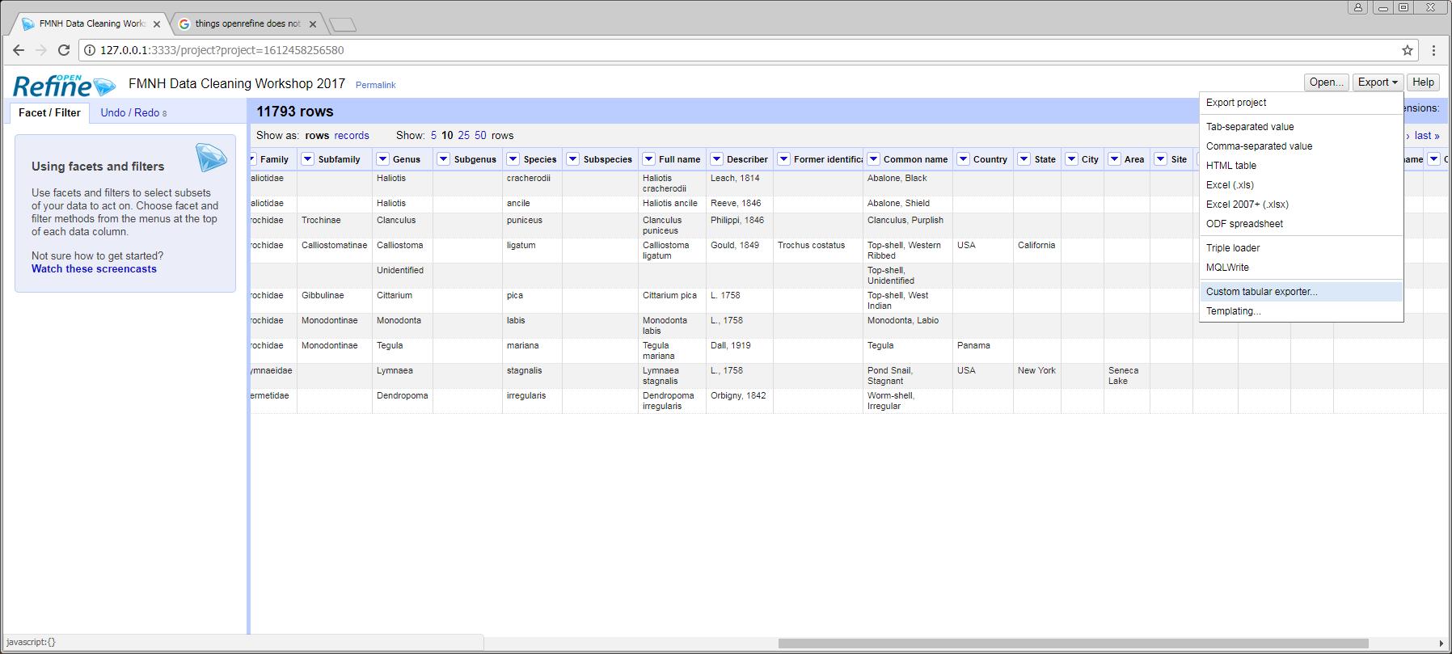
Getting Data out of OpenRefine
Export
Exporting allows you to:
Get only the fields you want in the file
Format the export file
There are several options for exporting cleaned data, but the following option is useful in most cases.

Slide 41
Exporting
GETTING DATA OUT OF OPENREFINE
In the upper-right corner of the window click Export and select Custom tabular exporter….

Slide 42
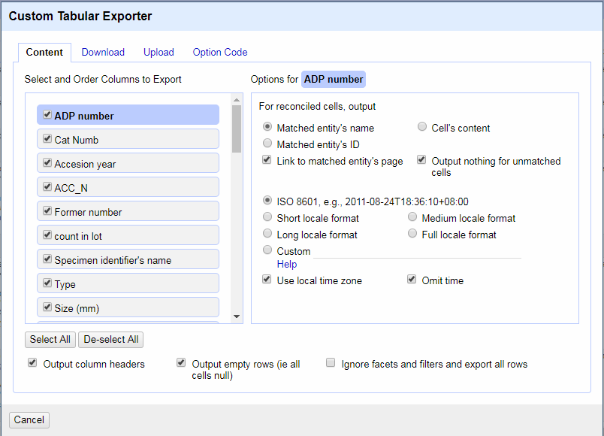
GETTING DATA OUT OF OPENREFINE
Getting Data Out of OpenRefine
In the Content tab, users can choose specific columns to export.
If you select Ignore facets and filters and export all rows all facets and filterings will be ignored.
This is useful if users forget to clear them before exporting.

Slide 43
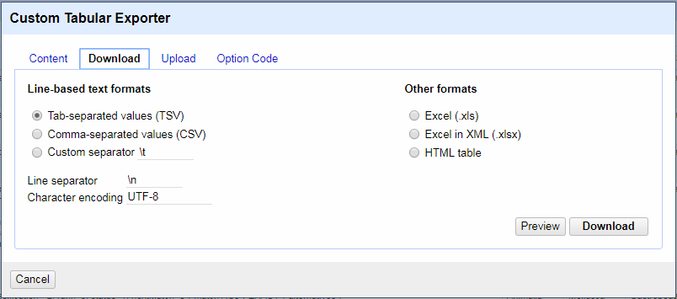
GETTING DATA OUT OF OPENREFINE
Getting Data Out of OpenRefine
Go to the Download tab and select a separator.
Don’t modify the other options unless necessary.

Slide 44
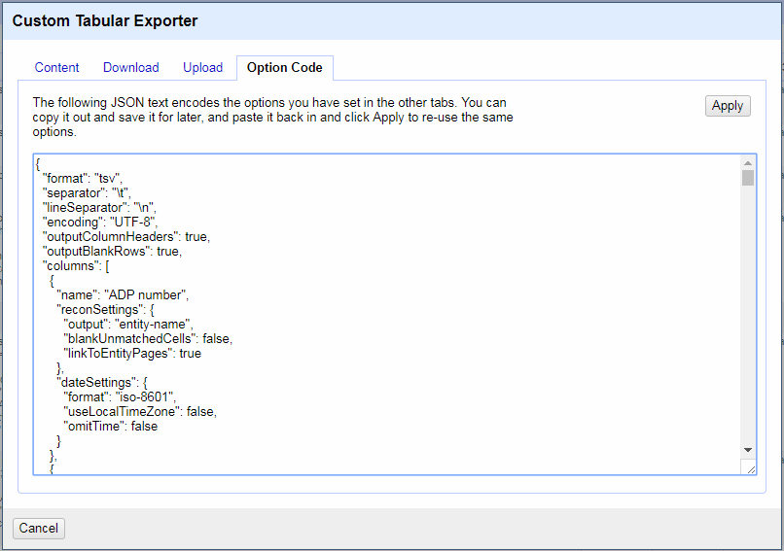
GETTING DATA OUT OF OPENREFINE
Getting Data Out of OpenRefine
Code
Go to the Option Code tab, select and copy all JSON text in the textbox, and save it.
The text encodes the options that have been set in the other tabs.
To use the code in the future, paste the JSON text into the textbox and click the Apply button.

Slide 45
FURTHER MATERIALS
Practice the skills:
Practice Exercises
Example Dataset
https://docs.google.com/document/d/1-l2Uh0zyNLD4GDokUedxApatdz4uFi76e_SAgTb776E
https://docs.google.com/spreadsheets/d/1Sdi-eT--SyaJFywSyFrLLwtCpQu2x6MOmK_EvXej4F0

Slide 46
Questions?
Ask now; we might have answers!

Slide 47
Presenter name
SECTION TITLE
Title or credentials
Insert Presenter Image
Bio
Contact Information

Slide 48

Sharon Grant
sgrant@fieldmuseum.org https://www.fieldmuseum.org/
Thank you!
Janeen Jones
jjones@fieldmuseum.org https://www.fieldmuseum.org/
Kate Webbink
kwebbink@fieldmuseum.org https://www.fieldmuseum.org/
Notes:
This project was made possible in part by the Institute of Museum and Library Services [include IMLS grant number when space allows]."
You may choose to include this acknowledgment in Spanish:
“Este proyecto ha sido posible en parte por el Instituto de Servicios de Museos y Bibliotecas, [include IMLS grant number when space allows].

