Slide 1

Excel for Data Cleaning
What is a spreadsheet? A tool for holding data in rows and columns.
Why use spreadsheets? For disposable data-cleanup or visualization…
Reference: Naidoo, H (Hush Naidoo Jade Photography), October 2020, Unsplash License, https://unsplash.com/photos/SutAduhzdRQ
Notes:
TIP: Click on image and choose “Replace image” in the menu. To move around the visible part of the image within the placeholder, click on “Crop” and move the image up or down.

Slide 2
Agenda
What are Spreadsheet Tools?
01
Getting Data into a Spreadsheet Tool
02
Summarizing Data in Excel
03
Manipulating/Mangling Data in Excel
04
Getting Stuff Out of Excel
05
Recap & Alternatives to Excel
06

Slide 3



Examples of Spreadsheet Tools
WHAT ARE SPREADSHEET TOOLS?
Excel is Microsoft’s standalone spreadsheet program. Available with the Office suite.
LibreOffice Calc is the “Document Foundation” free open-source spreadsheet program. Available here: www.LibreOffice.org
Google Sheets is part of the Google Apps Suite. If you have a Gmail and Google Drive, you have it.
Notes:
TIP: To quickly change the bullet point style, simply right-click on the bullet and choose another icon.

Slide 4
WHAT ARE SPREADSHEET TOOLS?
What Can/Can’t Excel Do?
 | Excel | LibreOffice Calc | Google Slides
Formulas
Charts & Graphs
Auto-formats fields
Allow creation of lookup lists
Allow character sets besides Latin1 (e.g., UTF-8) | Limited
Track changes after closing | Limited | Limited
Maintain integrity between rows and columns | Limited | Limited | Limited
Enforce referential integrity between different sheets | Limited | Limited | Limited

Slide 5
Spreadsheet Don’ts
WHAT ARE SPREADSHEET TOOLS?
What should you AVOID doing in a spreadsheet?
Mixing multiple datasets in a single spreadsheet
Using multiple tabs in a workbook
Not filling in zeros
Using problematic null values (e.g., -999, +/-, Null, NA)
Using visual formatting [color-highlights, fonts, borders] to convey information
Using visual formatting to make the data sheet look pretty
Placing comments or units in cells
Entering more than one piece of information in a cell
Using problematic field names
Using special characters in data (e.g., line breaks, em-dashes, quotation marks)
Inclusion of metadata in data table
P.S. DO NOT MERGE CELLS. DO NOT. BAD. SHAME.
github.com/datacarpentry/spreadsheet-ecology-lesson/blob/gh-pages/_episodes/02-common-mistakes.md
Notes:
TIP: To quickly change the bullet point style, simply right-click on the bullet and choose another icon.

Slide 6
Tables vs. Spreadsheets
WHAT ARE SPREADSHEET TOOLS?
Tables:
= records & attributes
= actual structure
= safer data…
Spreadsheets:
= rows & columns
= illusion of structure
= accident-prone data…
1 Excel file can hold multiple spreadsheets = more illusion...
Notes:
TIP: To quickly change the bullet point style, simply right-click on the bullet and choose another icon.

Slide 7
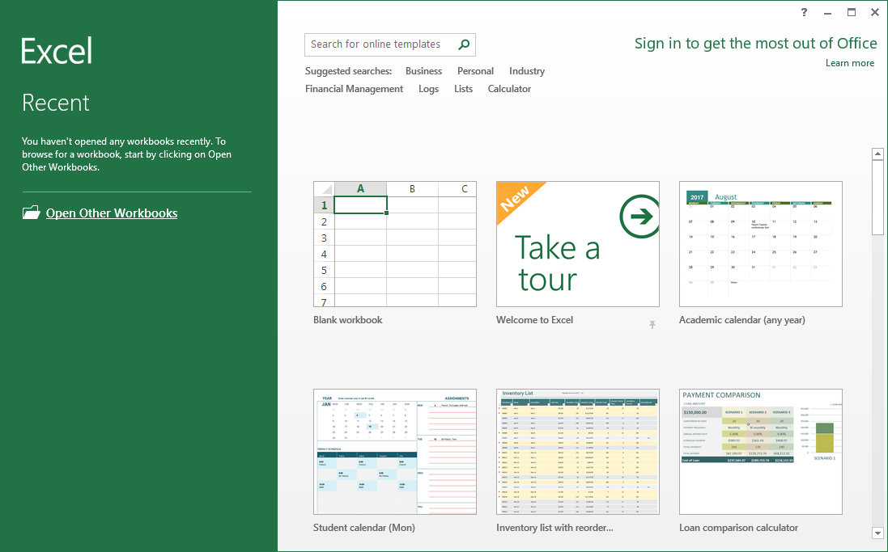
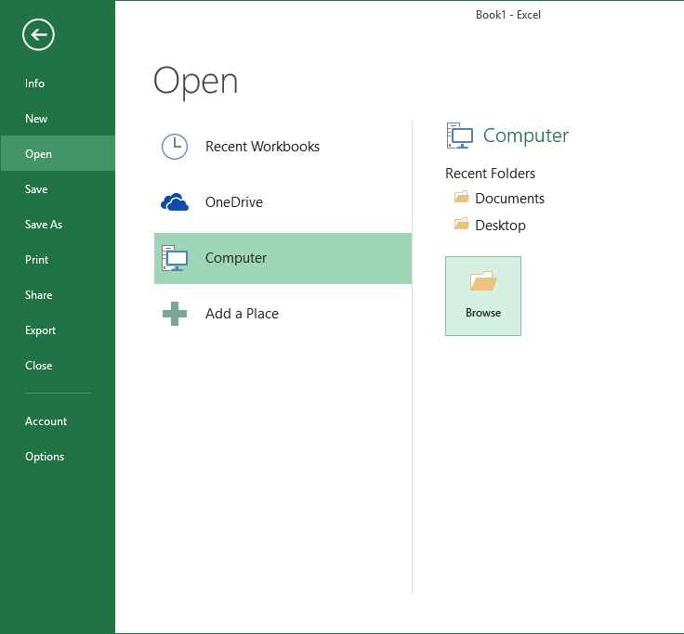
GETTING DATA INTO A SPREADSHEET TOOL
Getting Data into Excel
[the not-safe way]
File → Open…

Slide 8
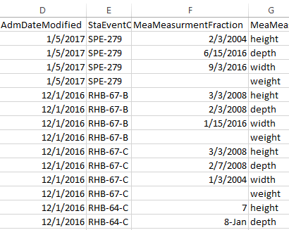
GETTING DATA INTO A SPREADSHEET TOOL
Getting Data into Excel
Dates!
But are they D/M/Y
or
M/D/Y...
[the not-safe way]
Not dates!
These should be fractions.
File → Open…
can subtly mangle CSV data.

Slide 9
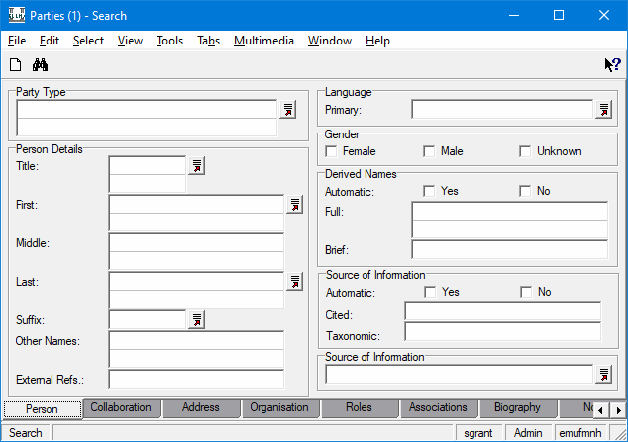
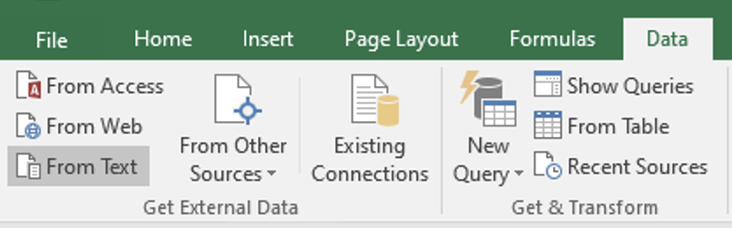
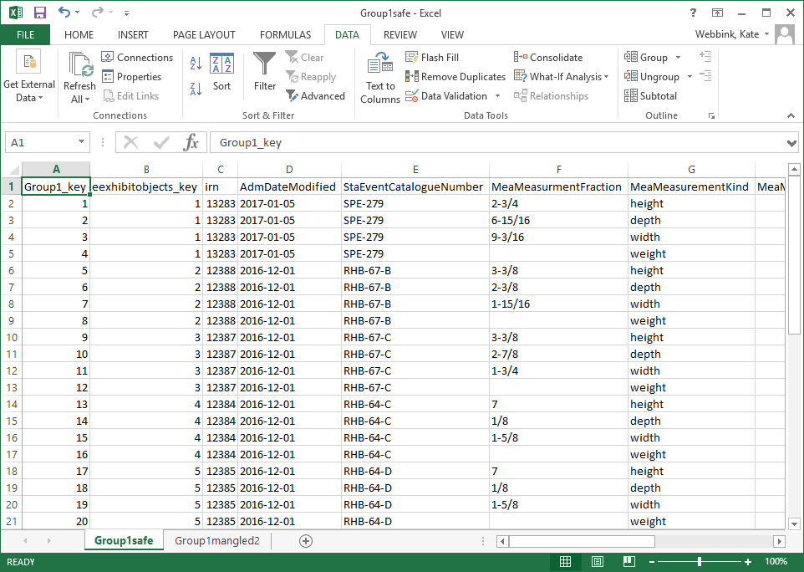
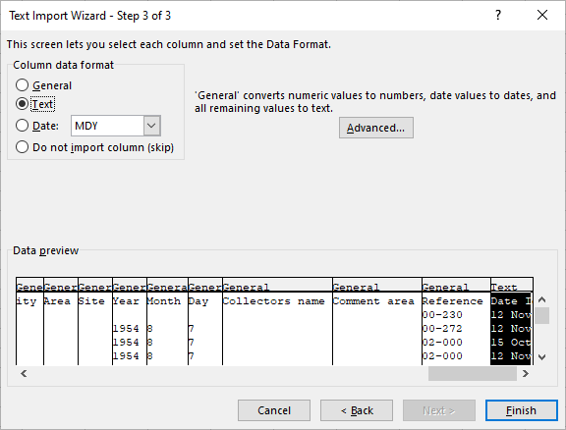
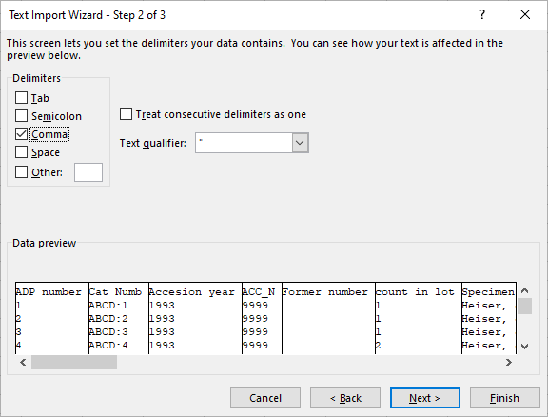
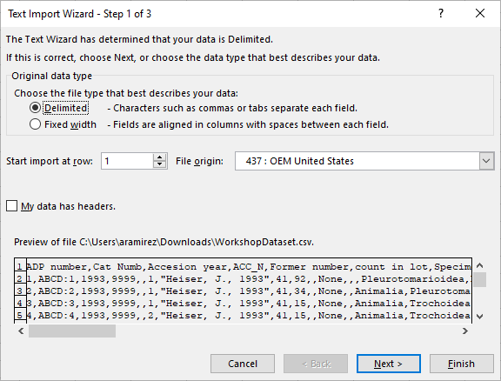
GETTING DATA INTO A SPREADSHEET TOOL
Getting Data into Excel
The Safer Way
Import it as External Data…
Click the From Text option in the Get External Data group of the Data tab.
Follow three steps in the Text Import Wizard
The data should now display properly.

Slide 10
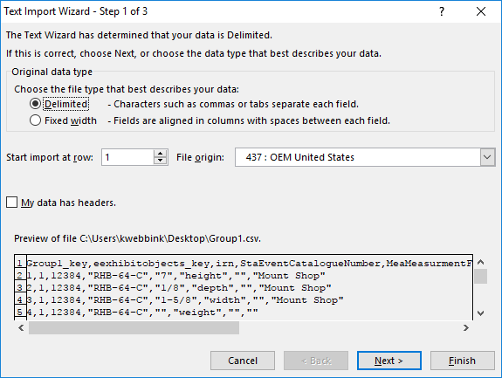
GETTING DATA INTO A SPREADSHEET TOOL GETTING DATA INTO EXCEL
Text Import Wizard
Step 1 of 3
Original data type:
“Delimited” for CSV files
Check “My data has headers”
Check the preview:
…Does data look mangled? (e.g.: ◊, □, ?, )
…If so, check the File origin and try “65001 Unicode (UTF-8)” [requires Excel 2007 or later]
Double-check the Preview...

Slide 11
GETTING DATA INTO SPREADSHEET TOOLS
Getting Data into Excel
The safer way – but beware
Data files (CSV, XLS, TXT, etc.) are encoded in a specific character-set.
Most commonly they are either Latin-1 or UTF-8.
Pre-2007 versions of Excel only read/write Latin-1.

Slide 12
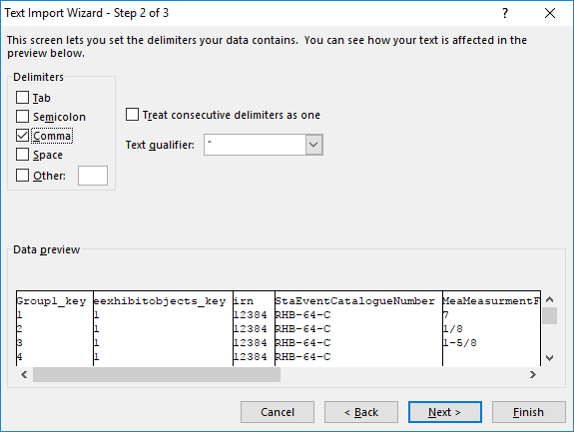
GETTING DATA INTO A SPREADSHEET TOOL GETTING DATA INTO EXCEL
Text Import Wizard
Step 2 of 3
Select Comma from the Delimiters options for CSV files
Select “ from the Text qualifier options
Again, check the Data preview:
Does data look mangled (columns run together)?
If so, try different delimiters.
Double-check the Data preview.

Slide 13
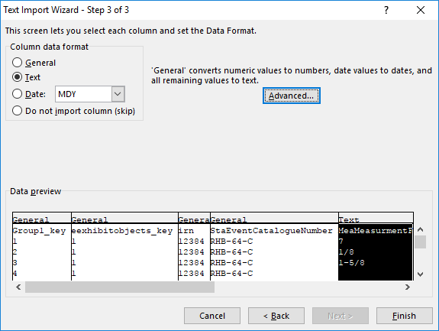
GETTING DATA INTO A SPREADSHEET TOOL GETTING DATA INTO EXCEL
Text Import Wizard
Step 3 of 3
Make sure to check each column’s data-type (Column data format).
If a column appears to be specially-formatted numeric data (dates, fractions, etc.):
Click on the column in the Data preview to select it
Change its data format to Text.

Slide 14
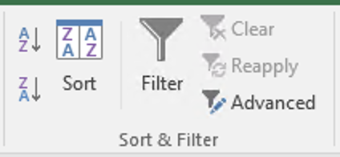
SUMMARIZING DATA IN EXCEL
Summarizing Data in Excel
Sorting and Filtering

Slide 15
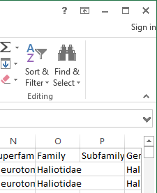
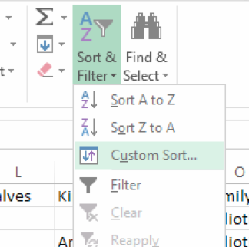
SUMMARIZING DATA IN EXCEL
Summarizing Data in Excel
Sorting
Beware of grabbing only part of your dataset
Beware of one-way trips…to bad places…

Slide 16
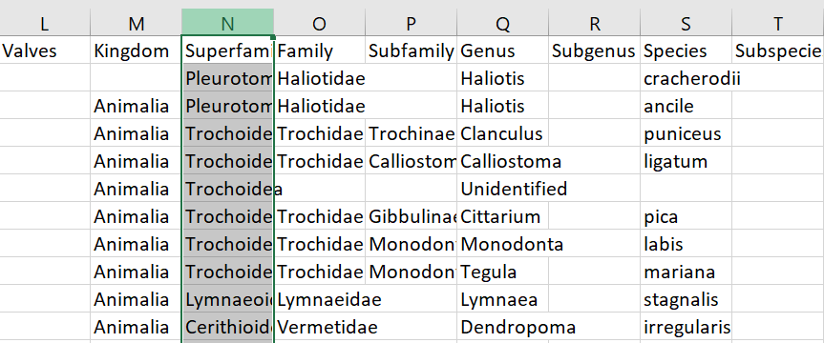
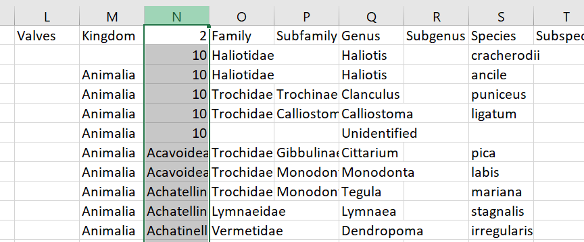
Sorting Errors
SUMMARIZING DATA IN EXCEL
Before Sort:
After Sort:
If you sort without expanding the selection, only the highlighted column will reorder, leading to mismatched data that is no longer connected to its record.

Slide 17
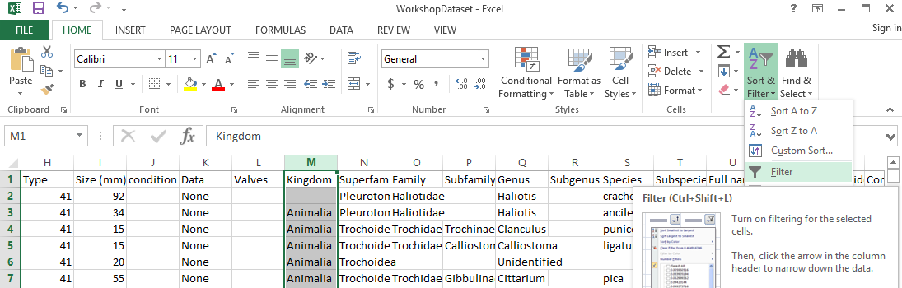
SUMMARIZING DATA IN EXCEL
Summarizing Data in Excel
Filtering
Select the desired column by clicking on its header, e.g., M.
Click the Sort & Filter button in the Home or Data tab and select Filter from the dropdown menu.

Slide 18
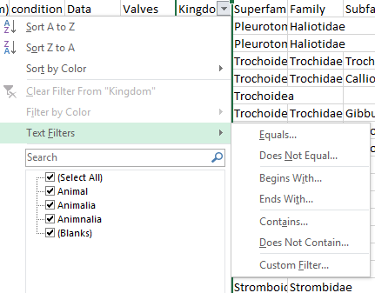
SUMMARIZING DATA IN EXCEL
Summarizing Data in Excel
Filtering
Click the dropdown button and use the checkboxes to select and exclude values.
Hover over the Text Filters to change the text filter condition from the default Equals….

Slide 19
MANIPULATING/MANGLING DATA IN EXCEL
Manipulating/Mangling Data in Excel
Functions
Build your own:
concatenate
vlookup
Built-in:
Split Text-to-Columns
Deduplication
Notes:
TIP: To quickly change the bullet point style, simply right-click on the bullet and choose another icon.

Slide 20
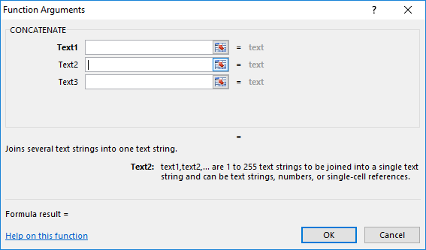
Functions
MANIPULATING/MANGLING DATA IN EXCEL
Build your own: CONCATENATE
The general syntax for function is: =FUNCTIONNAME(argument1, …)
The Function wizard takes care of the syntax, with users needing only to input the arguments.
The wizard offers built-in help and a a link to a help page.

Slide 21
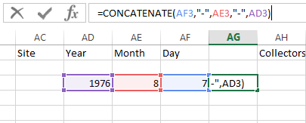
Functions
MANIPULATING/MANGLING DATA IN EXCEL
Build your own: CONCATENATE
=CONCATENATE(arguments)

Slide 22
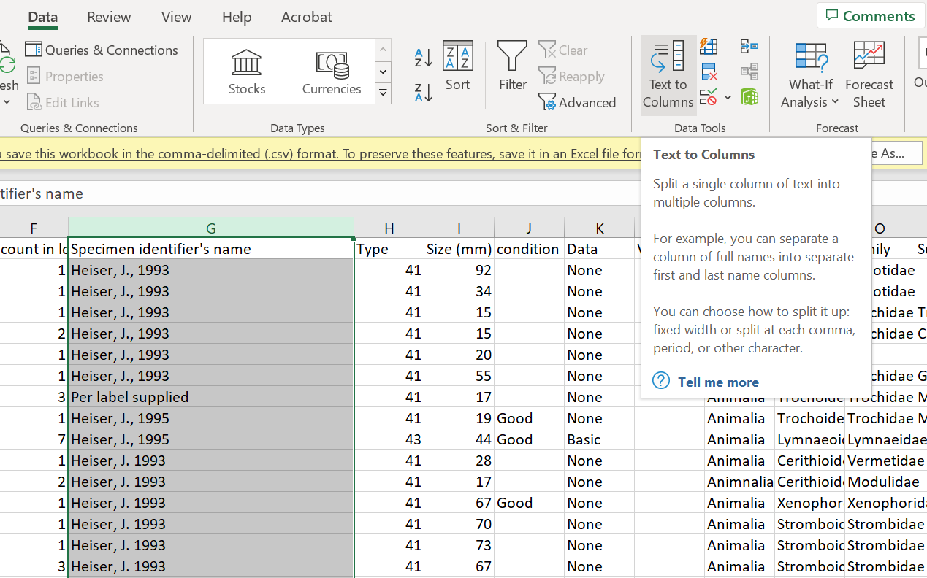
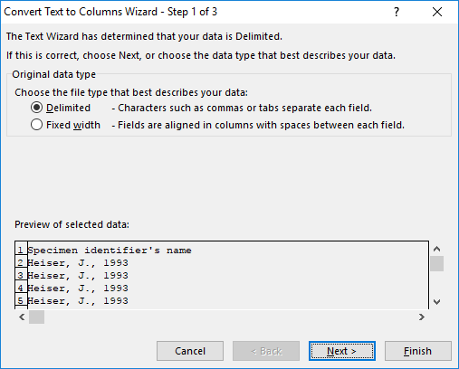
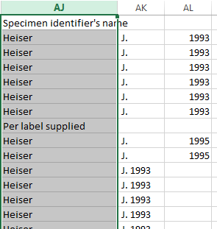
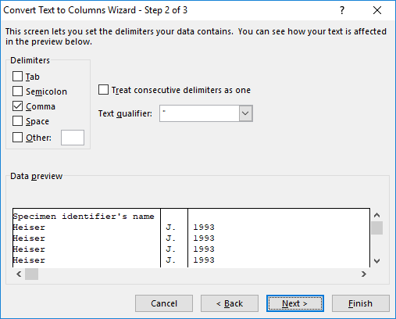
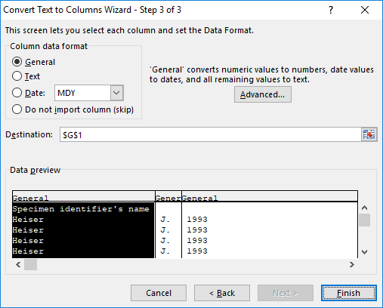
Functions
MANIPULATING/MANGLING DATA IN EXCEL
Built-in: Split Text → Columns
Select Text to Column from the Data menu.
Follow the steps in the Text to Column Wizard. Make sure the right delimiter is selected (typically a , . “ ” or ;) by previewing the data in the bottom window.

Slide 23
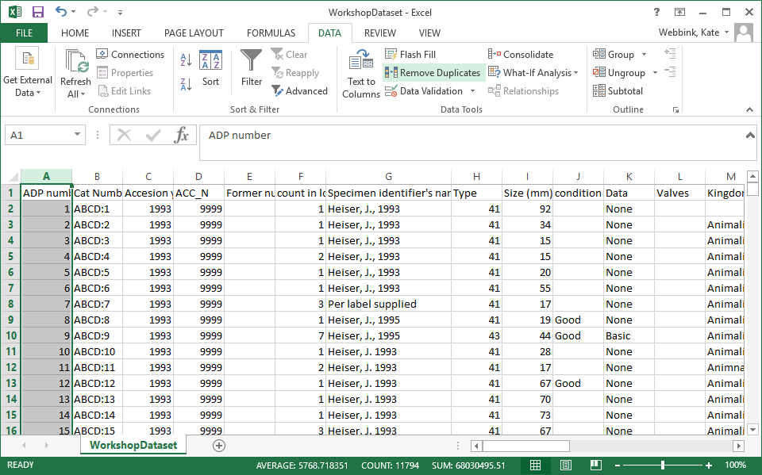
Functions
MANIPULATING/MANGLING DATA IN EXCEL
Built-in: Deduplicating Rows
To deduplicate rows, first highlight the column you wish to remove duplicates from. Under the Data heading, click Remove Duplicates.

Slide 24
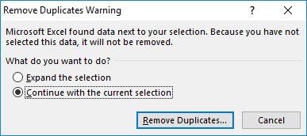
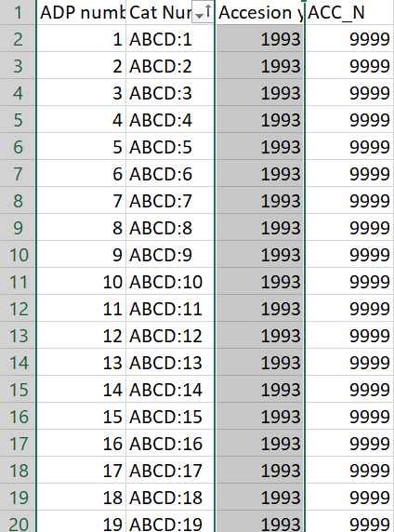

Functions
MANIPULATING/MANGLING DATA IN EXCEL
Built-in: Deduplicating Rows
the scary way:
Excel will ask if you want to expand the selection. If you say no, only the duplicates from one column will be cleaned. The rest of the data will remained unchanged, and the cleaned column will no longer line up with the same entries.

Slide 25
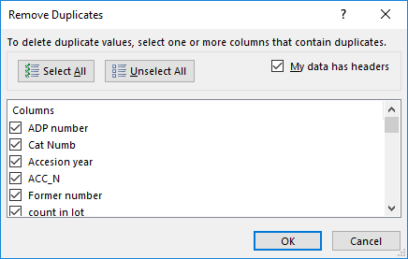
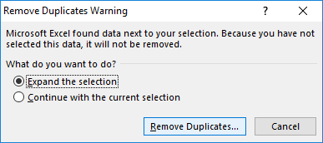
Functions
MANIPULATING/MANGLING DATA IN EXCEL
Built-in: Deduplicating Rows
the safe way:
If you expand the selection, all the data will be cleaned at once. The rows will remain intact.

Slide 26
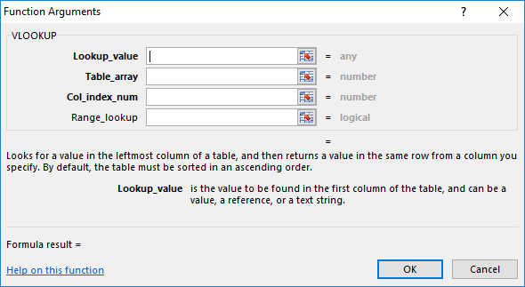
Functions
MANIPULATING/MANGLING DATA IN EXCEL
Build your own: Lookup Lists with VLOOKUP
The VLOOKUP function can be used to find a value in a range or table by row.
For example, look up scientific name by IRN.

Slide 27
Functions
MANIPULATING/MANGLING DATA IN EXCEL
Build your own: Lookup Lists with VLOOKUP
The VLOOKUP function requires four arguments:
The Lookup_value argument is used to define the value you want to look up. It can be a value, reference or text string.
The Table_array argument is used to define the table or range (via reference or table name) where you want to look for the lookup value.
NOTE: If the Lookup_value is a value or text string, it must be located in the leftmost column of the table or range.

Slide 28
Functions
MANIPULATING/MANGLING DATA IN EXCEL
Build your own: Lookup Lists with VLOOKUP
The VLOOKUP function requires four arguments:
The Col_index_num argument is used to define the column number of the column that contains the value to be returned.
The Range_lookup argument is used to return an approximate or exact match. Use 0/FALSE to prevent approximate matches.
NOTE: The column number for Col_index_num is specific to the selected table or range. Remember Excel uses one-based indexing.

Slide 29
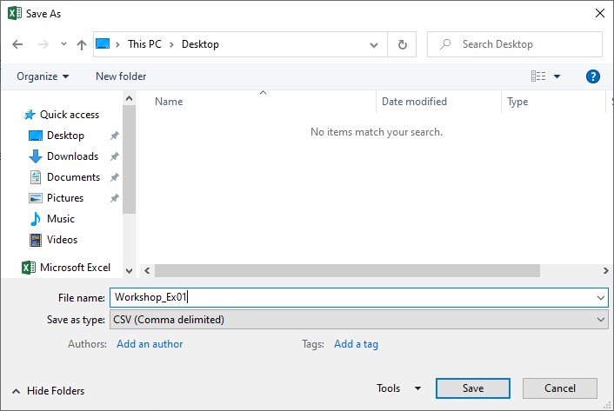
RECAP
Getting Data Out of Excel
The Safe Way
…without mangling date-type data.
Differences between:
A true CSV
where text-delimiter is specified and applied to all fields
An Excel CSV
where text-delimiter is specified but only applied to text fields

Slide 30
Recap
RECAP
Data in spreadsheets:
Good for one-time-use
Not good for maintaining
…Is it structured? No.
Alternatives to Excel:
Google Sheets
LibreOffice
Not using spreadsheets…?
Notes:
TIP: To quickly change the bullet point style, simply right-click on the bullet and choose another icon.

Slide 31


Thank you!
Sharon Grant
sgrant@fieldmuseum.org https://www.fieldmuseum.org/
Janeen Jones
jjones@fieldmuseum.org https://www.fieldmuseum.org/
Kate Webbink
kwebbink@fieldmusuem.org https://www.fieldmuseum.org/
Abigail McArthur-Self
amcarthur-self@fieldmusuem.org https://www.fieldmuseum.org/
Alexis Ramirez
aramirez@fieldmusuem.org https://www.fieldmuseum.org/

