Slide 1
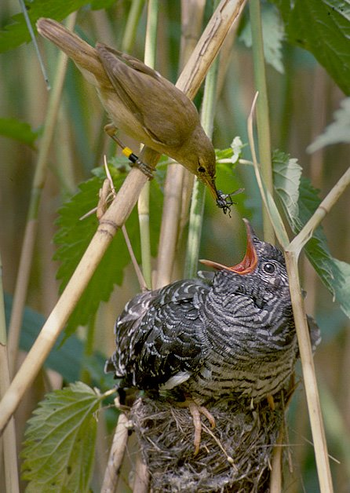
Multimedia and Documentation/
Licenses
on Museum Storage
Reference: Reed Warbler stuffing a Cuckoo chick’s face.
© Per Harald Olsen - CC BY-SA 3.0, wikimedia commons
Notes:
Subtitle: On Museum Storage
This presentation, titled Multimedia and Documentation/Licenses, is part of the Field Museum of Natural History’s EMu training series.
Image credit: © Per Harald Olsen - CC BY-SA 3.0 https://commons.wikimedia.org/wiki/File:Reed_warbler_cuckoo.jpg

Slide 2
Agenda
DAMS
01
Licenses and Documentation
02
EMu Collections
03
Questions and Resources
04
Notes:
In this presentation, we’ll cover proper documentation and usage rights in EMu and NetX, the digital access management system integrated with EMu.

Slide 3
DAMS
Digital Asset Management System

Slide 4
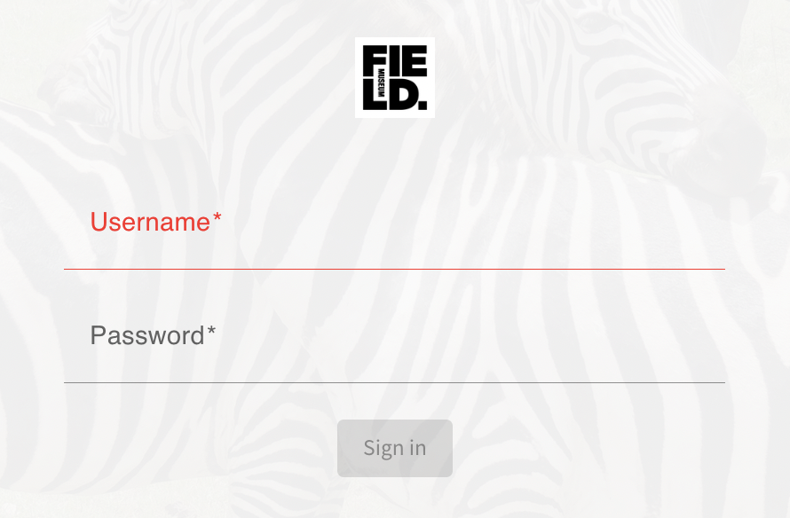
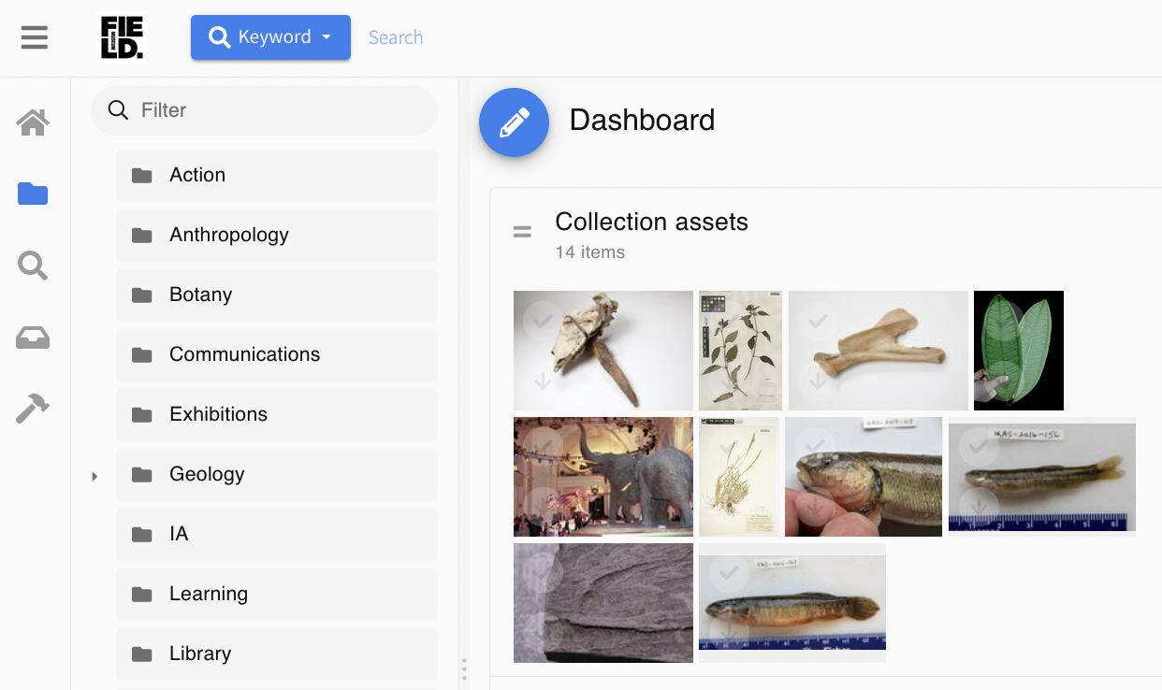
Digital Asset Management System, DAMS a.k.a. NetX
DAMS
https://dams.fieldmuseum.tech
Who can use it?
Employees
Interns
Volunteers
What can it do?
View
Search
Download
Share
What does it look like?
Notes:
The museum’s Digital Asset Management System (D.A.M.S) is also known as NetX.
It can be used by all employees, interns and volunteers to view, download, search, and share digital content.
NetX is more user-friendly than EMu.
The ability to add or edit multimedia files in NetX is not yet online (aiming for end of 2023).
Until then, media records must be added/edited in EMu.

Slide 5
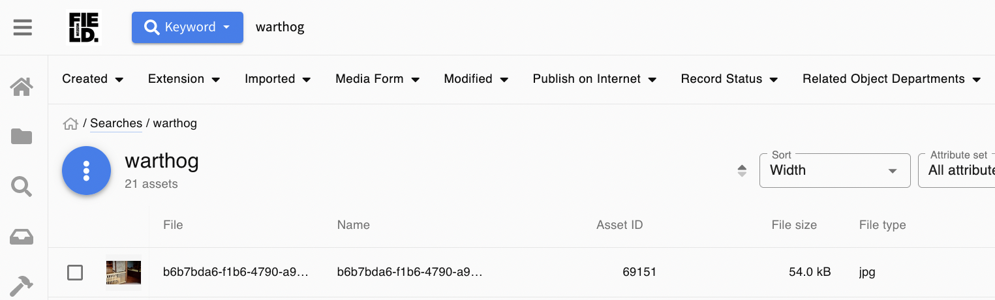
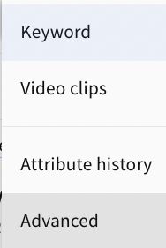
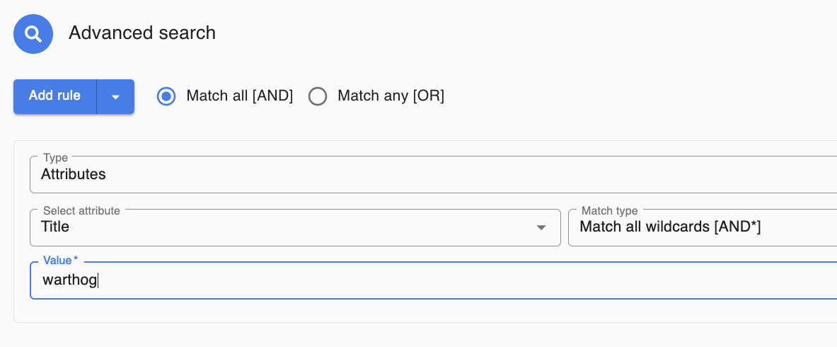
Inside NetX
DAMS
The Keyword search bar at the top of the screen searches broadly across all assets and all text fields.
Advanced Search is useful for more complex queries.
Notes:
It may still take some training to become familiar with NetX, but its user interface is generally more user-friendly and intuitive than EMu.
Users can run a simple search using the search bar at the top of the page.
Users can alternatively setup an ‘Advanced Search’ to query date-ranges, folders, or any attribute-field including title, subject, creator, related collections, etc.
The sample Advanced Search on the lower half of the screen queries specifically for records where the Title field (vs any field) includes “warthog”

Slide 6
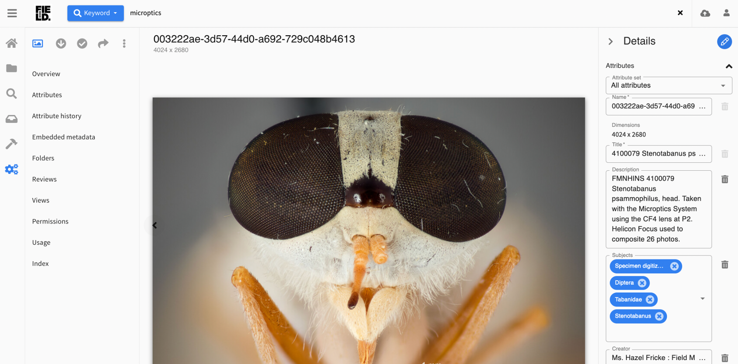
Inside NetX
DAMS
Download, Select, and Share buttons allow you to save or group the data beyond the original page.
Notes:
When viewing a record’s detail page in NetX, icons in the upper left corner of the page allow you to download, select, and share media.
NetX DAMS URL: https://dams.fieldmuseum.tech/app/#asset/426351/attributes
Image Credit: Courtesy of: H. Fricke. (c) Field Museum of Natural History. CC BY-NC 4.0. https://mm.fieldmuseum.org/003222ae-3d57-44d0-a692-729c048b4613 (accessed on 3 July 2023)

Slide 7
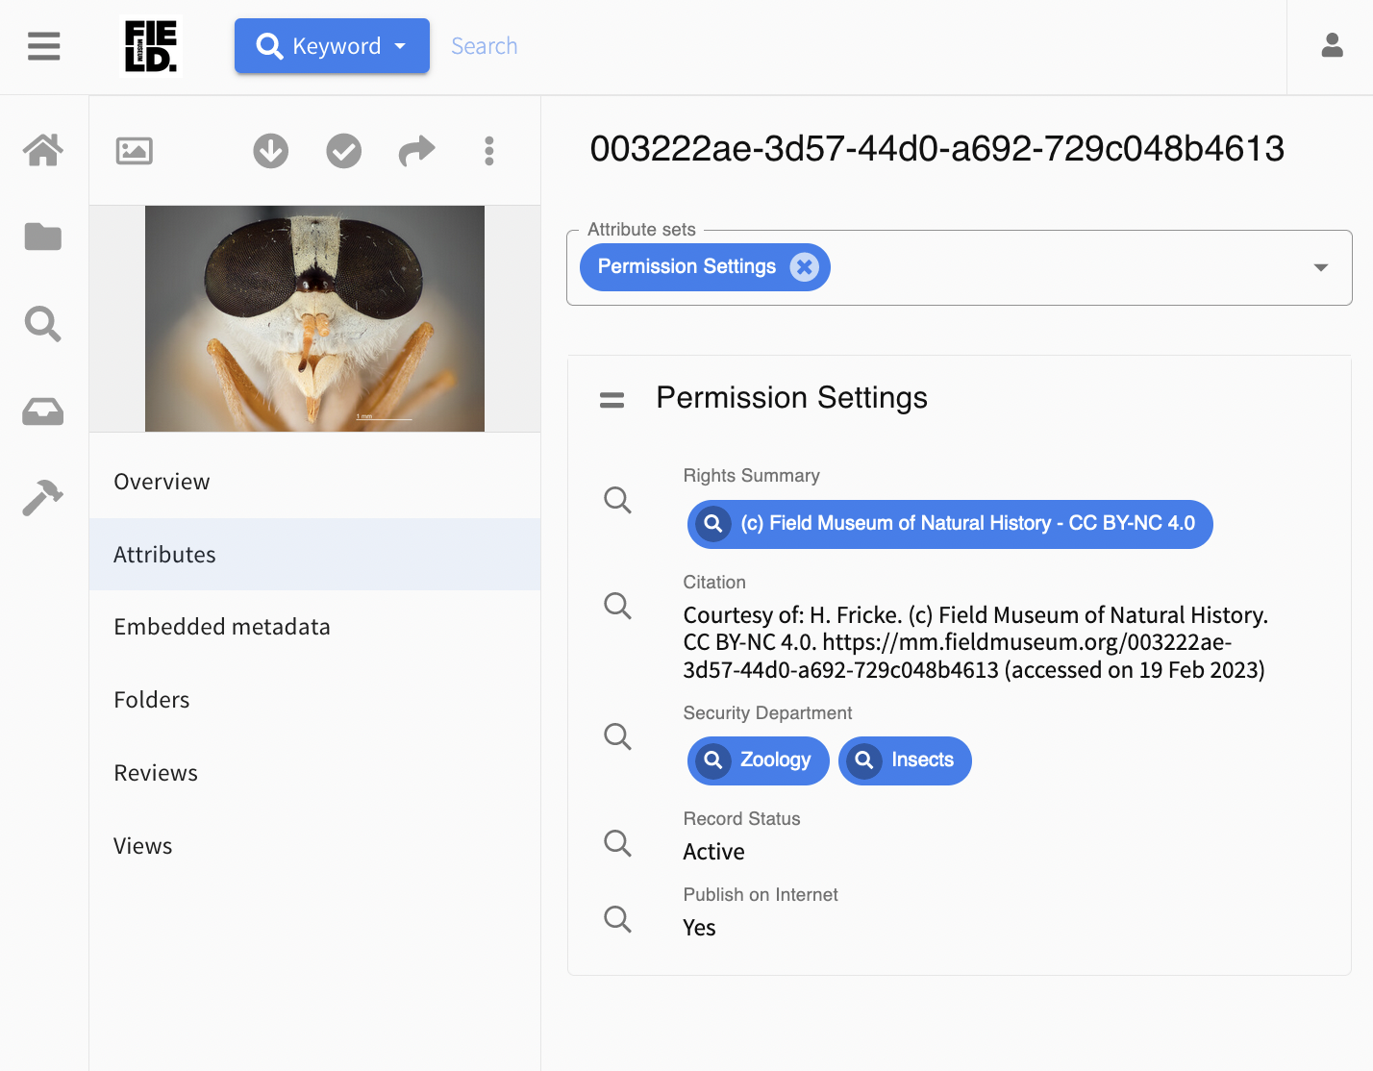
Inside NetX - How to check usage permissions
WHAT’S INSIDE
NOTE: Not all NetX media is “© Field Museum”, nor is it all “public”
Try the “Permissions” Attribute Set in NetX to see the fields highlighted below:
Rights Summary
Includes copyright holder and license
Citation
Follows Collections Data Norms fieldmuseum.org/use-collections-data-and-images
Security Department
For help, contact departmental EMu power users: github.com/fieldmuseum/EMu-Documentation/discussions/467
Record Status & Publish on Internet
Check these fields for restrictions
Notes:
NetX DAMS [LIVE] URL: https://dams.fieldmuseum.tech/app/#asset/426351/attributes
Image Credit: Courtesy of: H. Fricke. (c) Field Museum of Natural History. CC BY-NC 4.0. https://mm.fieldmuseum.org/003222ae-3d57-44d0-a692-729c048b4613 (accessed on 3 July 2023)

Slide 8
Licenses and Documentation

Slide 9
Why Document Media and licenses?
LICENSES AND DOCUMENTATION
To prevent the agony of orphaned works for our future selves/colleagues
To ensure that the museum can support growing media needs over time
Reference: Reed Warbler stuffing a Cuckoo chick’s face.
© Per Harald Olsen - CC BY-SA 3.0
Notes:
Documenting multimedia and licensing can prevent the agony caused by orphaned works for our future selves and our colleagues.
If we don’t know who created the media object, what it depicts, or where it came from, it can be difficult to achieve it properly.
Documenting multimedia and licensing helps the Museum ensure it can support growing media needs over time.
Multimedia grows over time. The average size of files is increasing, and the amount of media we keep tends to increase.
It is important to document how much media we actually want to keep.
How?
By making sure media can be used properly, published and reused.
This is accomplished by:
Following the Museum’s collections data and media norms and/or obtaining media creation agreements.
Documenting media with references to and from Events, Collections, Parties, or other records that offer context.
By properly preserving and managing media.
This is accomplished by:
Documenting related Events, Collections, Parties, Context or other records that offer context in coordination with the media.
Running file integrity checks and format validation in EMu.

Slide 10
Why Document Media and licenses?
LICENSES AND DOCUMENTATION
To prevent the agony of orphaned works for our future selves/colleagues
To ensure that the museum can support growing media needs over time
by ensuring media can be properly used, published & reused:
Following FMNH Collections Data & Media Norms and/or Media Creation Agreements.
With reference to related contexts including Collections, Events, and People.
by properly managing & preserving media:
In coordination with related Events, Collections, People, Context over time
With File integrity checks and Format validation (in EMu)
Notes:
Documenting multimedia and licensing can prevent the agony caused by orphaned works for our future selves and our colleagues.
If we don’t know who created the media object, what it depicts, or where it came from, it can be difficult to achieve it properly.
Documenting multimedia and licensing helps the Museum ensure it can support growing media needs over time.
Multimedia grows over time. The average size of files is increasing, and the amount of media we keep tends to increase.
It is important to document how much media we actually want to keep.
How?
By making sure media can be used properly, published and reused.
This is accomplished by:
Following the Museum’s collections data and media norms and/or obtaining media creation agreements.
Documenting media with references to and from Events, Collections, Parties, or other records that offer context.
By properly preserving and managing media.
This is accomplished by:
Documenting related Events, Collections, Parties, Context or other records that offer context in coordination with the media.
Running file integrity checks and format validation in EMu.

Slide 11
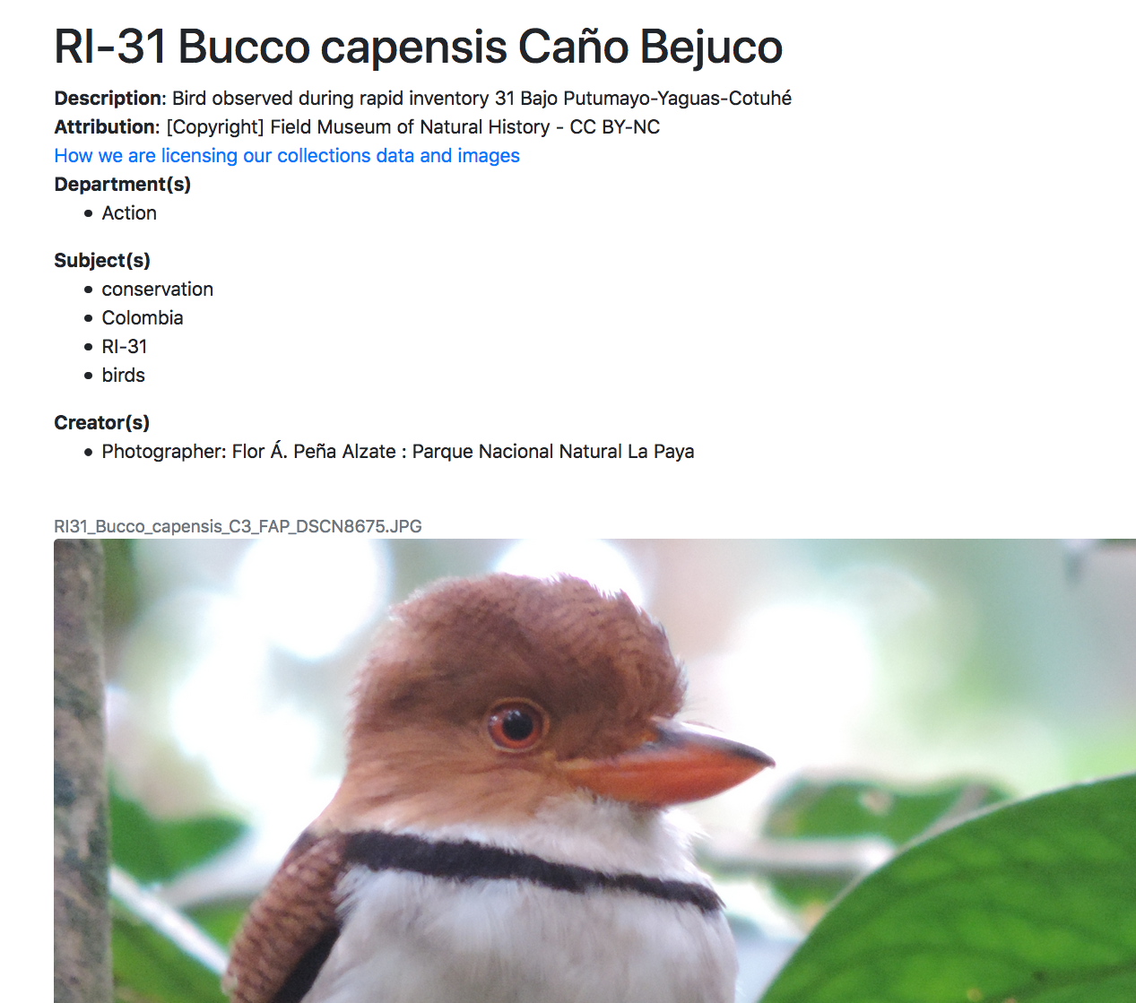
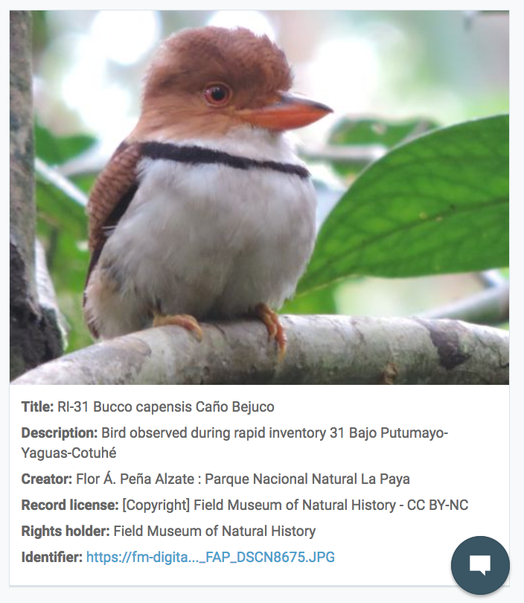
What we’re trying to do:
LICENSES AND DOCUMENTATION
https://mm.fieldmuseum.org/6803d8ea-d46e-4a1e-98da-9ed6fcd6f5fa
https://www.gbif.org/occurrence/2872162284
Notes:
We’re trying to keep all of the multimedia and licensing data together as the media object travels in-house and beyond the walls of the Museum.
On the left is a screenshot of another image from the RI-31 rapid inventory as viewable on the MM.FieldMuseum.org website.
https://mm.fieldmuseum.org/6803d8ea-d46e-4a1e-98da-9ed6fcd6f5fa
Notice the information included alongside it. We’ve highlighted the attribution and creator information.
The creator of this image was Flor, a photographer from another institution.
The attribution contains the copyright holder and the license, which indicates what permitted uses are permitted for this multimedia.
On the right is a screenshot of the same image and set of information after it's gone out to the Global Biodiversity Information Facility website.
https://www.gbif.org/occurrence/2872162284
GBIF is one of the organizations that often picks up Field Museum data.
Notice that the information has remained attached to the media object.
We realize that the longer media stays on the internet, the more likely it is that its metadata and associated information will be separated from it.
But what we’re trying to do is keep the data and its context together as long as possible.
Other Non-FMNH example:
https://mm.fieldmuseum.org/e65f6e2f-37de-492d-8094-4be2dcbf070d

Slide 12
How to document Media & Licenses
LICENSES AND DOCUMENTATION
What you need to know about a media file:
Who owns it (and FMNH-relation)?
When was it made?
How should it be credited?
What can it be used for?
Can FMNH allow others to use it?
Notes:
To document media, we need to know:
… who created the media file and what was their relationship to the Field Museum.
Were they a staff member, volunteer, or not affiliated with the Museum?
We need to know when the media file was created.
Notice that the date the file was created is missing from the image at right. In this particular case, the context of RI-31 would allow us to go back and add that information to the media file.
We need to know how it should be credited, what it can be used for, and whether or not the Museum can allow others to use it.

Slide 13
How to document Media & Licenses
LICENSES AND DOCUMENTATION
What you need to know about a media file:
What you need to know about a license:
Who owns it (and FMNH-relation)?
When was it made?
How should it be credited?
What can it be used for?
Can FMNH allow others to use it?
Who signed the agreement?
When?
What were the conditions?
How can FMNH and others use media?
What credit is required for whom?
Document original signed agreements
Notes:
To document media, we need to know:
… who created the media file and what was their relationship to the Field Museum.
Were they a staff member, volunteer, or not affiliated with the Museum?
We need to know when the media file was created.
Notice that the date the file was created is missing from the image at right. In this particular case, the context of RI-31 would allow us to go back and add that information to the media file.
We need to know how it should be credited, what it can be used for, and whether or not the Museum can allow others to use it.

Slide 14
How to document Media & Licenses in EMu
LICENSES AND DOCUMENTATION
What you need to know about a media file:
What you need to know about a license:
Multimedia record
Creator: Staff? Contractor? Visitor?
Date Created: …
Rights: Credit & Use-Restrictions?
Security: Who can access it? How?
Publish on Web: Use-Restrictions?
Rights record
Owner: FMNH + non-FMNH Creator
Date: of signed agreement
Conditions: of agreement to document permitted/restricted uses of media
Acknowledgement: as required
Multimedia attachment: to signed PDF
Notes:
To document the licenses, we need to know:
… who signed the agreement.
… when the agreement was signed.
We need to know the conditions of the agreement.
How can the Field Museum and others use the media?
It is necessary to document the original signed agreements.
In EMu, all the rights information can be documented in a separate record attached to the multimedia record. If the media wasn’t created by or owned by the Field Museum, the rights record will include the documented agreement between the owner of the file and the museum.

Slide 15
Documentation on How to Document things in EMu...
Rights & Multimedia help docs on how to document:
FMNH-owned media
“© FMNH CC BY-NC” (following FMNH data norms)
“© FMNH” (more restrictive)
Media Agreements for Non-FMNH-owned media
“© FMNH CC BY-NC” (with transfer of copyright)
“© J. Doe, CC BY-NC” (licensed / no transfer of copyright)
Media with Sensitive / Special conditions
Restricting Access for Sensitive media
Documenting & Setting notifications for Embargoed media
github.com/fieldmuseum/EMu-Documentation/discussions/329
How to use NetX (DAMS) - bit.ly/3KXkbv0
Notes:
How-to docs for:
EMu Multimedia: https://github.com/fieldmuseum/EMu-Documentation/wiki/emultimedia-workflows
EMu Rights: https://github.com/fieldmuseum/EMu-Documentation/wiki/erights-workflows
Netx: https://docs.google.com/document/d/1K5QC_7d8A6FzL6qWDsCphrhHKkiMbyuiKJPAToowTJY
EMu training/modules: https://github.com/fieldmuseum/EMu-Documentation/wiki/admin-TRAINING
There are different types of copyright that allow the museum to use a piece of media.
CC-BY-NC refers to a Creative Commons license for non commercial use.
© FMNH CC-BY-NC is used for content if:
the copyright that follows the data normalization standards.
© FMNH is more restrictive and is used for Field owned content.
© FMNH CC-BY-NC can also be used for non-Field-owned content that the Field has permission to use with a transfer of copyright.
© J. Doe, CC-BY-NC refers to content that the Field museum doesn’t own but has permission to use (without a transfer of copyright).
Media may also have special restrictions for sensitive content.

Slide 16
Photographers
Not Museum staff
Museum
Anyone working for the Museum – paid or not – if media use or management is in their scope of work for the museum.
Media Users
Anyone using the media who isn’t its copyright holder
Notes:
This is a birdseye view of the people involved in contributing, managing, and using media related in some way to the museum, collections, and/or projects.

Slide 17
non-FMNH Photos
Place Photos
People Photos
FMNH Specimen Photos
Photographers
Not Museum staff
Museum
Anyone working for the Museum – paid or not – if media use or management is in their scope of work for the museum.
Media Users
Anyone using the media who isn’t its copyright holder
Notes:
This is a birdseye view of the people involved in contributing, managing, and using media related in some way to the museum, collections, and/or projects.
…media, which might fall into one or some of these 4 categories:
Photos from non-FMNH photographers
Photos of places and/or people
FMNH specimen photos

Slide 18
non-FMNH Photos
Place Photos
People Photos
FMNH Specimen Photos
Site Release form
Permits the FMNH to use media in agreed ways.
e.g., Museum MUST include acknowledgement with use
Person Release form
Permits the FMNH to use media for any purposes.
i.e., Museum CAN use them for commercial purposes
Photographers
Not Museum staff
Museum
Anyone working for the Museum – paid or not – if media use or management is in their scope of work for the museum.
Media Users
Anyone using the media who isn’t its copyright holder
Media Agreement
Permits FMNH to use non-FMNH photos following agreement’s conditions.
e.g., “© Photographer, CC BY-NC” means FMNH CANNOT use photos for commercial purposes.
EMu Multimedia Rights record
Indicates copyright holder and permitted or restricted uses.
Must reflect media agreement & release form requirements (if any).
For Site release forms: http://intranet.fieldmuseum.org/legaldepartment/node/7278 &/or contact the Legal department.
For more information on how to archive media in EMu: https://drive.google.com/drive/folders/1M3EGqvyLY3gp1xaOvhD2ALGE7OX9Y_2l
Notes:
This is a birdseye view of the documentation process with the three involved parties in gray down the middle of the diagram.
On the left are the photographers who are outside contributors, i.e. non-Museum photographers.
If the Museum is obtaining media from outside contributors, we want to make sure to document an accompanying media agreement. The Field Museum has a standard CC-BY-NC media creation and assignment agreement document:
https://docs.google.com/document/d/1BAOWb7k3-k0RNinXcFBbEMypLzxvehn8Y1ninQ2uJTw/edit?usp=sharing
Without documented agreements, we can’t archive or distribute other people’s material.
Photos featuring people who are not Field Museum staff or volunteers as subjects should ideally be documented with an accompanying Person Release form.
{link}
If the Museum doesn’t document Person Release forms, it can potentially still archive those photos, but it won’t be able to use them for commercial purposes.
The portions of the diagram highlighted with green detail the process for documenting and distributing photos created in-house or depicting Museum staff, volunteers, specimens or objects.
These photos are usually the easiest for the Museum to document because the Museum holds the copyright and can license them as needed.
The EMu Multimedia Rights record is the rights record that accompanies any multimedia we archive in EMu.
The record indicates who the copyright holder is, whether or not they are affiliated with the Field Museum, and the permitted and restricted uses for the multimedia.
The record allows media users down the line to know what they’re able to do with that media and who they need to credit.

Slide 19
non-FMNH Photos
Place Photos
People Photos
FMNH Specimen Photos
How can the Museum use & publish media?
Site Release form
Permits the FMNH to use media in agreed ways.
e.g., Museum MUST include acknowledgement with use
Person Release form
Permits the FMNH to use media for any purposes.
i.e., Museum CAN use them for commercial purposes
How can subsequent users use & publish media?
Photographers
Not Museum staff
Museum
Anyone working for the Museum – paid or not – if media use or management is in their scope of work for the museum.
Media Users
Anyone using the media who isn’t its copyright holder
Media Agreement
Permits FMNH to use non-FMNH photos following agreement’s conditions.
e.g., “© Photographer, CC BY-NC” means FMNH CANNOT use photos for commercial purposes.
EMu Multimedia Rights record
Indicates copyright holder and permitted or restricted uses.
Must reflect media agreement & release form requirements (if any).
For Site release forms: http://intranet.fieldmuseum.org/legaldepartment/node/7278 &/or contact the Legal department.
For more information on how to archive media in EMu: https://drive.google.com/drive/folders/1M3EGqvyLY3gp1xaOvhD2ALGE7OX9Y_2l
Notes:
This slide highlights the documentation that makes it possible to archive and distribute multimedia.
These documents record
whether and how the museum is permitted to use, re-use, and distribute (publish) media.
whether and how subsequent media-users are permitted to use, re-use, and distribute (publish) media.
Standard Media Agreement:
https://docs.google.com/document/d/1BAOWb7k3-k0RNinXcFBbEMypLzxvehn8Y1ninQ2uJTw/
Release forms:
On-Camera releases: http://intranet.fieldmuseum.org/legaldepartment/node/7278
Site releases: (contact Legal)
How to archive them in EMu:
https://drive.google.com/drive/folders/1M3EGqvyLY3gp1xaOvhD2ALGE7OX9Y_2l

Slide 20
EMu Collections

Slide 21
Departments that upload non-collection MM in EMu
Research Projects: pj.fieldmuseum.org
General Multimedia: mm.fieldmuseum.org/search
Narrative-related & co-curation projects
Philippines.fieldmuseum.org/
Silurian-reef.fieldmuseum.org/
Action - have Event-related media -- Search PJ for “Rapid Inventory”
Photo Archives - have Event-related media -- Search MM for “Photo Archives”
Exhibits - have Event- & Narrative-related media -- Search PJ for “EX”
Education & archived Museum Media & Web projects -- Search PJ for “MM” or “facebook”
Anthro / Bot / Geo / Zoo have project-related media -- Search PJ for “RP” or “research project”
Notes:
EMu Events module information: http://intranet.fieldmuseum.org/emu/node/6287

Slide 22
Non-collections media can be archived in EMu with:
Documented Permission for the museum to use/reproduce/distribute it.
or the Museum needs to own it -- i.e., as the copyright holder
Standard Filenames
No special characters or spaces -- to prevent corruption when transferring
EMu-Documentation > wiki > admin-ESTABLISHED-STANDARDS > file-naming-conventions
Standards Formats ( http://intranet.fieldmuseum.org/emu/node/5969 )
Non-proprietary formats -- to maintain stability + access over time
an Event record to describe the project/context for the media
What/Where/When/Why was the [research, outreach, website, other museum-work] done?
e.g. Event IRN 7565 for “Green Chicago Plants on a Roof”
e.g. Events for Rapid Inventories -- search on PJ.FieldMuseum.org
Content/Quality that meets your area's defined criteria
other areas' criteria where data/media is shared
Notes:
WORKFLOW EXAMPLES:
Exhibits (EMu workflows documented here): http://intranet.fieldmuseum.org/emu/node/5914
What kind of non-collection-based multimedia can be archived in EMu ?
Any digital 'musuem' media that the Museum owns or has permission to archive. (i.e., if it was created in the scope of an FMNH project, and/or contributed with documented license/permission to archive)
as long as it follows:
- filename standards: http://intranet.fieldmuseum.org/emu/node/7069
- no special characters (to prevent corruption in transit)
- format-standards: http://intranet.fieldmuseum.org/emu/node/5969
- non-proprietary formats (to maintain stability + access over time)
Is there any criteria for that? E.g. grant proposal, annual report, budget, Zoom recording
- Documented Permission - Does the museum have permission to keep it?
- Content-wise: it needs to relate to the museum
- Documented Project (research, education, outreach, website)
---- e.g., Event record - Chicago Team Event (IRN/screenshot)
- Collections items/Action observations
---- e.g., Catalogue record - RI observation datasets + collections
- Type/Format & Filename
---- See standards above
- Conform to your Area's defined criteria for what's appropriate
+ other Areas' criteria where data/media is shared
Beyond that, IT doesn’t dictate content-requirements. General suggestions:
Content should relate to museum projects/areas or collections

Slide 23
What kind of media can be archived in EMu?
EMU COLLECTIONS
Files with:
Documented Permission:
Standard Filenames:
Standard Formats:
an Event record:
Sufficient quality:
No!
No Agreement/Release
“12# Réd (copy).jpg”
CR2 / raw image file, TIFF, XLS
No Event record
Out-of-scope or -focus
Yes!
Has Agreement/Release
“123_Flower.jpg”
JPG, DNG, CSV
Has Event record
In-focus and in-scope
Review files before adding to EMu:
When needed, does the museum have documented permission to keep?
Are their filenames and formats standardized?
Is their corresponding project/context documented — as an Event in EMu?
Do they meet your area's criteria for what's appropriate to keep?
Notes:
This slide shows examples of media that can and cannot be archived in EMu and why.
Things that can't be archived – files without documented permissions, with non-standard filenames that include things like parentheses, in non-standard formats like .tif or .xls files, lacking event records for its importation, out-of-scope.

Slide 24
Who can access or edit Multimedia in EMu?
EMU COLLECTIONS
Security tab (ALL modules):
Department: Add departments here to let them edit a record.
Record-level Security: Limit department-access here when required
(e.g., Sensitive or Embargoed media or data)
Notes:
EMu has a client/server model where data is stored remotely and is accessed by the user via a small client application that sits on your desktop.
Different records have different permissions. Some records include sensitive information that may not be available to everyone.

Slide 25
Questions and Resources

Slide 26
EMu & Media Storage-Access/Training questions
QUESTIONS AND RESOURCES
How/When/Why should I deal with Serenity/Filer01?
Help your future selves and the museum budget for the space
https://github.com/fieldmuseum/EMu-Documentation/discussions/346
How many people have an EMu login?
A few hundred.
(~800 active and inactive)
How can people get trained?
Once you know what you need (even just "to be able to search media"), request a login by emailing HelpDesk and CC-ing the power user for the data you need to access.
https://github.com/fieldmuseum/EMu-Documentation/discussions/467
Notes:
Here are a few common questions about EMu and Serenity storage.
When/why should you use Serenity/Filer01 for storage space?
Using Serenity helps future users and the museums budget for space.
Serenity is secure, and the IT Department can help you with issues that arise.
How many people have an EMu login for the Field Museum?
Roughly 800 people have accounts, though not all are active.
How can people get trained?
The IT department is responsible for helping train staff to use EMu. This series of presentations is part of those training resources. The IT department also runs workshops. Questions about specific functions or tasks can be submitted to the help desk.
How can people get access to EMu content?
Once you’ve been trained to use EMu, email the help desk (and CC your power user) to request a login and access to the data you need.

Slide 27
What about photos we can’t archive in EMu?
QUESTIONS AND RESOURCES
Managing orphan-media costs more than managing properly documented media.
Identifying: Are they just temporary/intermediate working files?
Yes — Delete/Clean up when done.
No…
Preventing: Avoid creating non-archivable media in the first place when possible.
Plan — Only collect the media and data you need for your projects.
Document creators, owners, and permission to use & archive.
Coping: For media that already exists and doesn't meet ‘keep’ criteria:
Remove it from museum storage
If it seems too valuable to delete, there are archiving workflows, but they are more complicated.
Notes:
Orphan media – media without proper documentation and permissions - is incredibly difficult to maintain and often can’t be used or archived.
It’s possible to avoid creating orphan materials. Only collect the data and media you need for a project. Document all the sources and information from the media, and keep the documentation in a central location.
If the non-archivable material is temporary, delete it as soon as you are done with the files. If it doesn’t meet the keep criteria or isn’t necessary, remove it from museum storage.

Slide 28
What about photos we can’t archive in EMu?
QUESTIONS AND RESOURCES
Managing orphan-media costs more people, resources, time, money than managing properly documented media.
Consider what you lose by trying to maintain these:
Projects have budgets; people don't have infinite time/stress levels.
Time might be otherwise spent more efficiently on useable assets
If it seems too valuable to delete, there are very restricted EMu workflows to document the fact that required info and/or permission is missing
BUT: media documented this way often cannot follow data norms and therefore often cannot be used easily/fairly.
Before employing these, be sure that the media/data is essential/critical to keep and that you have the resources to set up the full proper restrictions
Notes:
Projects have budgets, and people don’t have infinite time. It takes time and resources to maintain any media assets, and it’s more time and resource consuming to maintain improperly documented media assets. Unless an improperly documented asset is absolutely necessary, it’s better to focus those resources on properly-documented, usable materials.
If it’s absolutely necessary to keep an asset, there are ways to archive it. These workflows are often complicated, and the media is often unusable.

Slide 29
Other Situations
QUESTIONS AND RESOURCES
How to catalog Release Forms for images of non-FMNH people
Embargoes:
make sure to document project details and timelines in Event.
lock down Multimedia records in EMu until required date.
How to document Embargoed Media in EMu
Notes:
In order to use images with non-FMNH people in them, we need release forms to share those images.
If there are images that are temporarily embargoed (unable to be published or used), be sure to document those specifications and lock down the media in EMu until the end date of the embargo.

Slide 30
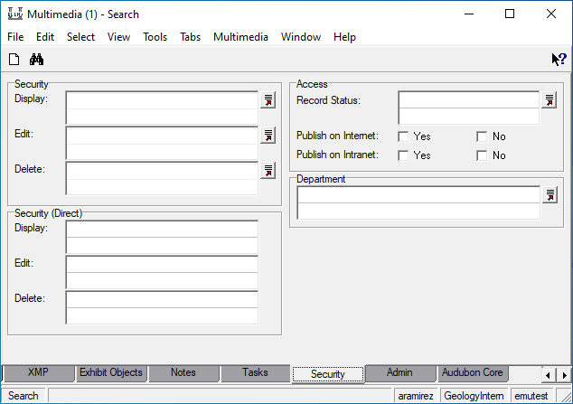
QUESTIONS AND RESOURCES
Where does “published” data/media go from EMu?
EMu Security tab
Every EMu record in every module has a Security tab.
Security fields:
Access and ability to edit can be restricted to user groups.
Two fields most frequently used:
Publish on Internet
Publish on Intranet
Notes:
Every EMu record in every module has a Security tab.
The most restrictive setting a user can restrict access to user groups, subsets within departments. This setting will determine who can see or add a given record.
Let the IT department know if you need to archive highly-sensitive data, so that they can help you prevent it from ending up in the wrong place or being accessible to the wrong people.
There are two other settings in the Security tab that are most frequently used: the Publish on internet and intranet fields.

Slide 31
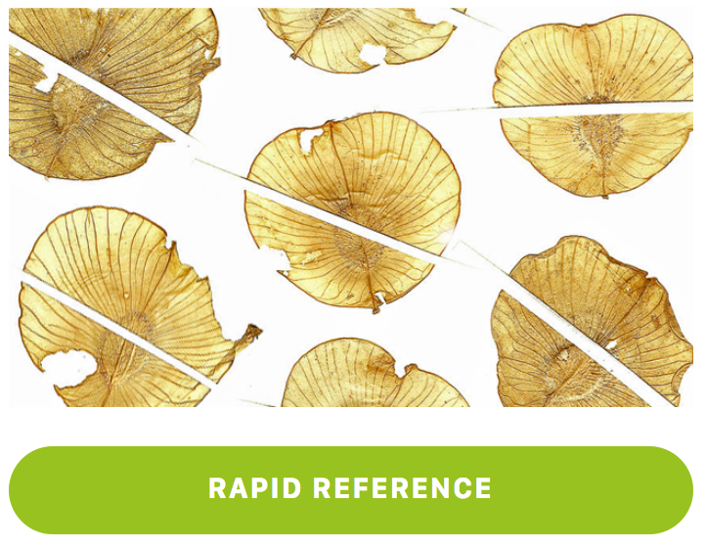

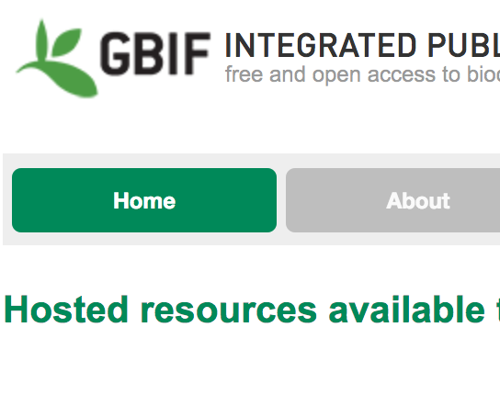
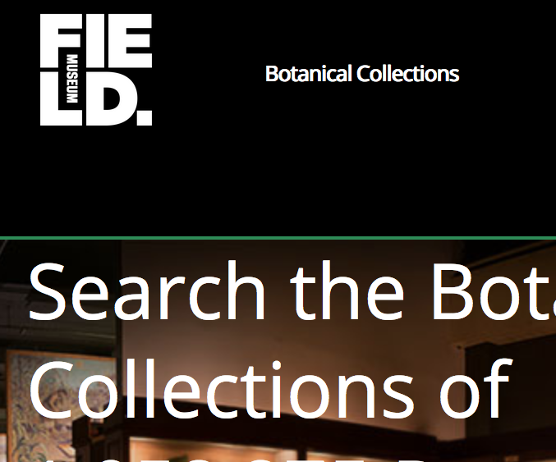
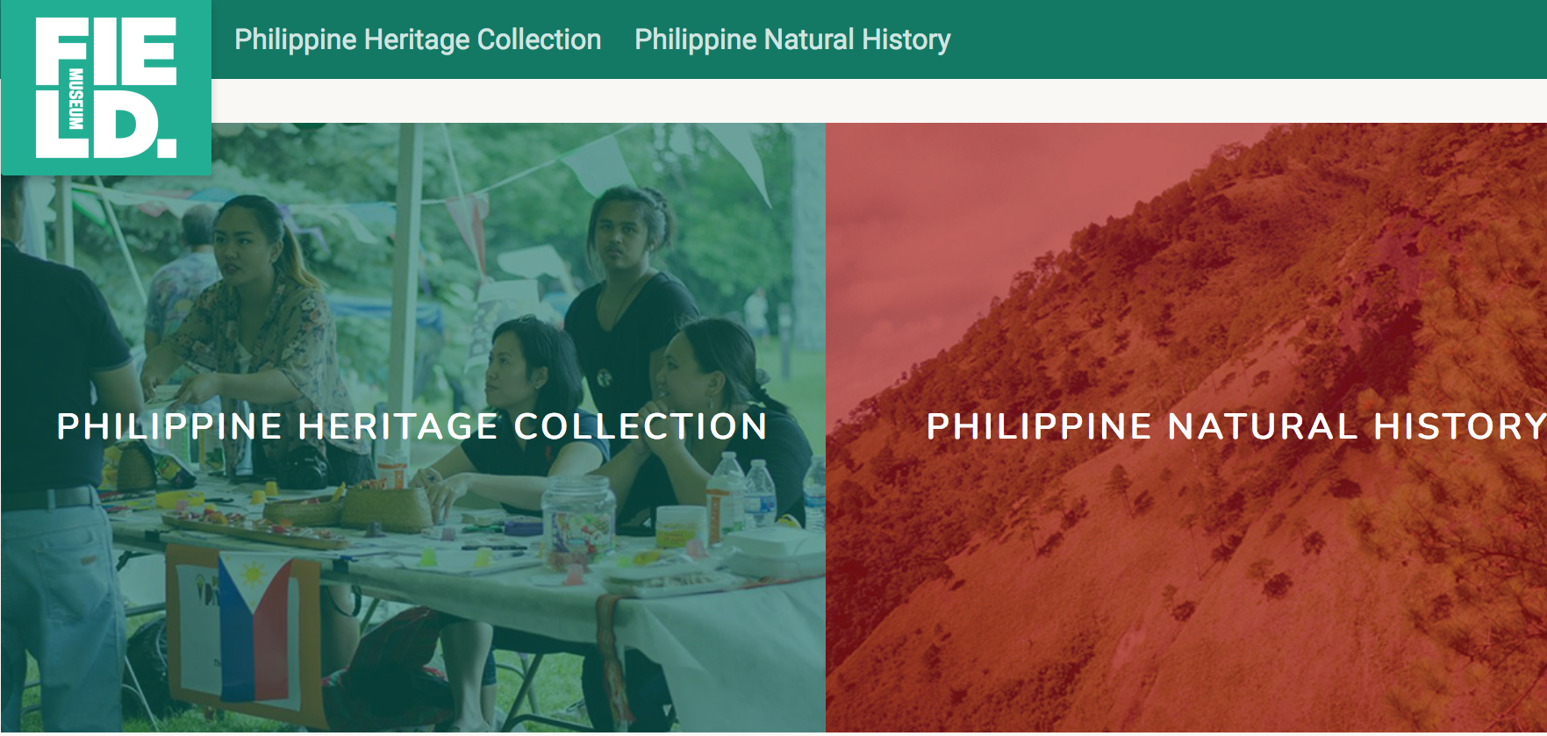
Where does “published” data+media go from EMu?
QUESTIONS AND RESOURCES
Publish on Intranet = Yes means:
Available the following day in NetX (dams.fieldmuseum.tech)
Publish on Internet = Yes means:
The data and media are normally online by the following week: (or with the next publication)
Public media files are hosted on “fm-digital-assets”
e.g. here is V0421543F.jpg from MM irn 1567893
Public data is hosted on these FMNH sites:
dams.fieldmuseum.tech/portals/museum-media
MM.fieldmuseum.org
PJ.fieldmuseum.org
Collections Sites – e.g.:
collections-zoology.fieldmuseum.org
IPT - fmipt.fieldmuseum.org
& elsewhere if other public projects use it – e.g.:
philippines.fieldmuseum.org
Notes:
Note - This slide is also referenced/linked in the Managing Media at FMNH slides
Multimedia records with “Publish on intranet” set to “Yes” will be immediately available on the DAMS (dams.FieldMuseum.tech).
If set to publish on the internet publicly, assuming a normal schedule, the multimedia will be available on at least three sites by the following week:
FM-digital-assets,
MM,
and PJ.
(And possibly some other Field Museum sites.)
It may take some time for multimedia to be published by GBIF, but setting it to publish on the internet is a prerequisite for it to be accessible at GBIF.org.

Slide 32
What if public data/media needs to be un-published?
QUESTIONS AND RESOURCES
For non-urgent issues:
In EMu, change a record to - Publish on Internet = “No” + Publish on Intranet = “No” (if needed)
It will be OFFline the following week (i.e., by the next web-copy)
For URGENT issues:
Email/Call helpdesk if a record on the web needs to be taken OFFLINE immediately.
Notes:
If a record needs to be unpublished from the internet but it is not urgent, simply change the “Publish on Internet” setting to “No” and it will be taken offline by the following week.
Please email or call helpdesk if a record on the internet needs to be taken offline immediately.

Slide 33
Resources:
QUESTIONS AND RESOURCES
FMNH Legal Docs:
Media Creation Agreement (+ FAQ)
https://docs.google.com/document/d/1BAOWb7k3-k0RNinXcFBbEMypLzxvehn8Y1ninQ2uJTw
FMNH Collections Data Norms
fieldmuseum.org/use-collections-data-and-images
Legal Dept - Release Forms
intranet.fieldmuseum.org/legaldepartment/node/7278
EMu Help Docs:
How-to for Multimedia module:
github.com/fieldmuseum/ EMu-Documentation/wiki/ emultimedia-workflows
How-to for Rights module:
github.com/fieldmuseum/ EMu-Documentation/wiki/ erights-workflows
NOTE: These resources are updated periodically. We recommend AGAINST printing documents.
Instead, refer directly back to the links for the most current instructions.
Notes:
This slide includes help resources for managing the legalities of media documentation and rights, including the forms that need to be filled out to get permission to use a file or to get release to use someone’s image.
These documents are updated regularly and should be checked online, rather than printed out to ensure they’re not out of date.

Slide 34


Thank you!
Sharon Grant
sgrant@fieldmuseum.org https://www.fieldmuseum.org/
Janeen Jones
jjones@fieldmuseum.org https://www.fieldmuseum.org/
Kate Webbink
kwebbink@fieldmusuem.org https://www.fieldmuseum.org/
Abigail McArthur-Self
amcarthur-self@fieldmusuem.org https://www.fieldmuseum.org/
Alexis Ramirez
aramirez@fieldmusuem.org https://www.fieldmuseum.org/
Notes:
Thank you for viewing this presentation. For further information, refer to the other EMu training presentations or reach out to the help desk.

Slide 35
Questions
Notes:
Serenity?

Slide 36
Serenity

Slide 37
Serenity and Filer01
SERENITY
When/why should files go on Serenity, not Filer01? … and How?
Media produced for museum projects needs to be archived in EMu.
Many projects produce media faster than it can be archived and need “scratchspace,” or workspace.
Serenity is that workspace.
When files move from Serenity to EMu, they are stored in Filer01-type storage, and in the context of related project or catalogue data.
Serenity:
Lower-cost than Filer01
To properly document media in its licensing and project context, it needs to be in EMu.
This also preps it for web publishing, if/when needed.
Notes:
One common question is: When or why should files go on Serenity instead of Filer01 … and how can that be done?
Media produced for Museum projects needs to be achieved in EMu.
Many projects produce media faster than it can be archived and need “scratchspace,” or workspace.
Serenity is that workspace.
Serenity is lower cost than Filer01 in part because it is backed up less frequently.
Filer01 storage is more expensive and more frequently backed up than Serenity.
Both Serenity and Filer01 are more robust than consumer-grade storage.
We recommend staging media files on Serenity instead of a cloud storage service like Google Drive for this reason.
Help and support for Google Drive is limited, but the information technology department is able to help with Serenity storage.

Slide 38
Serenity and Filer01
SERENITY
When/why should files go on Serenity, not Filer01? … and How?
Filer01 storage is more expensive and more frequently backed up than Serenity.
Both are more robust that consumer-grade storage.
Projects that generate media should budget for storage on these IT-supported museum systems.
Once an Event record is set up for a museum project, project organizers can put together a request for working space on Serenity:
github.com/fieldmuseum/ EMu-Documentation/discussions/346
Email helpdesk:
How big is the total set of files?
What kinds of files are they?
What is the EMu Event IRN?
Document media itself to gauge how much there is/will be:
This helps the museum budget for growing storage-needs over time in terms of both:
IT storage budget (longer-term)
Your project grant-proposals (shorter-term)
Notes:
If you know you have a set of media that needs to make its way into EMU, the information that the IT department needs to know is:
How big is the total set of files involved?
Even a rough estimate is helpful. Take the total number of files that you think you want to start with and multiply it by the average file size to calculate a gross estimate.
What kinds of files are they?
If it’s a folder containing files in many different file formats, just knowing that the files are images and knowing some of the formats is helpful.
What is the corresponding Event IRN?
For non-EMu users, event IRNs are created using the KSAC template spreadsheet discussed earlier.-

